Slide 1
Malucrawl
A Trending Topic Malware Crawler
Week 4 Progress Seminar

Slide 2
Introduction
Trending Topics
Twitter
Media
Google
Is Malware targeted towards trends?
Emma Watson => Malware?
McAfee Report
Build Distributed Framework

Slide 3
Literature Review: deSEO
First systematic study of search-result poisoning attacks and detection.
SEO: Search Engine Optimization techniques
Optimization of page rank / Search-result poisoning
Cloaking techniques from attacker
Classified into White-hat and Black-hat
Components of an SEO attack:
Automated generation of “relevant” content
Targeting multiple trending keywords
Creating dense link structures to increase page rank

Slide 4
Literature Review: deSEO
deSEO: automatically detect SEO attacks and campaigns
History-based detection
Clustering of suspicious domains
Group analysis
Result:
More than 300 billion URLs dataset
Result: 957 unique compromised domains, 15,482 malicious URLs.

Slide 5
Lit. Review: Automatic Malware Collecting System
A system collects search keywords and the malicious code which uses the keywords.
Malicious code collection approaches:
Passive method
Active method: Low interaction & High interaction
The automatic malicious code collecting system:
Active Hybrid Method
Collect search keywords
Filter search results by reviewing URL components (Low interaction)
Suspicious websites are visited with a client honeypot (High interaction)
Source code analysis with specialised VM
Result: 1,287 unique suspicious codes collected, 986 determined to be malicious.

Slide 6
Lit. Review: Fashion Crimes
First large-scale measurement and analysis of trending-term exploitation.
Classification of MFA (Made for AdSense) and malware sites.
Difference between MFA and malware sites tactics.
Trending-term abuse measurement.
Economics of exploitation / Revenue analysis.
Google’s intervention reduced revenue by 30%
Over 60 million search results and tweets collected.
Result: MFA $100,000 per month, Malware $60,000 per month before search-engine intervention.

Slide 7
Time Issues
Time cost for data collection in the previous reports:
deSEO: 28th May 2010 - 3rd Feb 2011 (~7 months)
Automatic Malware Collecting System: 22nd Nov 2010 - 11th Jan 2011 (~2 months)
Trending-term Exploitation: 24th Jul 2010 - 24 Apr 2011 (9 months)
GDP Duration: 1st Oct - 13th Dec 2012 (11 weeks)
Start the project from scratch
2 presentations

Slide 8
Design: Distributed Architecture
Celery with RabbitMQ for message passing and Redis to store results
"Celery is an asynchronous task queue/job queue based on distributed message passing.“
Work can be distributed over a cluster of many machines on different networks.
Machines can be added and removed from the cluster without losing tasks

Slide 9
Arch. Design: Task Type Breakdown
Trend Discovery
Find trends on Twitter, or news feeds like The Sun, BBC News and The Register
Takes no input, returns a list of keywords
Search
Searches for a keyword in a Search Engine such as Google or Dogpile.
Takes a keyword as input, returns a list of URLs
Malware Scan
Queues a page to be scanned for malware.
Takes a URL as input, returns a malware report.

Slide 10
Task Dispatch Example
Malware Scanner Dispatch
imdb.com/...
rottentomatoes.com/...
Search Engine
(eg. Dogpile)
asklaila.com/.../Taken-2/8024
movie2k.to/Taken-2-watch...
Taken 2
Trends
(eg. Twitter)
Armstrong
Russell Howard
Bees
Costa

Slide 11
Arch. Design: Periodic Tasks
Each period run each Trend Discovery, launching Search and Malware Scanning tasks as required.
Also run a new set of Search and Malware Scanning tasks for each Trend Discovery task that has been run historically.
So as to investigate malware incidence over time for each trend source
How long does it take on average for topics to be targeted by malware?
How long before malware is removed?
Which source gets the most malware?

Slide 12
Storage & Reporting
Technologies:
Django Web framework
Bootstrap Frontend Framework
jQuery, AngularJS, D3.js etc...
Used to:
Control and display status of workers
Display reports of malware data gathered

Slide 13
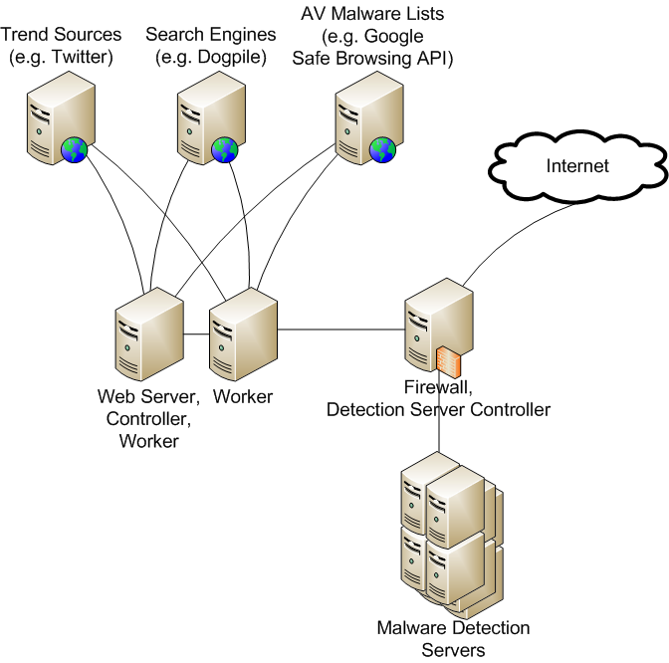
Physical Architecture

Slide 14
Malware Detection
Two main methods for malware detection:
Passive malware detection
Active malware detection
Passive method:
A malicious attacker injects a malicious code into a user’s PC.
Active method:
The malicious code collection system attempt to connect to a particular website and perform malicious action on the website in question. Called client honey pot.

Slide 15
Malware Detection
The client honey pot or active method divided into two groups:
Low interaction client honey pot
Determined what is a malicious webpage
The webpage is not rendered and code is not executed
The source code of target webpage is downloaded
Compare website source with the malicious action pattern of the system
High interaction client honey pot
Render webpage using a web browser
Analyse webpage by monitoring malicious behaviour
Monitor files, process creation, and registry modification

Slide 16
Malware Detection
There two possible solution for malware detection:
Hybrid client honey pot
Studying structure of URLs words
Studying the structure of URLs contains three steps:
Identify suspicious webpage
Derive lexical features for each suspicious webpage
Perform group analysis to pick out suspicious cluster

Slide 17
Framework Demo

Slide 18
Project Progress
Architectural Design
Literature Review
Development within Framework
Twitter, The Sun, and RSS Trend sources
Dogpile.co.uk search engine script
Placeholder malware anlayser
Work on active malware detection
Data Model

Slide 19
Remaining Work
Web Reporting interface
Graphing
Malware analysis result storage
Complete active malware detection
Add passive malware detection
Compile sample data for report

Slide 20
Any Questions?

Slide 21
References
http://www.mcafee.com/us/about/news/2012/q3/20120910-01.aspx?cid=110907
John P. John, Fang Yu, Yinglian Xie, Arvind Krishnamurthy, and Martín Abadi. 2011. deSEO: combating search-result poisoning. In Proceedings of the 20th USENIX conference on Security(SEC'11). USENIX Association, Berkeley, CA, USA, 20-20.
Byung-Ik Kim, B. I. K., Jongil Jeong, J. J., & Hyuncheol Jeong, H. J. (2012). A Study on the Automatic Malware Collecting System Based on the Searching Keyword. International Journal of Hybrid Information Technology, 5(1), 47-60
Tyler Moore, Nektarios Leontiadis, and Nicolas Christin. 2011. Fashion crimes: trending-term exploitation on the web. In Proceedings of the 18th ACM conference on Computer and communications security (CCS '11). ACM, New York, NY, USA, 455-466.

