Slide 1

Malucrawl
A Trending Topic Malware Crawler
Final Presentation

Slide 2
Contents
Introduction & Architecture Recap
Completed Work
Framework
Malware Analysis
Demo
Planning
Results
Challenges
Comparison with similar systems
Future Work
Questions

Slide 3
Introduction & Recap
Trending Topics
Is Malware targeted towards trends?
Distributed Framework
Gather Trends
Get URLs associated with trends
Analyse URLs for malicious content

Slide 4
Architecture Summary
Malware Scanner Dispatch
imdb.com/...
rottentomatoes.com/...
Search Engine
(eg. Dogpile)
asklaila.com/.../Taken-2/8024
movie2k.to/Taken-2-watch...
Taken 2
Trends
(eg. Twitter)
Armstrong
Russell Howard
Bees
Costa

Slide 5
Framework
Celery on top of RabbitMQ
Celerybeat for daily trend scan/URL list updates
Calls each Task with the results of the previous

Slide 6
Asynchronous Tasks
Celery Tasks cannot wait on component tasks
Prevent task pool exhaustion
Tasks use callbacks to describe test dependencies
Callback from Task returned to parent Task when child Tasks are complete

Slide 7
Asynchronous Tasks
Celery Tasks grouped as
Source
Search
Scan
Run each Source Task with a callback to run the Search Tasks, and so on.
Finally call storage Task to insert into MySQL database

Slide 8
Framework & Classification
Classification of URLs prior to malware analysis currently not implemented.
Classification unnecessary if high-interaction scanning not used.
However it is possible to adapt a zero-low interaction malware scanner to perform classification.
This can be achieved by separating high-interaction scanning tasks into another task group
Notes:
Note: run low task group before high group

Slide 9
Malware Detection Subsystems
6 subsystems using 3 interaction levels
Not all implemented subsystems are currently deployed
No Interaction
URL Classification
Calculate the probability of a page having malware
From history of other pages, stored in a database
And the other no interaction scanners
Malware List Scanners
Uses Alexa and WOT (Web Of Trust)
Notes:
Not deployed reasons explained later

Slide 10
Malware Detection Subsystems
Low Interaction
HTML Analysis
Focus on the frequency of trending keywords in a webpage
ClamAV Malware Scan
Signature based detection
Scans web pages and downloadable objects

Slide 11
Malware Detection Subsystems
High Interaction
Capture-HPC
Virtual Machine based
Accurate simulation of user browsing
Low URL throughput (slow processing)
Wine Explorer
Internet Explorer under Wine
Compatibility layer instead of VM
Resource saving, higher URL throughput

Slide 12
Conclusions: Deployment Issues
Previously mentioned malware scanners implemented, but not all deployed into framework.
High Interaction scanning deployed but exclusion lists not yet stable
Not enough execution time to test hypothesis of trending topics correlating with malware.
Notes:
Mention specific malware scanners
Some bugs apparent with longer test runs

Slide 13
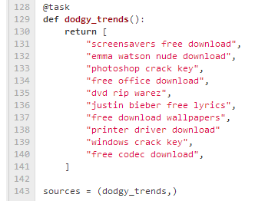
Conclusions: Systems Testing
To test the framework as a whole, a set of risky topics were created:

Slide 14
Conclusions: Malware Found
Using the risky topic list, a large amount of malware was discovered (e.g):
{'stream': ('FOUND', 'winnow.botnet.ff.trojans.3793.UNOFFICIAL')}
http://torrentz.eu/fb520fd9034543027172918dc430a171324fceff
{'stream': ('FOUND', 'winnow.botnet.ff.trojans.3793.UNOFFICIAL')}
http://torrentz.eu/fe0a2b3e3240cb2652f15bec706b160678472b79
{'stream': ('FOUND', 'winnow.botnet.ff.trojans.3793.UNOFFICIAL')}
http://torrentz.eu/2f3a1f3ea8d643a741b52349294cb729a99f553a
{'stream': ('FOUND', 'winnow.malware.m0.malware.740032.UNOFFICIAL')}
http://www.egydown.com/35666-euro-truck-simulator-2-pc-fightclub.html
{'stream': ('FOUND', 'Win.Trojan.8060046-1')}
https://dl.dropbox.com/u/85684172/FreeYouTubeDownloaderInstallerFull.exe

Slide 15
Conclusions: Testing Trends
Short term scanning of trending topics revealed occasional malware sites.
Longer term scanning of trends would be required to find a statistically significant result.
User agent matters
Framework is ready to begin testing of trending topic

Slide 16
Demo

Slide 17
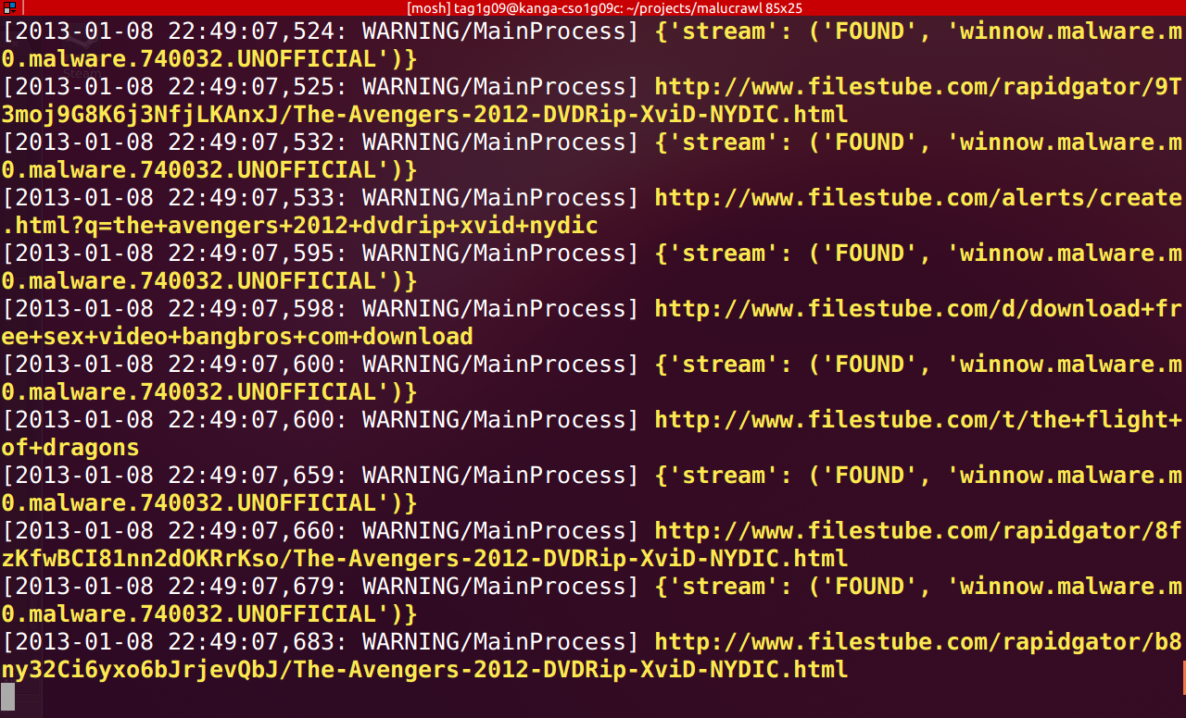
Malware Screenshot

Slide 18
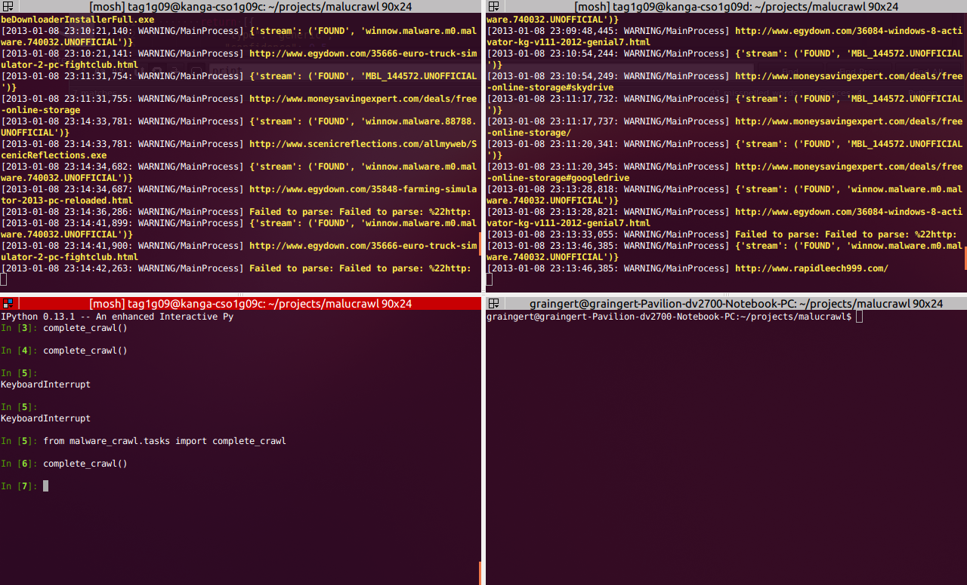
Malware Screenshot

Slide 19
Planning
Plan created at the start of the project.
Plan reviewed at 4 week intervals
Gantt chart updated after each plan review
(Gantt Chart Handouts)
Notes:
Gantt charts handed out, high level plans explained in next two slides

Slide 20
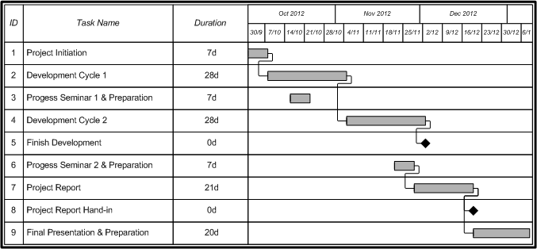
Project Plan: Predicted

Slide 21
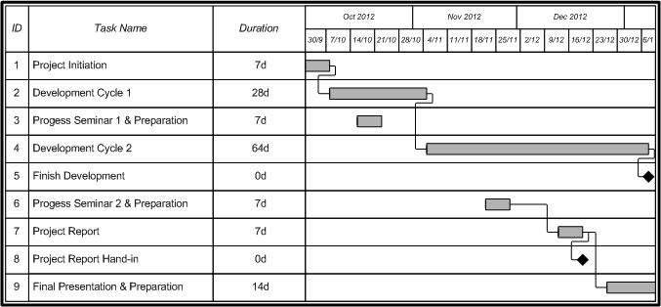
Project Plan: Final

Slide 22
Report Metrics
Wrote word count tool, “reportificate.py” to track contributions over time for each team member
Uses GitHub API to track commits made to the report
Uses texcount to calculate word count

Slide 23
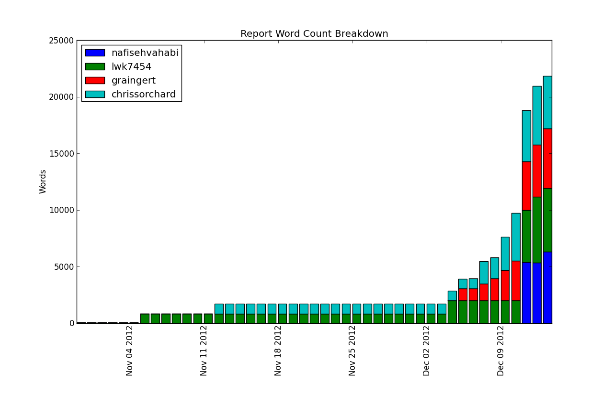
Report Word Count Breakdown

Slide 24
Evaluation against Existing Systems
Existing systems are designed for academic study, focussing on a narrow range of trend sources.
Malucrawl can be configured to use any list of words as a trend source.
Malucrawl is designed to be deployed by others, and is easily customised to fit a user’s specific needs.
Malucrawl is a distributed system so is scalable to larger deployments.

Slide 25
Future work
Deploy a suitable classifying method
Using the machine learning algorithms to improve accuracy and speed
SVM, Decision Tree and Naïve Bayse are popular algorithm to implement classification algorithm
Adding other malware scanning modules
Running the system for significant amount of time

Slide 26
Any Questions?

