Slide 1

Malucrawl
A Trending Topic Malware Crawler
Final Presentation

Slide 2
Contents
Introduction & Architecture Recap
Completed Work
Framework
Malware Analysis
Report
Results
Future Work
Questions

Slide 3
Introduction & Recap
Trending Topics
Is Malware targeted towards trends?
Distributed Framework
Gather Trends
Get URLs associated with trends
Analyse URLs for malicious content

Slide 4
Architecture Summary
Malware Scanner Dispatch
imdb.com/...
rottentomatoes.com/...
Search Engine
(eg. Dogpile)
asklaila.com/.../Taken-2/8024
movie2k.to/Taken-2-watch...
Taken 2
Trends
(eg. Twitter)
Armstrong
Russell Howard
Bees
Costa

Slide 5
Framework
Celery on top of RabbitMQ
Celerybeat for daily trend scan/URL list updates
Calls each Task with the results of the previous

Slide 6
Asynchronous Tasks
Celery Tasks cannot wait on each other
The thread pools would starve
So Tasks have optional callbacks

Slide 7
Asynchronous Tasks
Celery Tasks grouped as
Source
Search
Scan
Run each Source Task with a callback to run the Search Tasks, and so on.
Finally call storage Task to insert into MySQL database

Slide 8
Malware Detection Subsystems
6 subsystems in 3 interaction levels
No Interaction
URL Classification
Calculate the probability of a page having malware
From history of other pages, stored in a database
And the other no interaction scanners
Malware List Scanners
Uses Alexa and WOT (Web Of Trust)

Slide 9
Malware Detection Subsystems
Low Interaction
HTML Analysis
Focus on the frequency of trending keywords in a webpage
ClamAV Malware Scan
Signature based detection
Scans web pages and downloadable objects

Slide 10
Malware Detection Subsystems
High Interaction
Capture-HPC
Virtual Machine based
Accurate simulation of user browsing
Low URL throughput (slow processing)
Wine Explorer
Internet Explorer under Wine
Compatibility layer instead of VM
Resource saving, high URL throughput

Slide 11
Demo
Launch Demo

Slide 12
Planning
Plan created at the start of the project.
Plan reviewed at 4 week intervals
Gantt chart updated after each plan review
(Gantt Chart Handouts)
Notes:
Gantt charts handed out, high level plans explained in next two slides

Slide 13
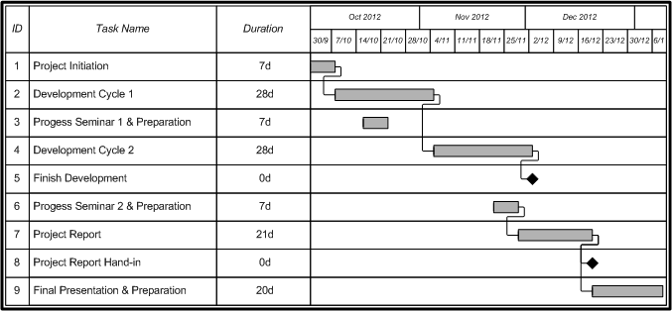
Project Plan: Predicted

Slide 14
Project Plan: Final

Slide 15
Report Metrics
Wrote word count tool, “reportificate.py” to track contributions over time for each team member
Uses GitHub API to track commits made to the report
Uses texcount to calculate word count

Slide 16
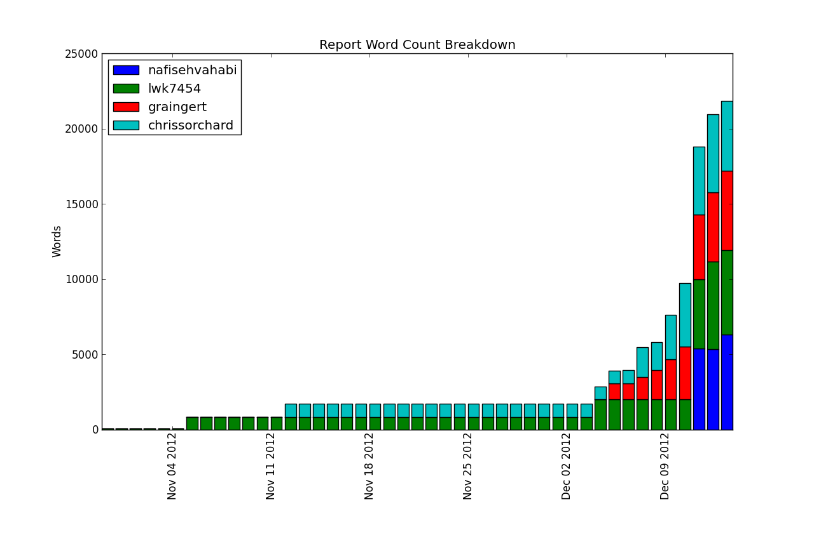
Report Word Count Breakdown

Slide 17
Results
Results derived from scanning conducted over the Christmas break
Not enough running time to make conclusions about the relation between trending topics and malware
However more malware was found from the trend source than a control trend of dictionary words.

Slide 18
Results
Malware Example?

Slide 19
Deployment Issues

Slide 20
Production Readiness

Slide 21
Evaluation against Existing Systems

Slide 22
Future work
Make the classifier faster
Using the machine learning algorithms
SVM, Decision Tree and Naïve Bayse are popular algorithm to implement classification algorithm
Using more feature of webpage for HTML malware detection to make it more accurate
Adding other malware scanning modules
Running the system for significant amount of time

Slide 23
Any Questions?

