Slide 1
Trendubad
A Trending Topic Malware Crawler
Week 8 Progress Seminar

Slide 2
Contents
Introduction / Recap
Architecture Recap
Implementation of Malware Analysis
URL Classification
Internet Explorer under Wine
ClamAV HTML scan
Good/Bad URL Lists
Capture-HPC
Integration and Reporting Database
Web Interface
Plan
Questions

Slide 3
Introduction / Recap
Trending Topics
Is Malware targeted towards trends?
Distributed Framework
Gather Trends
Get URLs associated with trends
Analyse URLs for malicious content

Slide 4
Architecture Summary
Malware Scanner Dispatch
imdb.com/...
rottentomatoes.com/...
Search Engine
(eg. Dogpile)
asklaila.com/.../Taken-2/8024
movie2k.to/Taken-2-watch...
Taken 2
Trends
(eg. Twitter)
Armstrong
Russell Howard
Bees
Costa

Slide 5
URL Classification
Malware detection based on repetition of the trendy keyword:
Analyse the content of the given URL (Crawling)
Check content of each hyperlink on the webpage
Consider frequently of reappearances of trendy keyword
Used the result of this algorithm for URL classification

Slide 6
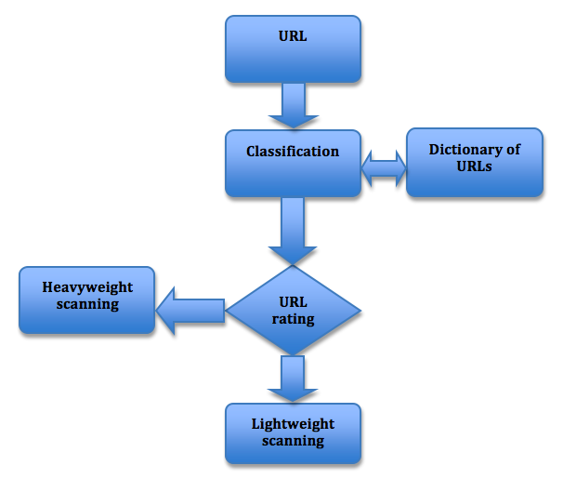
URL Classification

Slide 7
URL Classification
Two machine-learning methods applied in classification algorithm:
Levenshtein distance
String metric for measuring the difference between two sequences
Minimum number of edits needed to transform one string into the other
K-mean Clustering
Data mining
Partition n observations into k clusters
Applicable on large amount of data

Slide 8
Internet Explorer under Wine
High interaction malware detection.
Open suspicious URLs with Internet Explorer 6 by WineHQ.
WineHQ is a Windows emulator for non-Windows OS.
Each IE instance is ran in a separate Wine-prefix, i.e. an isolated temp virtual Windows environment.
Check for file system activities after that.

Slide 9
Clam AV HTML Scan
Low interaction malware detection.
Download the content of a suspicious URL then scan with ClamAV.
Both high interactive and low interactive approaches are achieved with Python.
Concurrent processing via threading.

Slide 10
Good/Bad URL Lists

Slide 11
Capture-HPC
Open source high-interaction “client honeypot”
Uses VM APIs combined with kernel drivers to automatically browse for malicious sites.
Slow, but provides high quality emulation of a vulnerable envrionment
Required customisation for ECS infrastructure.

Slide 12
Framework Integration

Slide 13
Storage of Analysis Results

Slide 14
Malware Analysis Demo??!

Slide 15
Remaining Work
Web Reporting interface
Graphing
Compile sample data for report
Produce Report
Latex template already produce
Including productivity tools??!

Slide 16
Any Questions?

Slide 17
References

