Slide 1
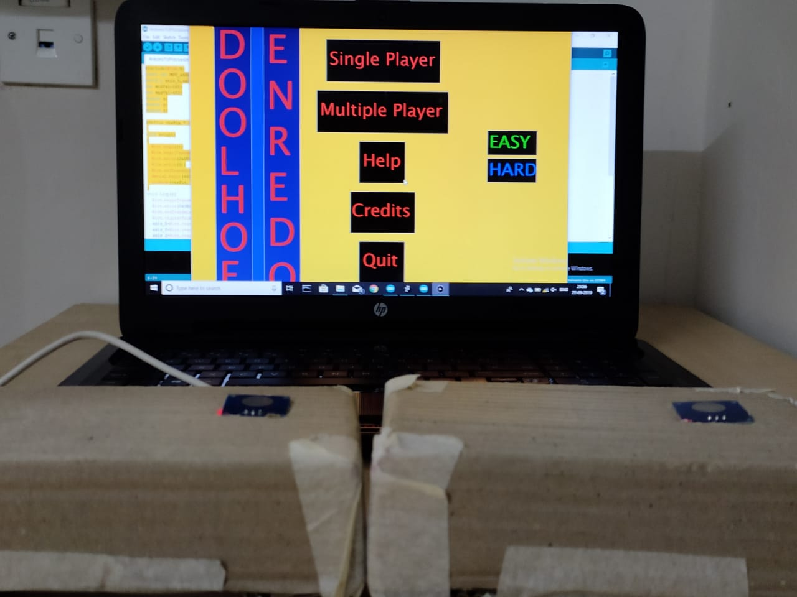
DOOLHOF ENREDO
Doolhof Enredo is an interactive 2D game.
The game is a Multiplayer Arcade Maze Runner.
The game is developed using processing with Arduino acting as the input source for controls.
Sensors used: Capacitive Touch and Gyroscope.
Prototyping Interactive Systems
By-
Rohit Roy
Abhish Panwar
Abhimanyu Gupta

Slide 2
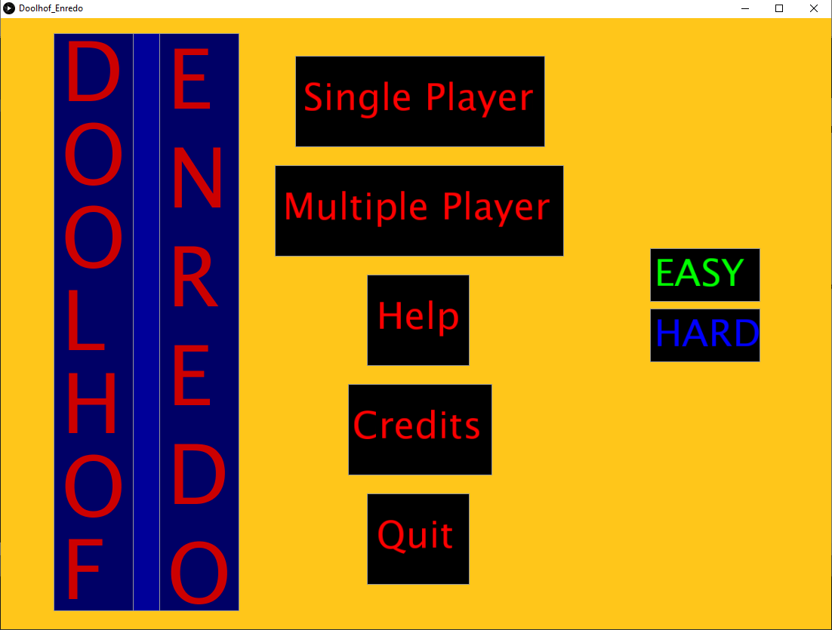
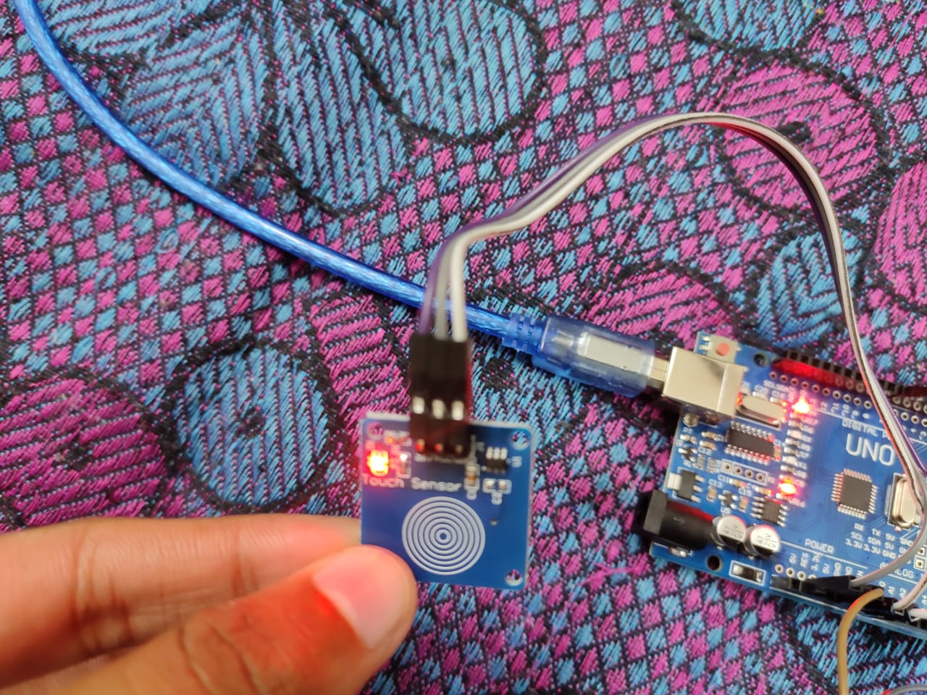
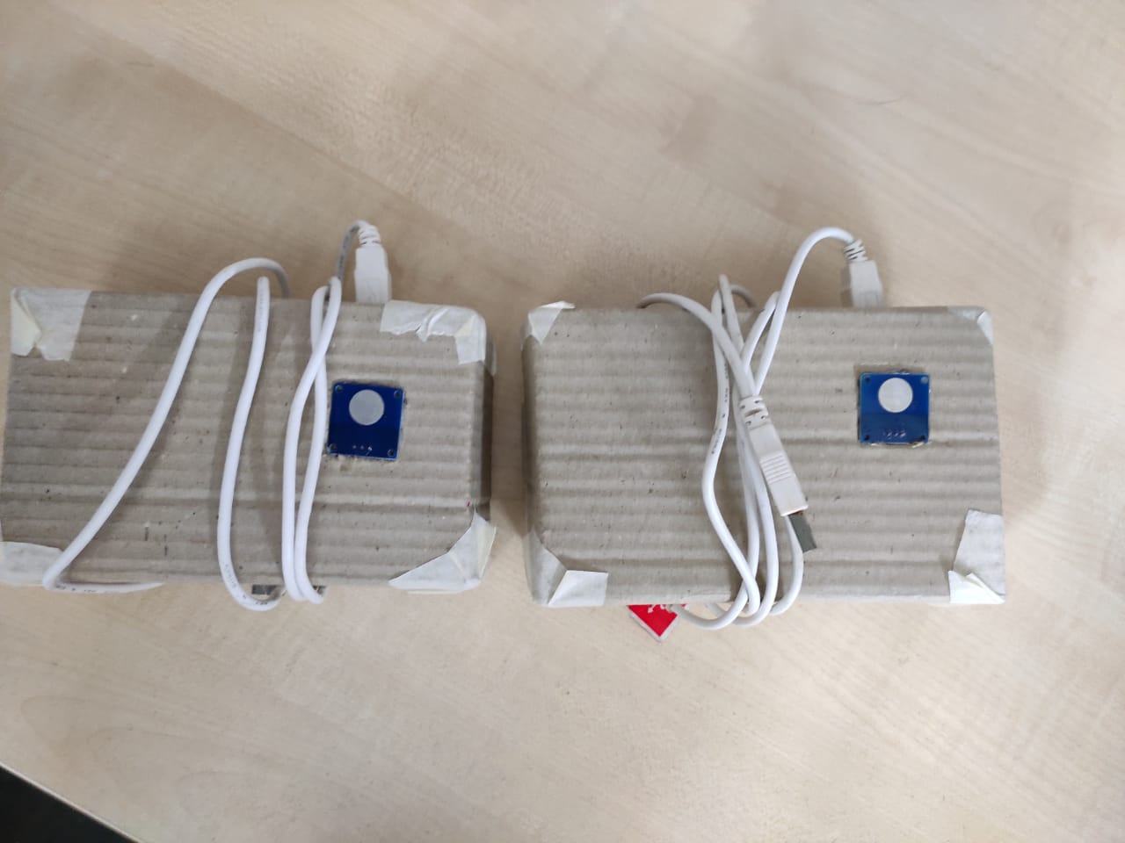
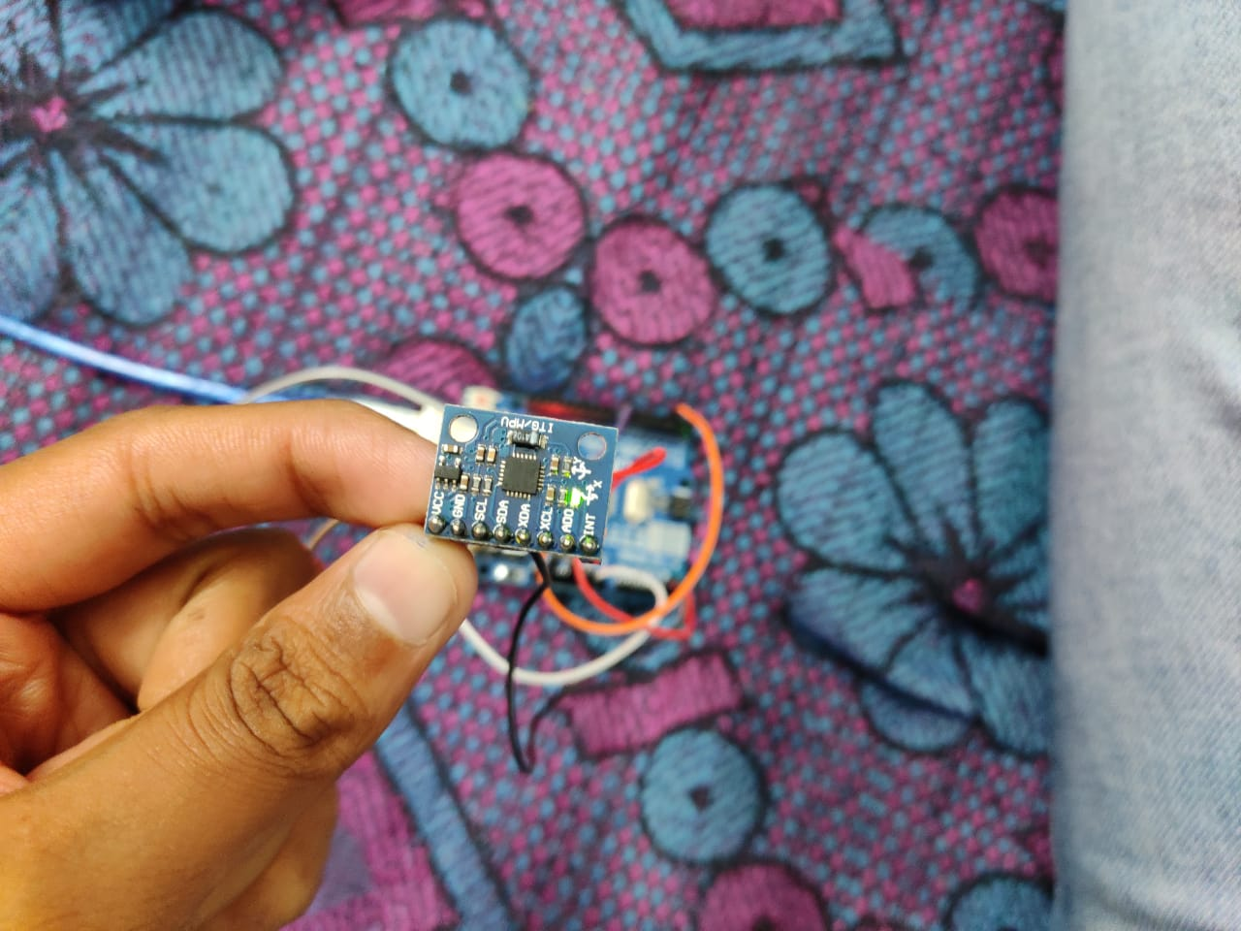
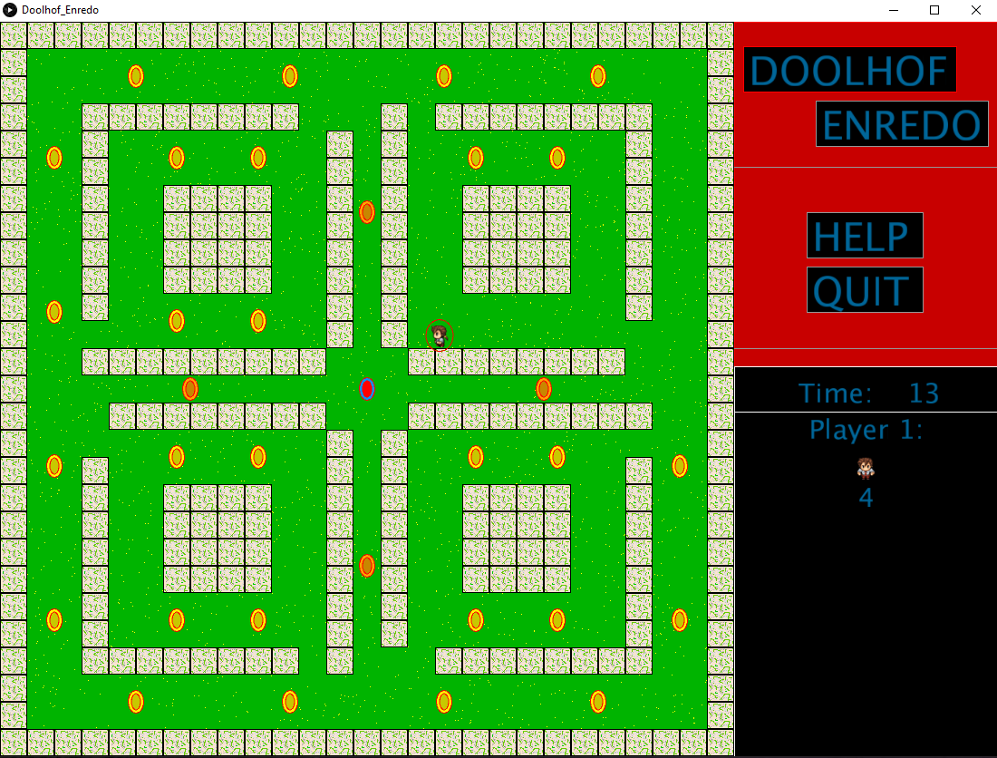
Single Player
The goal is to collect all the coins, avoiding the enemies if playing in Hard Mode.
CONTROLS:
Tilt the controller to select the direction and touch the sensor to move in the selected direction.

Slide 3
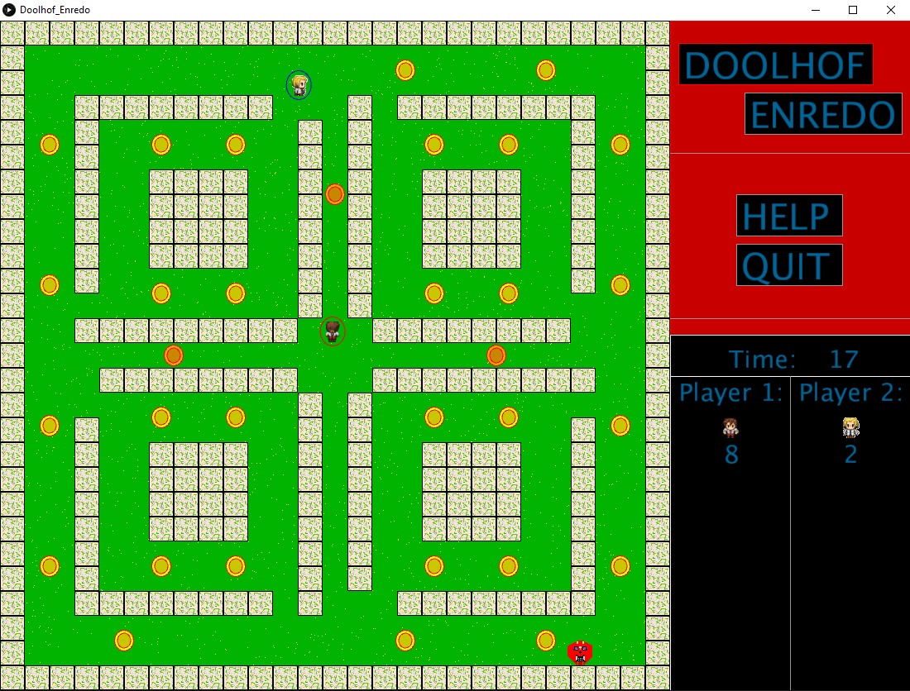
Multiplayer
The goal is to collect more point than the other player and be careful of the enemies.
REFERENCES:
1 Player 1 and 2 images: https://myrealdomain.com/explore/2d-game-sprite.html
2) Background Music: www.bensound.com
3) Capacitive Touch Sensor: https://playground.arduino.cc/Main/CapacitiveSensor/
4) Gyroscope Sensor: https://howtomechatronics.com/tutorials/arduino/arduino-and-mpu6050-accelerometer-and-gyroscope-tutorial/

