Slide 1
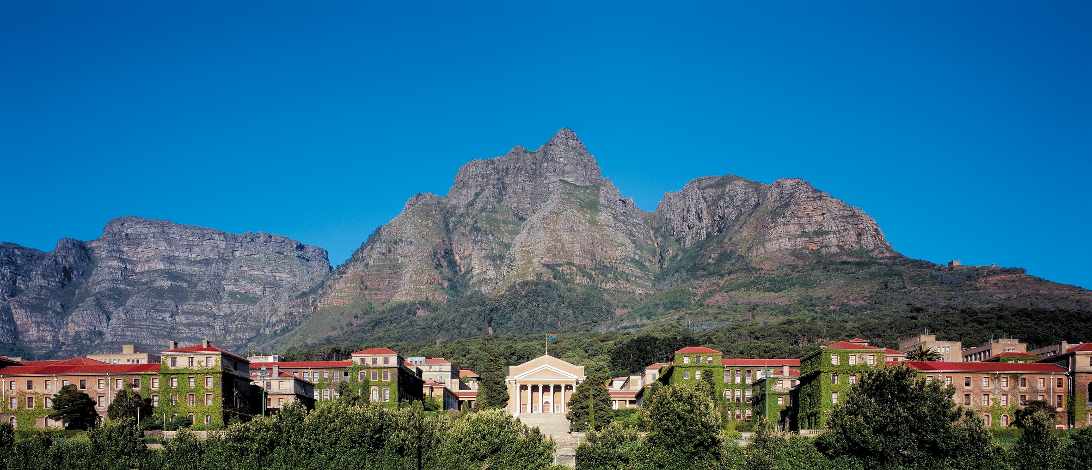
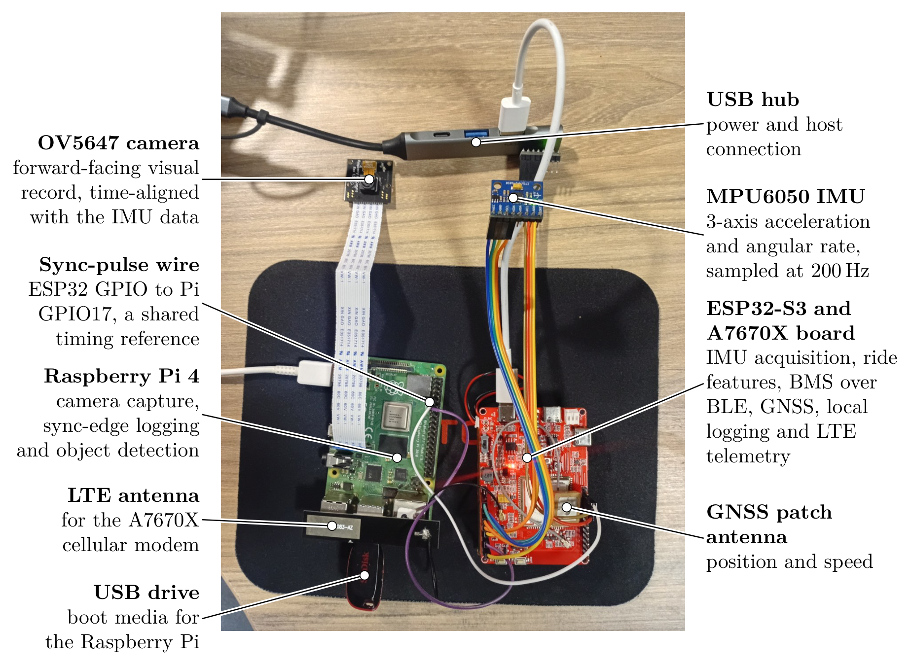
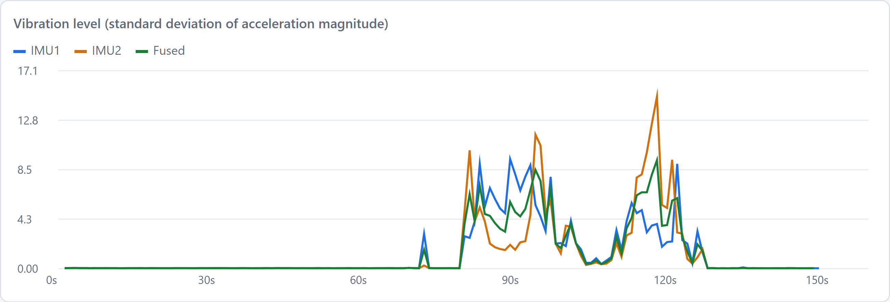

EEE4022S Final Year Project 2026, Department of Electrical Engineering, University of Cape Town
Development of an Embedded HPEC Telemetry Unit
and Dashboard Integration for the TUKZIE Rev 0 Platform
Samson Okuthe (OKTSAM001) | Supervisor: A/Prof. Simon Winberg | Co-supervisor: Sampath Jayalath
1
Background
4
Bench results
Electric cargo trikes are a low-cost route to last-mile freight in African cities, but their ride and road conditions go unmeasured.
Head-down displays draw the driver's eyes off the road; single glances should stay under 2 s.
Aim: a low-cost unit that characterises the trike's ride at the edge and gives the driver only safety-relevant alerts.
200 Hz
102 ms
both IMUs, zero dropped samples
median camera latency, sensor to result, at 19.5 fps
2.7 m
149 / 149
median GNSS error against a phone, 104 fixes
windows fused from both IMUs
2
System
Recorded 150 s bench session: board still, then disturbed by hand from about 75 s. The fused estimate (green) sits between the two sensors.
5
Found and fixed
GNSS reply layout differed from the one assumed, so satellite counts were read as the position; the parser was rewritten.
Battery checksum included one byte too many, so every real frame failed; fixed and confirmed on the pack.
Flash writes stalled both IMUs (proved by switching the log off); the log is now buffered and written once a minute.
Pink image: the camera has no infrared filter; the NoIR tuning plus saturation 1.8 restores the colours.
Stored records held nan, which is not valid JSON; now written as null.
Bench setup: ESP32-S3 telemetry unit with LTE modem, two IMUs, GNSS, BLE battery link and Hall counter; Raspberry Pi 4 with camera detector and three distance sensors, time-aligned by a sync-pulse wire.
3
Approach
1 Bring up each interface on the target board
2 Acquire both IMUs at 200 Hz and calibrate them
6
Conclusions and next steps
3 Compute ride features and fuse the two IMUs
4 Log locally and publish over LTE
Every subsystem runs together on the target board; camera and distance hazards are fused and shown live on the existing dashboard (Pi 5).
Next: mount on the trike, recalibrate in place, and run the field test for the ride and latency questions.
5 Validate on the moving vehicle
Each stage is tested before the next is built on it. Stage 5 is still to come.
Department of Electrical Engineering, University of Cape Town | EEE4022S 2026 | Project SW-7

