Slide 1

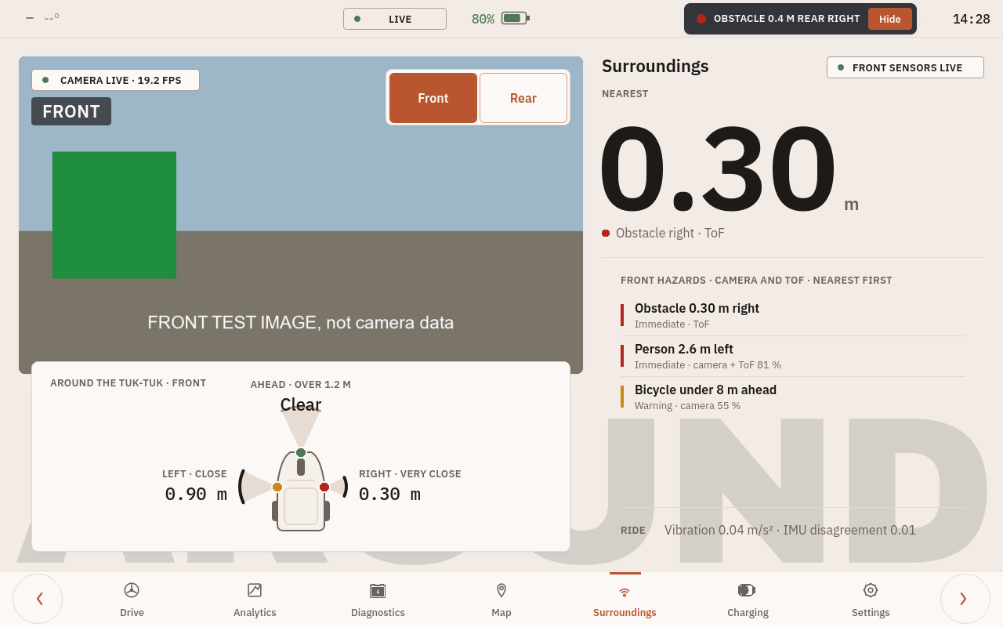
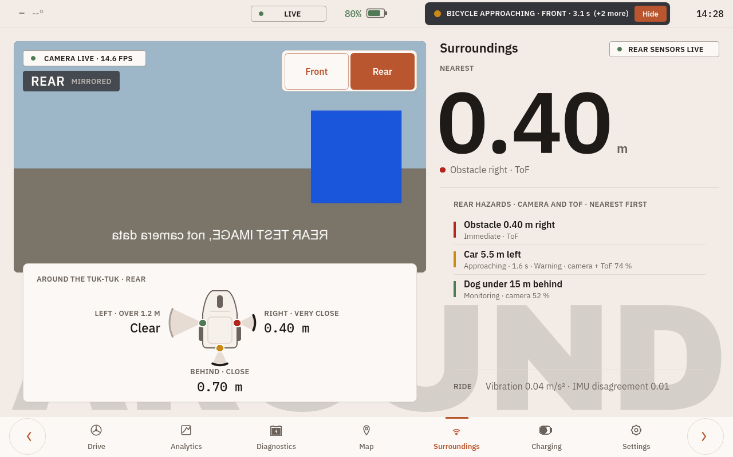
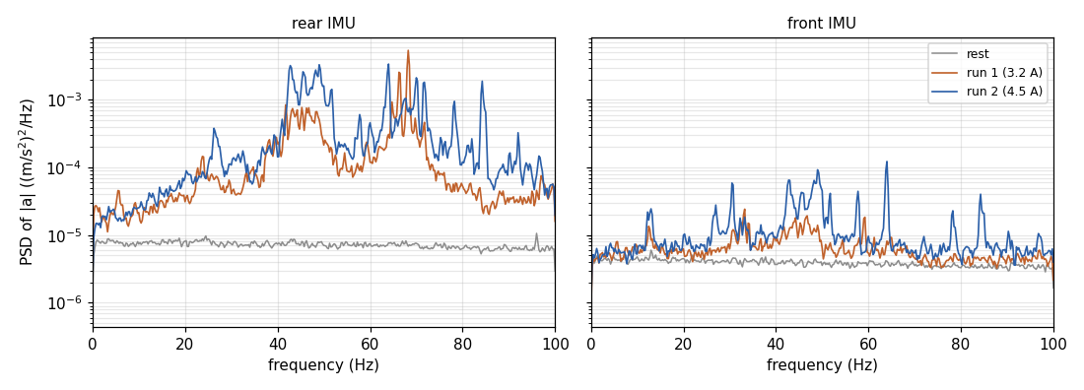

EEE4022S Final Year Project 2026, Department of Electrical Engineering, University of Cape Town
Embedded Telemetry with Road-Surface Characterisation
and Camera-Based Hazard Detection for the TUKZIE Electric Trike
Samson Okuthe (OKTSAM001) | Supervisor: A/Prof. Simon Winberg | Co-supervisor: Sampath Jayalath
1
Background
4
Bench results
Electric cargo trikes are a low-cost route to last-mile freight in African cities, but their ride and road conditions go unmeasured.
Head-down displays draw the driver's eyes off the road; single glances should stay under 2 s.
Aim: a low-cost unit that characterises the ride at the edge and gives the driver only safety-relevant alerts, each stage tested before the next.
200 Hz
51 to 54 ms
both IMUs, no samples dropped; 149 of 149 windows fused
median detection on the Pi 5 at 19.2 fps (Pi 4: about 120 ms)
2.7 m
112 / 112
median GNSS error against a phone, 104 fixes
records stored in the database across a 10-minute LTE outage
2
System: front and rear
within 2 %
about 20 W
Front: Raspberry Pi 5,
behind the dashboard
Rear: Raspberry Pi 4,
beside the battery
time to contact in 40 synthetic tests; 0.27 ms per frame
power budget, 0.27 A from the 72 V pack; only the Pi 5 measured
Front camera, detector and time-of-flight board
Front node: ESP32-S3 with one IMU at 200 Hz
Dashboard on the 10.1 in touchscreen
Phone GNSS for speed; road recorder
Ethernet
Rear camera, detector and time-of-flight board
Rear node: ESP32-S3 with one IMU at 200 Hz
LTE, GNSS, battery over Bluetooth
Local log and LTE uplink to a database
1000 Mb/s
0.22 to 0.25 ms
5
Fault investigations
Seven faults diagnosed as symptom, candidate causes, deciding test, cause and fix, from a flash-mode boot loop to a battery checksum off by 3.
The one that mattered most: Pi 4 reboots. Power flags logged every 2 s showed under-voltage 14 s after the modem came up on its USB port; it returned in the closed box (76.9 °C), so the unit needs its own supply.
Two sides since 15 October: the battery's Bluetooth did not reach the front, and the Pi 5 runs the detector more than twice as fast.
3
Hazard warnings on the dashboard
6
On the vehicle: road and stands
Road session, 19 Oct: 108.6 min recorded, about 16 min driving. 200 Hz with no counted drops, but one 2 s stall: R1 not met on the vehicle. Battery link held at up to 46.9 A. No GNSS fix (no antenna).
Front | Rear switch on the existing dashboard (test images).
Rear view mirrored; a car approaching at 1.6 s.
Detection on the Pi 5 beside the display: 51 to 54 ms median from sensor readout at 19.2 fps, against 118 to 122 ms on the Pi 4 with the whole system.
Approaching objects: time to contact from the growth of the box, τ = w / (dw/dt), with no focal length or object size (Lee 1976). Warning under 4 s, immediate under 2 s.
Synthetic tests within 2 %; not yet tested on a real approach. Live data only; frames never stored.
Legibility at 0.70 m (ISO 15008: 16 arc minutes acceptable, 20 recommended): speed digits 84, alert banner 9, labels a median of 9. The speed is legible at a glance; the warnings are not. Glance time needs a participant.
Stand runs, 23 Oct, drive wheel raised: rear vibration 5 to 7 times rest, energy 40 to 70 Hz; the same lines at the front (42.75, 49.0, 64.0 Hz). Throttle settings not recorded.
Pending, road run 26 Oct: repeatability over passes (RQ1) and the stand lines' share of the road spectrum (RQ4).
Next: enlarge the warnings, then glance time; the real approach test; a regulated supply for the telemetry unit.
Department of Electrical Engineering, University of Cape Town | EEE4022S 2026 | Project SW-7

