Slide 1
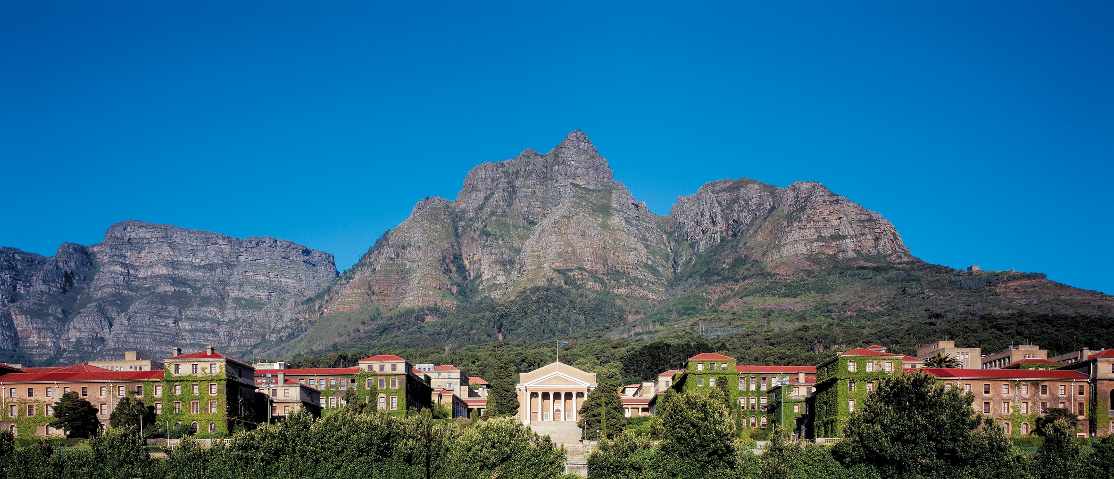


Embedded Telemetry with Road-Surface
Characterisation and Camera-Based Hazard Detection
for the TUKZIE Electric Trike
Samson Okuthe
Supervisor: A/Prof Simon Winberg | Co-supervisor: Sampath Jayalath
Department of Electrical Engineering, University of Cape Town | EEE4022S Final Year Project, 2026
Notes:
Good morning. I'm Samson Okuthe. My project gives the TUKZIE electric cargo trike embedded telemetry: it measures how the trike rides, warns the driver of hazards on the dashboard it already has, and keeps its data when coverage drops. I was supervised by Associate Professor Simon Winberg, with Sampath Jayalath as co-supervisor.

Slide 2
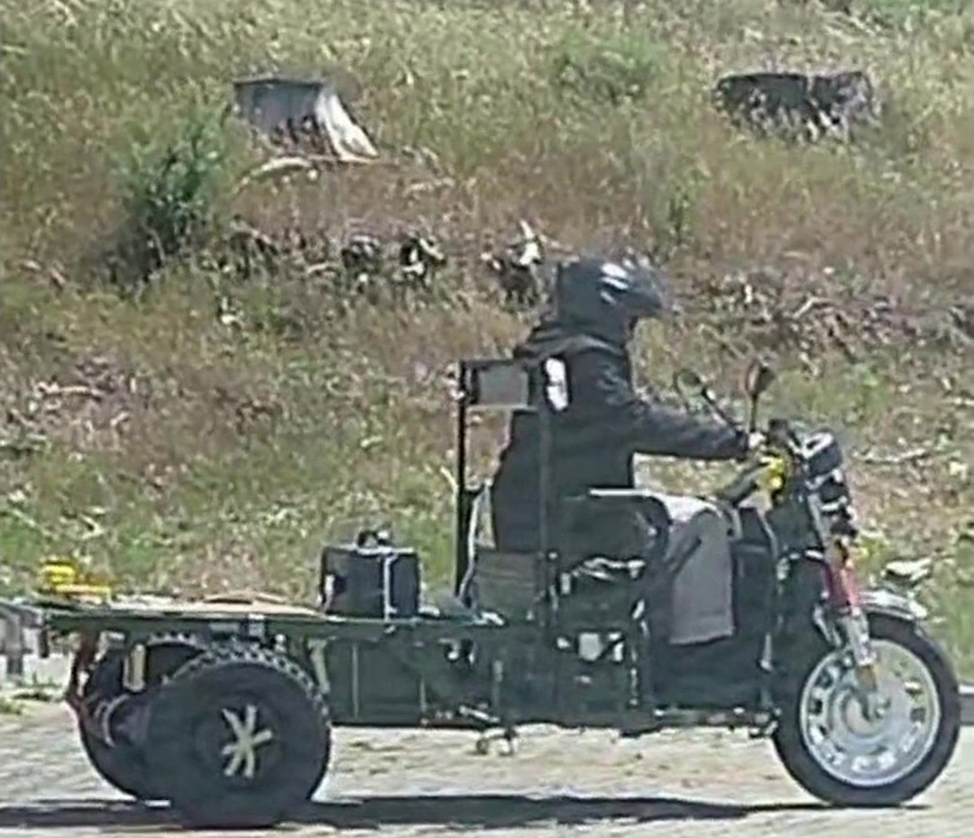
1
Why this matters
45.5 to 86 %
lower running cost per km for an electric cargo tricycle than a motorcycle or a light car, Dar es Salaam (Sebwa et al., 2025)
2 s
glances away from the road should mostly last 2 s or less (NHTSA, 2013), so alerts must be short and safety-only
The problem: edge telemetry and sparse, safety-only alerts together on a low-cost electric trike, with each part measured.
The TUKZIE Rev 0 on the road test, 27 October 2026
Samson Okuthe | EEE4022S 2026 | UCT
2
Notes:
Electric cargo trikes make sense for freight in African cities: in Dar es Salaam an electric cargo tricycle cost 45.5 percent less per kilometre to run than a motorcycle, and 86 percent less than a light car. But anything that takes the driver's eyes off the road is a risk; NHTSA guidance wants glances away from the road to mostly last two seconds or less. So the problem is to put edge telemetry and short, safety-only alerts on a low-cost trike, and to measure whether each part works.

Slide 3
2
Aim, research questions and approach
Aim: measure the trike's response to the road and its powertrain, warn of hazards on the existing dashboard, and keep the data through gaps in coverage.
RQ1
How accurately and repeatably can a low-cost edge unit characterise the trike's ride?
Approach
13 requirements
RQ2
How should safety alerts appear on the existing dashboard with the least distraction?
criterion fixed before each test
Bench
RQ3
What latency, data loss and recovery from sensor to the LTE database?
each part tested before the next
RQ4
Which features separate road vibration from powertrain vibration?
Vehicle
road sessions, 19 and 27 Oct
Samson Okuthe | EEE4022S 2026 | UCT
3
Notes:
The aim is on the slide. Four research questions follow from it: how accurately and repeatably the ride can be measured; how alerts should appear with the least distraction; what latency, loss and recovery the data chain achieves; and which features separate road from powertrain vibration. The approach was a V-model: thirteen requirements with criteria fixed before each test, every part tested on the bench, then on the vehicle on 19 and 27 October.

Slide 4
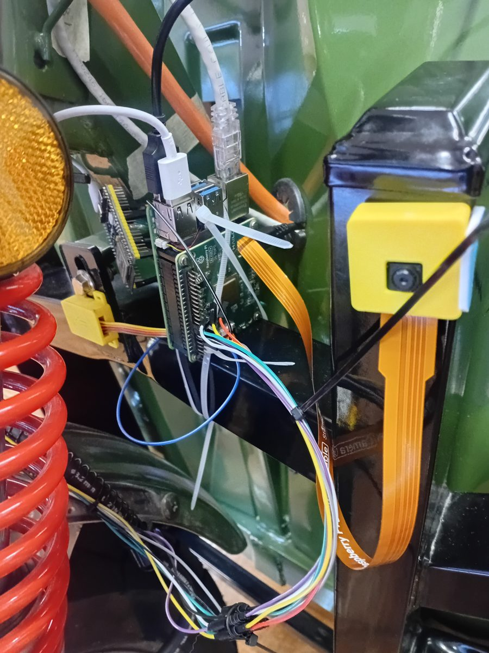
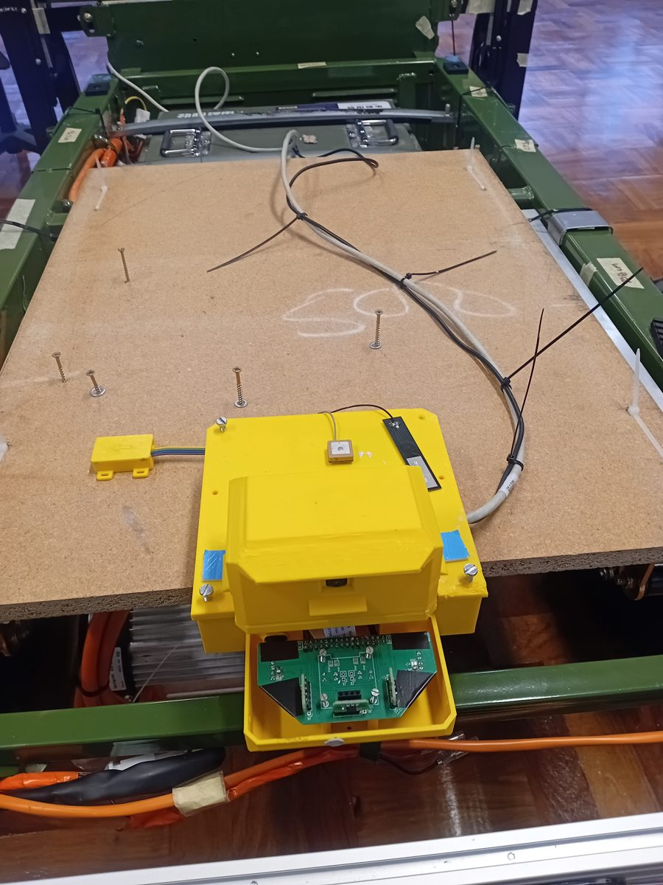
3
The system as driven on 27 October
Front: Raspberry Pi 5, behind the display
Dashboard on the 10.1 in touchscreen
Front camera, detector, 3 time-of-flight sensors
Front IMU node (ESP32-S3, 200 Hz)
Phone GNSS over its hotspot, for speed
Ethernet, 1000 Mb/s, one shared clock
Rear: Raspberry Pi 4, beside the battery
Rear camera, detector, 3 time-of-flight sensors
Rear IMU node (ESP32-S3, 200 Hz)
Telemetry unit (ESP32-S3): battery, GNSS, LTE, log
Front camera in its printed case on the frame (22 Oct)
Rear enclosure on the deck: Pi 4, antennas, camera (22 Oct)
Three ESP32-S3 boards hold the fixed-rate sensing; the Pis run the cameras. 27 W whole system, measured at the EcoFlow output.
Samson Okuthe | EEE4022S 2026 | UCT
4
Notes:
This is the system as driven on 27 October. It has two sides joined by one Ethernet cable, which also shares the clock. At the front, a Raspberry Pi 5 behind the display runs the dashboard, the front camera and detector, three time-of-flight sensors and the front IMU node; a phone streams its GNSS for speed. At the rear, a Raspberry Pi 4 beside the battery runs the rear camera and reads two boards: the rear IMU node, and the telemetry unit, which reads the battery, GNSS and LTE and logs to flash. So there are three ESP32-S3 boards. Run from a portable power station, the whole system drew 27 watts at its output.

Slide 5
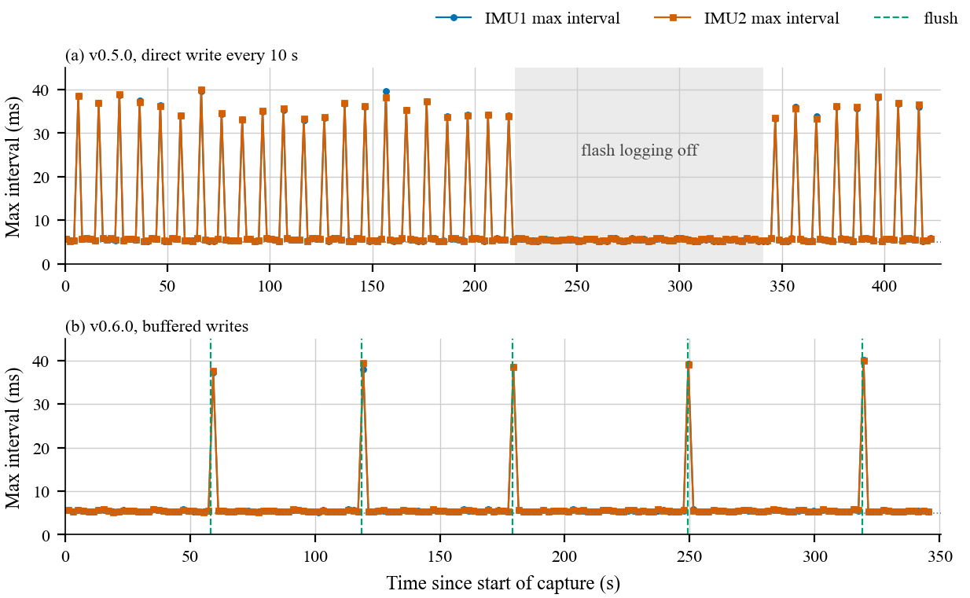
4
Deterministic acquisition: a 33 to 44 ms gap found and removed
Design: timing where it is predictable
FreeRTOS on an ESP32-S3: IMU task at top priority, 5 ms period. Bounded queue: drop and count, never block.
Fix: no flash log on the IMU nodes
On the vehicle both held 200.00 Hz with no interval over 5.2 ms (about 35,000 samples at rest).
0 gaps
0.08 %
Bench: longest interval between IMU samples in each 2 s window. (a) writing to flash every 10 s; (b) buffered writes. Nominal interval 5 ms.
front node on the road: 1,791,190 samples
rear lost in transport on the road; the node dropped none
Samson Okuthe | EEE4022S 2026 | UCT
5
Notes:
Ride measurement needs a fixed sample rate. Under FreeRTOS the IMU task runs at top priority on a 5 millisecond period and never blocks: if its queue is full, the sample is dropped and counted. Counting exposed the one timing fault. Every flash write paused reading for 33 to 44 milliseconds, the spikes in this plot. Buffering made the pauses rarer, not shorter. The fix was to take logging off the IMU nodes: on the vehicle they held 200 hertz with no interval over 5.2 milliseconds. On the road the front node lost nothing in 1.8 million samples; the rear lost 0.08 percent in transport, none at the node.

Slide 6
5
Fault investigations: symptom, test, cause, fix
Pi 4 under-voltage, restarts
IMU stall (21 to 22 Oct)
Rear IMU lost (26 Oct)
Power flags every 2 s: under-voltage began 14 s after the modem on its USB port came up. Moved off: 3 restarts in 20 min, then none in 4 h. It needs a regulated supply.
Drop counts rose while the rate still read 200 Hz. Cause: statistics and ride tasks starved on the IMU core. Moved in v0.7.6; a 62-minute soak had no drops.
No device at 0x68 on the telemetry unit: wiring or module supply open. The sensor worked on a second ESP32-S3, which became the rear IMU node.
Boot loop at full flash
Battery checksum
Invalid JSON in the log
Reset at a fixed address after enabling 16 MB flash. Cause: quad mode asked for, the chip runs dual (DIO). Fix: size, mode and partition table set together.
Every frame rejected. The firmware's own query frame showed the rule: the register byte was left out, so replies failed by 3. Fixed: 74.78 V read.
5,545 of 6,020 records failed to parse. A length-checked read-back showed the transfer intact; cause: nan for missing values. Fix: null; all parse.
Samson Okuthe | EEE4022S 2026 | UCT
6
Notes:
Because each stage was tested before the next, each fault could be traced to one change. The one that mattered most is power. The Pi 4 kept throttling and restarting. Logging its power flags every two seconds showed under-voltage starting fourteen seconds after the telemetry unit's modem came up on its USB port. Moved off, it went from three restarts in twenty minutes to none in four hours. The others: a task stall hidden behind a healthy-looking rate, a dead sensor connection that led to the third board, a flash-mode boot loop, a battery checksum off by three, and invalid JSON found only by reading the log back.

Slide 7
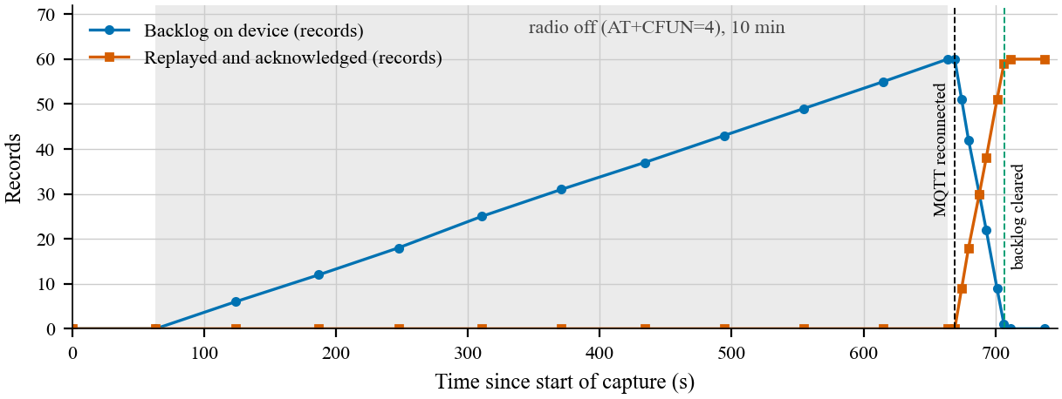
6
Telemetry: log first, then store and forward
Bench: 10-minute LTE outage
Road, 27 October
99.9 %
4,196 of 4,201 records over the wired link (62 % over USB, 19 Oct)
153
records over LTE, 116 of them replayed from the backlog
0.44 s
median delay from stamp to database (n = 9)
5.2 s
38 s
112 / 112
to reconnect after the radio returned
to clear the 60-record backlog
records stored, none missing or doubled
From 11:51 the LTE link did not reconnect; the rest stayed in the unit's log.
Samson Okuthe | EEE4022S 2026 | UCT
7
Notes:
Every record is written to flash whatever the coverage, then sent over LTE and replayed when the link returns. On the bench I switched the radio off for ten minutes. The unit reconnected 5.2 seconds after it came back, cleared its 60-record backlog in about 38 seconds, and the database held 112 of 112 records, none missing or doubled. On the road the wired link to the Pi carried 4,196 of 4,201 records, 99.9 percent, against 62 percent over USB on the first session. Over LTE 153 records arrived, 116 of them replays, with a median delay of 0.44 seconds; but only nine records carry that figure, and from 11:51 the link did not reconnect.

Slide 8
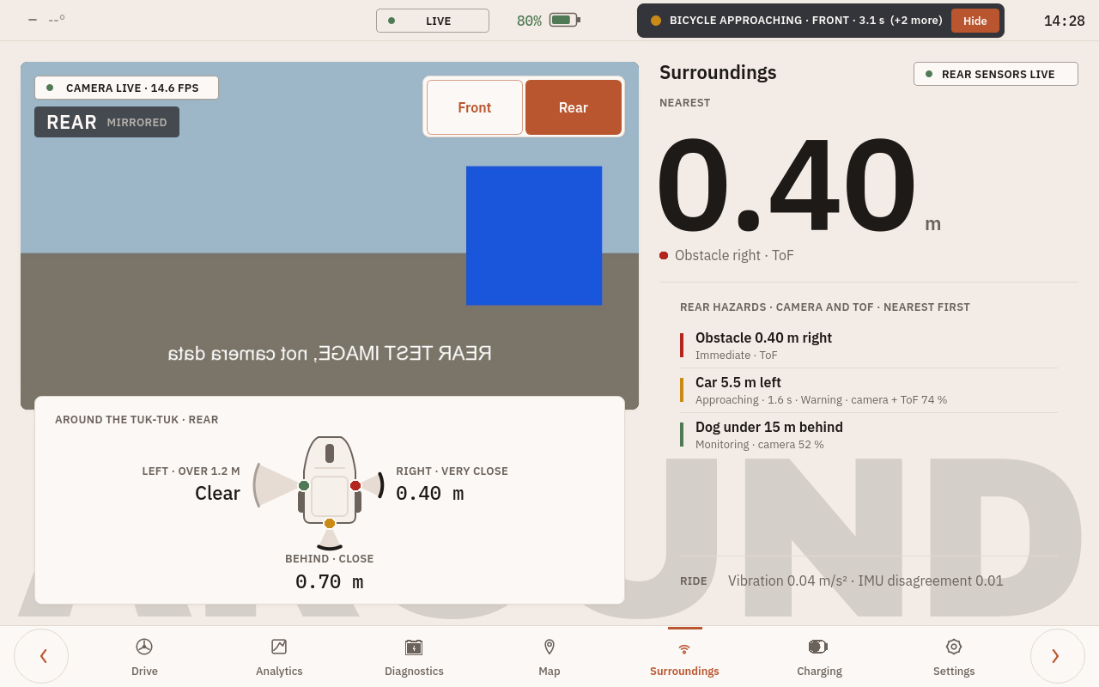
7
Hazard detection on the road: front and rear
68 ms
103 ms
front, Pi 5: median on the road, 23.3 fps (bench 51 to 54 ms)
rear, Pi 4: median on the road, 12.1 fps (bench 118 to 122 ms)
Alert logic and privacy
Raised after 3 frames, cleared after 5. No frame is ever stored.
Dashboard, rear view mirrored, with an approaching-object warning (test image)
Not yet checked
Time to contact from box growth, τ = w / (dw/dt): within 2 % in 40 synthetic tests; no real approach yet.
No forward video kept, so road precision is unknown. Fused range 0.47 m at about 0.5 m on a person (n = 43); a flat-target check is needed.
Samson Okuthe | EEE4022S 2026 | UCT
8
Notes:
Each camera runs a pretrained 8-bit SSD-MobileNet detector. On the road the front, on the Pi 5, took a median of 68 milliseconds from readout to result at 23.3 frames per second; the rear, on the Pi 4, 103 milliseconds at 12.1. An alert is raised after three frames and cleared after five, and no frame is ever stored. Distance bands do not say whether something is closing, so the system also estimates time to contact from how fast a box grows; it is within 2 percent in 40 synthetic tests but has not met a real approach. No forward video was kept, so how many road alerts were correct is still unknown.

Slide 9
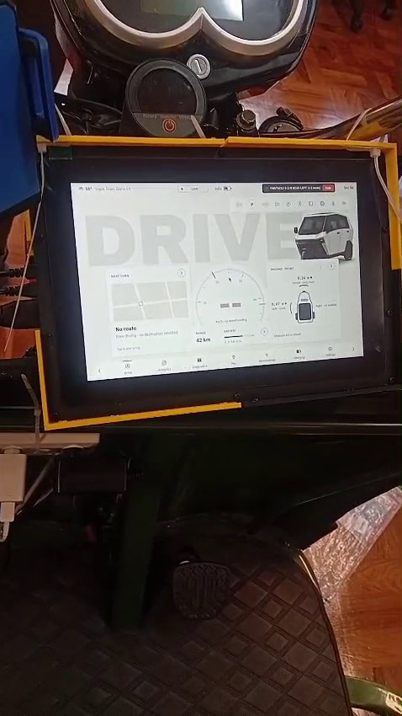
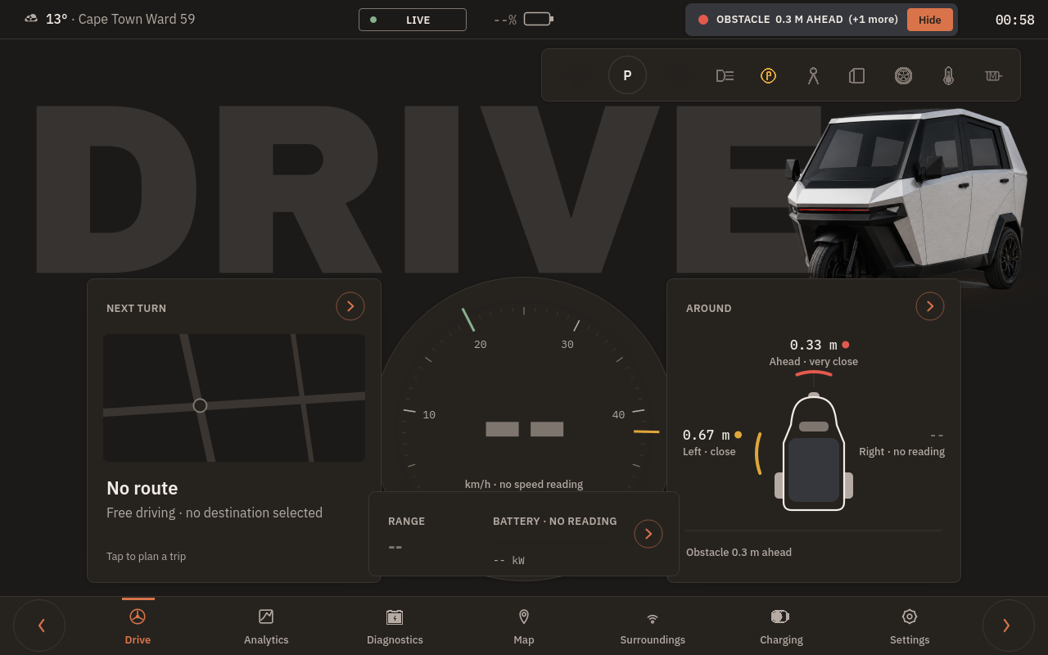
8
The existing dashboard: live alerts, honest legibility
Legibility at 0.62 m (ISO 15008)
94 arc min
speed digits; 20 recommended
10 arc min
alert banner; below the minimum of 12. Only 4 of 110 labels reach the acceptable 16.
Live on the Pi 5: an obstacle banner over the driving page; absent data shown as absent
The speed is legible at a glance; the warnings are not. Enlarge them first, then a glance study (R12, not tested: needs a participant).
Voice commands, offline
On the vehicle: the driving page
15 to 18 of 18 synthetic-voice commands on the bench, in 1.8 to 2.4 s; alerts and battery read out on request. No driver tested.
Samson Okuthe | EEE4022S 2026 | UCT
9
Notes:
RQ2 lands on the dashboard the team already runs, here on the vehicle. It shows only live data, never a simulated value, and an immediate hazard appears as a banner over every page. Glance time needs a participant and an ethics amendment, so it was not tested; but legibility needs neither, so I measured it at the driver's eye distance of 0.62 metres. The speed digits subtend 94 arc minutes, far above the 20 that ISO 15008 recommends. The alert banner subtends 10, below even its minimum of 12. So the hierarchy is inverted: the warnings must be enlarged before any glance study. Spoken commands work offline, 15 to 18 of 18 on the bench, but no driver was tested.

Slide 10
9
Road test, 27 October: repeatable per pass, not per place
Place by place: not met
ICC 0.16
at most 0.32 in sensitivity checks, against 0.75. Whole passes repeat; place by place they do not.
Speed index I_v rose with speed
Rear 1.14, 1.59, 2.44 at about 10, 13, 18 km/h: not speed-invariant.
Met at both ends
About twice: separates surfaces
Laps 11:30 to 12:40; speed from the phone's GNSS; passes found from speed and current, no section markers or video. Only 2 passes at 15 km/h and 1 at 20 km/h. Battery peaked at 82.9 A.
Samson Okuthe | EEE4022S 2026 | UCT
10
Notes:
This is the main road result. On a smooth loop at 10 kilometres an hour, five passes gave a weighted acceleration, a w, that varied by 5.0 percent at the rear and 5.3 at the front, inside the 10 percent criterion. On a rougher strip it read about twice as high at the same speed, so the measurement responds to the road. But aligned by position in 8 metre cells, the passes did not agree place by place: an ICC of 0.16, at most 0.32 in the sensitivity checks, against 0.75. With one-second phone positions I cannot separate this from the line each lap took. The speed index also rose with speed, so it is not speed-invariant here.

Slide 11
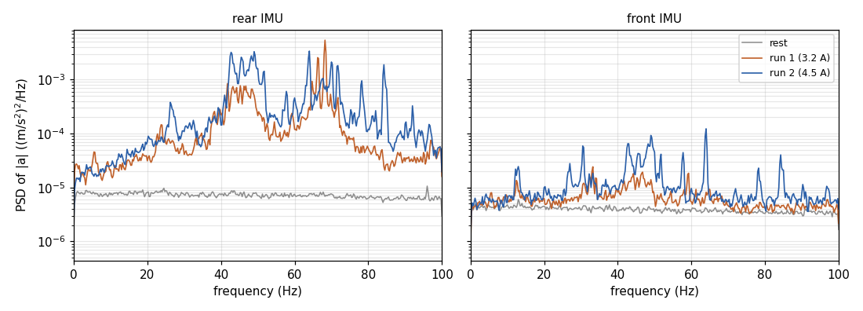
10
Powertrain against road: the road dominates
0.9 to 3.1 %
of the 0.5 to 80 Hz road energy in the powertrain lines, powered passes (0.4 % coasting)
65 to 84 %
Stands, 23 Oct, drive wheel raised: rear vibration 5 to 7 times rest, energy 40 to 70 Hz; the same lines at the front (42.75, 49.0, 64.0 Hz).
between 4 and 8 Hz: the body's response to the road
At these speeds the road dominates the measured vibration; at higher power the 40 to 70 Hz energy of the stand runs would weigh more.
1.80 vs 1.78
rear a_w (m/s²), coasting against powered, smooth loop at 10 km/h
Samson Okuthe | EEE4022S 2026 | UCT
11
Notes:
RQ4 asks what is road and what is powertrain. With the drive wheel raised on stands, the motor shook the body between about 40 and 70 hertz, with the same lines at the front as at the rear, so the front sensor does not escape it. On the road, those lines held only 0.9 to 3.1 percent of the energy in powered passes, while 65 to 84 percent lay between 4 and 8 hertz, the body's response to the road. A coasting pass gave the same reading as a powered one, 1.80 against 1.78. So at these low speeds the road dominates; at higher power the motor's share would grow.

Slide 12
11
Conclusions: each question answered in part
RQ1
Bench: rate, calibration and features verified. Road: repeats over whole passes (CV 5 %), not place by place (ICC 0.16).
13 requirements (bench)
Partly
5
met
RQ2
Sparse, live-only alerts on the existing dashboard; warning text below ISO 15008; glance time not measured.
Partly
7
partly met
1
not tested (R12, glance time)
RQ3
Bench: every record replayed after a 10-minute outage. Road: 99.9 % over the wired link; LTE latency rests on 9 records.
Partly
On the vehicle, 27 Oct
R1 met at the front
R4, R9, R10 partly met
R2 not met
RQ4
Powertrain lines at 40 to 70 Hz on the stands; 0.9 to 3.1 % of the road energy; one coasting pass did not lower a_w.
Road dominates
Samson Okuthe | EEE4022S 2026 | UCT
12
Notes:
So, honestly, each question is answered in part. RQ1: the instrument is verified on the bench, and on the road it repeats over whole passes but not yet place by place. RQ2: the alerts are built and live-only, but the warning text is too small and glance time was not measured. RQ3: on the bench every record survived a ten-minute outage; on the road the wired link carried 99.9 percent, but LTE latency rests on nine records. RQ4: at these speeds the road dominates. Of thirteen requirements, five are met on the bench, seven partly and one, glance time, was not tested. On the vehicle R1 was met at the front, R2 was not.

Slide 13
12
Contribution and next steps
Contribution
An integrated, low-cost architecture for a three-wheeled EV, run on the vehicle
A measured account of timing and loss: flash gap, detector latency, outage replay
Road evidence: repeats over whole passes, separates surfaces; not yet place by place
1
Regulated supply
2
LTE reconnection
3
Marked sections, video
4
Fusion and time to contact
Power the telemetry unit from a vehicle converter, never a Pi's USB port; measure each unit inline.
Fix the reconnection lost from 11:51, then measure latency on the road.
Straight sections with side video, three passes per speed, for a place-by-place ICC.
Flat-target ranging, a car approaching the parked trike, at least 200 road alerts labelled on video.
Thank you. Questions?
Videos of the system on the road: https://tuksense.site
Samson Okuthe | EEE4022S 2026 | UCT
13
Notes:
The contribution is an integrated low-cost architecture, a measured account of its timing and loss, and road evidence that the ride measurement repeats over whole passes. Four steps would make it dependable. First, a regulated supply for the telemetry unit, never a Pi's USB port. Second, fix the LTE reconnection and measure latency on the road. Third, marked sections with side video and three passes per speed, for a place-by-place ICC. Fourth, validate the fusion and time to contact against a flat target, a real approaching car and labelled video. Videos of the road test are at tuksense.site. Thank you; I'm happy to take questions.

