Slide 1
RSNA Bone Age Challenge
predict age based on pediatric hand X-rays
Ya Lu
Lukas Zbinden
Joel Niklaus

Slide 2
Content
Introduction
Prior Work
Methods & Experiments & Results
Conclusion
Future work

Slide 3
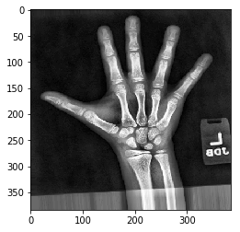
Introduction
skeletal age prediction based on pediatric hand X-rays
2017 RSNA global ML competition to develop best model
winner: 16BitNet with MAE of 4.265 months
our methods:
image preprocessing
transfer learning
different architectures
child age ?
Notes:
comment noneffective results for image preprocessing, no further mention

Slide 4
Prior work
Kevin Mader’s VGG16 model on kaggle.com
→ used as baseline
competition winner: 16BitNet
→ used as basis for experiments
theory on data augmentation and transfer learning

Slide 5
Methods & Experiments
Transfer learning experiments - Overview
performed 7 experiments
using 2 datasets:
Stanford pediatric hand X-rays ~12k
training: 12’612
validation: 1’426
test: 200
NIH chest X-rays ~112k
with respect to
predict disease or age, age range, #fixed layers, pretraining on ImageNet, gender as extra input, regression vs. classification on age

Slide 6
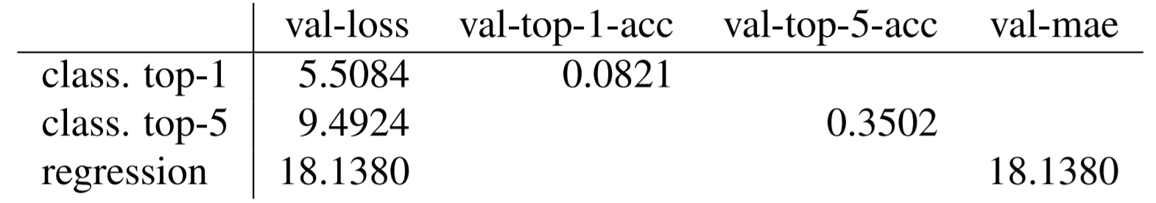
Methods & Experiments
Transfer learning experiments - Results
regression vs. classification on age

Slide 7
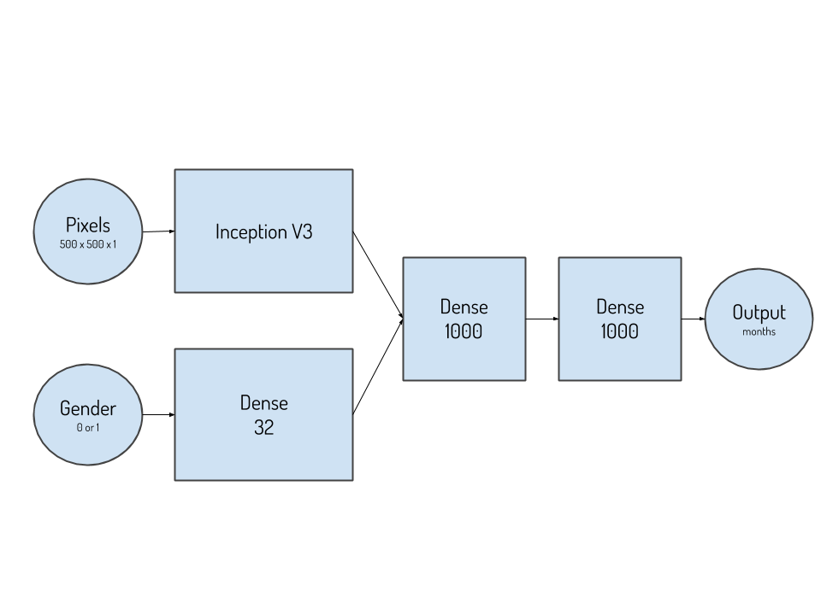
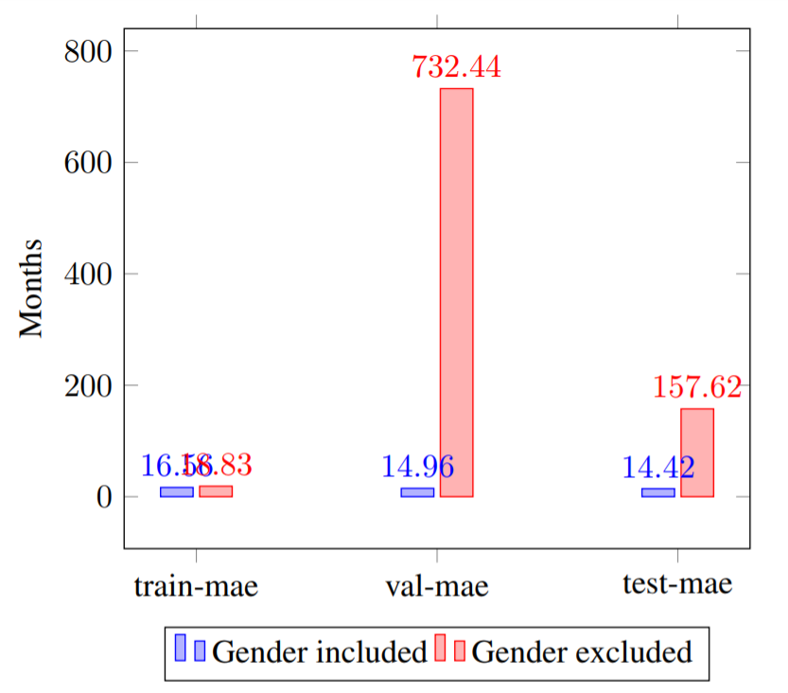
Methods & Experiments
Transfer learning experiments - Results
add gender as extra input

Slide 8
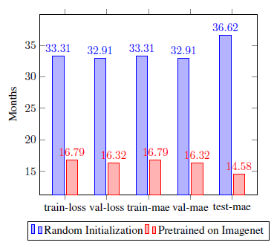
Methods & Experiments
Transfer learning experiments - Results
pretraining on ImageNet vs. rand. init.

Slide 9
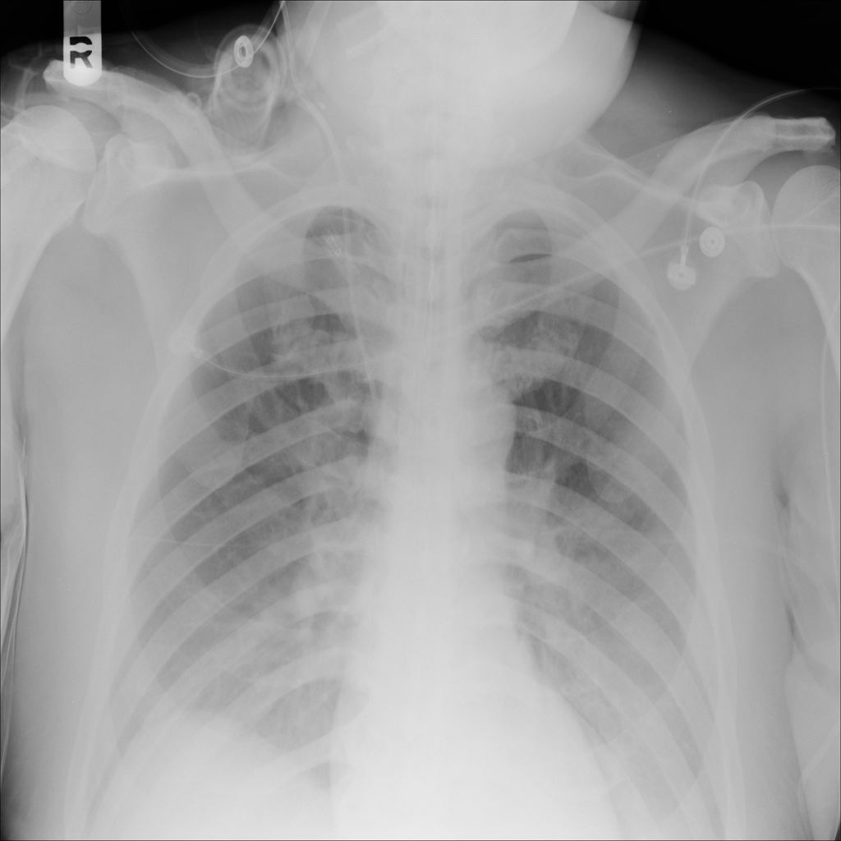
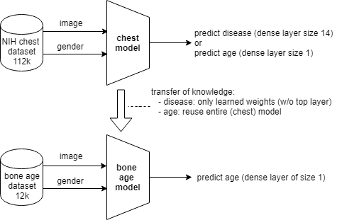
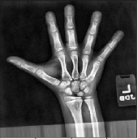
Methods & Experiments
Transfer learning experiments - Setting
Transfer learning from NIH chest dataset

Slide 10
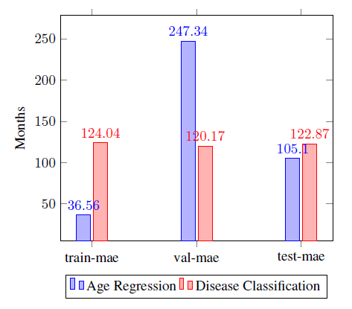
Methods & Experiments
Transfer learning experiments - Results
predict disease vs. age on chest dataset
disease:
Atelectasis, Cardiomegaly, Effusion,
Nodule,
Pneumonia,
...
Notes:
finetuning of bone age model with 20 trainable layers

Slide 11
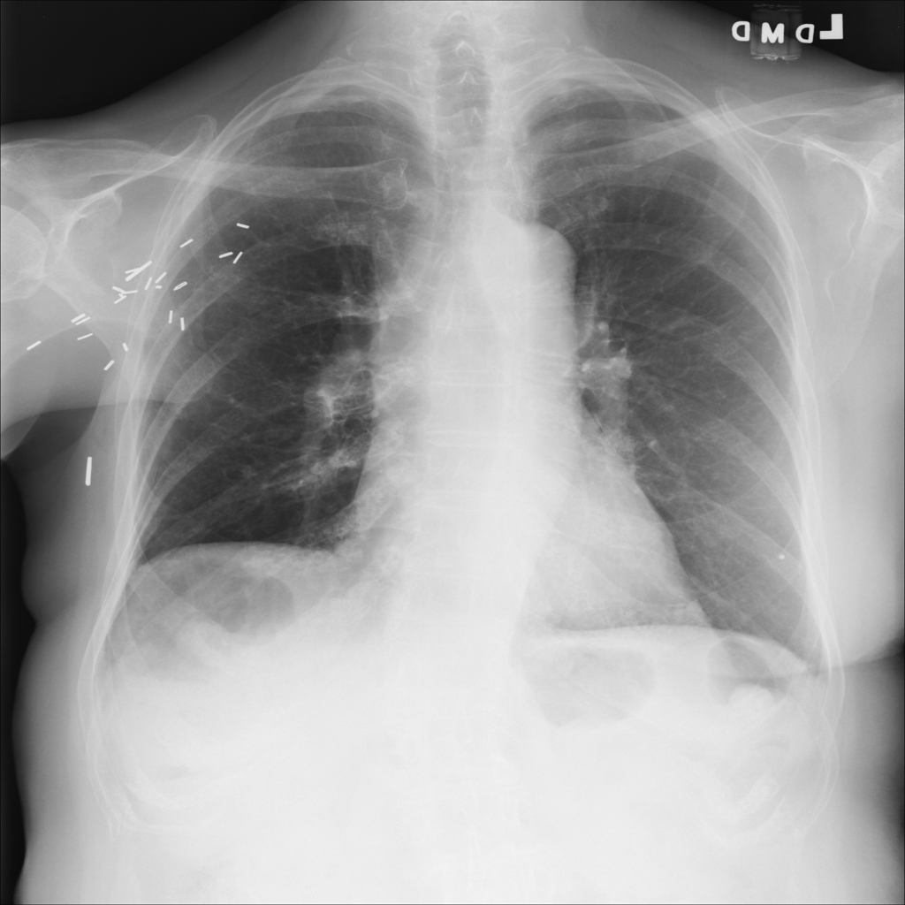
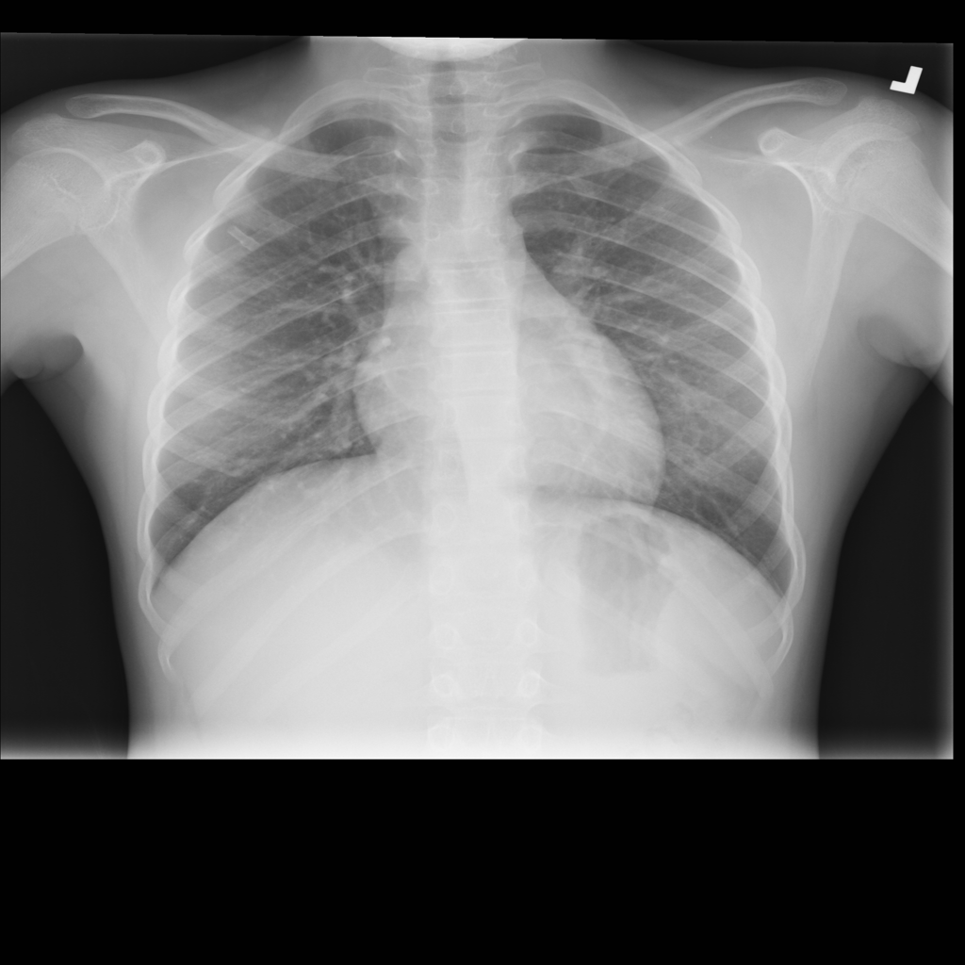


Methods & Experiments
Transfer learning experiments - Results
predict chest within bone age range only
87 years, female
12 years, female

Slide 12
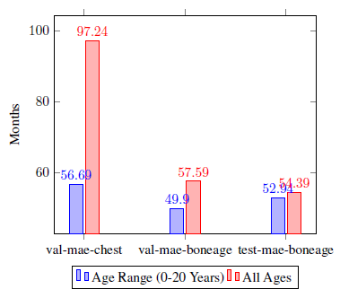
Methods & Experiments
Transfer learning experiments - Results
predict chest within bone age range only
NB: dataset for age range about 15x smaller
Notes:
reason: model gets more confused when training with all ages
reason: perhabs chest structure changes significantly with increasing age

Slide 13
Methods & Experiments
Comparison of different network architectures
VGG net
GoogLeNet & Inception
ResNet

Slide 14
Methods & Experiments
Comparison of different network architectures
i) Baseline Network
Architecture:
Input image
(384x384x3)
VGG16
(12x12x512)
Conv
(12x12x64)
Conv
(12x12x16)
LocallyConnected
(12x12x16)
Boneage prediction value
Dense
(1)
Dense
(1024)
GlobalAvg
(512)
Conv
(12x12x512)
Reference: https://www.kaggle.com/kmader/attention-on-pretrained-vgg16-for-bone-age/notebook

Slide 15
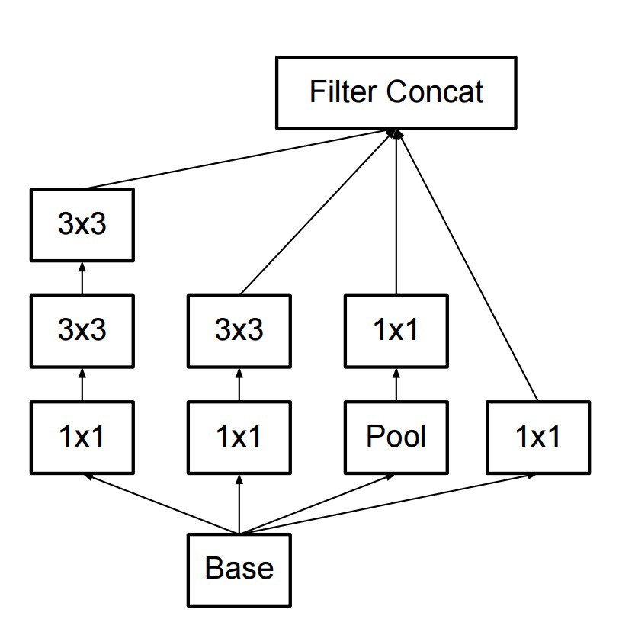
Methods & Experiments
Comparison of different network architectures
ii) Network of challenge winner (16BitNet)
10384
the 10384 is the output size of the final concatenation layer from the Inception V3 network, flattened it,
Inception module of InceptionV3 net
Reference: https://www.16bit.ai/blog/ml-and-future-of-radiology

Slide 16
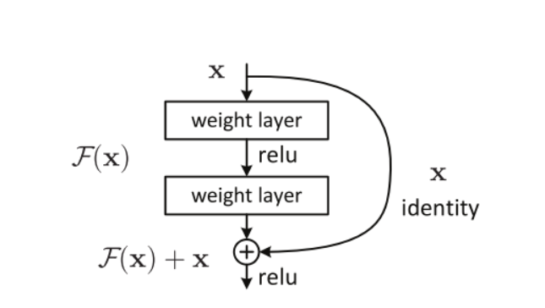
Methods & Experiments
Comparison of different network architectures
iii) Network with ResNet50 as backbone architecture
Architecture:
Input image
(500x500x1)
SeResNet50
(16x16x2048)
AvgPooling
(4x4x2048)
Dense
(1000)
Dense
(1000)
Boneage prediction value
Dense
(1)
Reference: Kaiming He, et al. Deep Residual Learning for Image Recognition, 2015
The architecture of resnet block

Slide 17
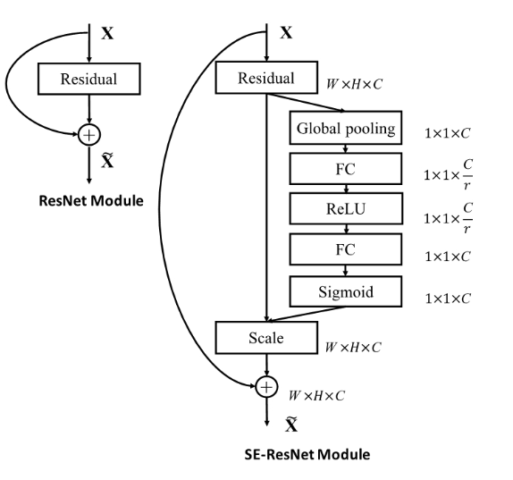
Methods & Experiments
Comparison of different network architectures
iv) Network with SeResNet50 as backbone architecture
Architecture:
Input image
(500x500x1)
SeResNet50
(16x16x2048)
AvgPooling
(4x4x2048)
Dense
(1000)
Dense
(1000)
Boneage prediction value
Dense
(1)
Reference: Jie hu, et al. Squeeze-and-Excitation Networks, 2017

Slide 18
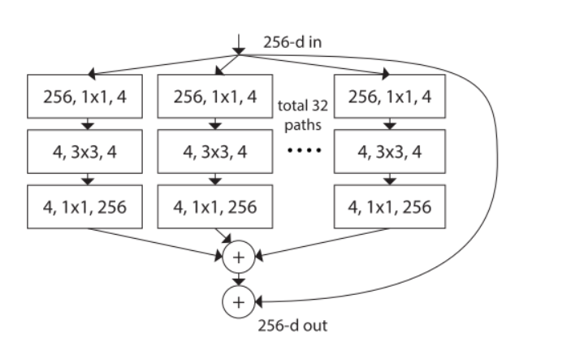
Methods & Experiments
Comparison of different network architectures
v) Network with ResNetXt50 as backbone architecture
Architecture:
Input image
(500x500x1)
ResNetXt50
(16x16x2048)
AvgPooling
(4x4x2048)
Dense
(1000)
Dense
(1000)
Boneage prediction value
Dense
(1)
Reference: Saining xie, et al. Aggregated Residual Transformations for Deep Neural Networks, 2017
The architecture of resnetXt block

Slide 19
Methods & Experiments
Comparison of different network architectures
Experimental setup & results:
The whole dataset is split into training and validation dataset with ratio 4:1.
Gender information is not used for all experiments.
Data augmentation: left-right flip, random shift (20%), random rotation (20 degree), zoom (0.2).
Batch size is 16 for all the networks.
All the networks are training from scratch except the baseline network (which applies imagenet pretrain weight).
Adam optimizer is applied for all networks and the initial learning rate is 1e-3.
MAE loss function

Slide 20
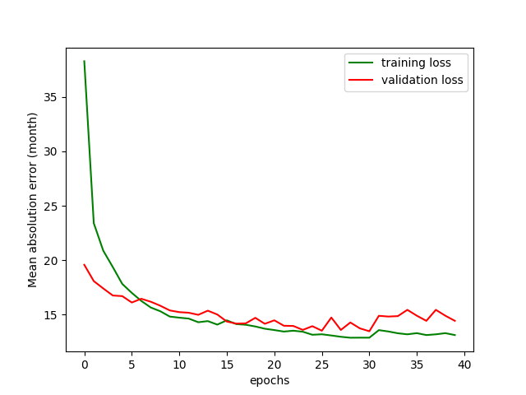
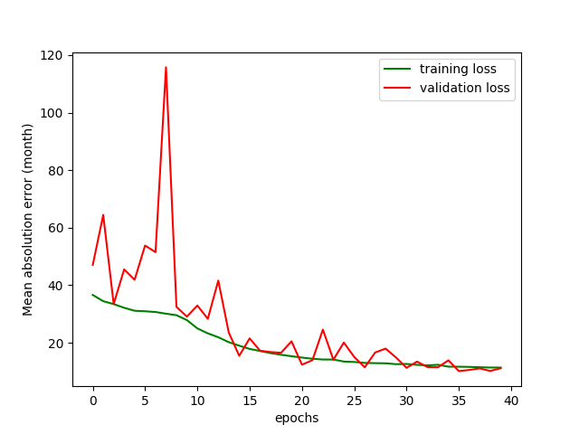
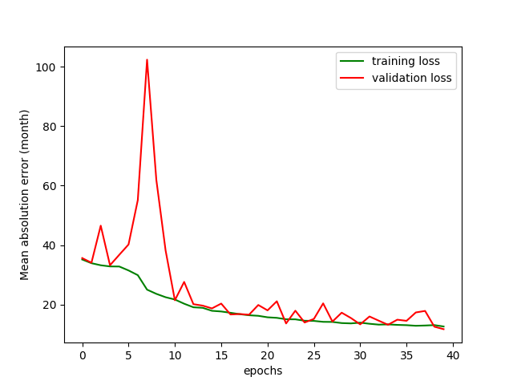
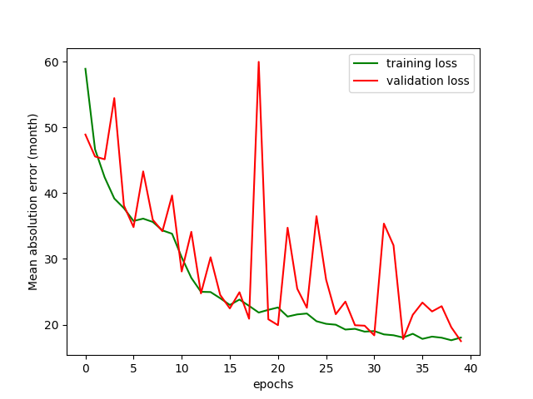
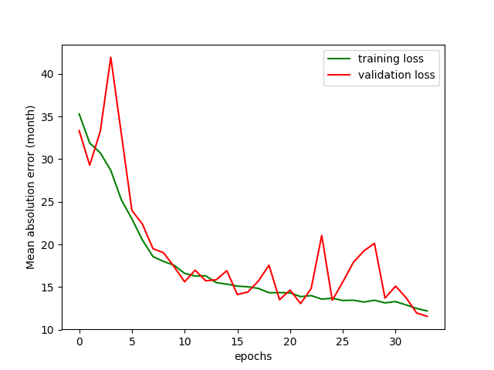
Methods & Experiments
Comparison of different network architectures
Training & Validation loss
Baseline net
16BitNet
ResNet50
ResNetXt50
SeResNet50

Slide 21
Methods & Experiments
Comparison of different network architectures
Evaluation performance on validation set (40 epochs)
 | Mean average error (Month) | Parameters
Baseline Net | 13.48 | 15,279,905
16BitNet | 10.18 | 123,157,209
ResNet50-backbone | 11.79 | 57,352,441
ResNetXt50-backbone | 14.89 | 56,812,857
SeResNet50-backbone | 10.51 | 59,825,465

Slide 22
Conclusion
image preprocessing attempts noneffective
“winner” model yet the best one
training needed with epochs >> 5 (winner: 500!)
transfer learning on chest dataset promising?
gender information advantageous
effect of classification versus regression unclear
use of different architecture an option to consider

