Slide 1
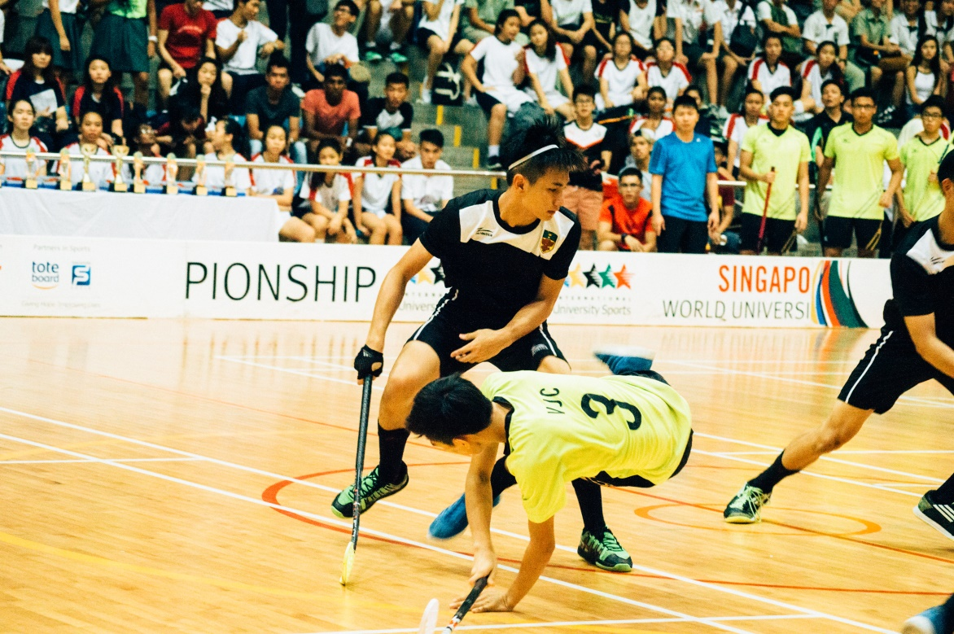
Safety Measures for Injury Prevention in Floorball
Qualitative Forschungsmethoden FS 2018
Dr. Olivier Schmid
Joël Niklaus
Tobias Nussbaum
Fabian Moser

Slide 2
Context
TTTTTTTTTTOOOOOOOOOOOOOOBBBBBBBBBBBBIIIIIIIIIIIIII
What safety measures prevent injuries in floorball

Slide 3
Theoretical Framework (I)
Floorball players are prone to injury (Engel & Kälin, 2017; Maffioletti & Gianella, 2007; Pasanen, Bruun, Vasankari, Nurminen, Frey, 2017)
Knee, back, face, ligaments
According to J&S: no rules on safety gear, recommendations only (J&S Quelle)
Rules in floorball theoretically prevent injuries (Maffioletti & Gianella, 2007)
Need to be used correctly (player and referee)
Reasons for injury:
Ball, other players, individual

Slide 4
Theoretical Framework (II)
Joël plays floorball, Fabian and Tobias do not
Different knowledge on the topic “floorball”
TTTTTTTTTTOOOOOOOOOOOOOOBBBBBBBBBBBBIIIIIIIIIIIIII
Research Question: How is the topic “safety” in relation to health of the players managed in a semi-professional floorball club?

Slide 5
Methodological Approach (I)
Design:
Semi-structured interviews
Observation, different foci
Participant(s):
Interview: National League A floorball club coach, male, ~50, coach for 30 years
Observation: National League A floorball team (25 players), coaches, physiotherapist
Notes:
Semi-structured interviews: no experience with interviews, as a guide in case of breakdown

Slide 6
Methodological Approach (II)
Procedure:
Interview with athletes, coach, physiotherapist, referee
Observation of player behavior during training or game
Our research question can be analyzed by interviewing the coach and observation of a training
Accessibility of coach and training
Execution:
Interview on March 28, before training, audio-recording and transcription
Observation of a whole training session, fieldnotes
Analysis:
Grounded Theory (Glaser & Strauss, 1998)
Content Analysis (Mayring, 2000)
Notes:
Our research question can be analyzed by interviewing the coach and observation of a training
: Coach has best overview
Accessibility of coach and training influenced decision
Observation: complete observer : explain a bit

Slide 7
Findings (I)
Player in center (individual responsibility)
a) Questionnaire (feedback app)
“wie sie sich fühlen und ähm, wenn wir merken, dass ein Spieler im Übertraining ist, also die müssen so Fragebogen ausfüllen,”
b) Individual strength training
“plus dass die Spieler ja individuell noch die Kraftsequenzen ein bis drei Mal pro Woche machen”
c) Moving preps, warm up
d) Regeneration
e) Psyche

Slide 8
Findings (II)
Prevention of injuries
a) Warm up, moving preps
b) Regeneration
Different kinds of injuries
a) Ball, stick induced
b) Injuries of teeth, eyes, knee, ligaments
c) Caused by overtraining
Observation:
Autonomy realized differently
Notes:
Autonomy realized differently: example warm-up with football after coach said not to do that

Slide 9
Discussion
Summary of the findings:
Core Category:
How can the player self-reliantly prevent injuries?
Autonomy of the player
Autonomy supporting leadership style of the coach
Reflection of the methods and procedure:
Interview provided good inputs on what to observe
Complete observer position did not interfere with training
Notes:
Joël macht die Folie
Complete observer : explain position more exactly

Slide 10
Discussion
Problems:
Interview setting in a corridor on floor, cleaning lady around
Observation: complete observer position made us miss some of the dialog
Analysis: Start with Grounded Theory, ended up with Content Analysis
Outlook:
Further studies on player motivation, autonomy
Look into feedback app
Notes:
Start with Grounded Theory, ended up with Content Analysis: explain why
Autonomy: how do players realize it (another qualitative study)

Slide 11
References
Mayring
Engel & Kälin;
Maffioletti & Gianella
J&S Rule books
Glaser, B. & Strauss, A. (1998). Grounded Theory: Strategien qualitativer Forschung.Bern: Huber.
https://www.ncbi.nlm.nih.gov/pmc/articles/PMC5566261/ (Pasanen et al)
https://rafflespress.com/2015/05/19/flooring-the-competition-a-div-floorball-boys-finals-2015/ (Titelbild)
TTTTTTTTTTOOOOOOOOOOOOOOBBBBBBBBBBBBIIIIIIIIIIIIII

