Slide 1
Lecture #0
DATA VISUALIZATION
(INT233)

Slide 2
Course Overview
L T P :
Text Book:
TABLEAU DESKTOP POCKET REFERENCE: ESSENTIAL FEATURES, SYNTAX AND DATA VISUALIZATIONS by RYAN SLEEPER
Reference Book:
1.HANDS-ON DATA VISUALIZATION: INTERACTIVE STORYTELLING FROM SPREADSHEETS TO CODE by JACK DOUGHERTY, SHROFF PUBLISHERS & DISTRIBUTORS PVT. LTD
2. TABLEAU DATA VISUALIZATION COOKBOOK by ASHUTOSH NANDESHWAR, PACKT PUBLISHING
3. TABLEAU: CREATING INTERACTIVE DATA VISUALIZATIONS by ASHUTOSH NANDESHWAR, PACKT PUBLISHING
2 | 0 | 2

Slide 3
Marks Breakup
Credits:- 3
Marks Breakup:
* 2 Best CA out of 3 CA each of 30 marks
Activity | Marks
Attendance | 5
Continuous Assessment | 45
End-Term Practical (ETP) | 50
Total | 100

Slide 4
Complete evaluation criteria for the course
CA1: Quiz (15 questions for [30 marks])
CA2: Test (3 questions [10 marks each])
CA3: Skill Based Assignment
20 Marks: Project implementaion and Viva
10 Marks: Sharing on Linkedin (4+3+3) Like, comments, Share

Slide 5

Revised Bloom’s Taxonomy

Slide 6
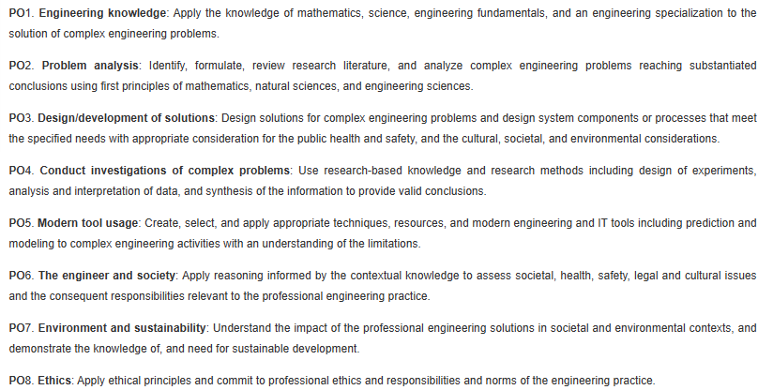
Program Outcomes (POs)

Slide 7
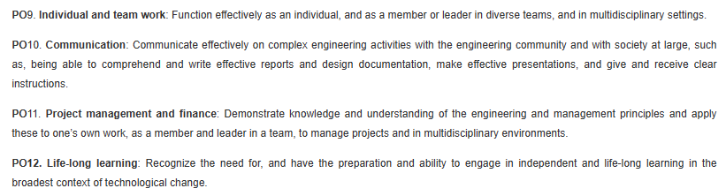
Program Outcomes (POs)

Slide 8
Course Outcomes
CO1 :: identify and recall fundamental concepts and terms in data visualization and Tableau.
CO2 :: demonstrate understanding of data visualization principles and Tableau functionalities.
CO3 :: apply Tableau techniques to create and customize visualizations.
CO4 :: analyze data using Tableau to identify patterns, trends, and relationships.
CO5 :: evaluate the effectiveness of different data visualizations in conveying information.
CO6 :: design and develop advanced Tableau dashboards and data stories to address complex business problems.

Slide 9



Slide 10
Why star course?
Advanced Analytics:
Tableau provides a range of advanced analytics features, such as trend analysis,
forecasting, and statistical analysis, empowering users to derive
actionable insights from their data.
Interactive Visualizations:
Tableau excels in creating interactive dashboards that allow users to explore
data dynamically. Features like filters, drill-downs, and tooltips enhance the
user experience and enable deeper data exploration.

Slide 11
Why star course?
Data Storytelling:
Tableau emphasizes the importance of data storytelling, providing
features like story points that allow users to create narrative-driven
visualizations. This focus on storytelling helps in communicating
insights more effectively.

Slide 12
OER
Unit mapped | Broad topic | Sub Topic | Source Type | Source Title | *%age mapping (approx) | Source URL
Unit 1 | DATA VISUALIZATION FUNDAMENTALS | Design principles for charts and graphs, Value of Visualization | Great Learning | Data Visualization using Tableau | 100 | https://www.mygreatlearning.com/academy/learn-for-free/courses/data-visualization-using-tableau

Slide 13
Unit 2 | INTRODUCTION TO TABLEAU | Basic functions of tableau, Operations of tableau, | Great Learning | Data Visualization using Tableau | 100 | https://www.mygreatlearning.com/academy/learn-for-free/courses/data-visualization-using-tableau
Unit 3 | MANAGING, ORGANIZING AND ENHANCING DATA IN TABLEAU | Create hierarchies to drill down into data, Creating groups for data, Creating and Using Sets | Simplilearn | Introduction to Data Visualization | 65 | https://www.simplilearn.com/free-data-visualization-course-online-skillup

Slide 14
Unit 4 | CHART TYPES AND THEIR USAGE IN TABLEAU | Visualization data with advanced analytics | Great Learning | Data Visualization using Tableau | 100 | https://www.mygreatlearning.com/academy/learn-for-free/courses/data-visualization-using-tableau
Unit 5 | MATHEMATICAL AND VISUAL ANALYTICS IN TABLEAU | Number calculations, String calculations | Simplilearn | Introduction to Data Visualization | 60 | https://www.simplilearn.com/free-data-visualization-course-online-skillup

Slide 15
Unit 6 | INTERACTIVE DASHBOARDS AND STORY POINTS IN TABLEAU | Adding interactivity with actions, Dashboard layout and formatting | Simplilearn | Introduction to Data Visualization | 100 | https://www.simplilearn.com/free-data-visualization-course-online-skillup

Slide 16
What are Cohorts
A group of students of a common programme who intend to attain similar characteristics by means of learning similar skills in order to target a particular career opportunity.

Slide 17
Purpose of Cohorts
Student shall be able to have a goal oriented approach for his/her career
Student identifies the goal in the very first year
Student shall be able to follow the stage wise career progression.
Early identification of skill set required for selected goal.

Slide 18




Outline
Cohort’s:
Cohort 1: Software Development (Product Based)
Cohort 2: Data Science
Cohort 3: Cyber Security
Cohort 4: Full Stack Web Development
Cohort 5: Machine Learning
Cohort 6: Cloud Computing
Cohort 7: Software Methodologies And Testing
Cohort 8: Software Development (Service Based)
Cohort 9: Entrepreneurship
Cohort 10: Mobile Application Development
Cohort 11: Government jobs/Higher studies

Slide 19
Cohort 2: Data Science
Companies
Skills Required
Skills Sources – Internal
Skills Sources – External

Slide 20













Cohort 2: Data Science
Companies
10-20 LPA
Accenture
Quick Heal
Informatica
IBM
AMDOCs
Norton
Up to 10 LPA
TCS
Deloitte
Quantiphi
Capgemini
20-30 LPA
Amazon
Flipkart
Deloitte
HP

Slide 21
Cohort 2: Data Science
Skills Required
S1 - DATA MANAGEMENT
S2 - DATA VISUALIZATION
S3 - DATA EXPLORATION AND ANALYSIS
S4 - R LANGUAGE
S5 - PREDICTIVE ANALYTICS
S6– DATA CLASSIFICATION
S7 - DATA ANALYTICS
S8 – PYTHON LANGUAGE
S9 – RECOMMENDER SYSTEMS
S10 - DATA PREDICTION

Slide 22
Cohort 2: Data Science
Skills Sources – Internal
MAIN COURSE
INT306: DATABASE MANAGEMENT SYSTEM[S1]
INT108: PYTHON PROGRAMMING[S8]
ELECTIVE COURSE
INT217: INTRODUCTION TO DATA MANAGEMENT [S1]
INT233: DATA VISUALIZATION[S2,S3]
INT232: R PROGRAMMING [S4]
INT234:PREDICTIVE ANALYTICS [S7,S10,S5]
INT254: FUNDAMENTALS OF MACHINE LEARNING[S6]

Slide 23
Cohort 2: Data Science
Skills Sources – External
Source | Description | Suggested Source
Industry Certification | Data Visualization[S2] Data Exploration and Analysis[S3] | Tableau Tableau
MOOCs | Data Visualization in Excel[S1] Create Charts and Dashboards Using Microsoft Excel [S1] Excel Basics for Data Analysis"[S1] Data Visualization with Tableau Specialization[S2] Tableau Certified Data Analyst"[S2] R Programming[S4] Supervised Machine Learning: Regression and Classification [S5,S8] Machine Learning Specialization"[S5,S10] Recommender Systems Specialization[S9] | 1. Coursera 2. Coursera 3. Coursera 4. Coursera 5. Coursera 6. Coursera 7. Coursera 8. Coursera 9. Coursera

Slide 24
Applications of Data Visualization Techniques
Retail Banking
Government
Insurance
Health Care and Medicine
Telecommunications
Transportation
Capital Markets
Asset Management

Slide 25
Unit 1
DATA VISUALIZATION FUNDAMENTALS : Basics of Data visualization, Data types, Exploratory versus explanatory visualizations, Design principles for charts and graphs, Value of Visualization, Data and Image Models, Common tools for creating data visualizations, Excel vs SPSS vs R vs Tableau
Data Processing using tableau Prep : Introduction to tableau Prep, Installation of tableau Prep, Basics of tableau prep, Connecting to data, Creating Data Flow, Blend Data Sources, Cross Database Join, Project task, Tableau Prep for Business

Slide 26
Unit 2
INTRODUCTION TO TABLEAU : Introduction to tool, Installing Tableau, Tableau features, Connecting data with tableau, Joining data sources, Live data connections vs data extracts, Basic functions of tableau, Operations of tableau, Usage of Menus and Toolbar, Usage of Data Pane, Analytics Pane, Sheet Tabs, Shelves and Cards, Marks Card, Legends, Layout for dashboard and stories, Difference between Green and Blue pills

Slide 27
Unit 3
MANAGING, ORGANIZING AND ENHANCING DATA IN TABLEAU : Splitting data, Pivoting & Transforming data, Blue & green pills Filters, Blue & green pills affect on dates, Cleaning data by Bulk Re-aliasing, Setting data defaults to save time later on, Create hierarchies to drill down into data, Creating groups for data, Creating and Using Sets, Create data filters, Create calculated fields, Combine data sources using data blending, Creating & using Parameters, Bringing in More data with Joins

Slide 28
Unit 4
CHART TYPES AND THEIR USAGE IN TABLEAU : Defining data and their different visualization ways, Building various charts, Visualizing data using Bar Chart, Lines Charts, Scatterplots, Heat maps, Histograms, Maps, Dual Axis Charts ,Pie Charts, Visualization data with advanced analytics Polygon Maps, Bump Charts, Control charts, Funnel charts, Pareto charts, Waterfall charts, Usage and filtration of data with charts, Visualizing categorical data, Visualizing time series data, Visualizing multiple variables, Visualizing geospatial data, Mapbox integrations, Web Mapping Services, Background Images

Slide 29
Unit 5
MATHEMATICAL AND VISUAL ANALYTICS IN TABLEAU : Math and data, Aggregate calculations, Date calculations, Logic calculations, Number calculations, String calculations, Type calculations, Conceptual Topics with LOD Expressions, Nested LOD Expressions Showing change instead of raw numbers, Summary statistics in visualizations, Annotations and pre-attentive attributes, Use visual analytics to find answers in your data, Adding annotations to visualization, Add reference lines and trend lines, Visualizing forecasting data, Clustering, Drag and drop analytics, Analysis with cube and MDX

Slide 30
Unit 6
INTERACTIVE DASHBOARDS AND STORY POINTS IN TABLEAU : Creating a dashboard, Designing dashboard, Add motions, Adding interactivity with actions, Dashboard layout and formatting, Add extra detail to visualization using Marks Shelf, Add Size, Shape, Labels, Details, Tooltips in visualization, Sharing and collaborating dashboards, Story Points and how to create them, Designing effective slide presentations to showcase data story, Publish online business dashboards with Tableau, Exporting Pdfs, Sharing Dashboard Securely

Slide 31
Learning Outcomes
Experience the role of visualization for analytics in an organization
Use data visualization principles to help you to design dashboards that enlighten and support business decisions
Acquire knowledge of data representation and subsetting techniques for real time datasets
Use and customize the various graphical packages for creating various types of graphs, plots and charts
Analyze real life business problems by using various visualization techniques
Integrate data to provide mashed-up dashboards

Slide 32
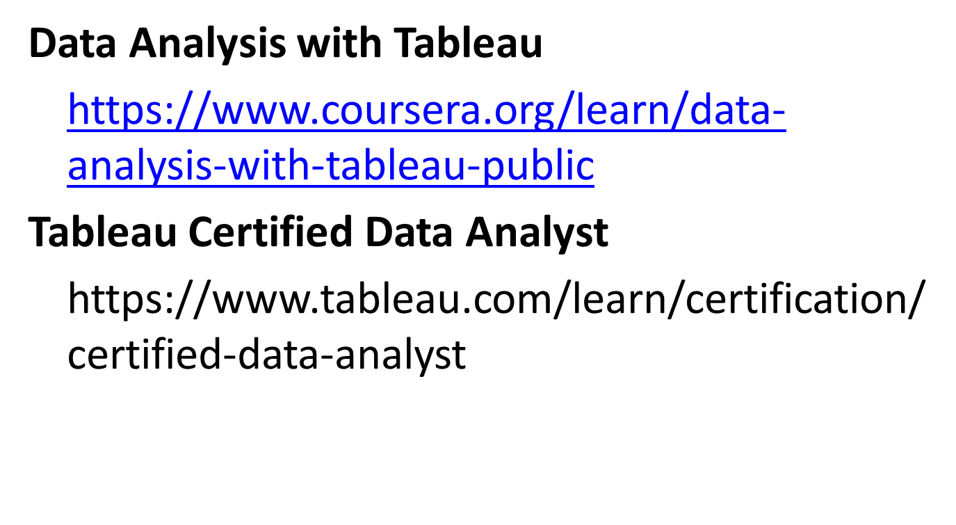
MOOCs and Certification

Slide 33

Jump Board Initiatives
to
foster your
DREAM CAREER

Slide 34

B2B : Need
Forgetfulness
Lack of clarity of concepts
Limited Retention
Uneven association of basic to advance
Reading – A dying habit
What to revise?
One shoe size does not fit all

Slide 35

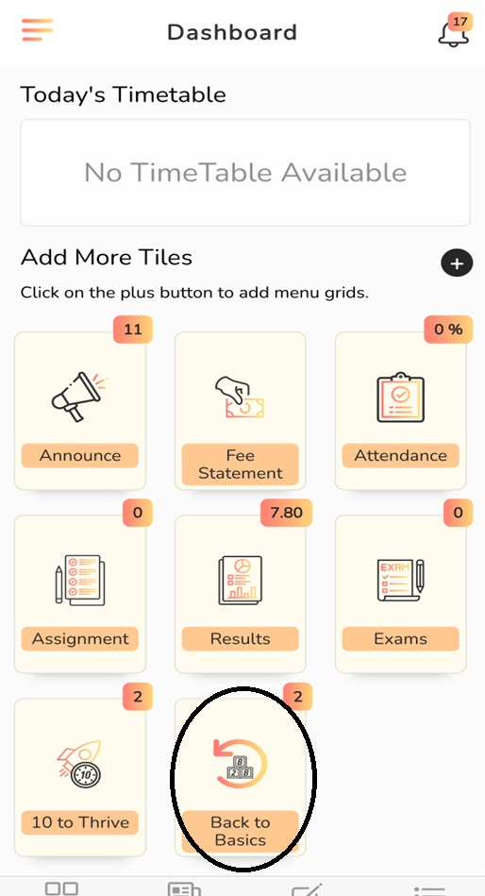
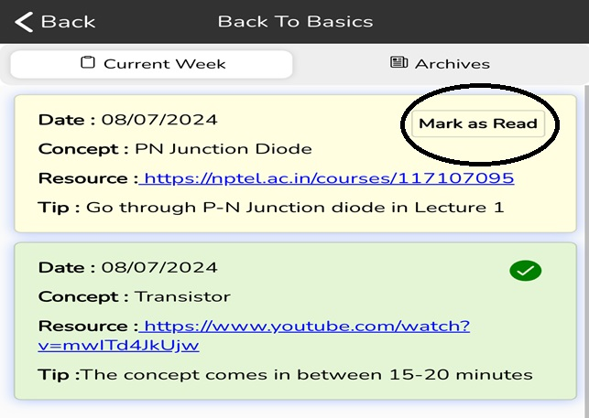
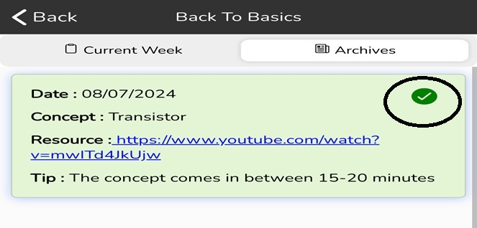
B2B : Construct

Slide 36
B2B : Construct

Slide 37
B2B : Construct

Slide 38

B2B : Blueprint
Two reading/watching links every week
Monthly practice test from the content covered in the month
Final B2B test along with ETE
Capturing the learning and assimilating it in SMART

Slide 39

Ten to Thrive : Need
Missing Breadth
Inability to comprehend
Lack of expression
Missing crispness
Unable to pitch to the point
Public speaking fear

Slide 40
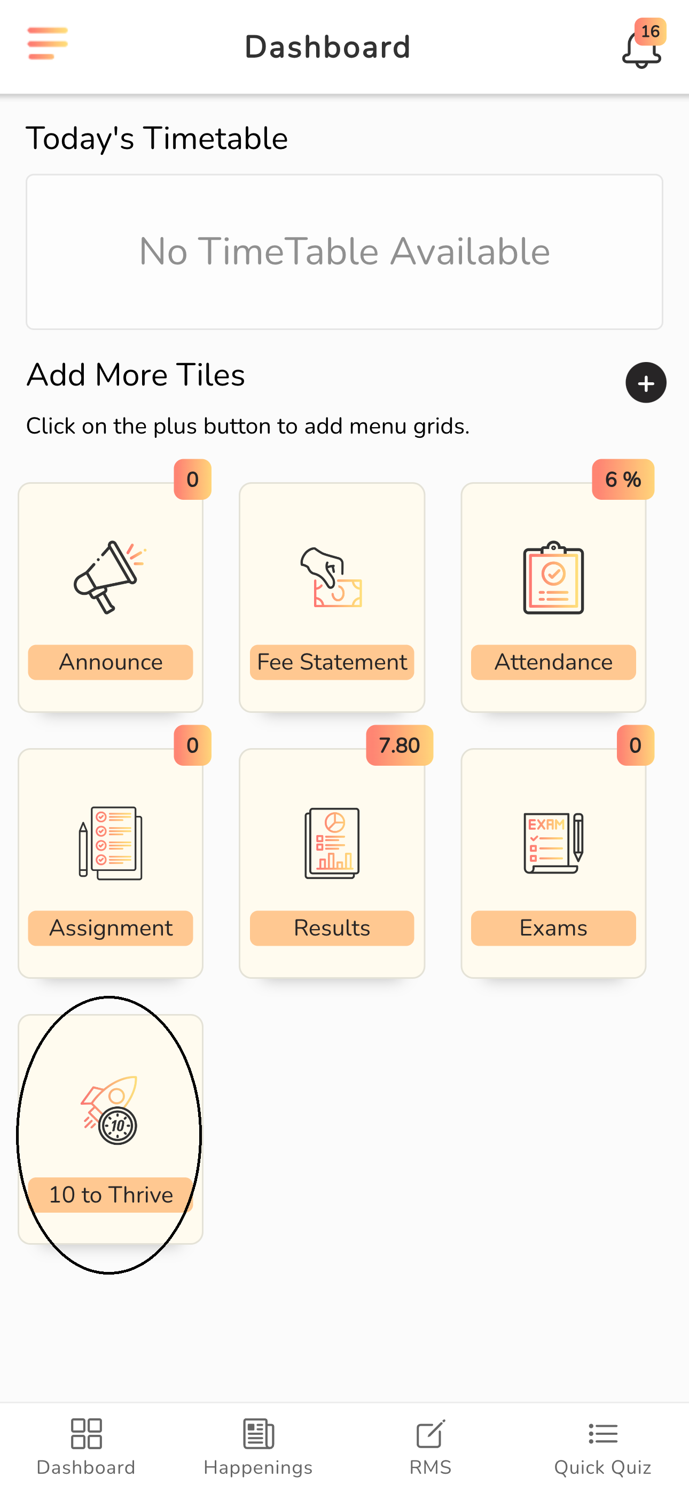
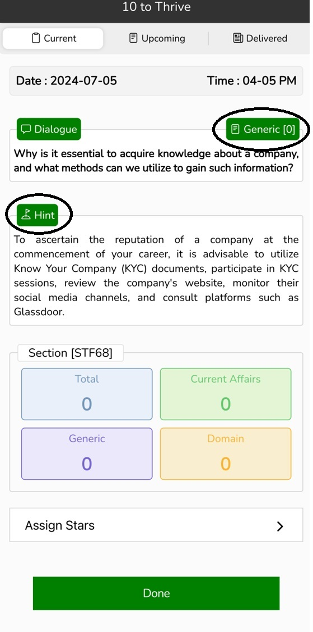
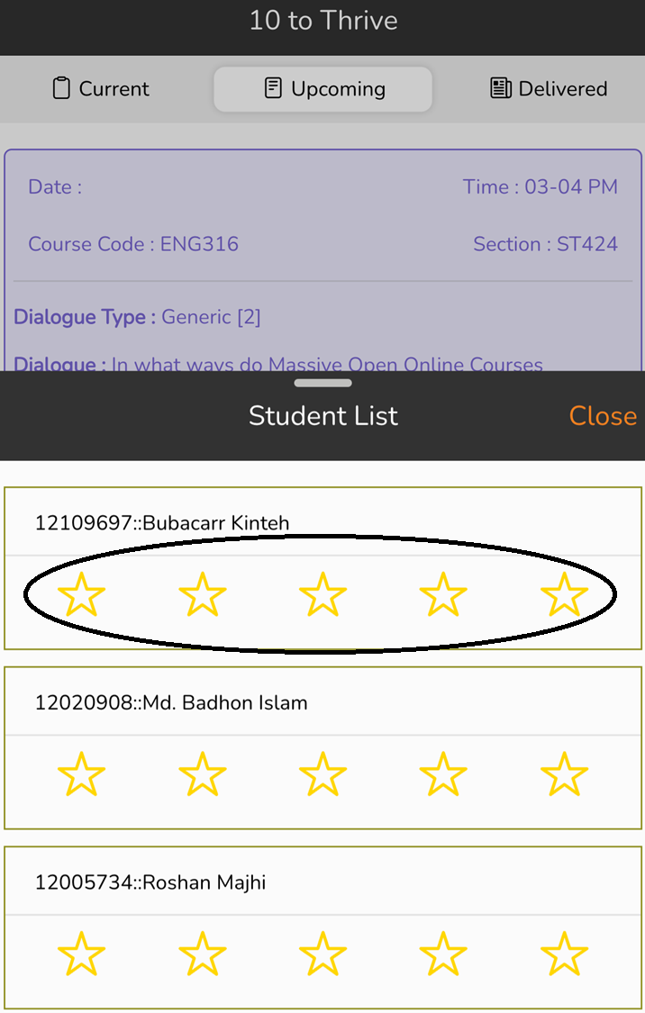
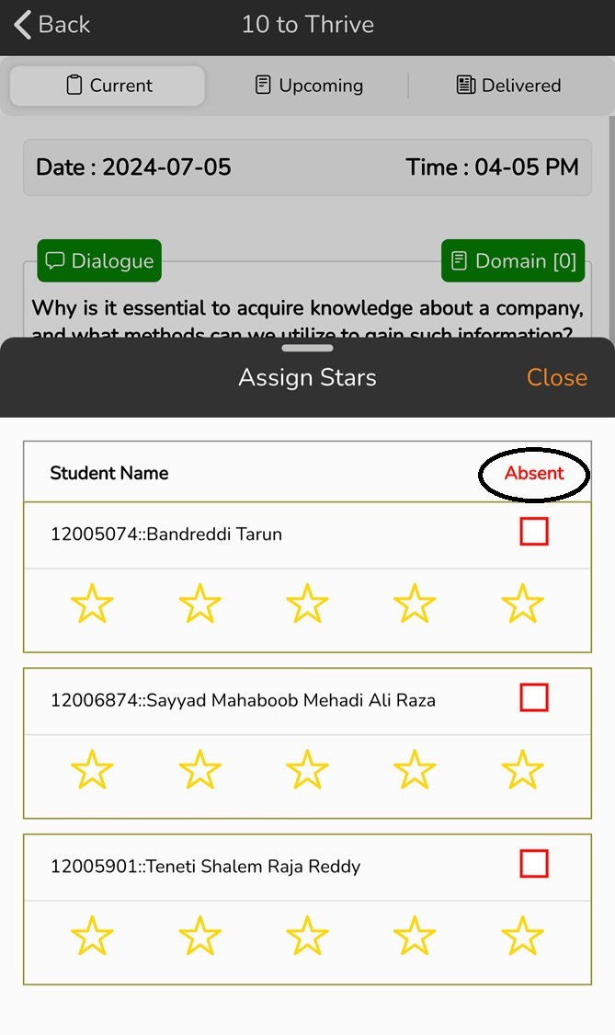
TTT : Construct

Slide 41
TTT : Construct

Slide 42
TTT : Construct

Slide 43
TTT : Blueprint
Dialogue will be visible 2 days in advance to prepare well
Three realms of dialogue
  Domain
  Generic
  Current Affairs
Pitch in 3 minutes only
No PPT, Notes or any other reference material
Stars from 0 to 5 based on preparedness, confidence, coherence, fluency and timely accomplishment
A student will get 6 chances in a term, 4 best would be counted
One of the game elements for PO - I

Slide 44



