Slide 1
The Zero Install system
Thomas Leonard
University of Southampton
http://0install.net

Slide 2
Overview
Problems with traditional systems
Zero Install example: running ROX
Libraries and the cache
Security
Packaging for Zero Install
Current state and future work

Slide 3
Problems with traditional installation
Ease of use
  Find package for your system
  Enter root password
  Unclear what changes are being made
Security
  Install scripts execute as root
One package for each distribution
  Unnecessary extra work

Slide 4
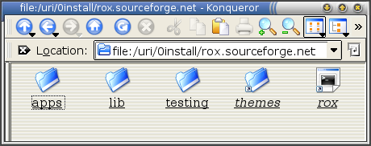
Getting ROX-Filer with Zero Install
If you don’t have ROX-Filer, run it like this:
  $ cd /uri/0install/rox.sourceforge.net
  $ ./rox
  or
ROX-Filer is downloaded, cached and executed.
Root access is not required.

Slide 5
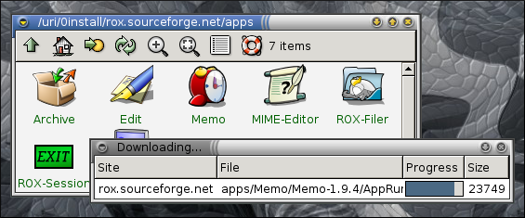
Getting the rest of ROX
To the user, all applications appear available.
When clicked, they are cached and run.

Slide 6
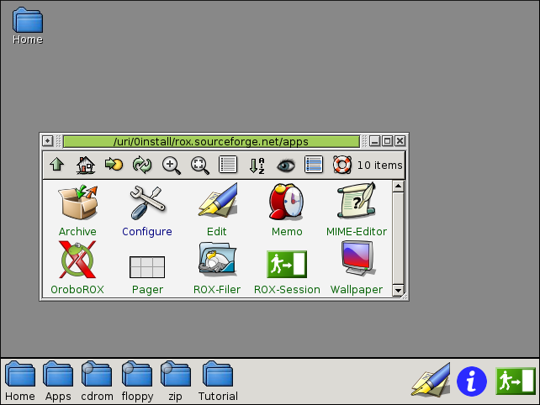
Running ROX

Slide 7
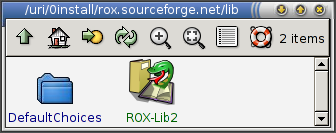
Libraries
Dependencies loaded by globally unique paths.
  “Web of software”
Memo loads ROX-Lib from:
  /uri/0install/rox.sourceforge.net/lib/ROX-Lib2
ROX-Lib loads pygtk from:
  /uri/0install/zero-install.sourceforge.net/libs/pygtk-2

Slide 8
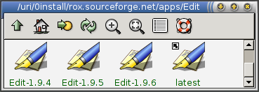
Multiple versions
All software is available.
All versions (‘latest’ symlinks).
All platforms (mainly Python code, though).
Source code.
Debugging symbols.
Download-on-demand: can include everything!

Slide 9
The network and the cache
Simple cache structure:
  /uri/0install/rox.sourceforge.net/rox
  /var/cache/zero-inst/rox.sourceforge.net/rox
Safe to delete anything from the cache.
Running cached programs doesn’t use the net.
Conceptually similar to web caches (squid).
    Unix filesystem interface
    Faster for cached data: mmap
    Site-at-a-time updating

Slide 10
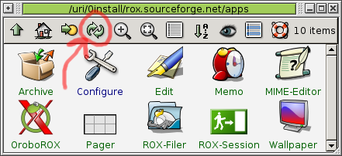
Updating the cache
0refresh updates a site’s index:
  gimp.org $ ls
  gimp-1.2
  gimp.org $ 0refresh
  gimp.org $ ls
  gimp-1.2
  gimp-2.0
Programs can update the cache if needed.
  #!/bin/0run python.org/python2.3 2004-01-01
  print “Hello from Python!”

Slide 11
Slow connections
You need broadband, right?
Getting ROX-Filer over GPRS (mobile phone):
  1m48s
  265 K received, 13 K sent
Normal ROX-Filer binary release is over 1Mb.
Didn’t need translations, manual or icon theme.
No global index (apt-get update).

Slide 12
Security
Anyone can run any software.
Nothing is run as root.
Uses GPG signatures and MD5 sums.
Does not listen for incoming connections.
No SUID binaries. Use sudo.
Nothing run on updates.

Slide 13
Future security possibilities
Basis for sandboxing systems:
  Subterfugue, Systrace, Java, UML.
Other trust schemes:
  https, web-of-trust, key-servers, certificate authorities.
Whitelists and blacklists.

Slide 14
Packaging for Zero Install
Need good binary compatibility.
  See http://autopackage.org
Create and populate the directory structure.
  $ ./configure --prefix=/uri/0install/...
Run 0build:
  $ alias 0build=/uri/0install/zero-install.sourceforge.net/bin/0build
  $ 0build /var/www myhost.com
Use any web server (e.g. apache).

Slide 15
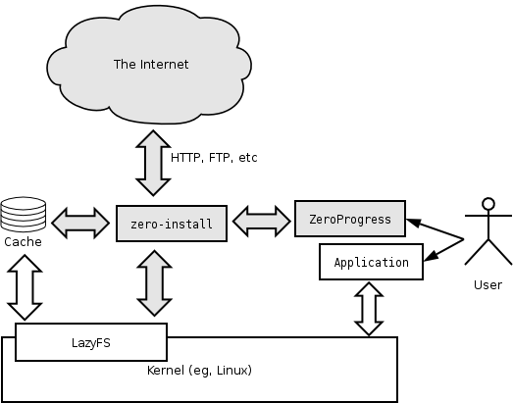
Architecture

Slide 16
Future work
Better support for mirrors / peer-to-peer.
Better cancelling of downloads.
Intelligent cache cleaning.
Port lazyfs to other OS kernels.
Limits to prevent local DoS attacks.

Slide 17
Summary
ROX is using Zero Install successfully
Zero Install is the easiest way to get ROX
Anyone can join in (decentralised)
Easier for users
Easier for upstream authors
Security benefits

Slide 18
Questions – install to PATH?
(summary of questions asked after the talk)
Can Zero Install be used without also switching to ROX-style applications (e.g. still put binaries in PATH)?
  Per-user union FS (like Plan/9) ideal.
  Stow could achieve much the same effect, installing symlinks in $HOME pointing into /uri/0install.
  But ROX is cool, because you don't need all that!

Slide 19
Questions - configuration?
Installing on Debian asks about configuration (e.g. apache). What about on Zero Install?
  On Debian: 'apt-get install apache' installs apache, and configures it as a side-effect.
  On Zero Install: '/uri/0install/apache.org/config' configures apache, and installs it as a side-effect.
  Same number of steps, but configuration is always explicit in Zero Install.
  User apps (gimp, etc) do configuration on first run anyway.

Slide 20
Questions - caching
Is Zero Install web-cache friendly?
  Yes!
  GPG detached signature and index name is fetched bypassing cache (about 1K) to ensure up-to-date.
  Index and all archives are fetched through the cache. They are uniquely named including a date-stamp, so that the same name always refers to the same data => never need to check whether they are out-of-date => excellent for caches (squid, etc).

Slide 21
Questions – how do I repackage?
ROX apps are easy to package for zero install. What about more traditional auto-tools packages?
  Use ./configure –prefix=/uri/0install/... to build.
  Then distribute using 0build as normal.
  To link against Zero Install libraries, either specify the full path of the library, or add an rpath entry to the ELF header to add a /uri/0install/... directory to the search path.

Slide 22
Questions – versions and bug reports
When a Debian user uses reportbug, the bug report automatically includes all library versions. Can Zero Install do the same?
  In a pure Zero Install system, this isn't a big problem, since everyone is using recent libraries anyway. Same binaries everywhere.
  Not done automatically when mixing Zero Install with traditional system. Same problem as normal binary packages.
  But advantages too: debugging symbols and source are trivially available when using Zero Install.

Slide 23
Questions – get everything?
Should we package everything this way (glibc, etc)?
  Probably not.
  Users already have glibc; they see no advantage over traditional methods to get it.
  Better to package applications, and add libraries when you get complaints that some distro doesn't have them.

