Slide 1
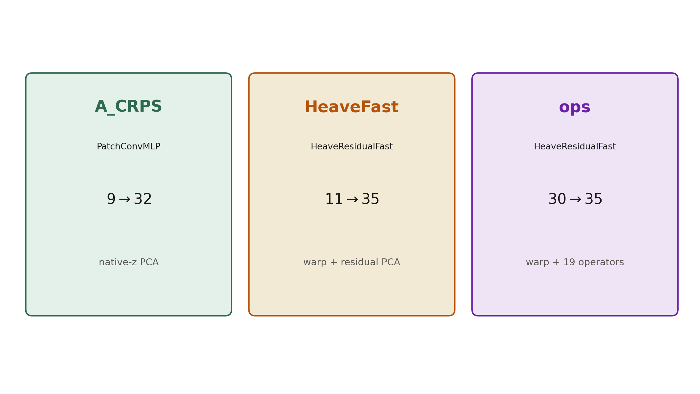
v2 models for data assimilation
Shared encoder. Distinct decode.
1 / 12
Notes:
Three served configurations share PatchConvMLP in point mode. They differ in input width and in the map from μ to T(z), S(z).

Slide 2
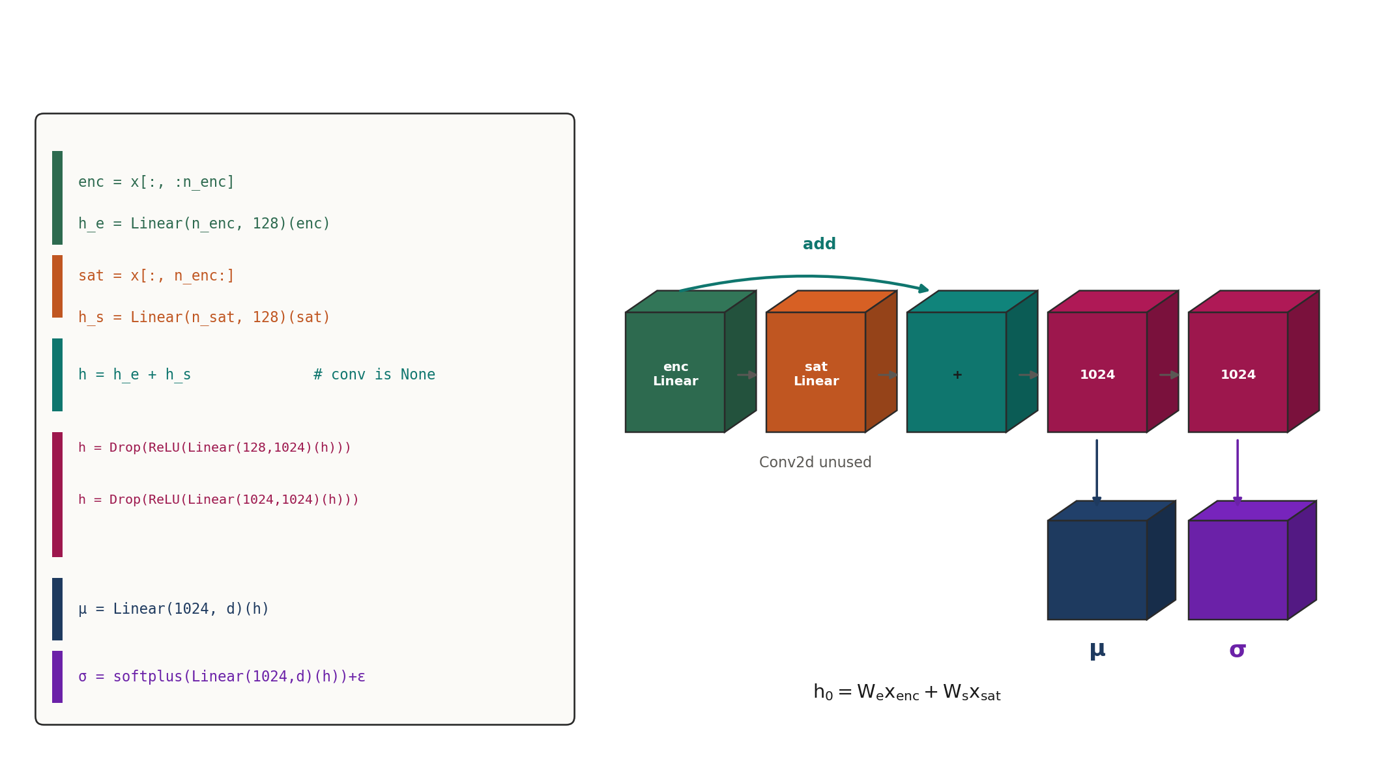
PatchConvMLP
patch_shape is None. Satellite encoding is Linear. Conv2d is unused.
2 / 12
Notes:
The class name is historical. DA cells set patch_shape=None, so sat_proj is Linear(n_sat, 128) and self.conv is None. Conv2d is only built for the unused conv3 / patch ablation.

Slide 3
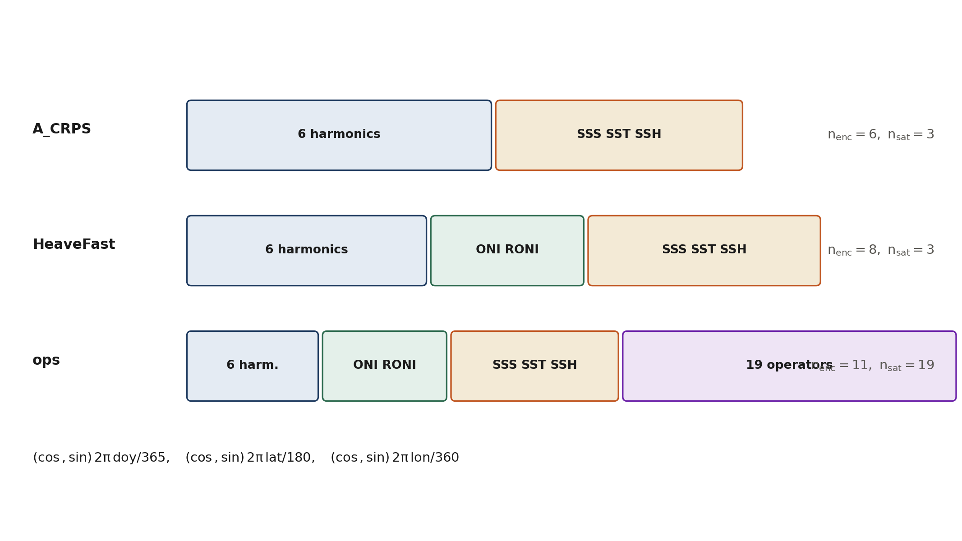
Input layout
Harmonics, optional ENSO, then satellite columns.
3 / 12
Notes:
Base encoding is six Fourier features of doy, latitude, and longitude. HeaveFast and ops insert ONI and RONI after those six. ops places local SSS/SST/SSH in the encoder half (n_enc=11).

Slide 4
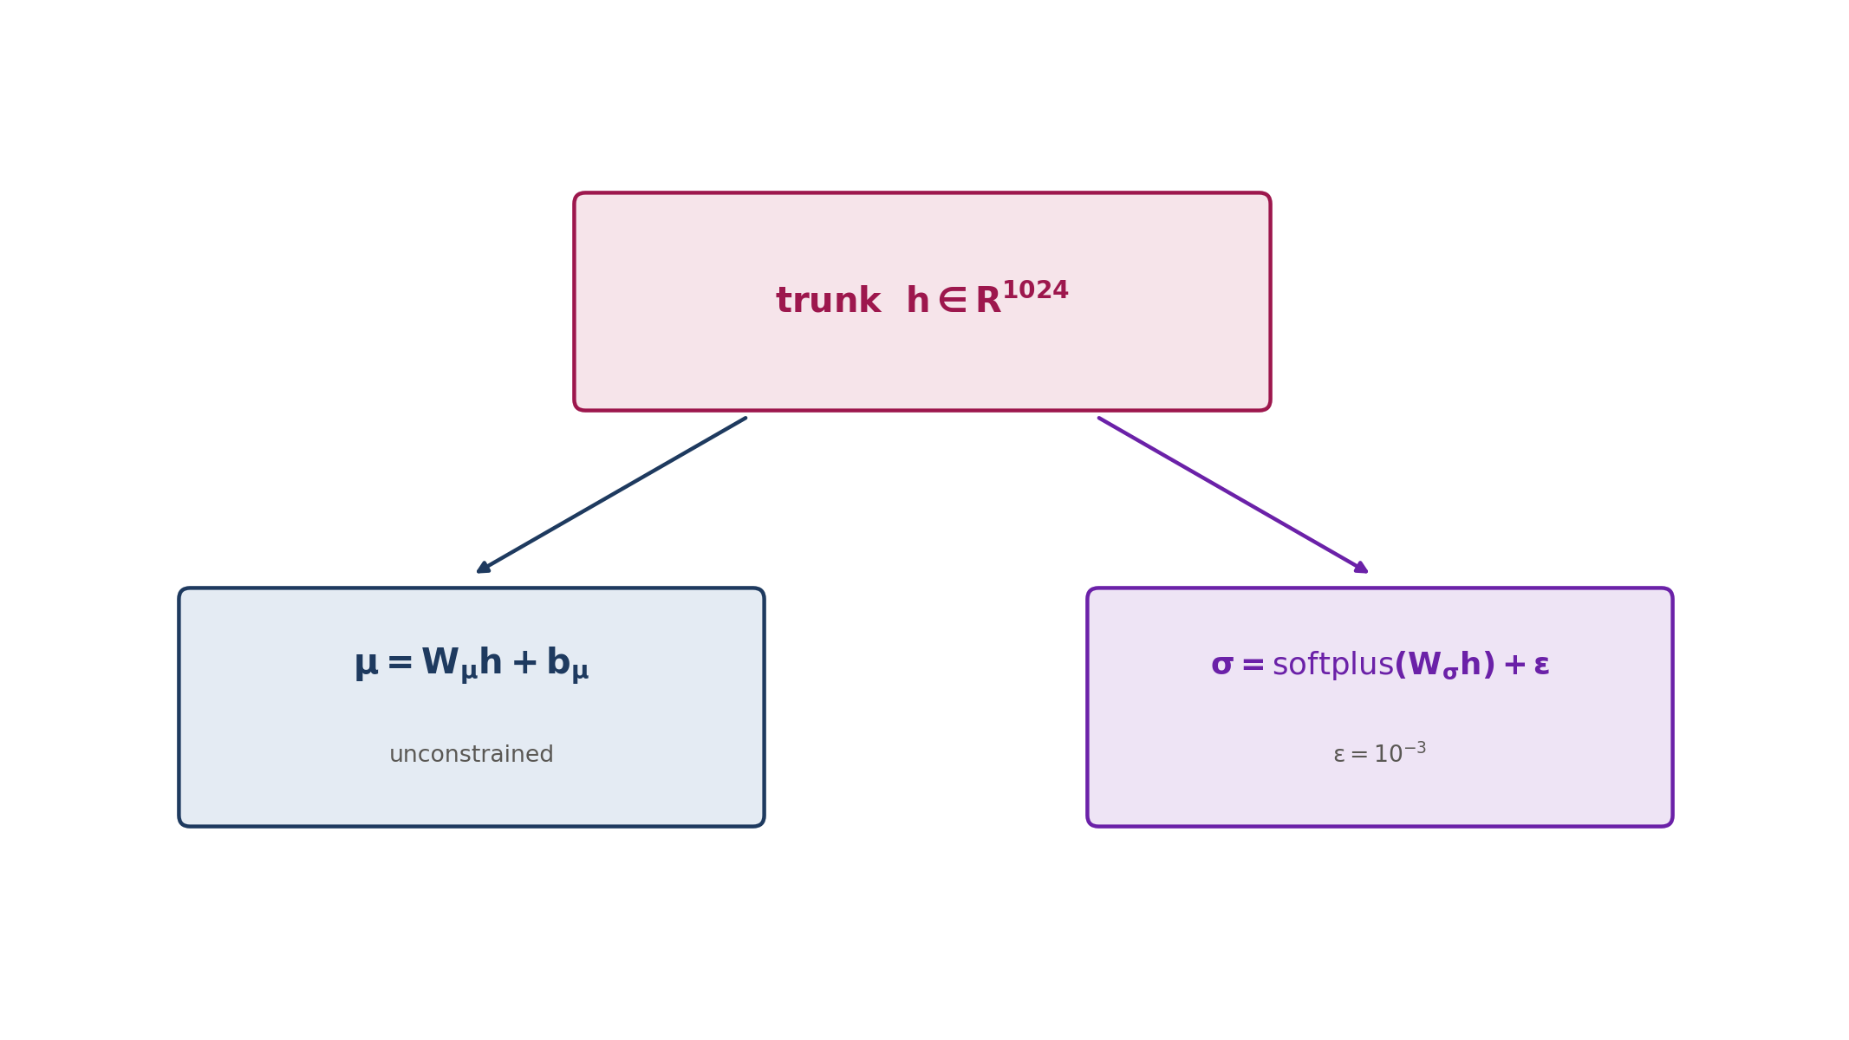
Heteroscedastic head
Only μ is assimilated.
4 / 12
Notes:
Forward returns concat(μ, σ). softplus plus 1e-3 enforces σ>0. The analysis uses only μ. Observation error is not this σ.

Slide 5
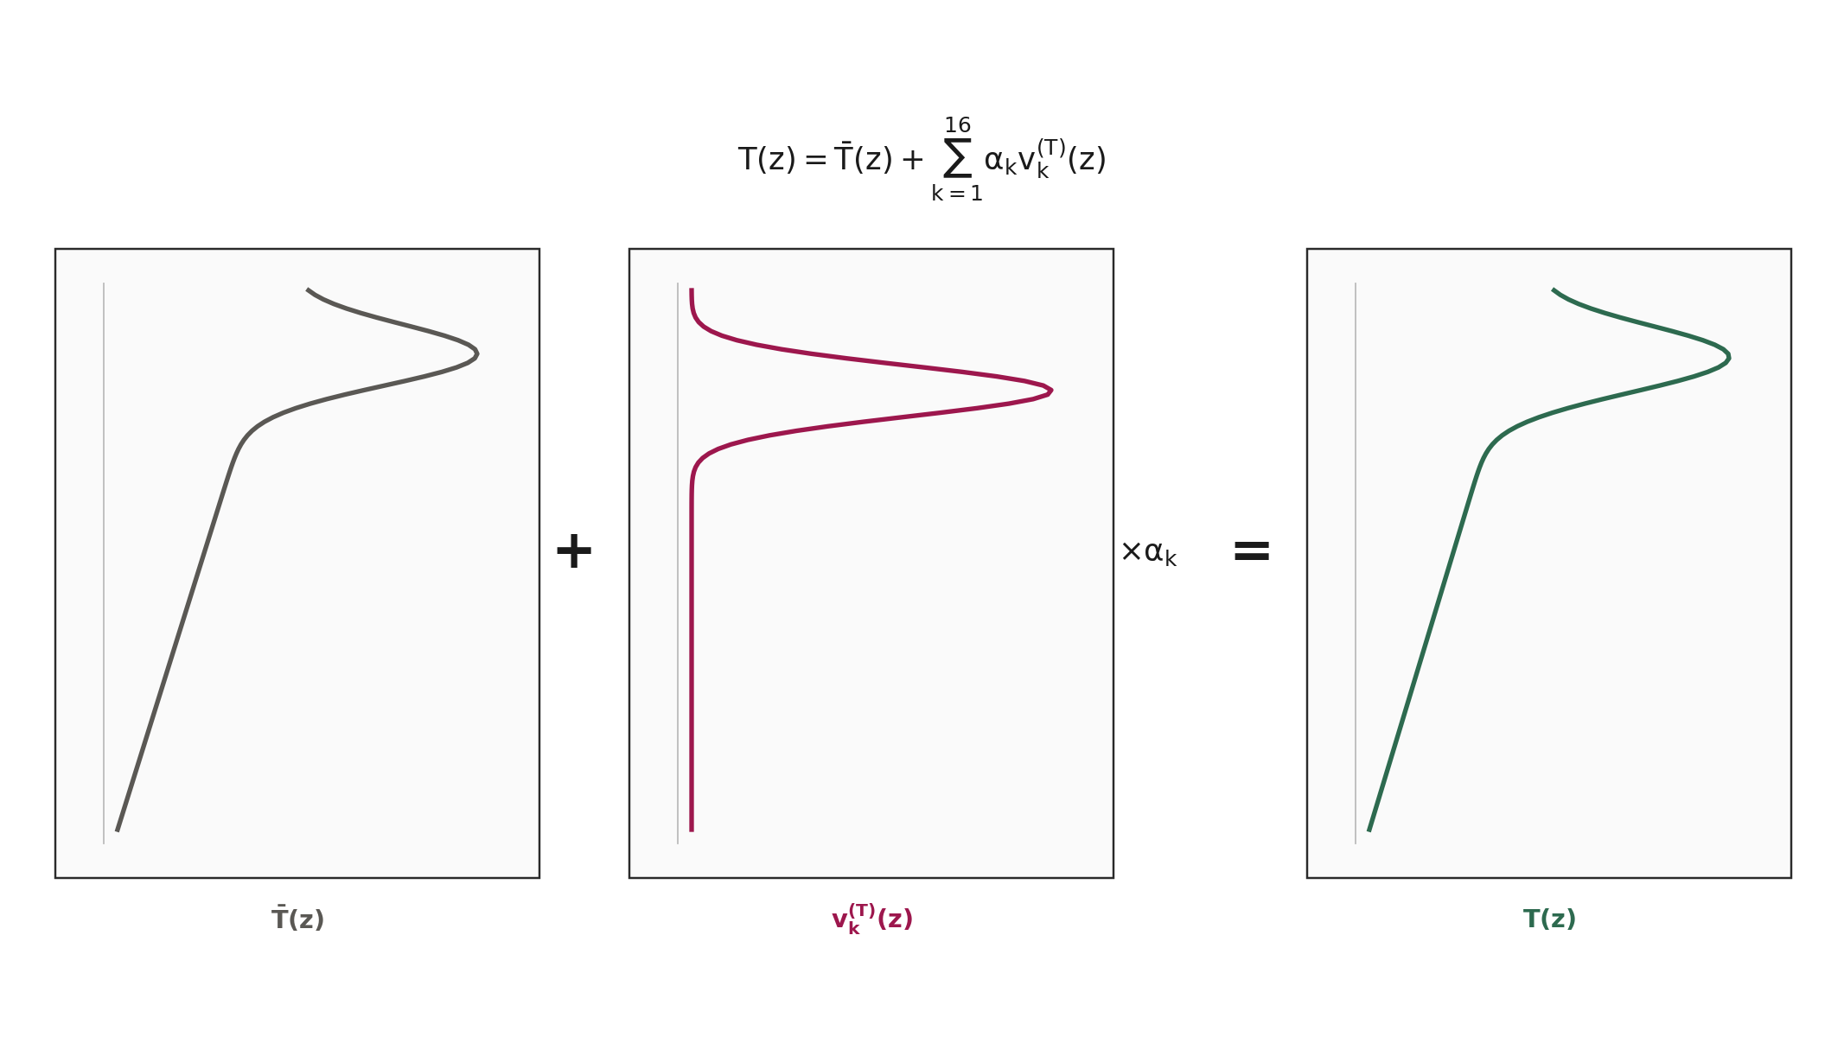
A_CRPS reconstruction
Native 1 m grid. 16 T and 16 S principal components.
5 / 12
Notes:
A_CRPS inverts a 16-component PCA for temperature and a 16-component PCA for salinity on the native 1 m grid, z=0…1800 m. Pair the checkpoint with cache 3adcff404b0b.

Slide 6
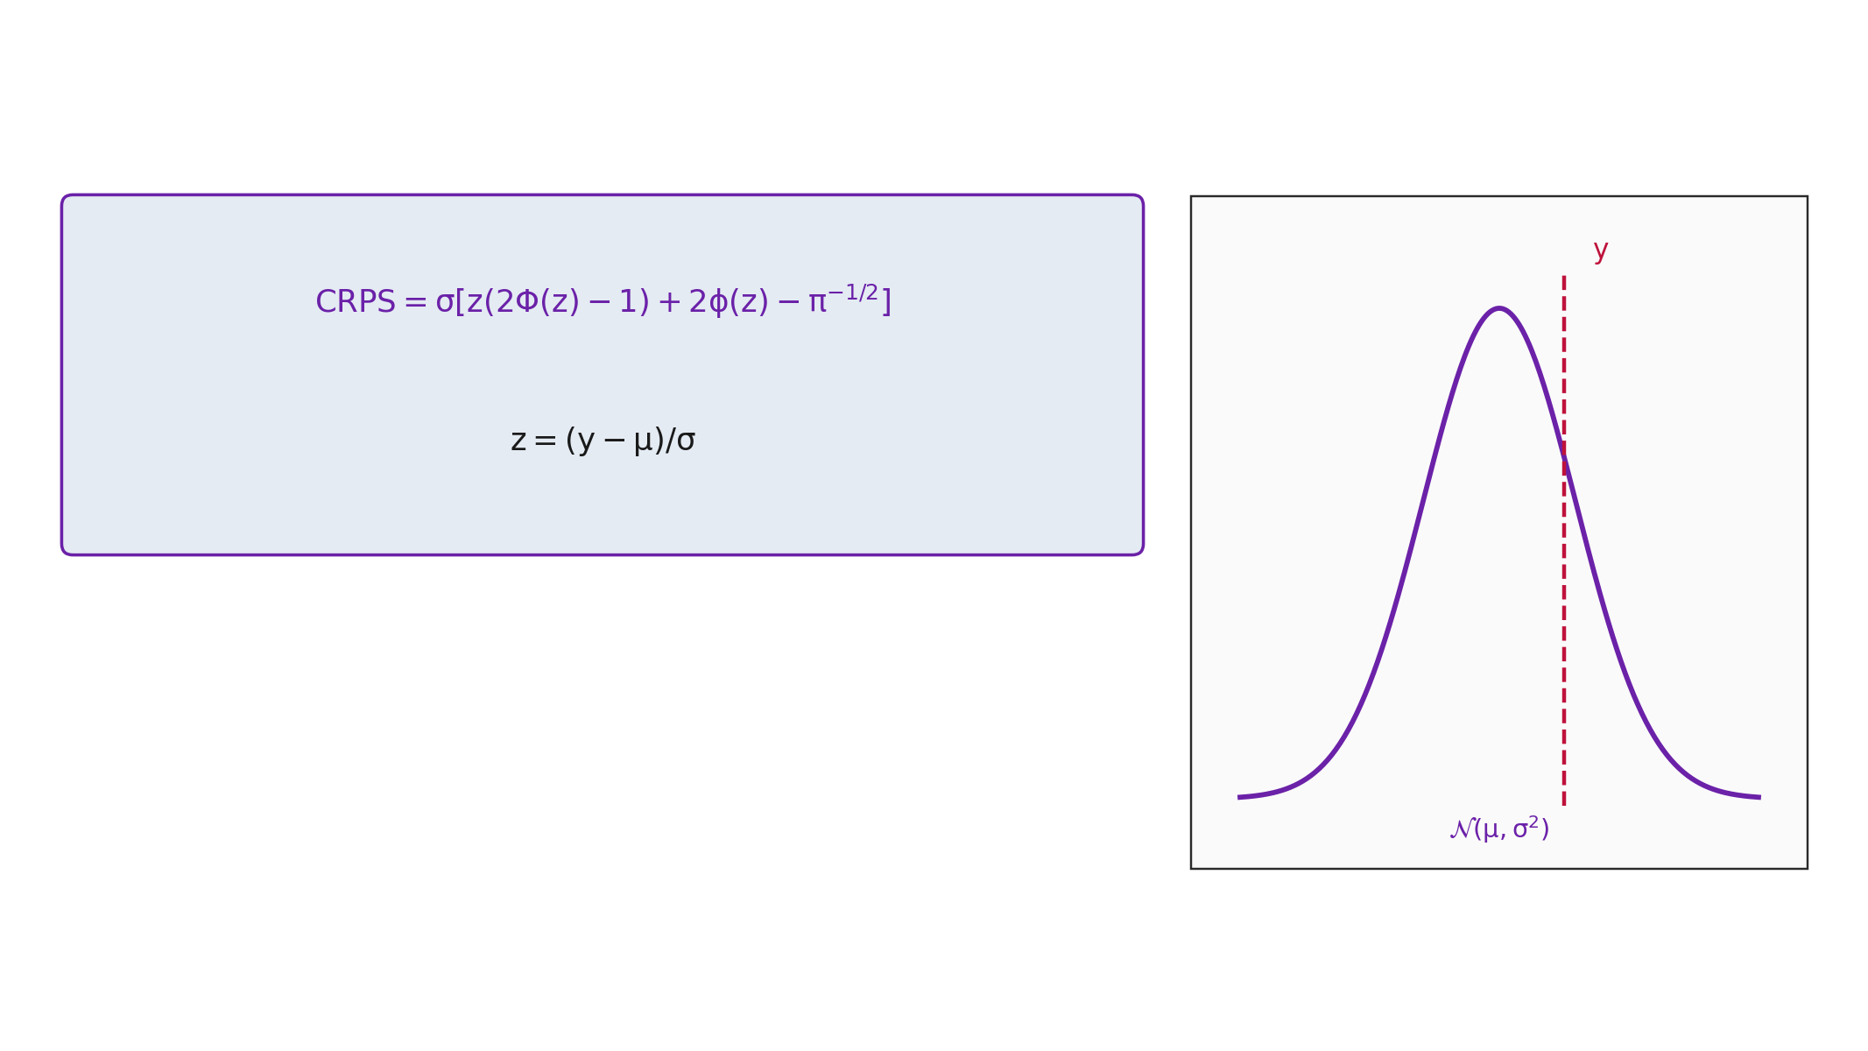
CRPS
Independent Gaussian scores. No predicted covariance.
6 / 12
Notes:
Training uses the closed-form Gaussian CRPS, independently per output. Predicted cross-level covariances are not used. Ingest R is diagonal Dai σ_o after H.

Slide 7
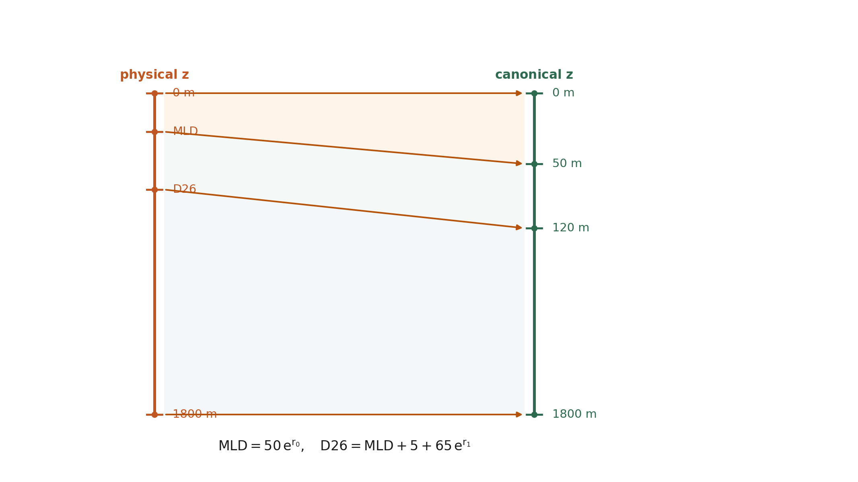
Heave warp
Piecewise-linear map of MLD and D26 onto a canonical grid.
7 / 12
Notes:
Heave predicts MLD and D26 as exponentials of unconstrained logits. Physical knots (0, MLD, D26, 1800 m) map piecewise-linearly onto (0, 50, 120, 1800 m).

Slide 8
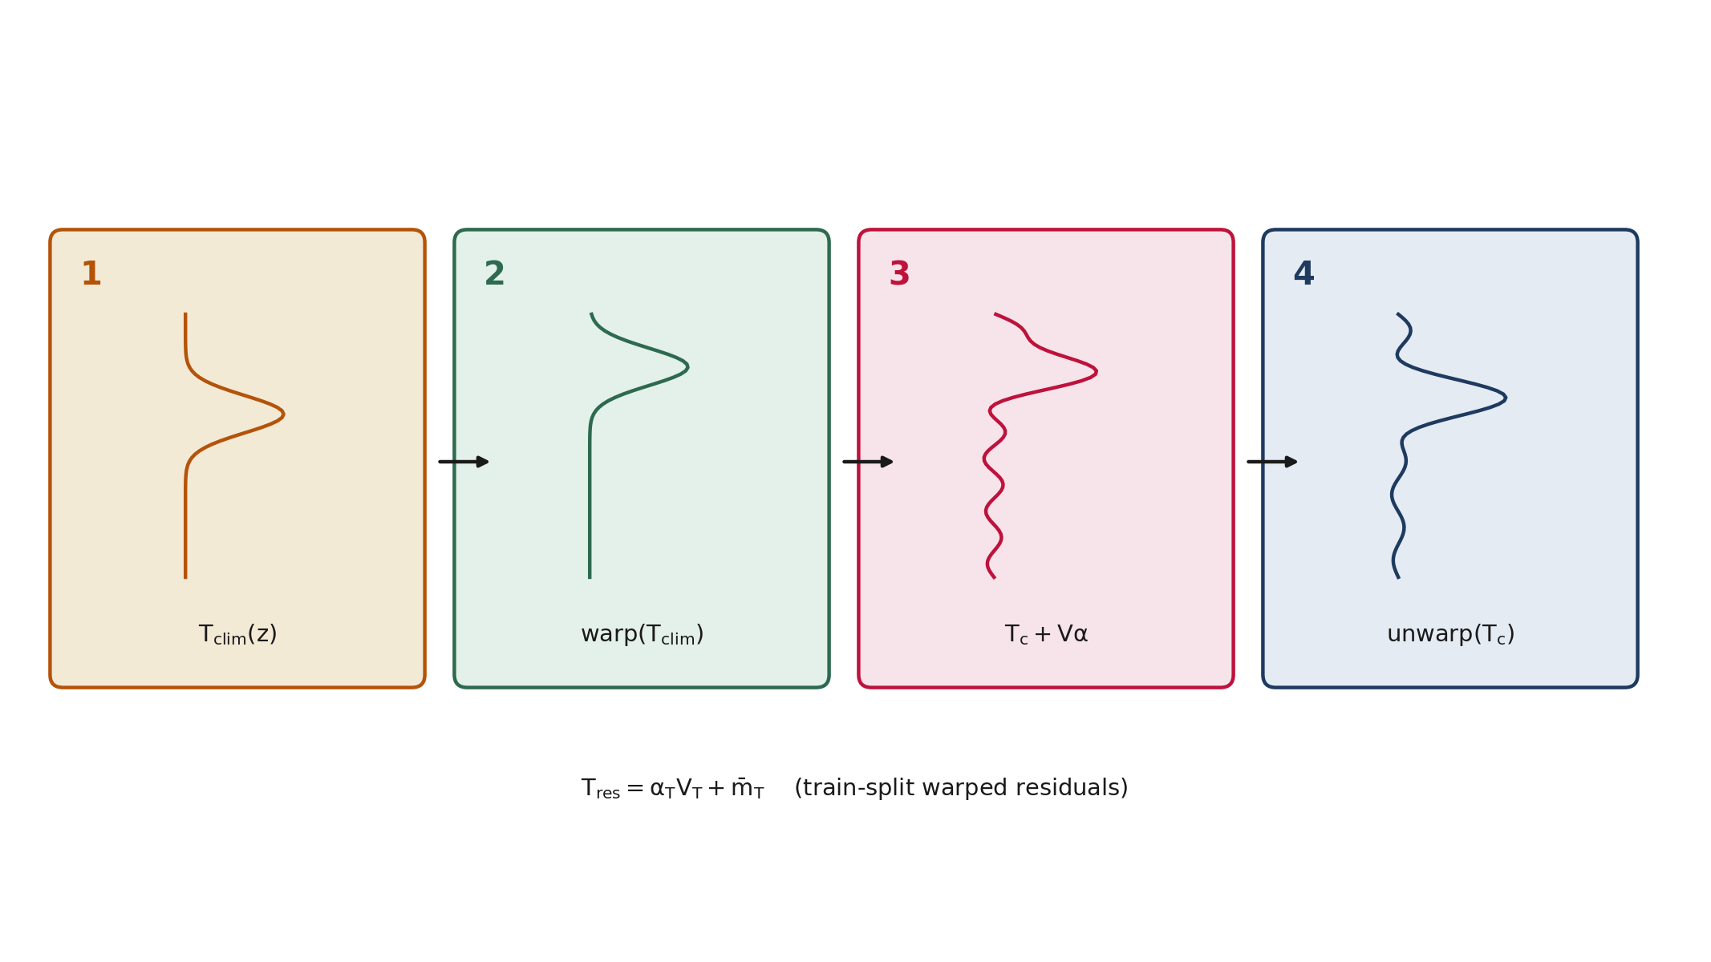
Heave residual
Warp climatology, add residual PCA, invert the map.
8 / 12
Notes:
Climatology is the basin nanmean of cache profiles. Residual PCA is fit on train-split warped residuals, not the native-z cache PCA. Unwarp returns profiles to physical z.

Slide 9
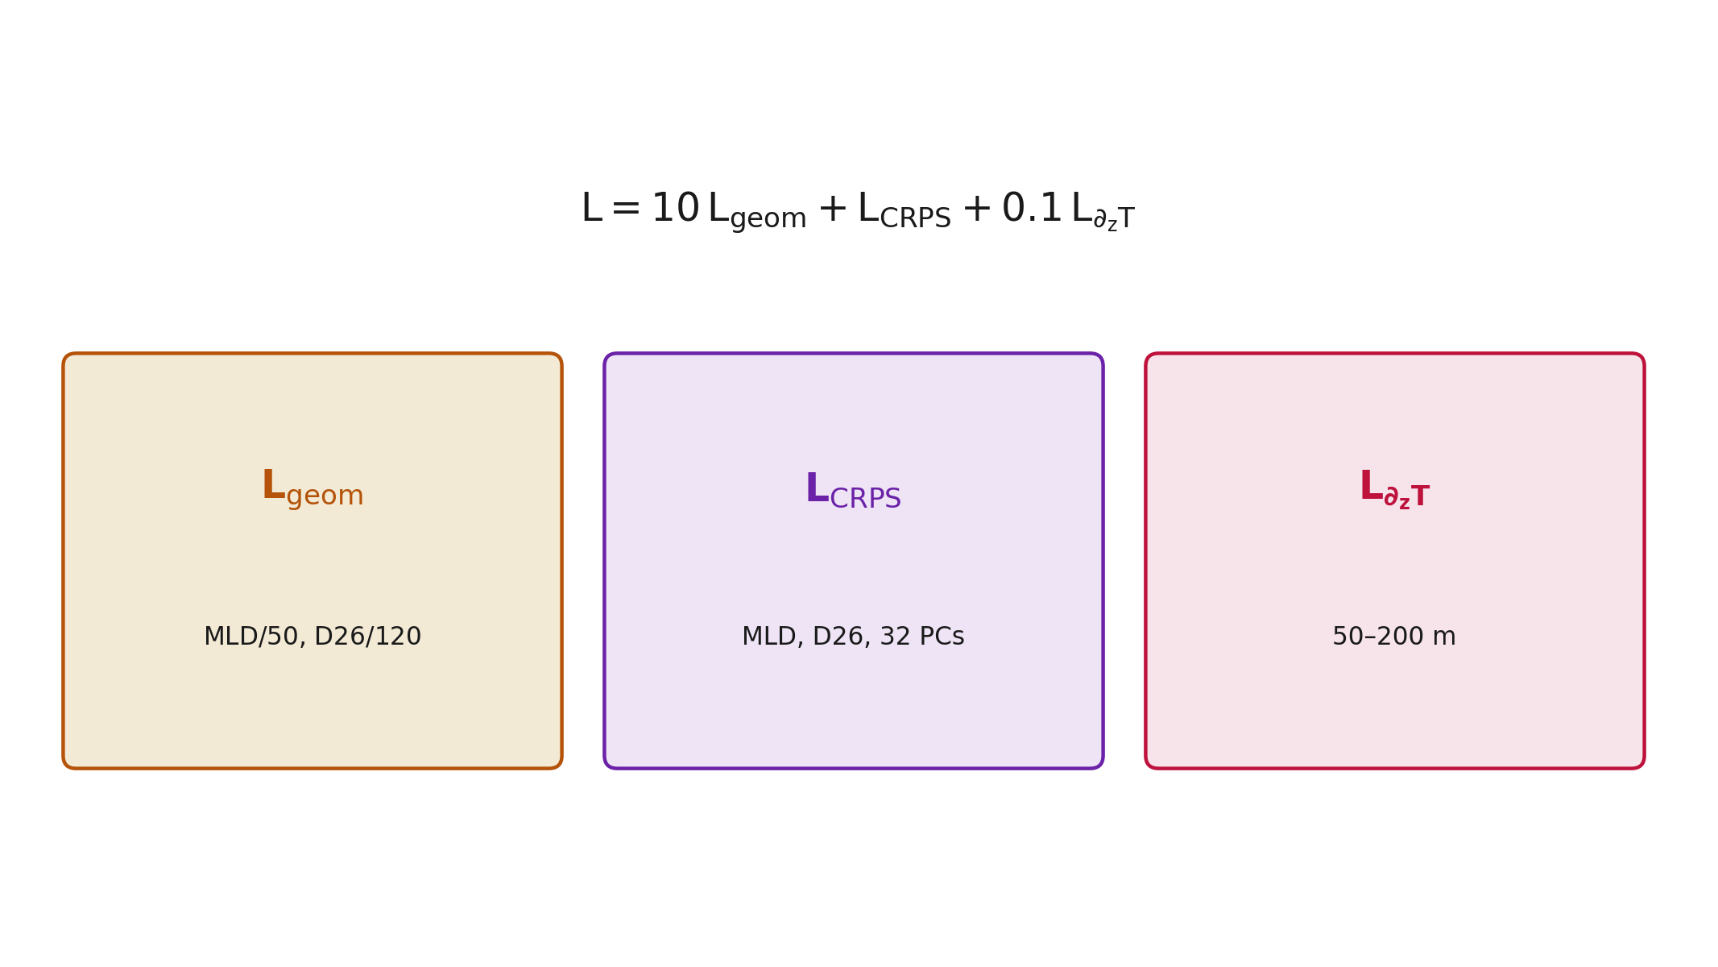
Heave loss
Geometry, CRPS, and a weak 50–200 m Tz term.
9 / 12
Notes:
Geometry loss is dimensionless MSE on MLD/50 and D26/120. CRPS is applied to MLD, D26, and 32 residual scores (34 scalars). Stretch is unused. A weak T_z penalty acts on 50–200 m.

Slide 10
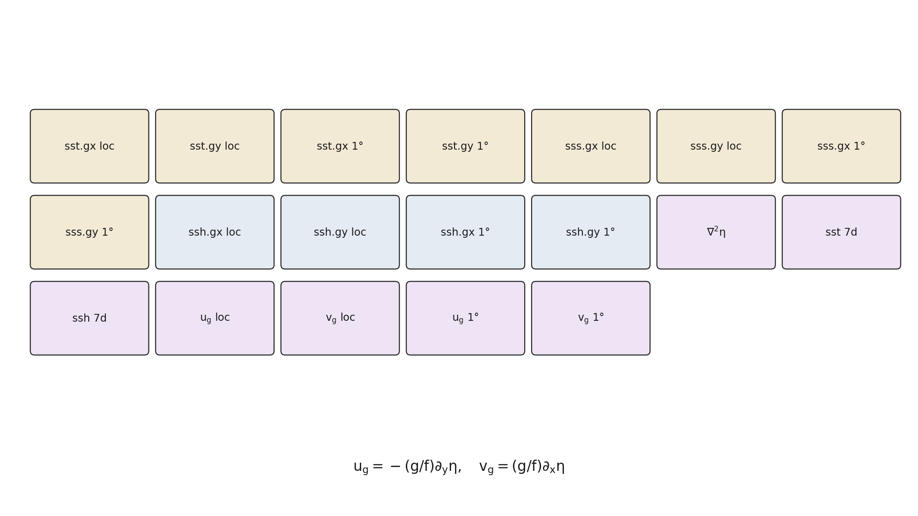
ops features
Nineteen operators sampled from the regional cube.
10 / 12
Notes:
ops appends 19 cube operators: gradients of SST, SSS, SSH at native and 1° scales, SSH Laplacian, 7-day tendencies, and geostrophic velocities. Sample from gom_cube.zarr at request time.

Slide 11
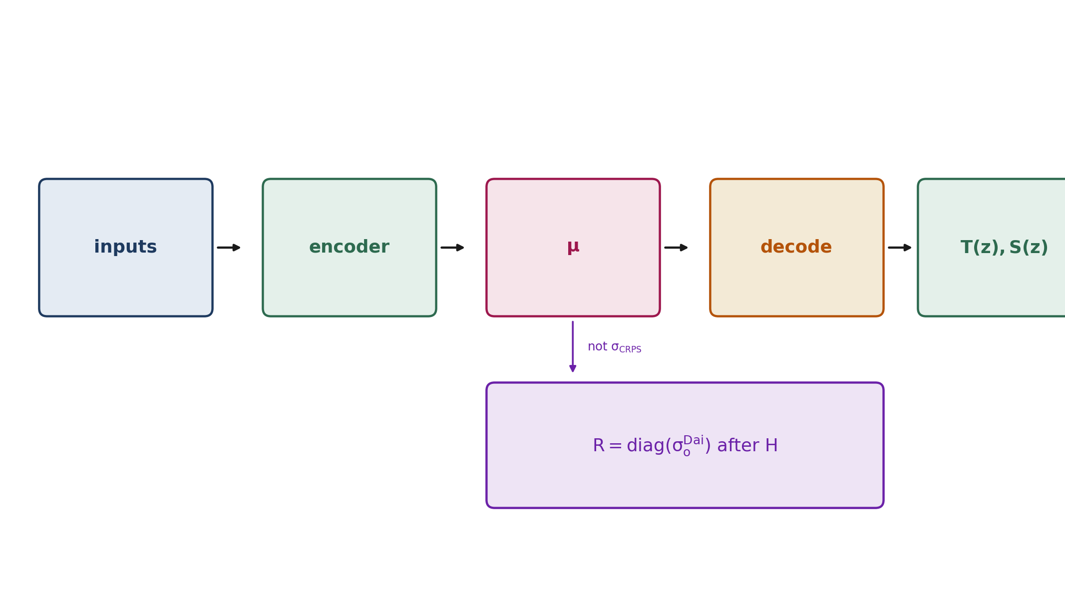
Assimilation products
Profiles from μ. Diagonal R from Dai σ_o after H.
11 / 12
Notes:
API decode writes T(z), S(z) from μ. Do not write CRPS σ into R. H is applied by TSIS on cycle layer thickness. Do not apply HYCOM layer_sample in the API.

Slide 12
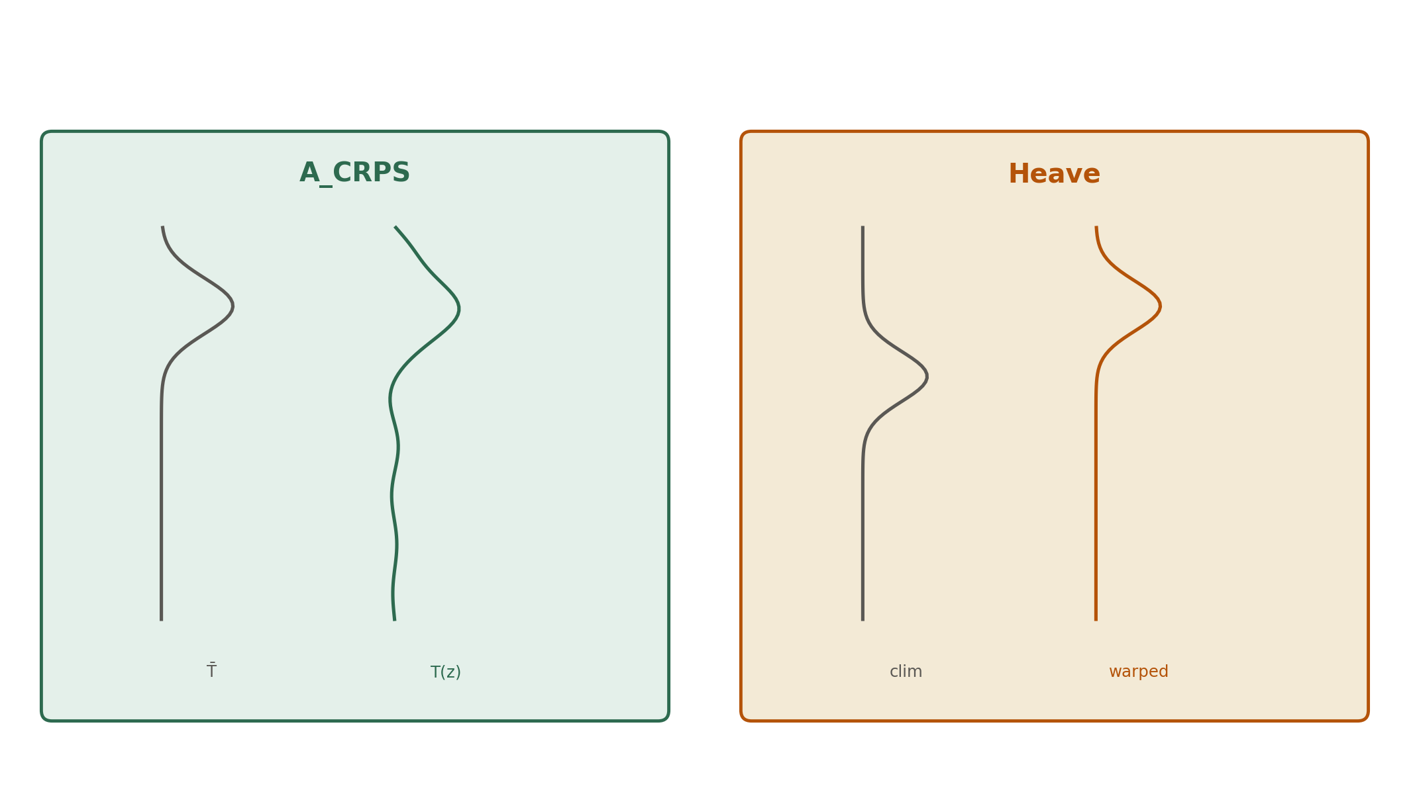
Two reconstructors
A_CRPS is additive in z. Heave is additive after a vertical map.
12 / 12
Notes:
A_CRPS adds PCA modes at fixed depth. Heave first registers two landmarks, adds residual shape on the aligned grid, then inverts the map.

