Slide 1
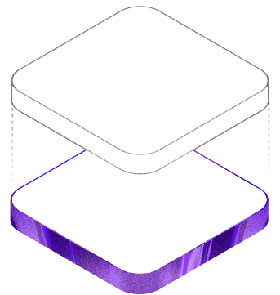
COLLECTIBLE LOYALTY
PassportSOL
Collect badges. Build reputation. Unlock rewards.
PassportSOL turns on-chain identity into a collectible reward loop that projects can trust and users actually want.
Free for users
Built for Solana
Sybil resistant
A loyalty passport for communities that reward real participation.

Slide 2
THE SHIFT
Airdrops reward speed. Communities want to reward belonging.
$94.5M
drained by sybil bots in one airdrop
• Projects struggle to tell a loyal fan from a temporary wallet farm.
• Users get one more claim page instead of something fun to collect and keep.
• Cross-chain users still need an easy first step into Solana before they can participate.
The real opportunity is not another whitelist. It is a collectible loyalty layer that makes participation visible, portable, and worth building over time.

Slide 3
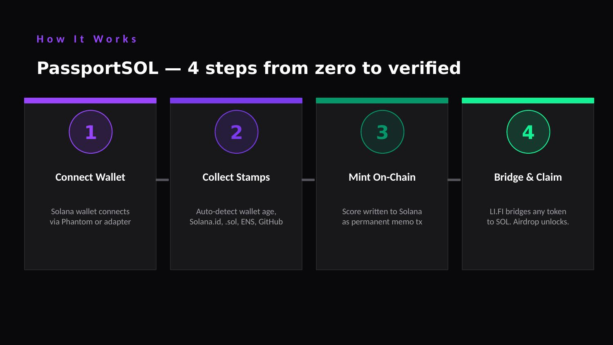
HOW IT WORKS
Simple for users. Sticky for communities.
• Fund a Solana wallet in one smooth step, even if the user starts on another chain.
• Collect badges for real signals like events, dev identity, and community presence.
• Mint one passport that turns those signals into a reusable reputation card.
• Unlock rewards that feel earned, not sprayed at random wallets.
Smooth entry
Collectible loop
Portable proof

Slide 4
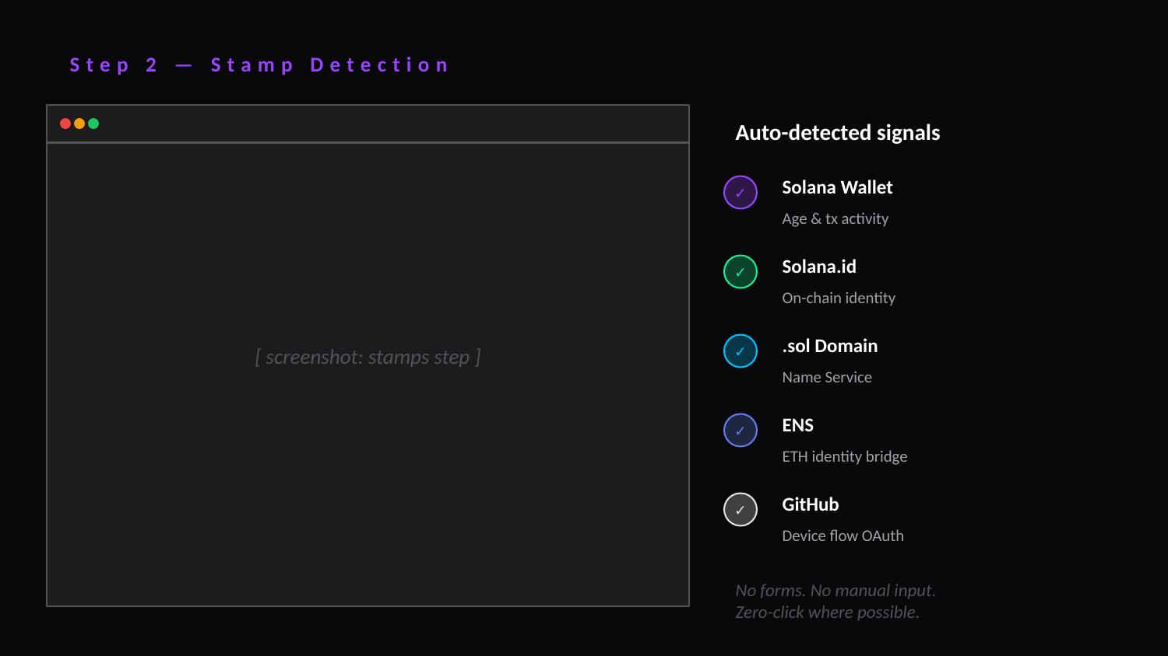
COLLECTOR MOMENT
Badges make participation visible.
Every badge gives the user something to show: attended, built, claimed, belonged. That is what turns a one-time campaign into a habit.
• Feels like a loyalty card, not a compliance form.
• Encourages repeat engagement because people want the full set.
• Raises reward quality because badges are harder for bots to fake.

Slide 5
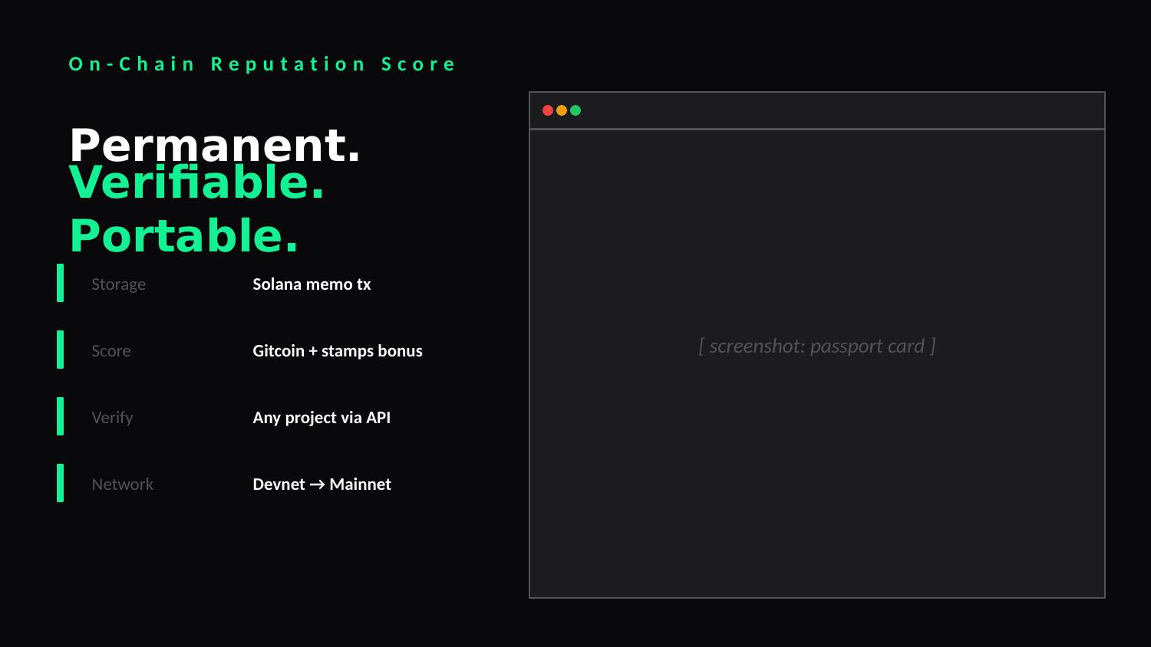
THE PASSPORT
One card. All your proof.
A passport people actually want to keep:
• Collectible: your progress is visible and shareable.
• Portable: one identity can travel across Solana apps and communities.
• Compounding: the more you collect, the stronger your reputation becomes.
Projects do not need to rebuild trust from scratch every time. Users bring their passport with them.

Slide 6
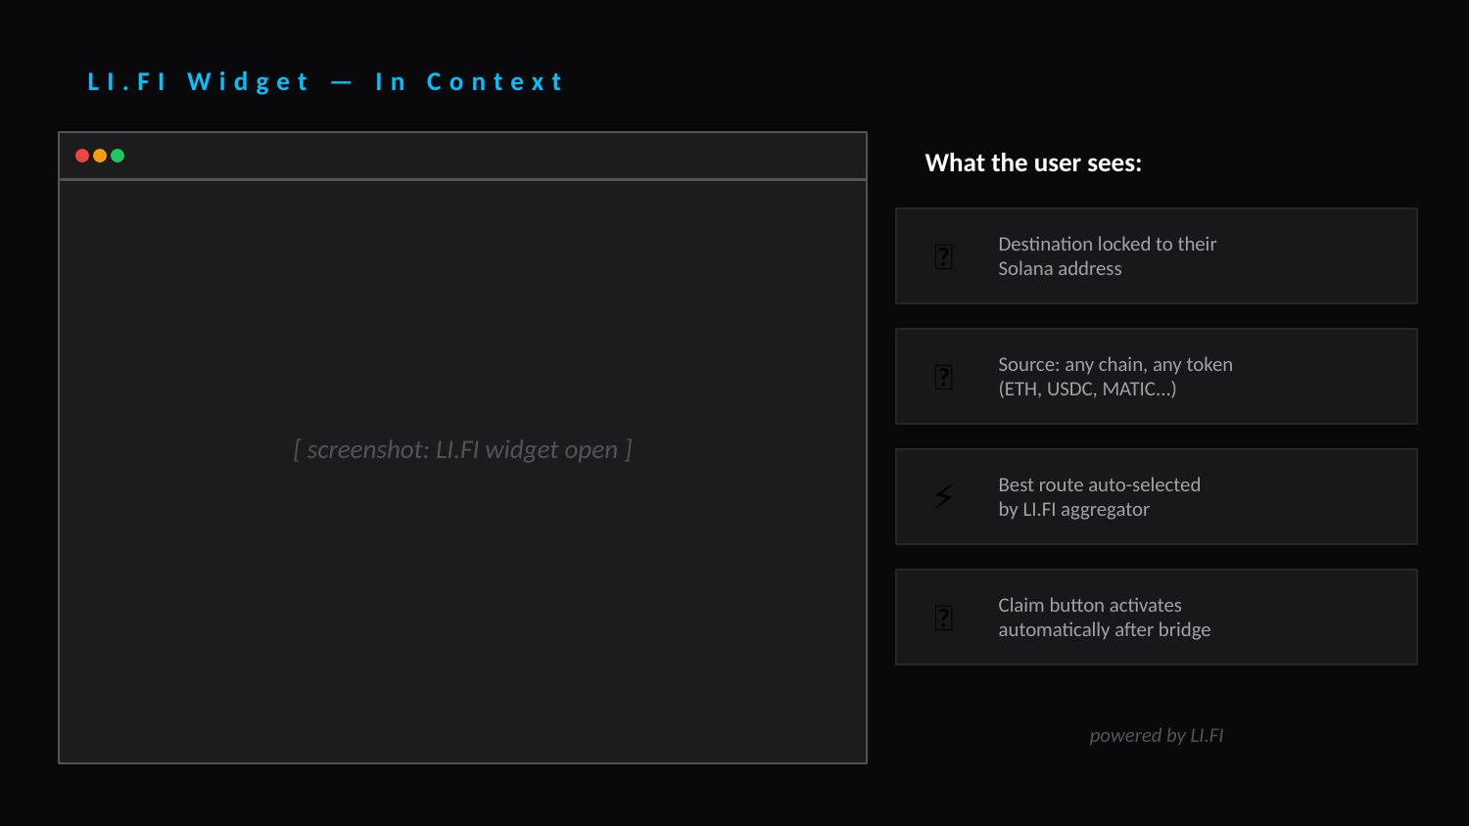
WHY IT WINS
PassportSOL makes sybil defense feel invisible.
• For users: a smooth entry point, clear progress, and rewards that feel earned.
• For projects: fewer fake claimants and a better way to find real community members.
• For the product: security sits in the background while the front-end experience stays playful and collectible.
The experience leads with collecting. The defense is built in.

Slide 7
BUSINESS MODEL
Projects pay. Users never do.
$0 user cost
Starter
Larger projects
$49 / month
Pay as you go
A fixed monthly price for smaller launches, new communities, and pilot campaigns.
Volume-based pricing for bigger drops, bigger communities, and higher verification demand.
Memecoin launches
NFT communities
DAOs
Games
DeFi campaigns

Slide 8
PASSPORTSOL
The collectible reputation layer for Solana communities.
Users collect badges. Communities reward real participation. Bots have less room to hide.
The more you collect, the more you unlock.
Repo: github.com/0jz/passportsol

