Slide 1
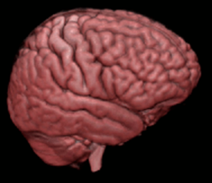
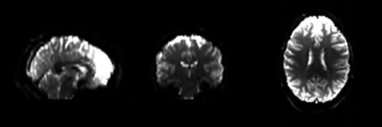
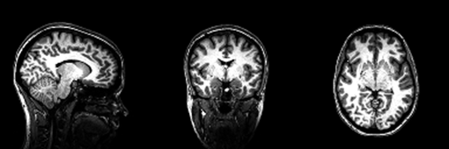
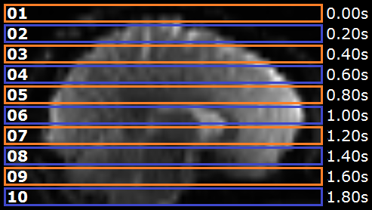
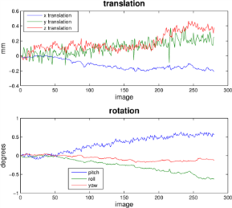
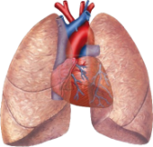
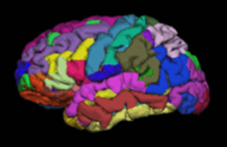

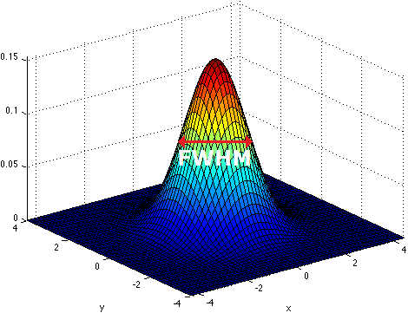
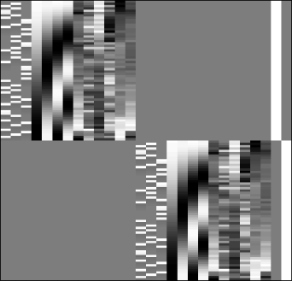

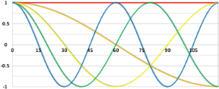
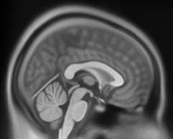
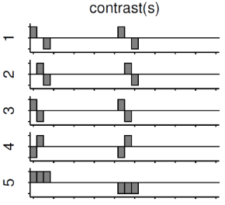
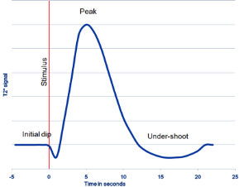
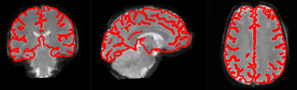
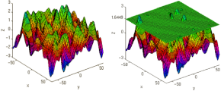

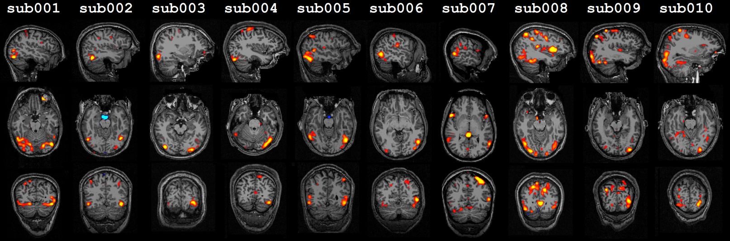

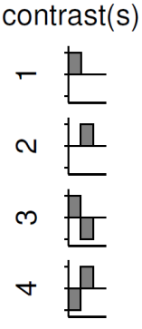
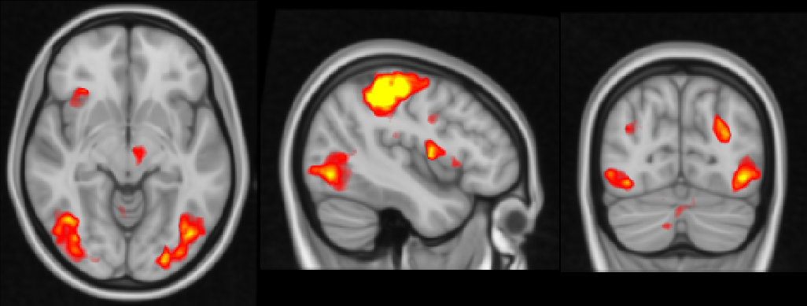
Human Brain
scanning (T2*)
scanning (T1)
Data Acquisition
functional Images (low resolution)
anatomical Image (high resolution)
Conversion to NIfTI
Conversion to NIfTI
Preprocessing
Slice Timing
Movement, Pulse & Breathing
Realignment
Segmentation
Artifact Detection
Smoothing
Analysis
Predictor Specifications (e.g. movement, HRF, stimuli, …)
1st level functional Analysis
Specify Design (Design Matrix)
Model Estimation
Template
Specify Contrasts
Contrast Estimation
Coregistration
Statistical Thresholding
Normalization
2nd level functional Analysis
Predictor Specifications (e.g. group assignment,
socio-demographic parameters, …)
Specify Design (Design Matrix)
ROI Analysis
Model Estimation
ROI extraction
Specify Contrasts
2nd Level Analysis
Contrast Estimation
Statistical Thresholding

