Slide 1
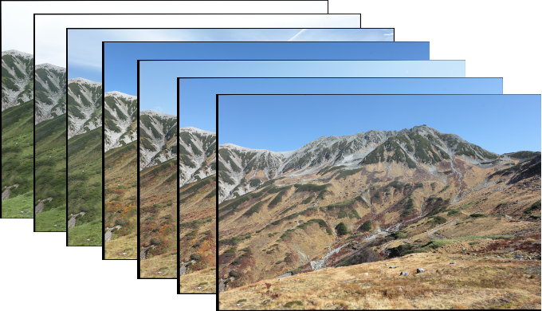
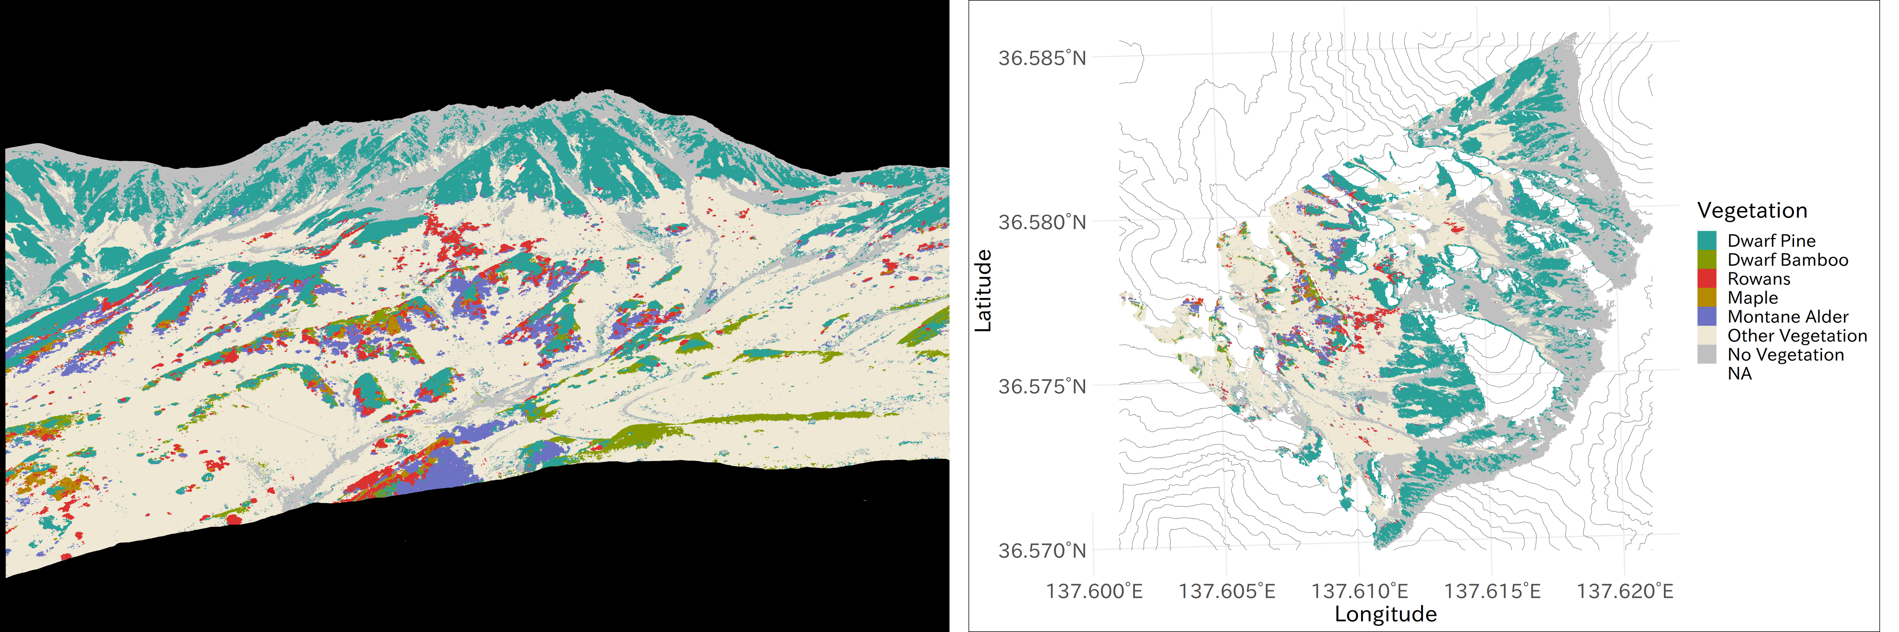
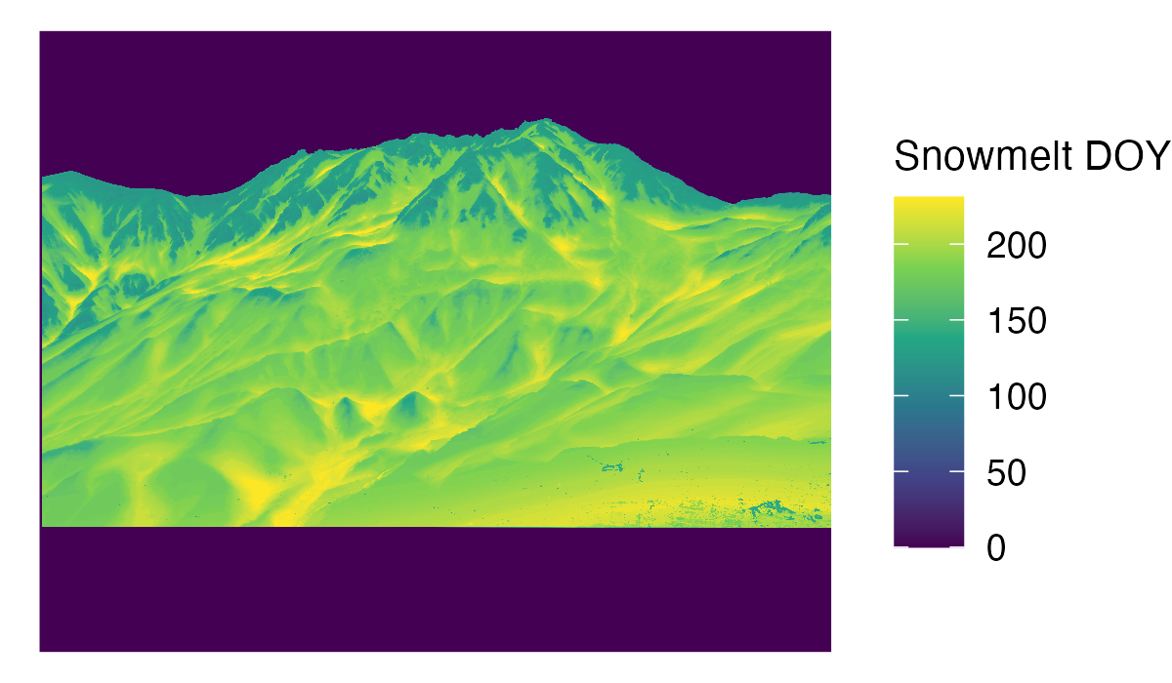
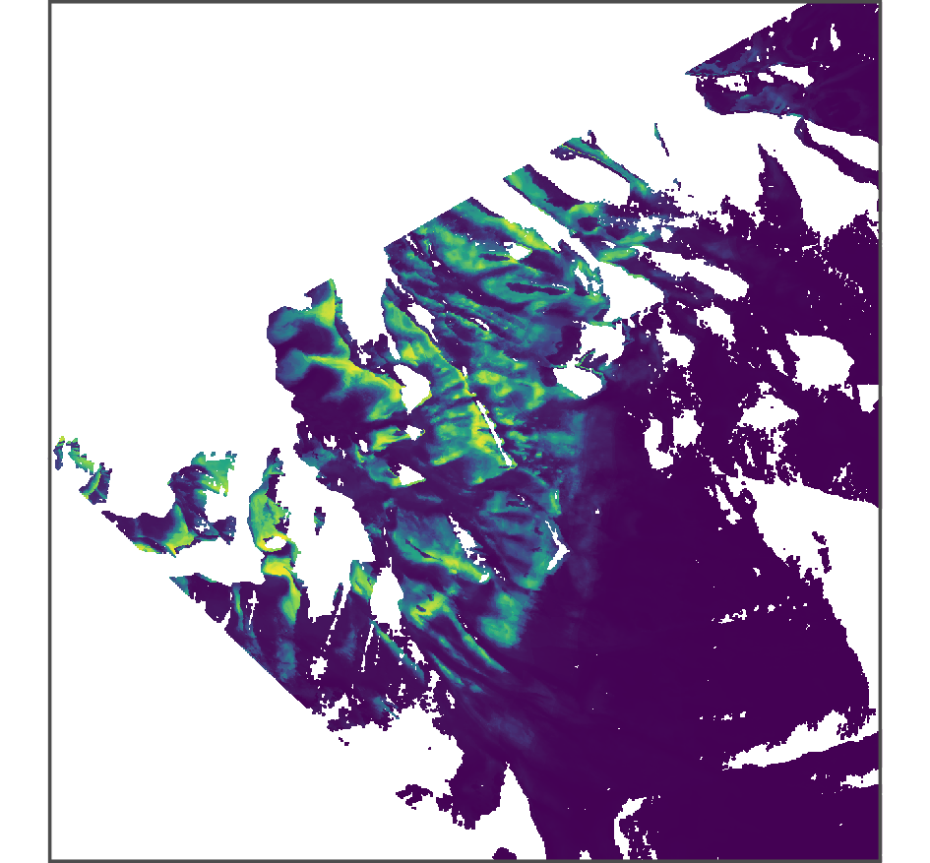
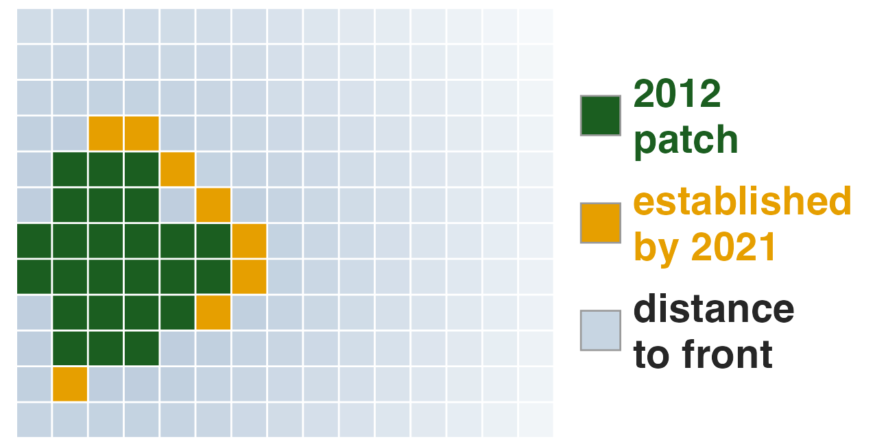
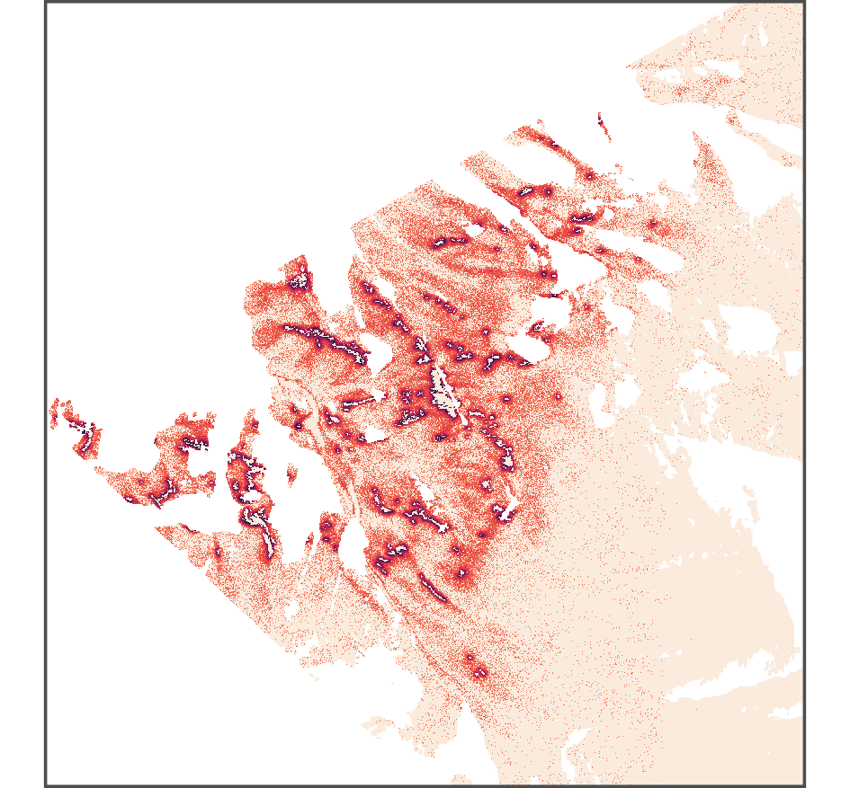
(a)
Time-lapse imagery
(2011–2021)
Vegetation maps (2012, 2021)
align,
classify,
geo-correct
Terrain (DEM)
elevation, slope, TPI, TWI, aspect
Snowmelt DOY (2011–2021)
(b)
2021 presence + environment
(c)
2012→2021 transitions + distance to front
+ environment
(d)
Model B applied annually
Snowmelt scenarios
s = 0, −0.71, −2.24 days/year
Model A: habitat suitability
environmental potential (seed layer)
Model B: establishment
front distance + environment (rhizome layer)
Projection: cellular automaton
annual establishment trial, 2022–2030
Habitat suitability surface
Establishment hugs the 2012 front
P(established by 2030), s = 0

