Slide 1
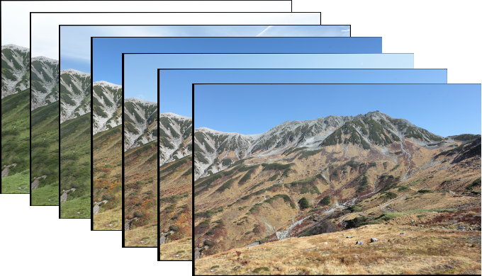
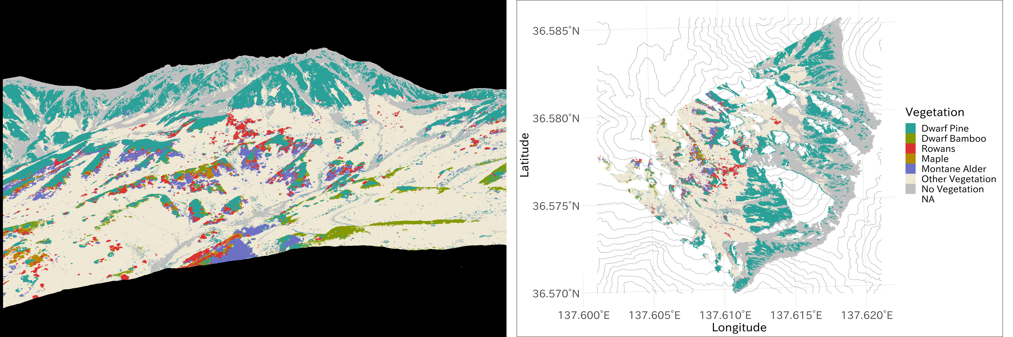
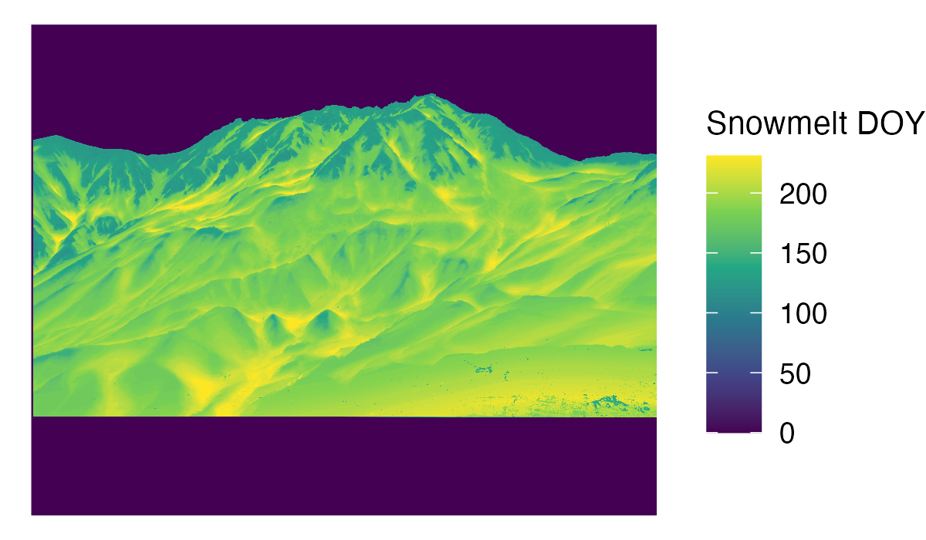
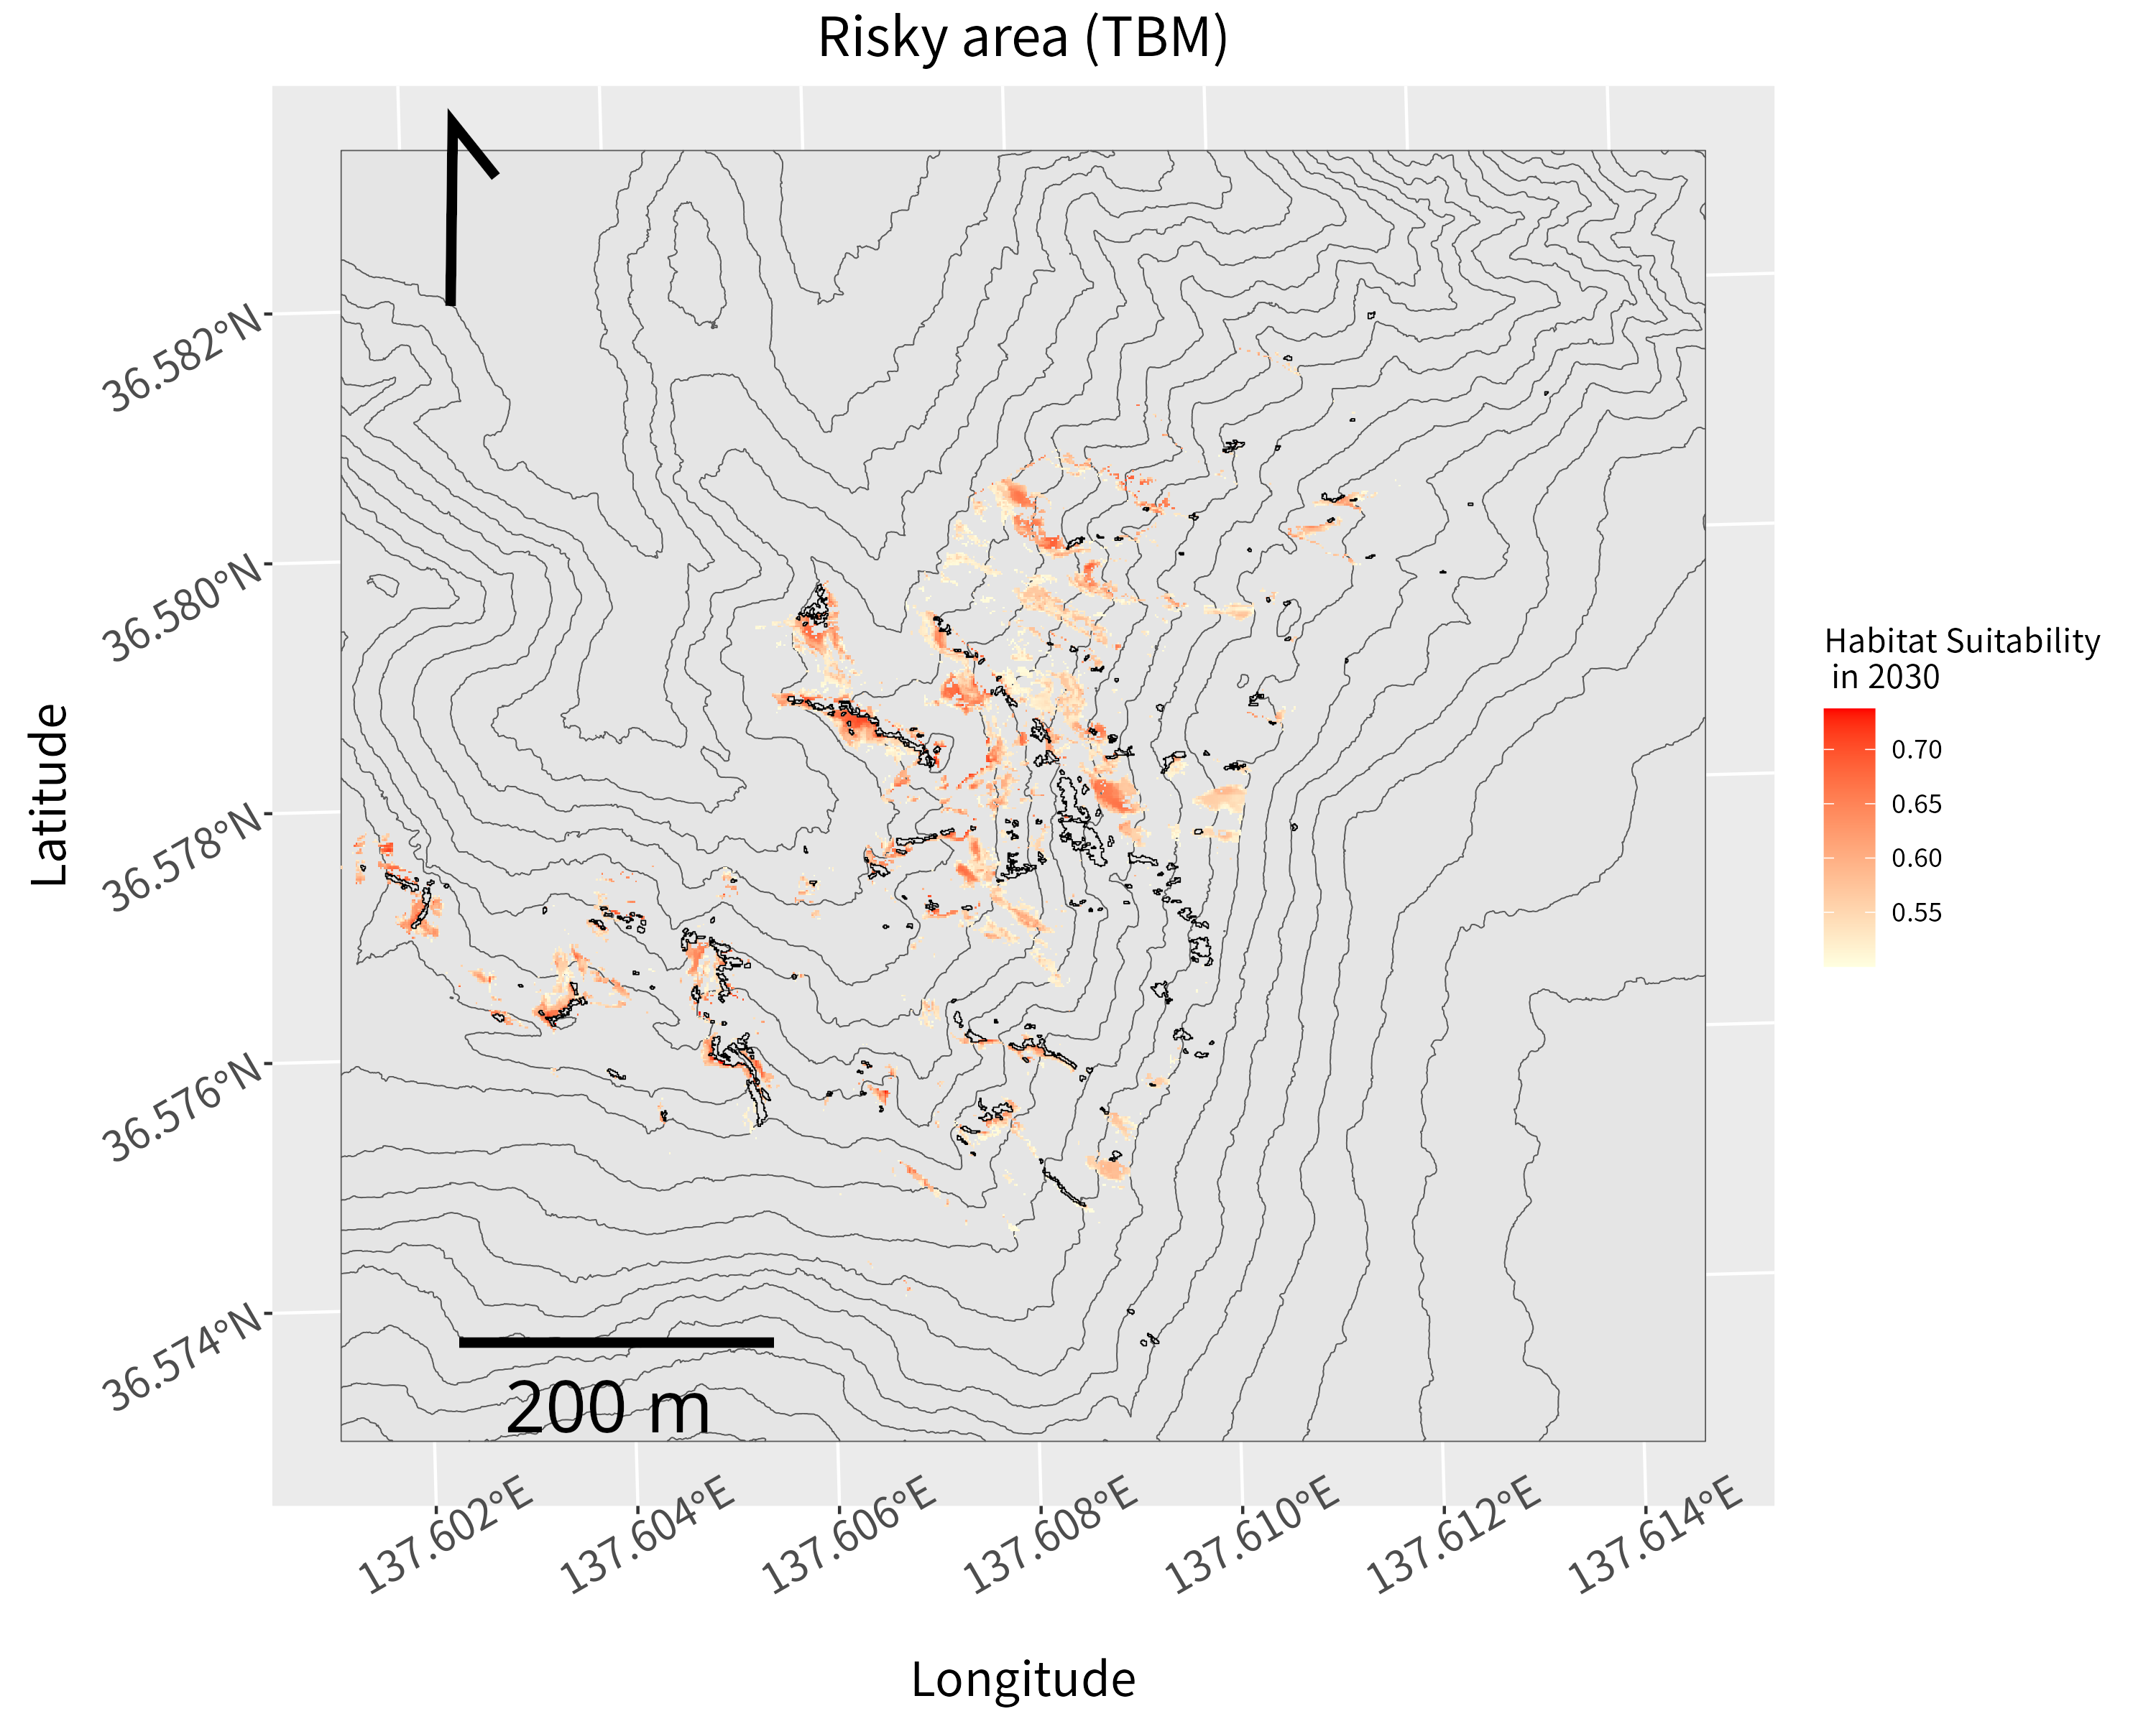
Time-lapse imagery
(2011~2021)
Vegetation Classification Map
(2012 & 2021)
Vegetation Classification Map
Sasa expansion
(2012-2021)
Terrain Features
(from DEM)
Snowmelt Day of Year
(2011 ~ 2021)
Prediction of
Sasa invasion
Habitat Suitability Models
Future prediction of snowmelt DOY

