Slide 1




Why Graph Genome Storage and Updating Wakes Me Up at 4 am
Valerie Schneider NCBI/GRC

Slide 2
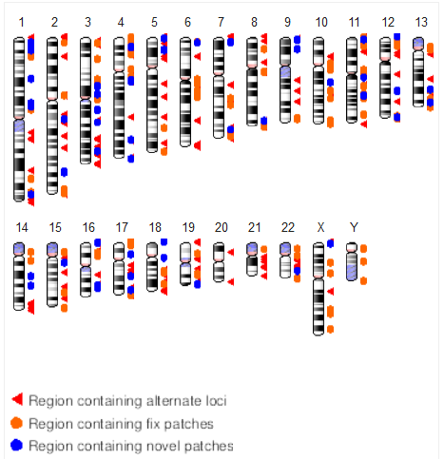
GRCh38 Curation
chromosome
fix patch scaffold
novel patch scaffold
Spoiler alert: GRCh38 isn’t perfect!
>300 unresolved issues remain
Incorrectly assembled seg dups
Catch-22: Constant coordinates vs. correct sequence?
Patch releases to date (GRCh38.p13):
72 novel patches (future alt loci)
113 fix patches!
Gap closures/extensions
Path updates (replacements, rearrangements)
There are other updates that can’t be released as patches
Sequence removal (including alt loci)

Slide 3


More genome assemblies
Managing updates: incremental or full rebuilds?
Impact of assembly quality on the pan-genome?
7.7 billion people: 300 genomes (99% of MAF 1%)
Intra-population diversity
Under-representation from Africa, middle East and Oceanic populations

Slide 4
Pan-genome reference data definition
What does the reference become?
Collection of assemblies
Graph representation
A “golden” path
Specific representations
Data representation
Identifier for the pan-genome (e.g. GCA_000001405.$$)
Versioning: what changes trigger an update?
Distributed data: what authority manages updates?
File formats: sequence = FASTA; graph = ? Graph-based annotations = VCF, BED, GFF, ??
Metadata
Assembly quality (old: finishing status, alignment criteria)
Today’s reference assembly does not represent:
The most common allele/haplotype
The longest allele/haplotype
The ancestral allele/haplotype

Slide 5
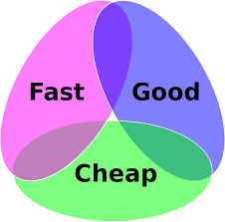

Diverse users, diverse needs
Mapping reads
Coordinate system
Annotations
Relating samples to one another
Visualization (as a means for analysis)
Clinical reporting
Regulations for reporting on a graph?
Truth sets, documented changes essential
Clinical tools lag by at least 1 year
And the tools to support these things…

