Slide 1
FARMALYTICS
Agriculture meets data:
AgResources Inc crop yield report & Business plan
HIT
Ibrahim Abdulrahim, Toluwase Shoniran, Hope Udoh

Slide 2
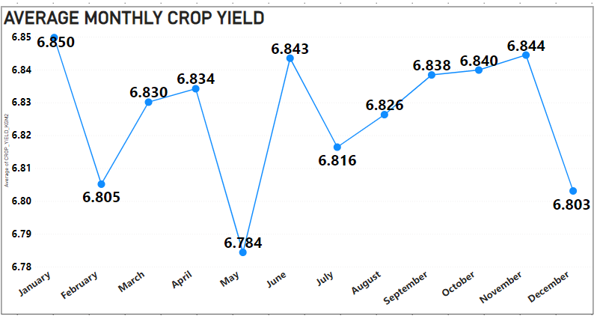
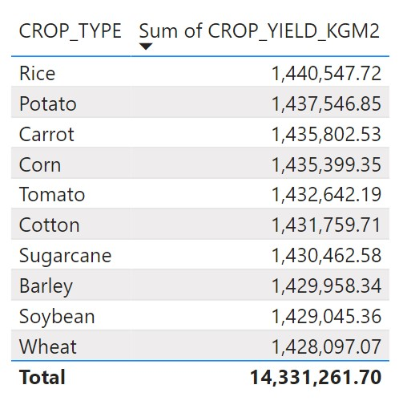
HOW MUCH DO WE PRODUCE?
CROP YIELD ANALYSIS
AgResources Inc’s farms on average have yielded 6.83kg/m^2 monthly.
Rice has produced the highest yield for the business followed by potatoes with wheat producing the least
1

Slide 3
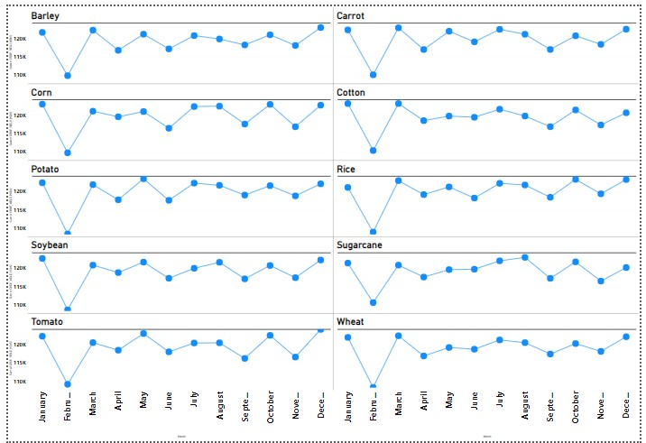
WHEN DO WE GET THE MOST YIELD
From the graph below its clear in what month each crop produced a higher total yield.
Barely, tomatoes and wheat had thier highest yield in December.
Carrots had their highest yield in march.
Corn and cotton had their highest yield in January.
Potatoes and soybeans had their highest yield in May.
Rice had it's highest yield in October.
Sugarcanes had their highest yield in August.
2

Slide 4
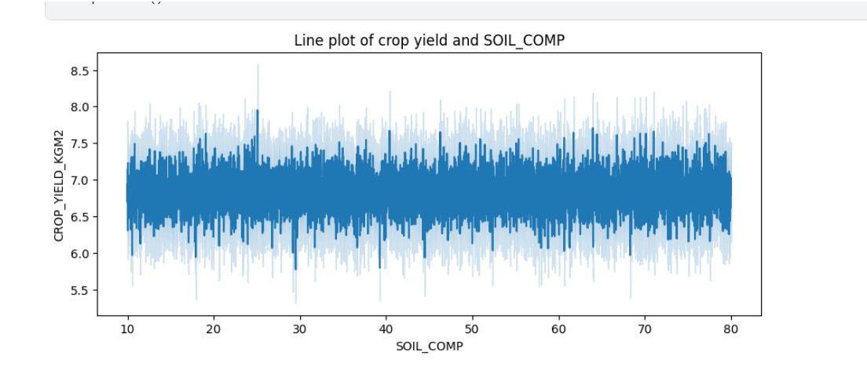
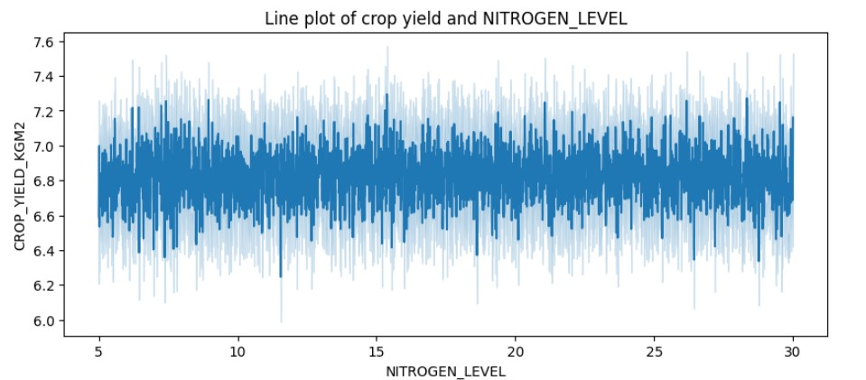
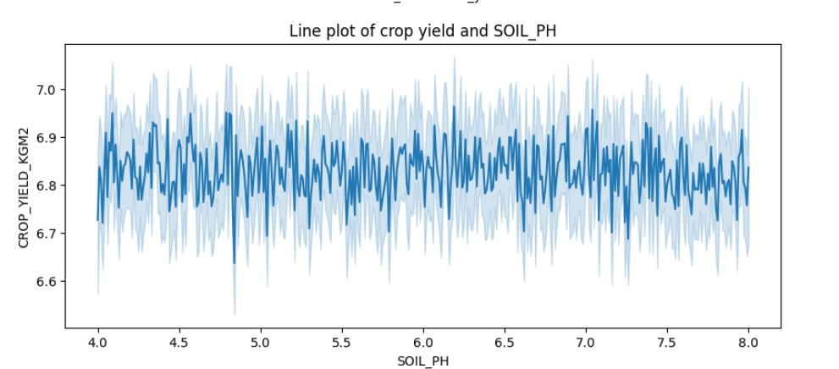
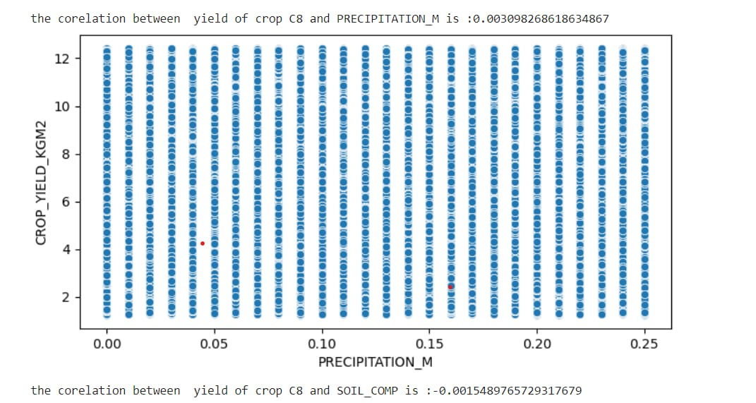
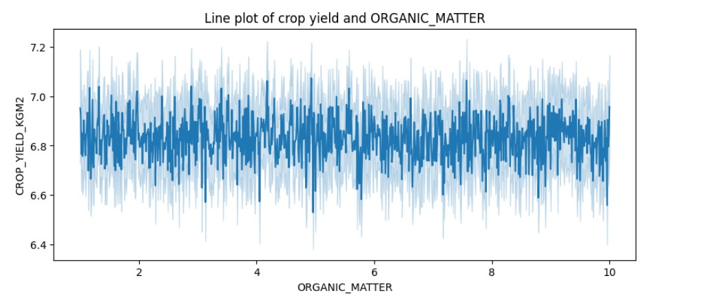
HOW DO ENVIRONMENTAL FACTORS AFFECT CROP YIELD
From the plots below we notice environmental factors appear to have no correlation to crop yield. They produce random noise and there appears to be no optimal value to produce higher crop yields.
This observation is most likely due to data recording errors, AgResources will need to confirm if the sensors are working properly.
3

Slide 5
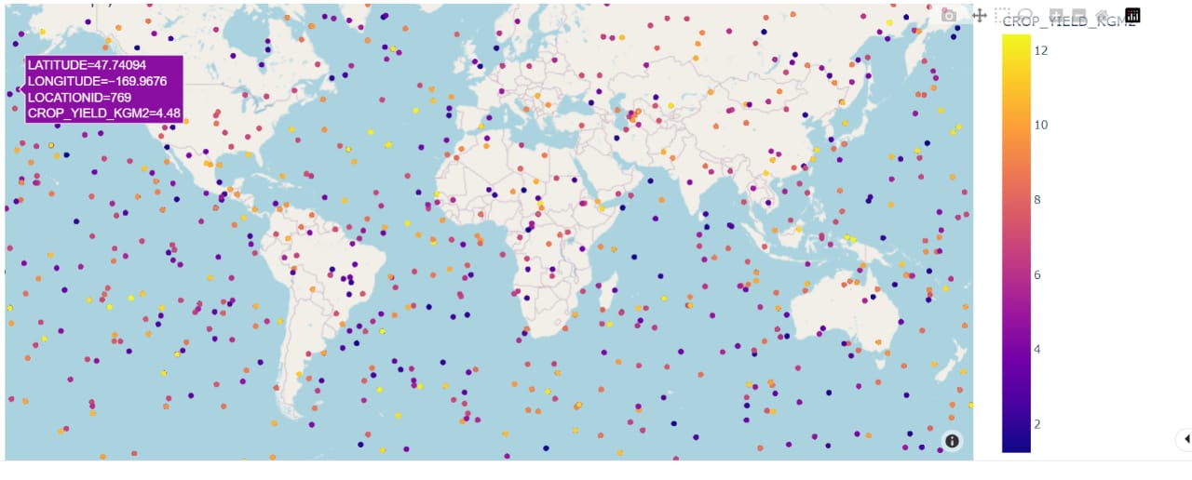
WHICH LOCATIONS ARE THE MOST IDEAL
From the data we see the location AgResources’ farms are located a spread all over the place. Some appearing to be in the ocean (most likely error with the latitude and longitude recording).
Following this logic we can also assume that each location cultivates a portion of all the various crops.
This is not ideal as as crops like rice would need more water and a certain soil texture to thrive while barley would whither and we rot under those same conditions

Slide 6
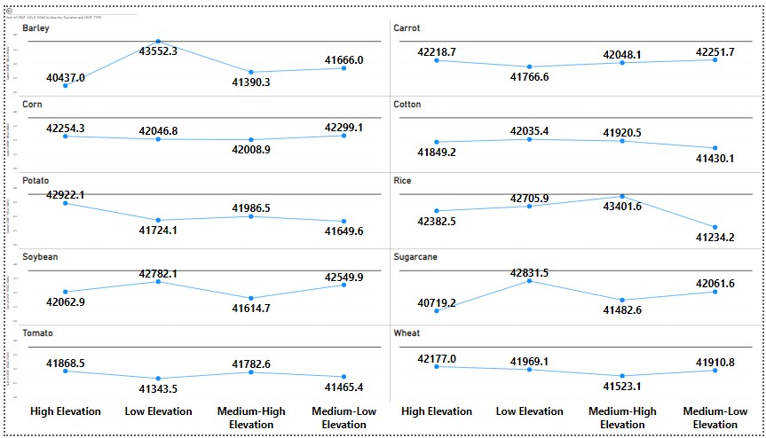
We have divided locations using their elevation into four categories. From this graph we can see which crops prefer higher or lower elevation.
Barley, cotton, ,soybean, sugarcane, and rice prefer low elevation.
Carrots, corn and wheat prefer medium low elevation.
Potatoes prefer high elevation.
Tomatoes prefer medium high elevation

Slide 7
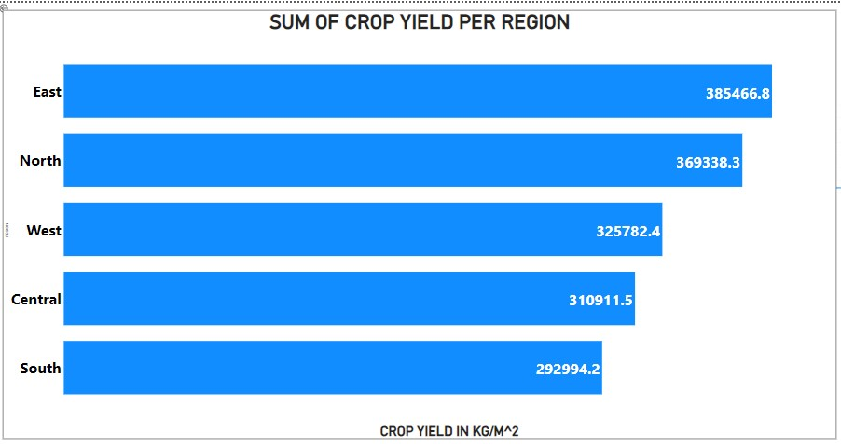
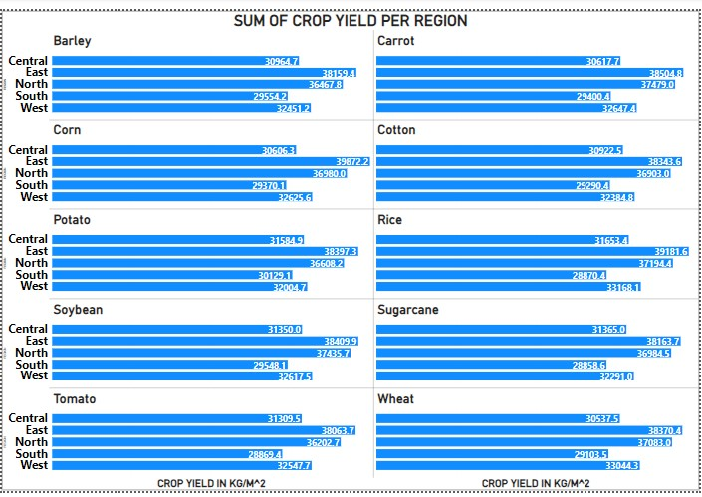
REGIONAL ANALYSIS
The east produces the most crop yield amongst the 5 regions and this holds true for each individual crop type
This could be due to having more crops being planted in the region than others

Slide 8
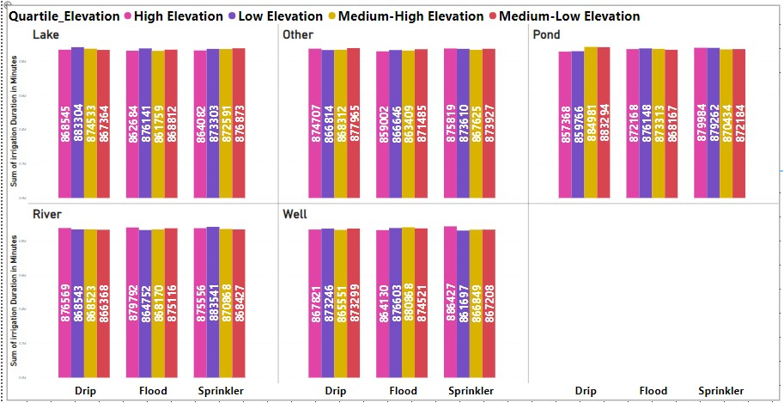
Water resource allocation
We have seperated the regions by elevation into high, low,medium high and medium low elevation areas, from this we can see overall the drip method of irrigation takes more time,but since it is more controlled may save water
The sprinkler method is the fastest in low elevation areas using a well.
The flood method is the fastest in high elevation areas using ponds as your water source.

Slide 9
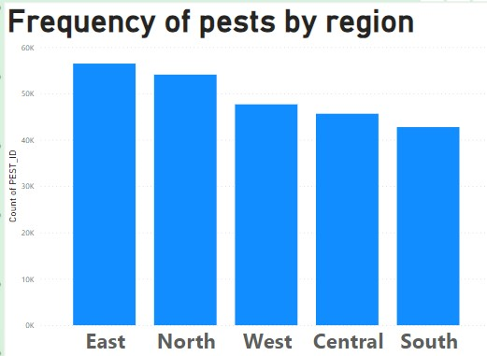
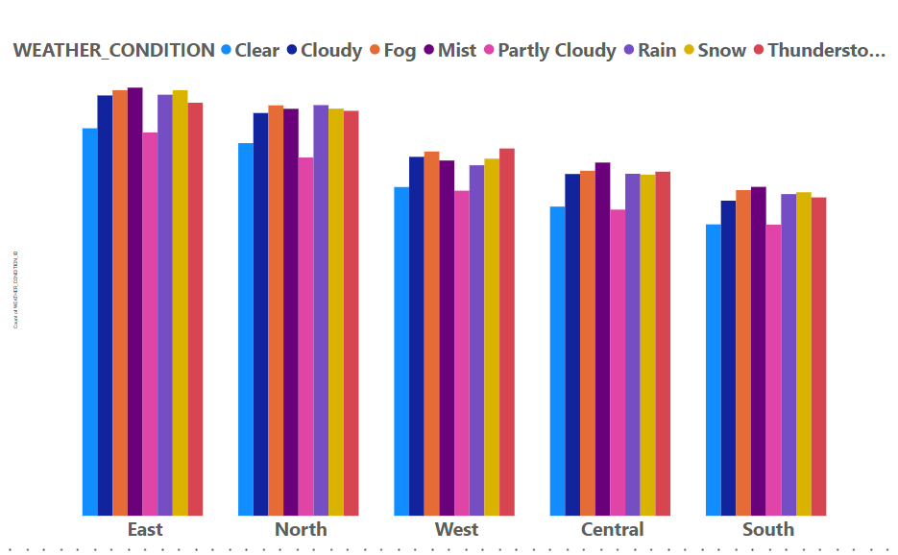
The east has the highest pest frequency this could lead to future problems for the company.
The south has the lowest pest frequency but the east has 50 more locations in it. The high pest frequency can be associated with the higher number of locations.
This graph shows the frequency of weather conditions in each region. The east is mostly misty, foggy or cloudy, there is a good chance of rain which is good for crops, the problem is it also shows a high frequency for snow, the west which has the least frequency for snow is the best choice.
Although from the graph it seems the south is the best choice we need to remember it has fewer locations than others which makes the frequency look less.

