Slide 1
Preprocessors

Slide 2
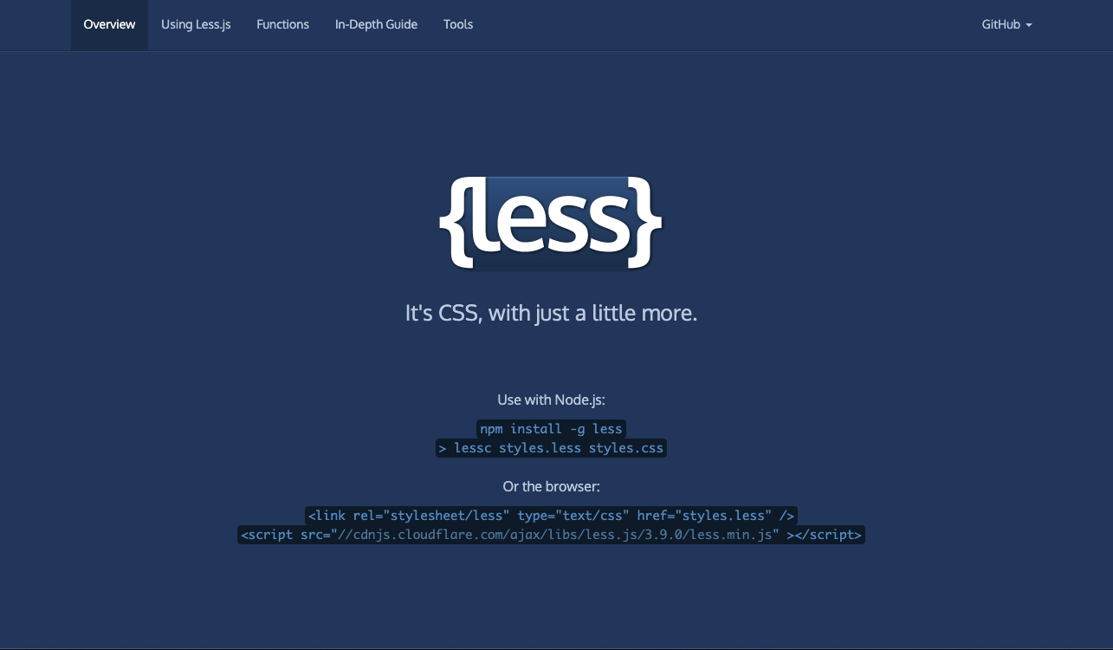
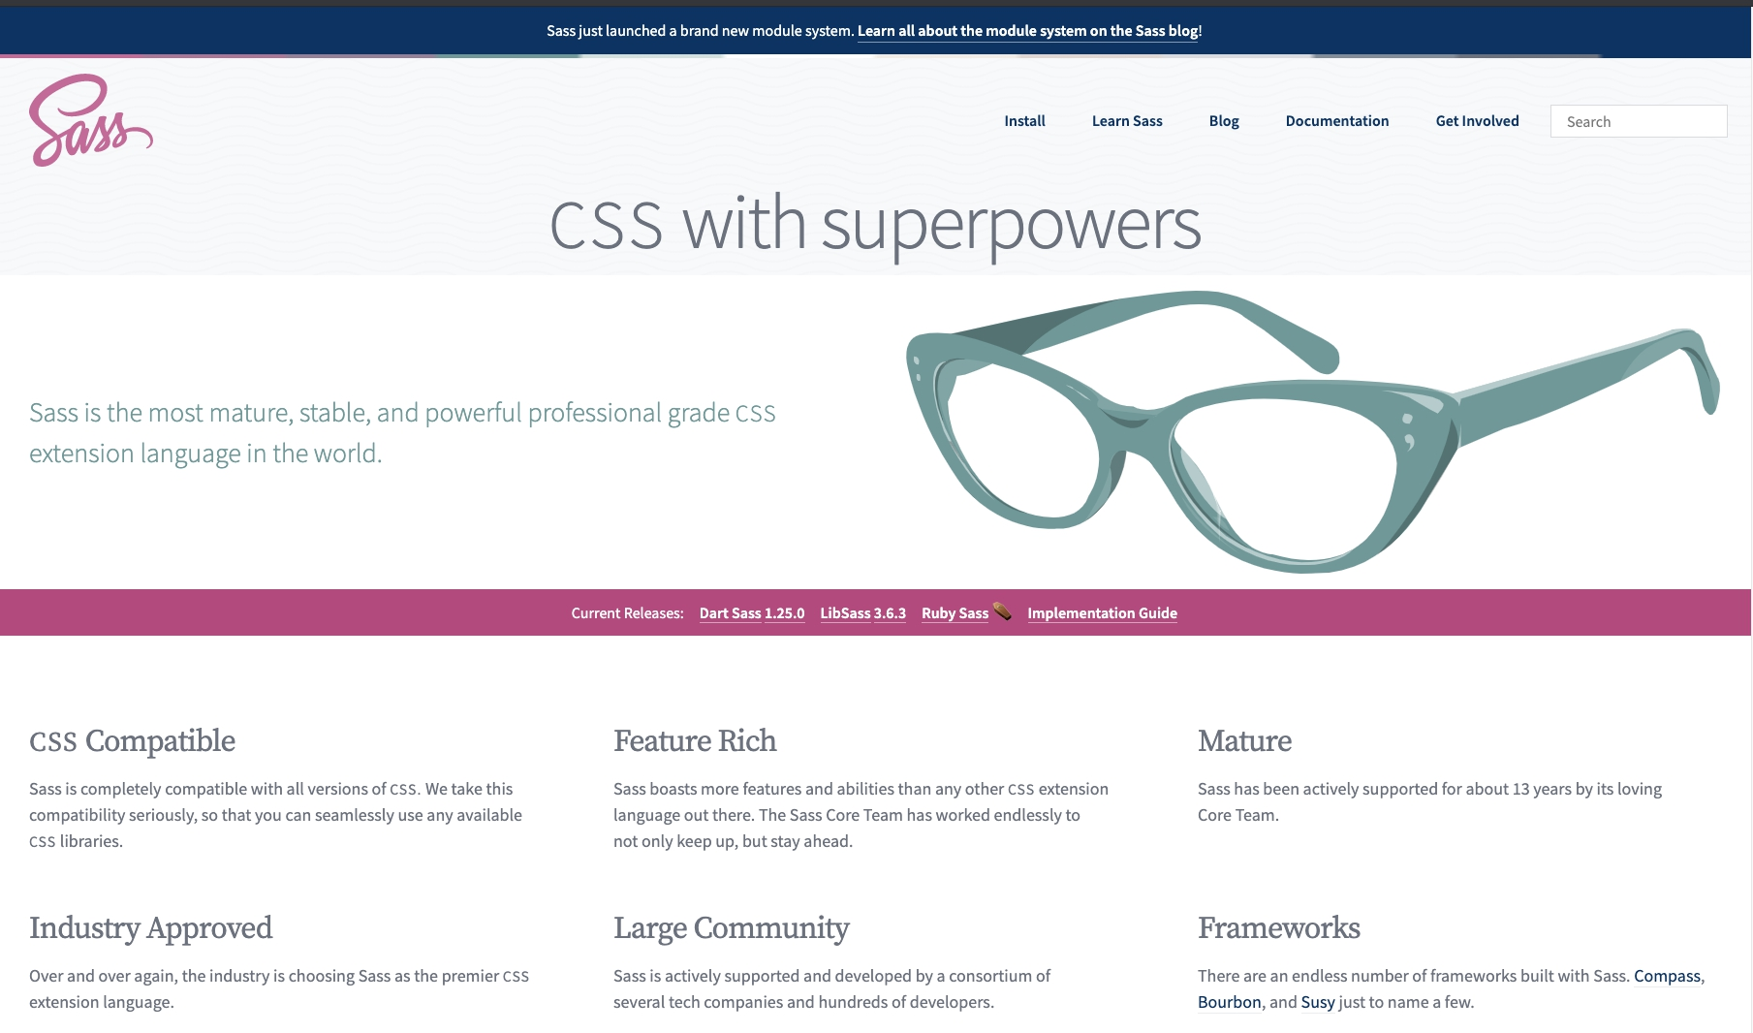
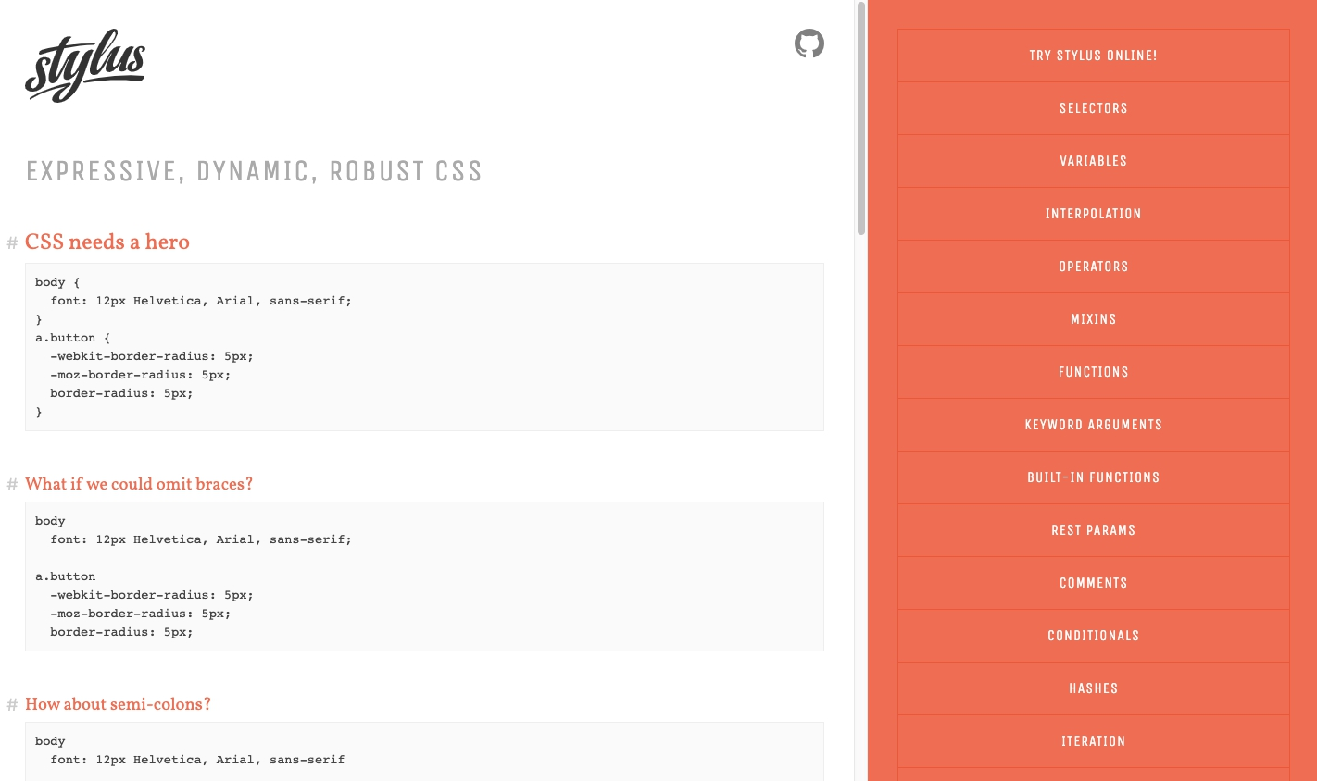
Sass(scss), Less, Stylus

Slide 3
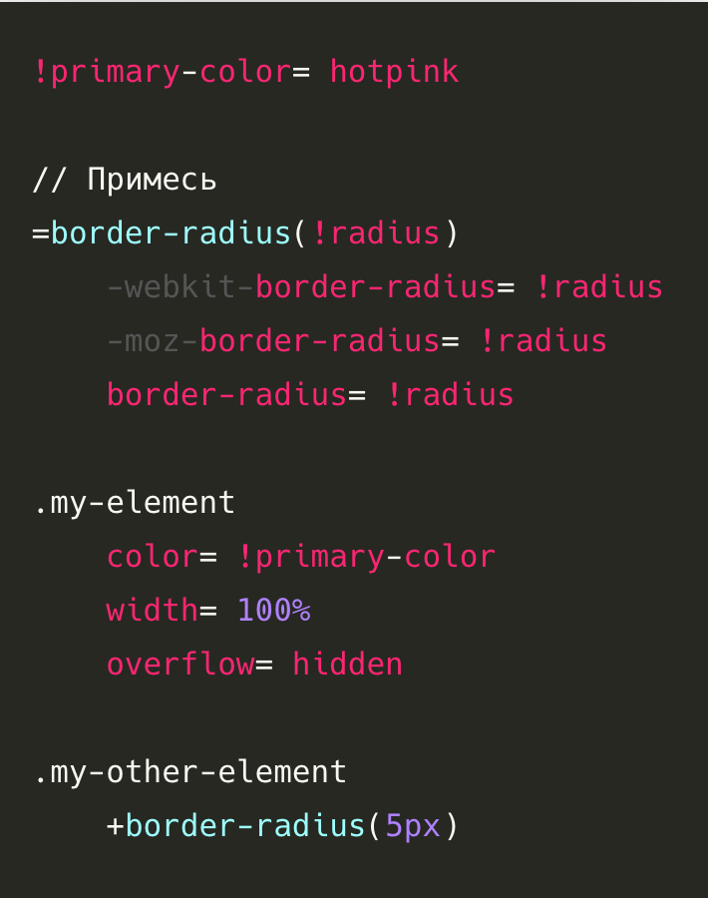
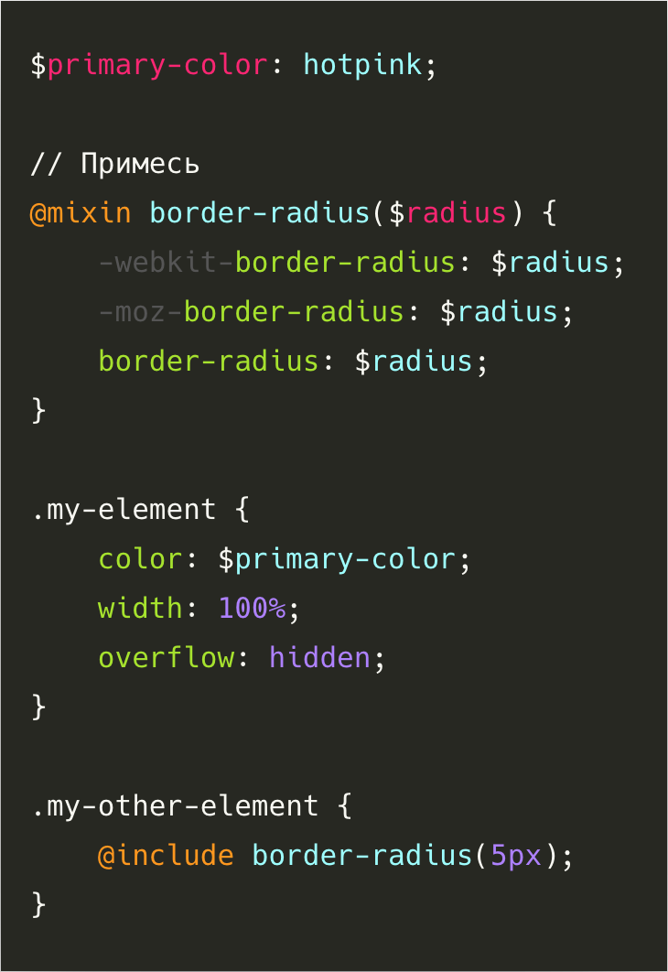
Sass vs Scss
Sass
Scss

Slide 4
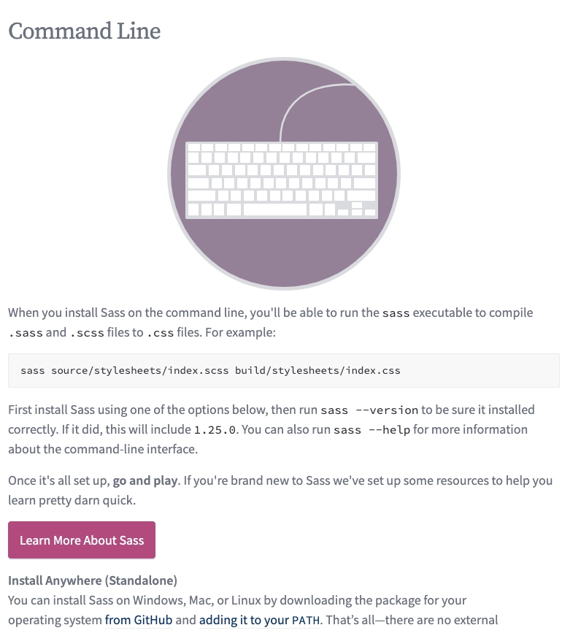
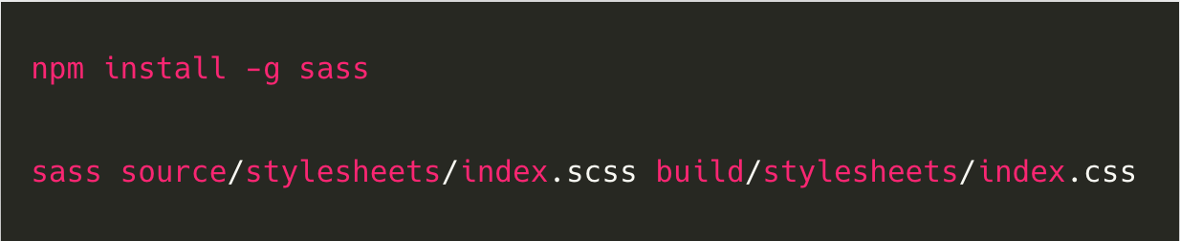
SCSS
Command line

Slide 5
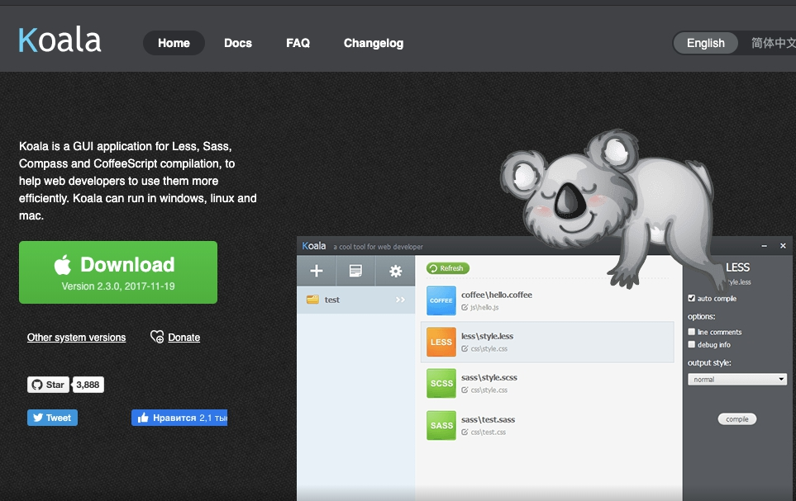
SCSS
Compilers GUI apps:
CodeKit (Paid) Mac
Compass.app (Paid, Open Source) Mac Windows Linux
Ghostlab (Paid) Mac Windows
Hammer (Paid) Mac
Koala (Open Source) Mac Windows Linux
LiveReload (Paid, Open Source) Mac Windows
Prepros (Paid) Mac Windows Linux
Scout-App (Free, Open Source) Windows Linux Mac

Slide 6
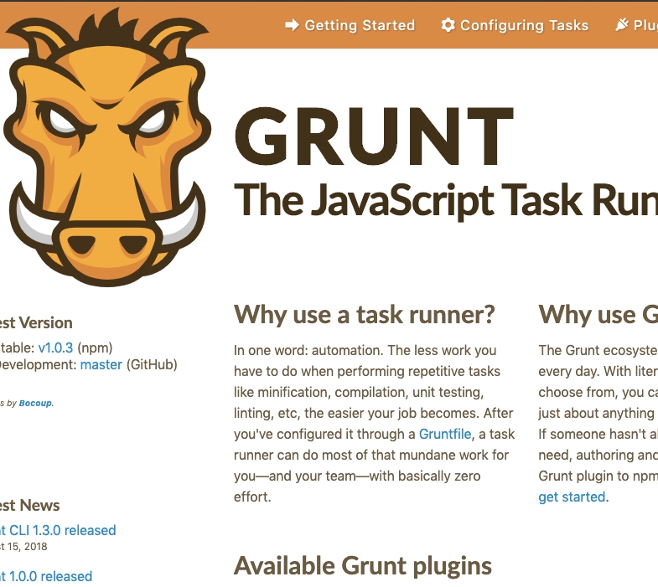
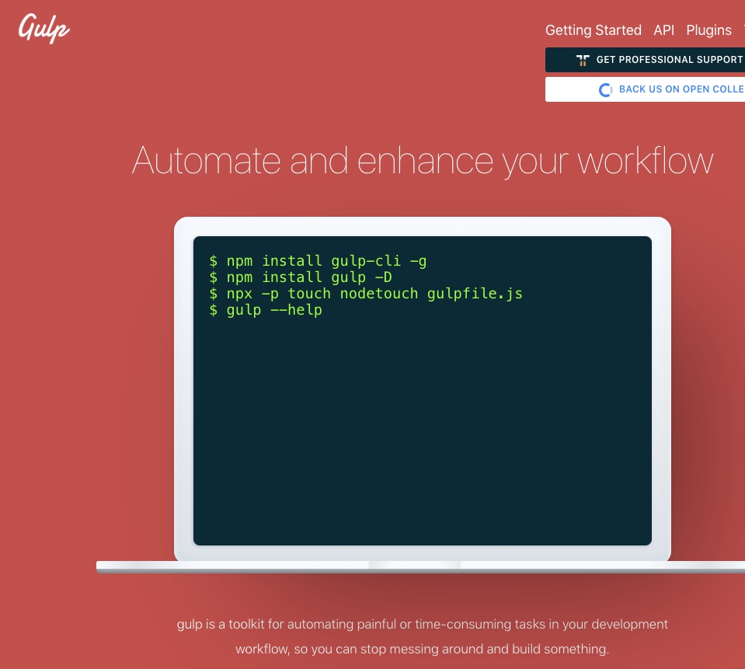
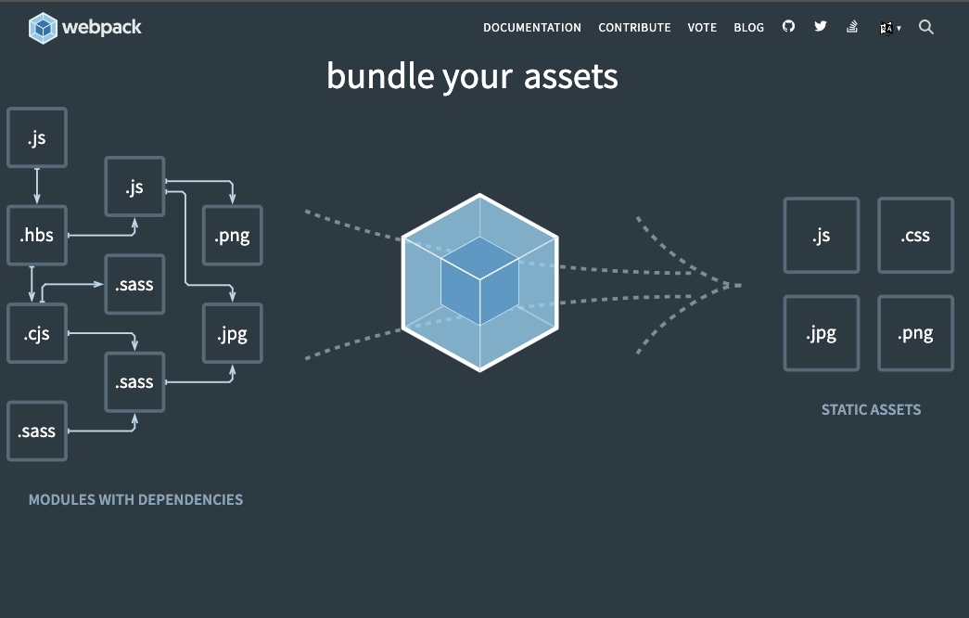
SCSS
Task runners, module builders
Gulp
Grunt
Webpack

Slide 7
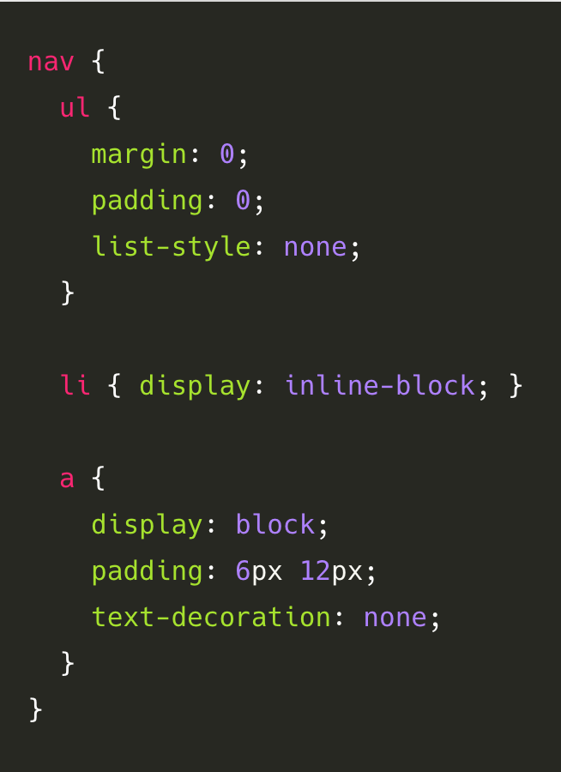
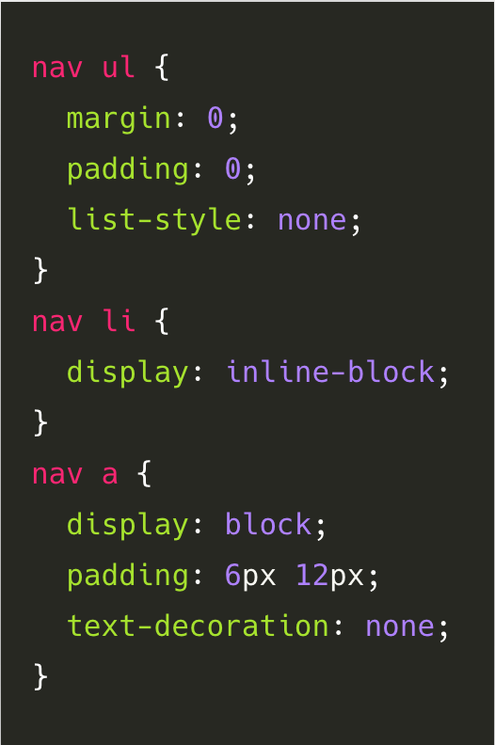
SCSS - вложенность
SCSS
CSS

Slide 8
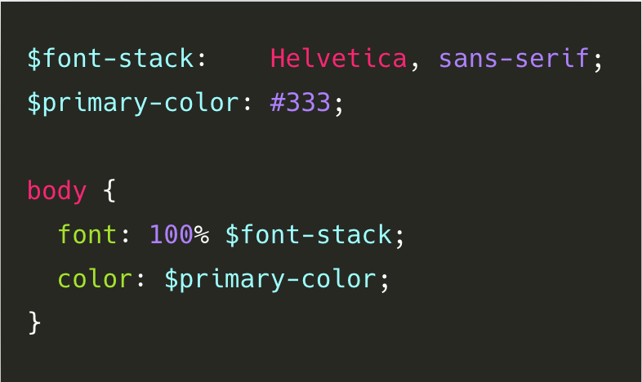
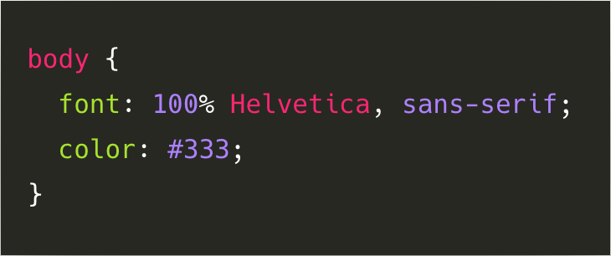
SCSS - переменные
SCSS
CSS

Slide 9
SCSS - переменные
SCSS
CSS

Slide 10
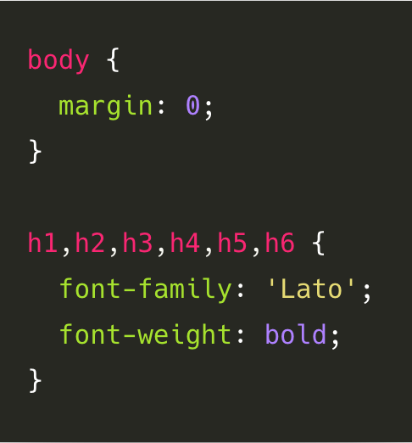
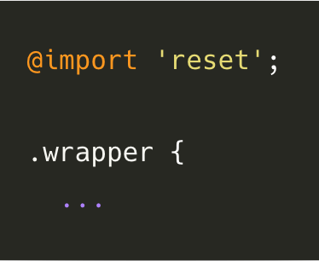
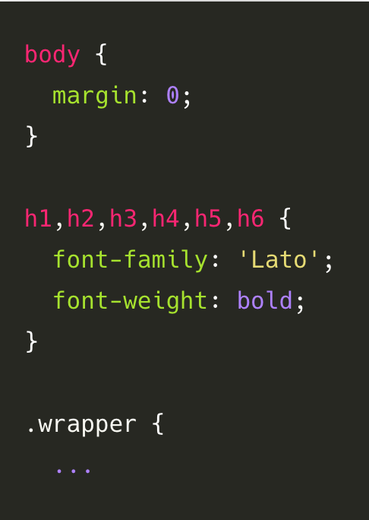
SCSS – @import
_reset.scss
style.scss
style.css

Slide 11
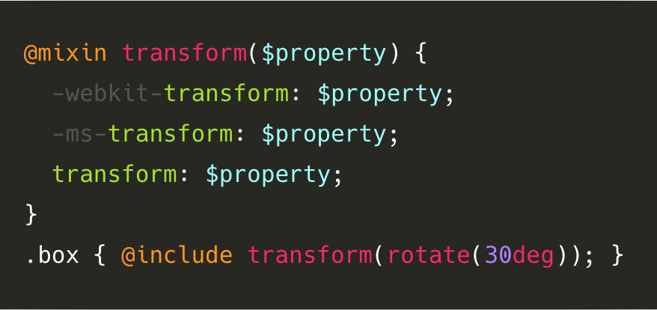
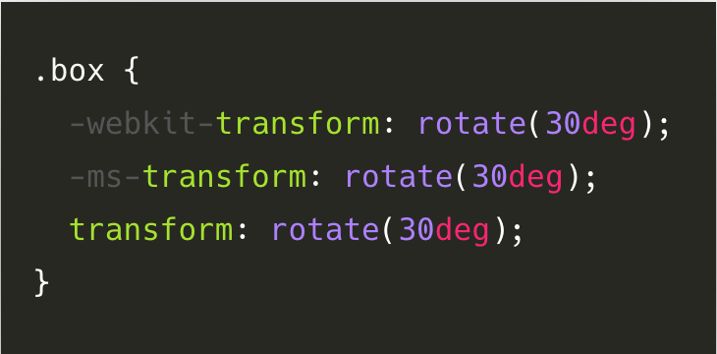
SCSS - Mixins
SCSS
CSS

Slide 12
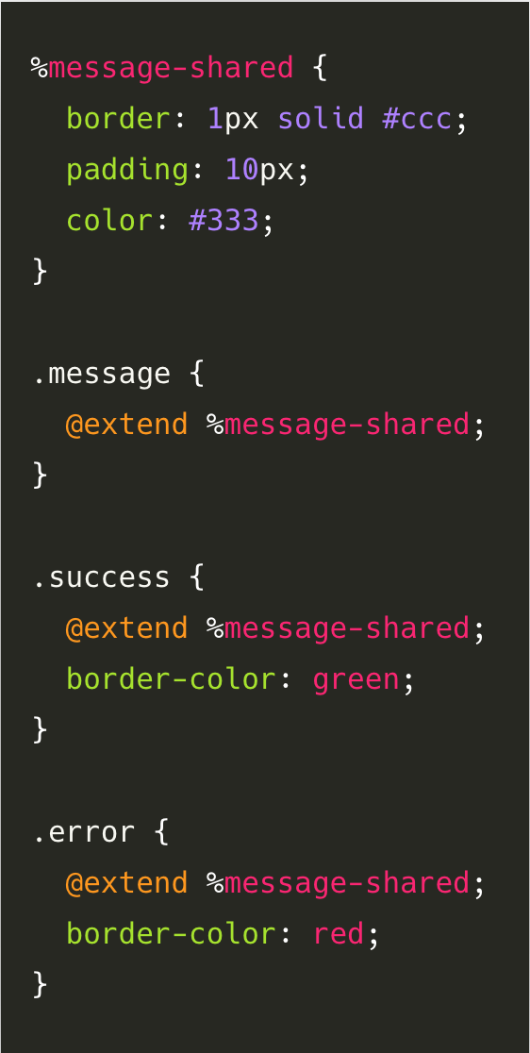
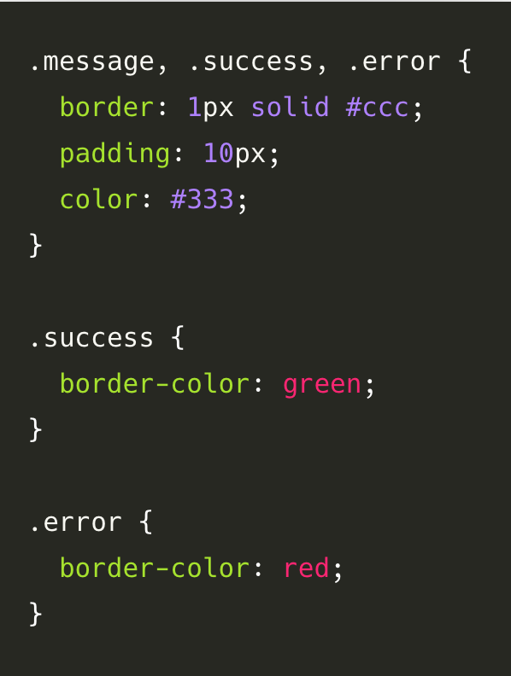
SCSS - Extends
SCSS
CSS

Slide 13
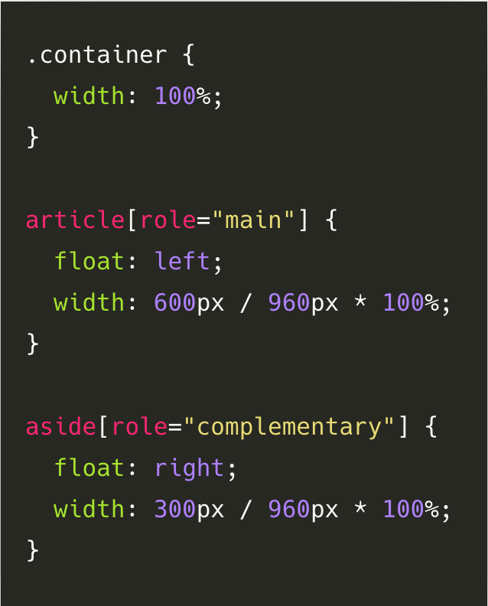
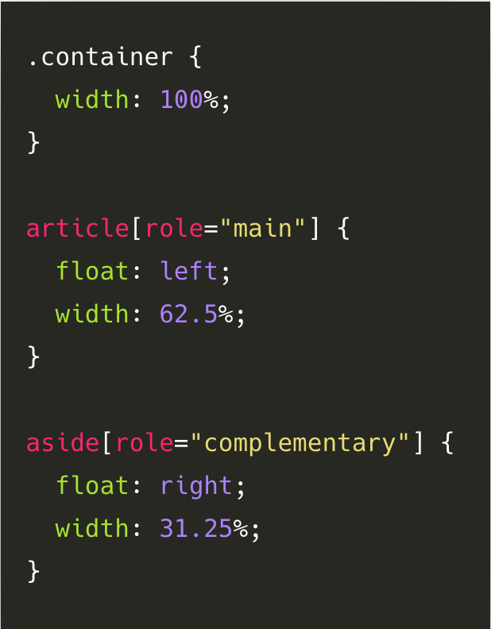
SCSS – Mathematical operators
SCSS
CSS

Slide 14
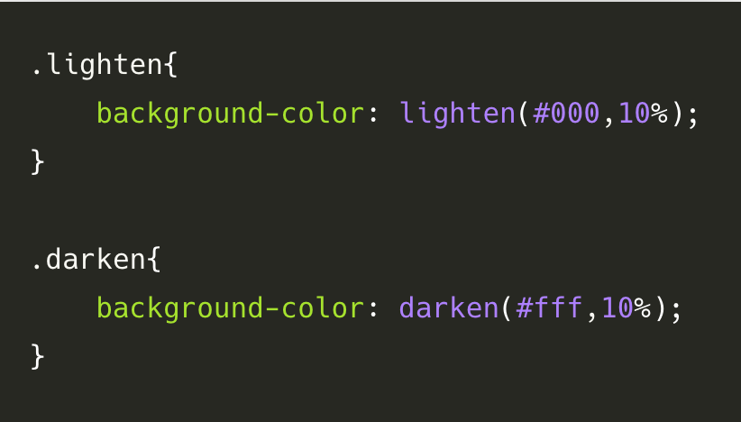
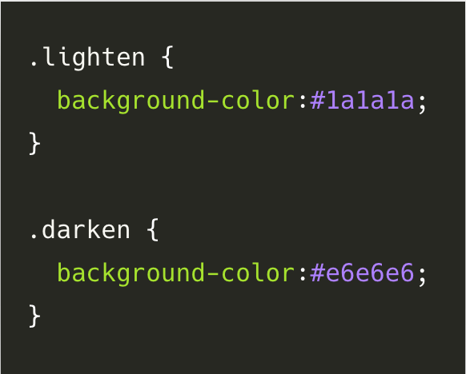
SCSS – Mathematical operators
SCSS
CSS

Slide 15
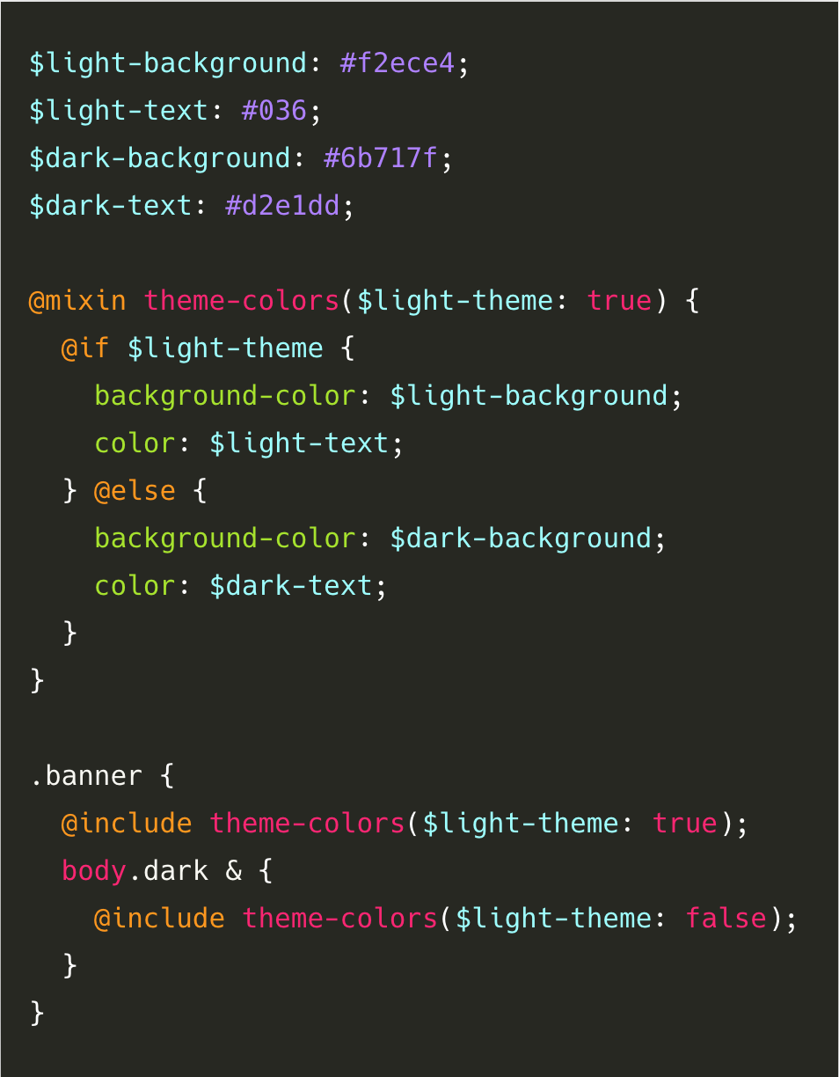
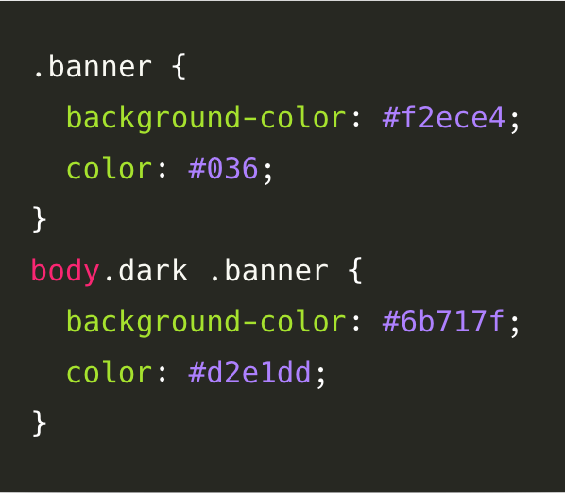
SCSS – Conditional operators
SCSS
CSS

Slide 16
Практика

