Slide 1
Catch Joe
Feature Extraction and
Modeling to Identify the User Joe
November, 2021
Embracing the Technology of Tomorrow

Slide 2
Agenda
01
Project Overview
02
Data Loading, Inspection, Cleaning,
Transformation and Encoding
03
Correlation Analysis and Visualization
04
Data Pipeline
Modeling Experiments
Notes:
4. My Vision on My Future Role

Slide 3
Project Overview
Application Setup and Dataset
Data analysis and modeling for an online user system.
The dataset contains recorded user sessions data.
Training dataset: containing labeled user IDs.
Verification dataset: same features but without user ID labels.
Goal
Create a method to identify the user with ID = 0, codename Joe, based on the recorded session data of all users.
Requirements / Deliveries
Exploratory Data Analysis
This presentation and the Jupyter Notebook: catch_joe.ipynb
Standalone Script - The full pipeline to run on verification dataset
catch_joe.py
Usage: python catch_joe.py test.json
Results generated from running the standalone script on the test dataset, containing the predictions
result.csv
Each line is a predicted label (0=Joe, 1=Not Joe).

Slide 4
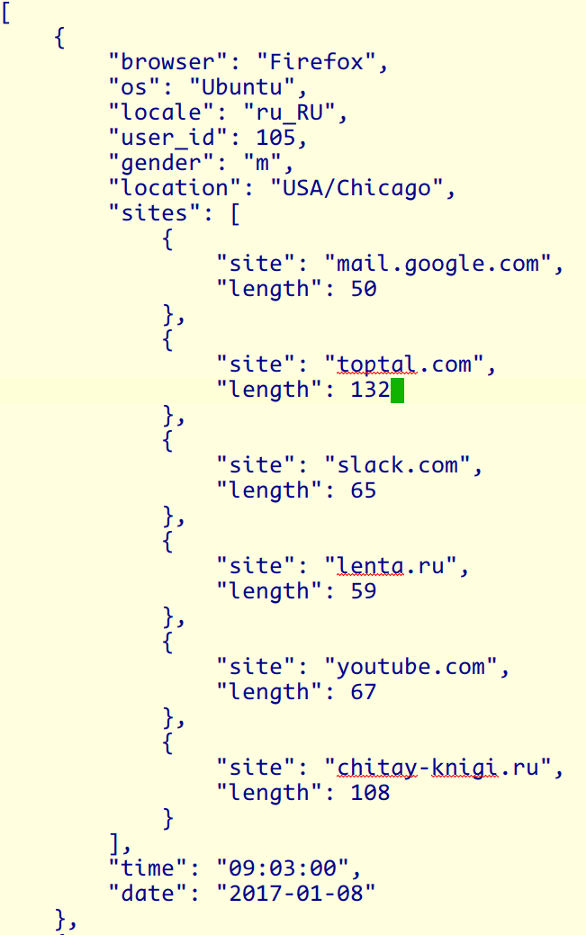
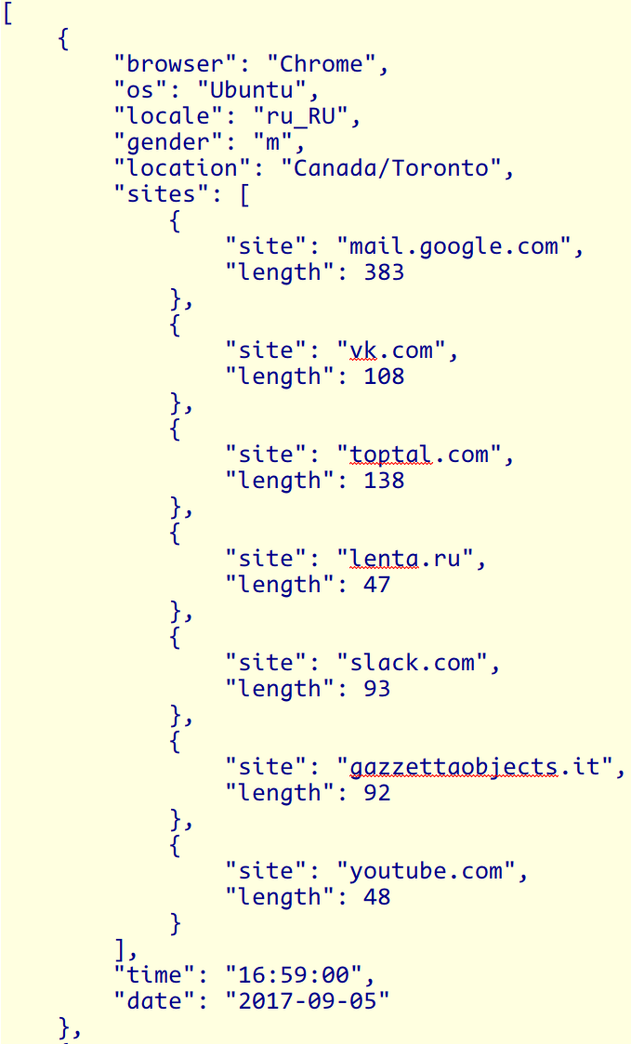
Load Data
JSON data structure
Dataset contains a list of records, with a nested field “sites”.
Data loading procedure
Load dataset from files with Python json library
Training
Dataset
Verify Dataset
No “user_id” field;
Other fields same.

Slide 5
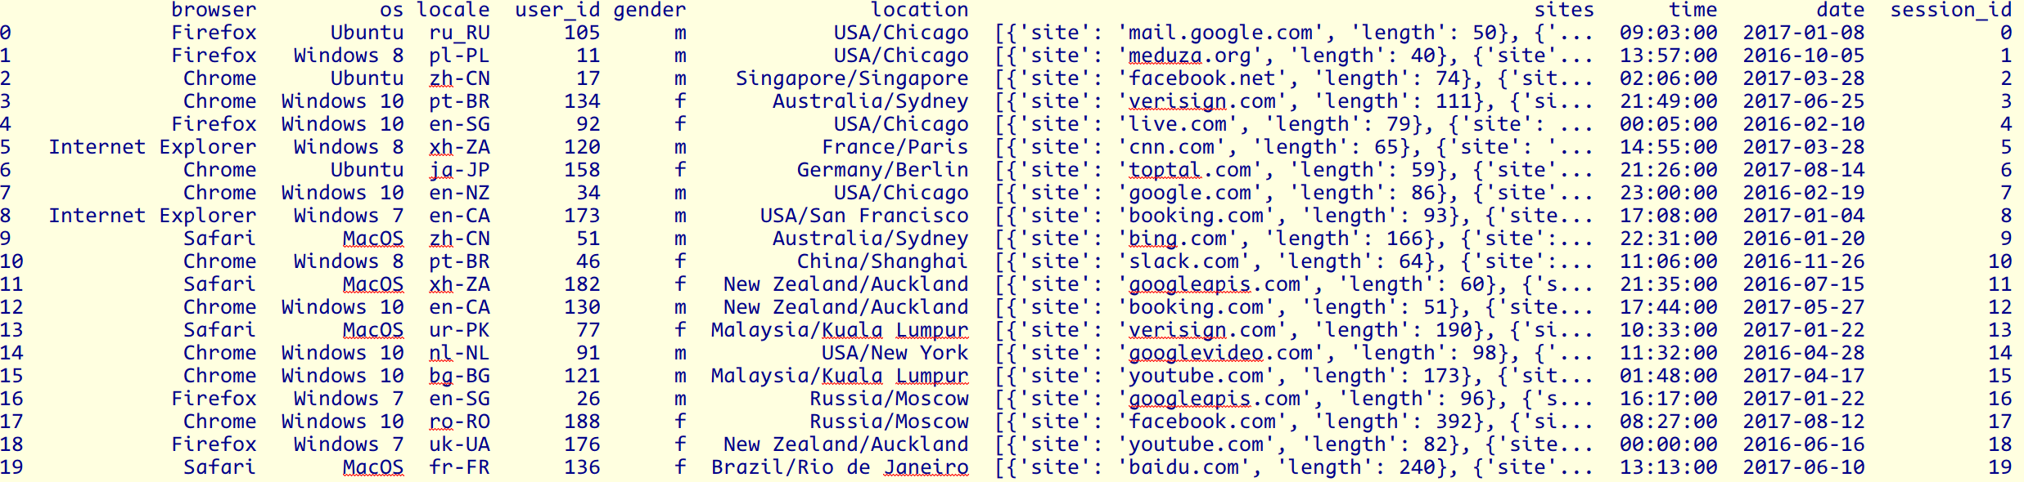
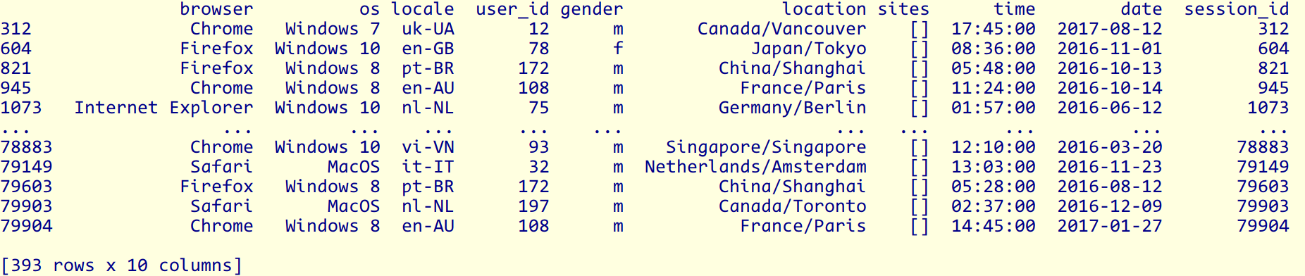
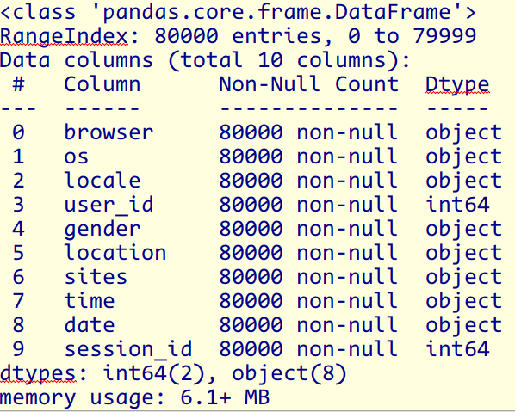
Data Inspection
Summary of Data Columns
80000 session records.
7 string columns; user_id is target; and the nested sites column.
393 entries have empty sites.

Slide 6
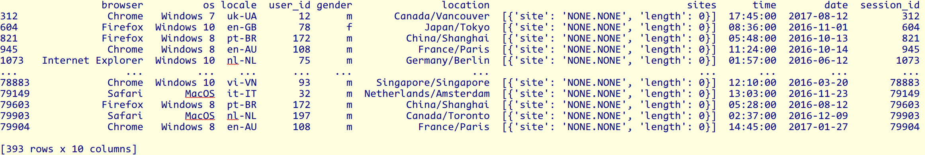
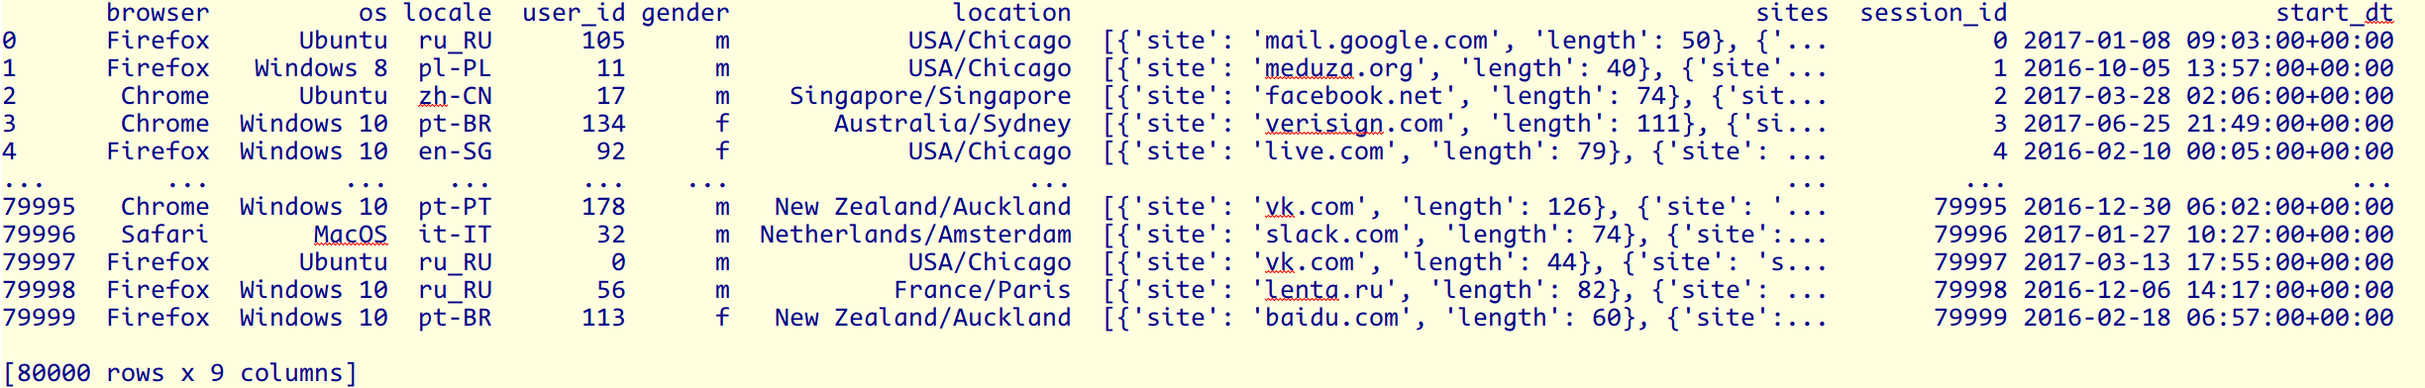
Data Cleaning
Impute empty sites with site=‘None.None’ and length=0
Combine date and time columns, convert strings to standard datetime objects.

Slide 7
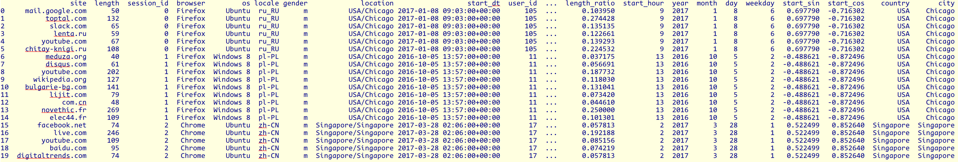
Custom Features
Site Visiting Time Lengths
length_session: the sum of all site visiting time lengths for each user session.
Date / Time
Year / Month / Day / Weekday
local_time: the local start date/time converted based on users’ locations.
Sine/Cosine transform of local start time - Cyclic features of start time.
Location
Split location to Country and City.
The original location feature is actually the same as City.

Slide 8
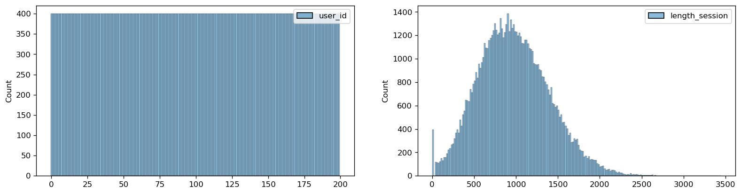
Visual Inspection - user_id / Session Length
Counts of sessions / user
Users: 200 users totally, with id = 0 - 199.
Session counts / user: 400.
Joe’s (user_id = 0) sessions only 400/80000 = 0.5%. The dataset is extremely skewed/imbalanced under binary classification requirements.
Session length
Close to normal distribution, centered around 980 with scale = 420.
Right skewed.
About 400 sessions without sites record, length_session = 0.

Slide 9
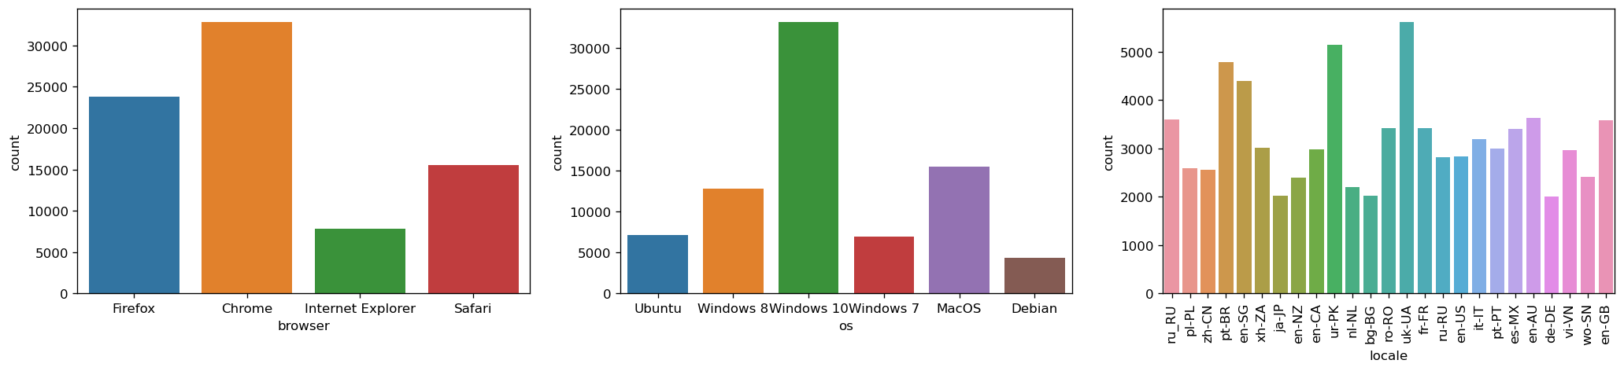
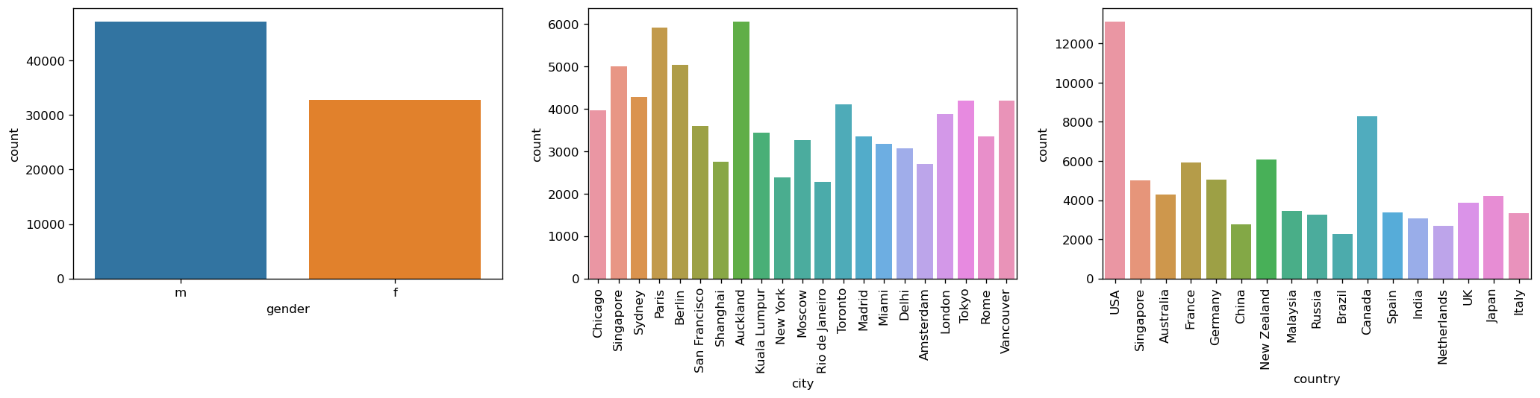
Visual Inspection - Client Systems / Demographic
Clinet systems
4 browsers, 6 OSes, 25 locales. Windows 10 / Chrome are mostly used.
Demographic Statistics
Session counts: Male 47200 Female 32800. Difference: 14400.
21 cities in 17 countries.

Slide 10
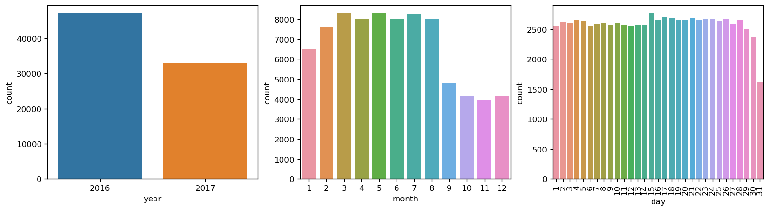
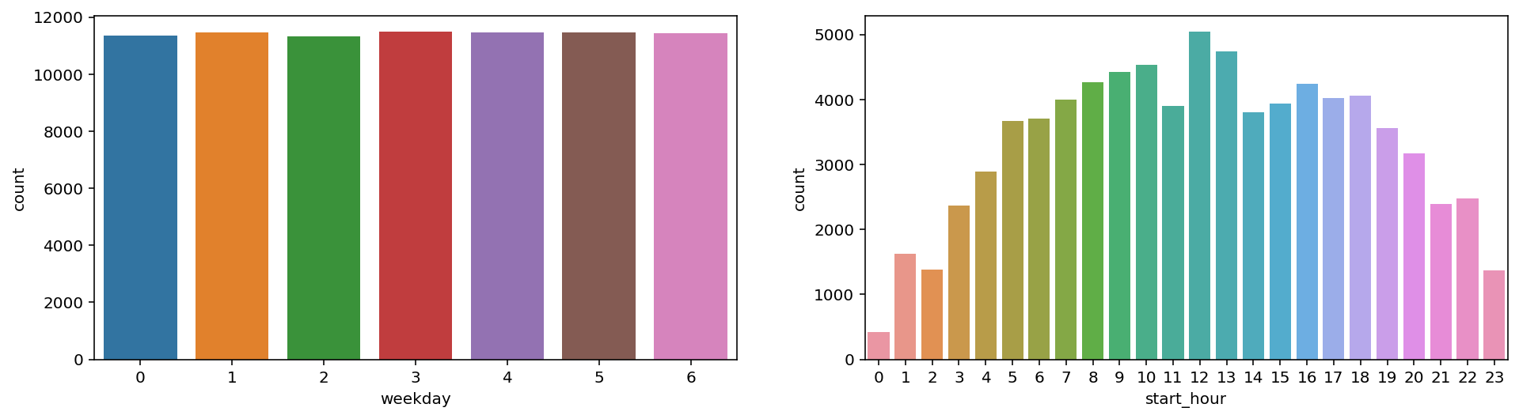
Visual Inspection - Start Date / Time
Distribution of start year / month / day / weekday / start_hour
Two years data: 2016-2017.
Lower user activities from Septermber to December.
start_hour / time are bell-shape distributed, centered at 12PM local time.

Slide 11
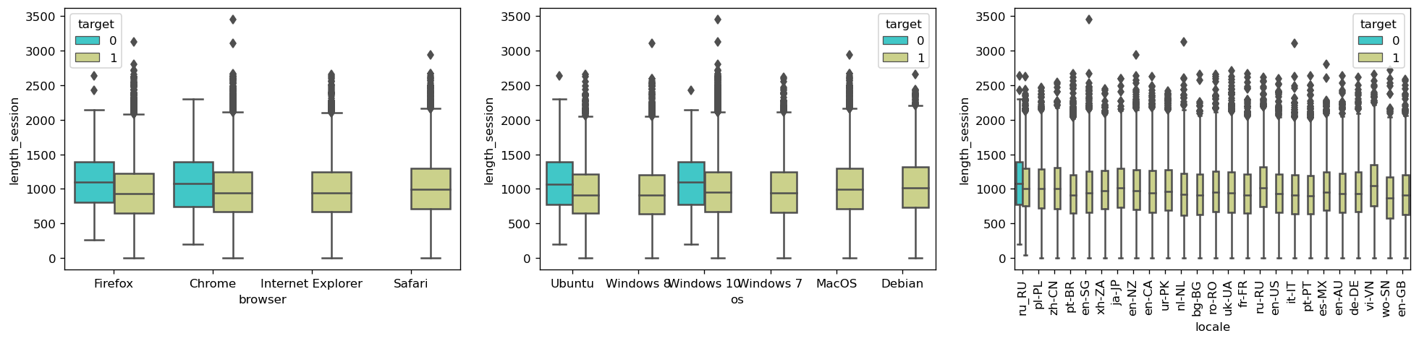
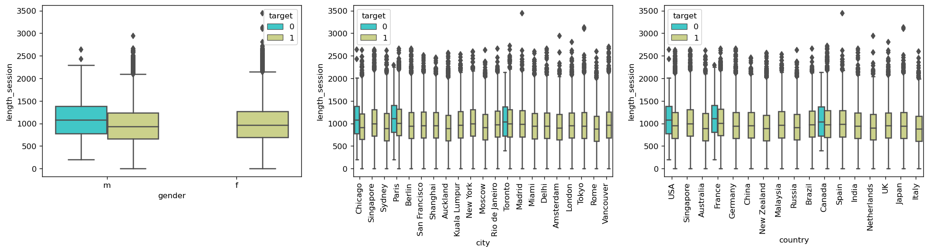
Characteristics of Joe
Joe’s client systems: Firefox / Chrome on Ubuntu / Windows 10, locale is ru_RU.
He is a male, in Chicago / Paris /Toronto.

Slide 12
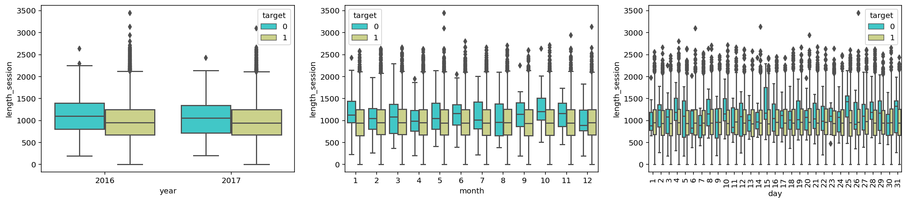
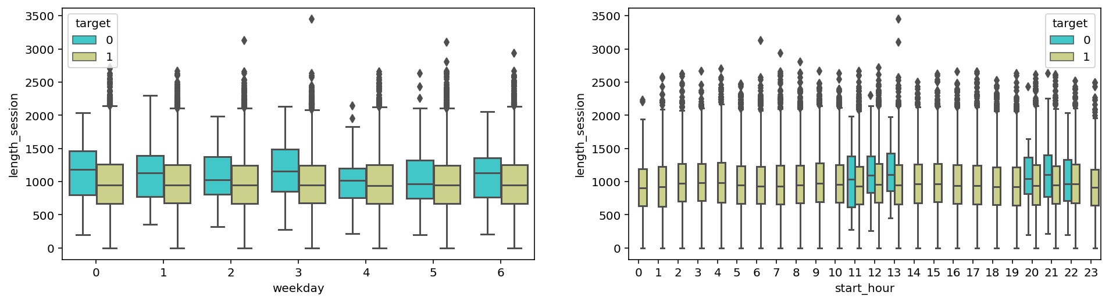
Characteristics of Joe
Joe’s sessions started in 11AM-1PM and 8-10PM, but could be any date.
Joe’s session lengths are longer than other users overall, regarding all features.

Slide 13
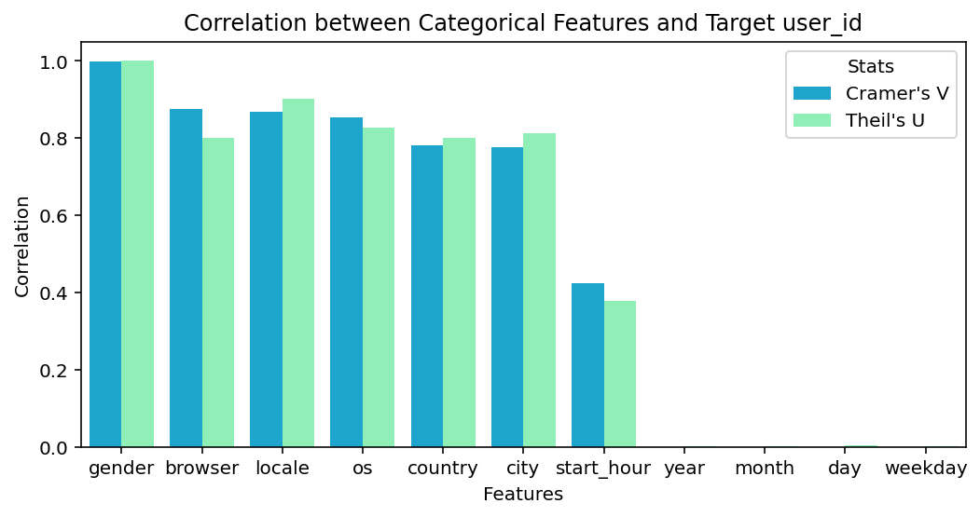
Correlation Analysis - Categorical Features vs. Target
Correlation by Crmaer’s V and Theil’s U
The best correlated categorical features
Demographic / client systems: gender: 1, browser, os, locale: 0.8-0.9, country, city: 0.8
Session: start_hour: 0.4
Date: year / month / day / weekday: 0.001-0.004

Slide 14
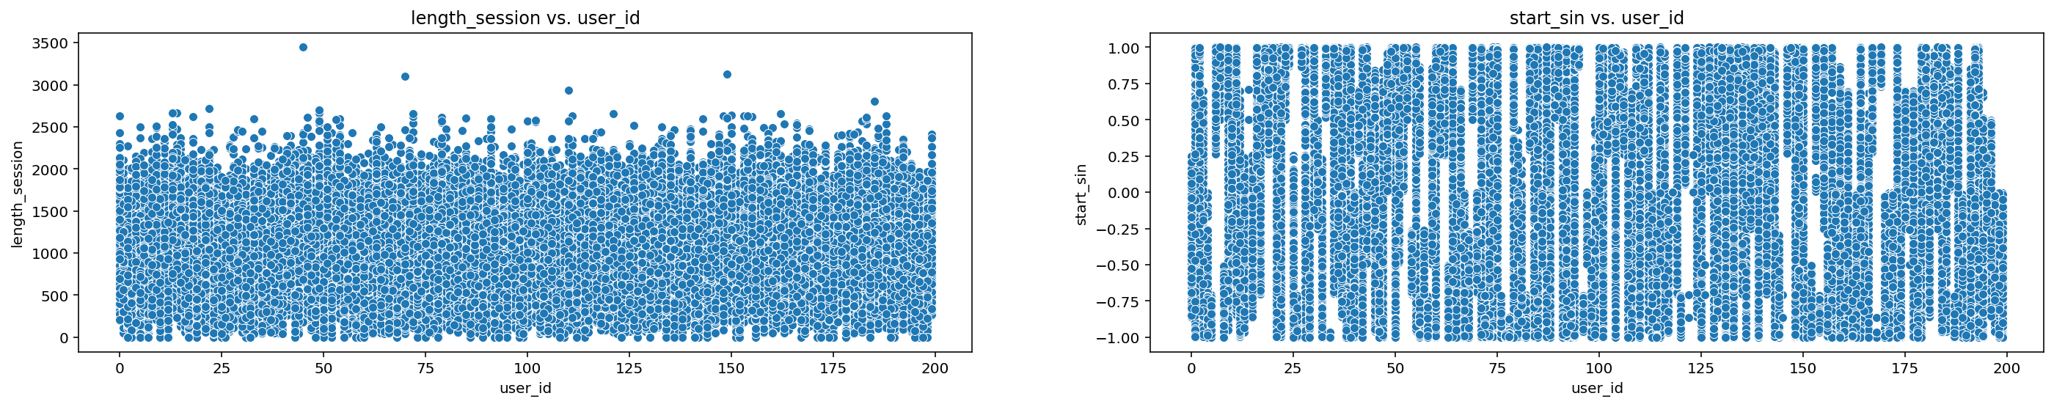
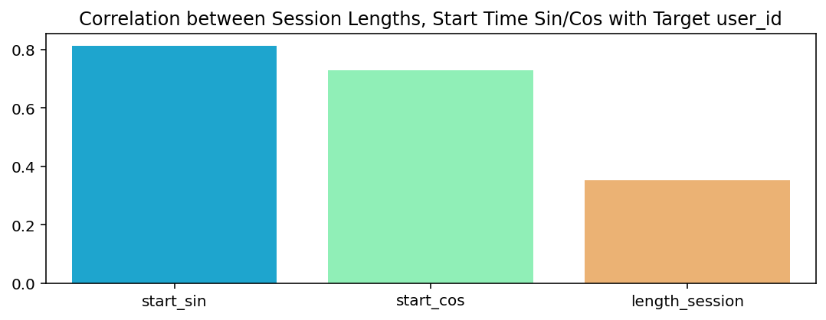
Correlation Analysis - Numerical Features vs. Target
The distribution of session length over user_id are almost same, uniform from 0-2800.
The distribution of start time over user_id are different, useful to identify users.
Correlation ratios to user_id
Session Length: 0.35
Start sin/cos: 0.81 / 0.73

Slide 15
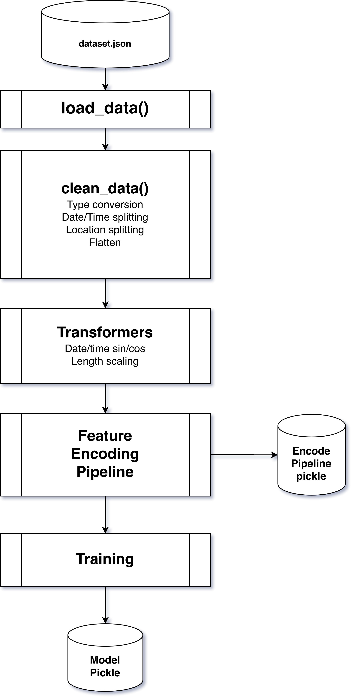
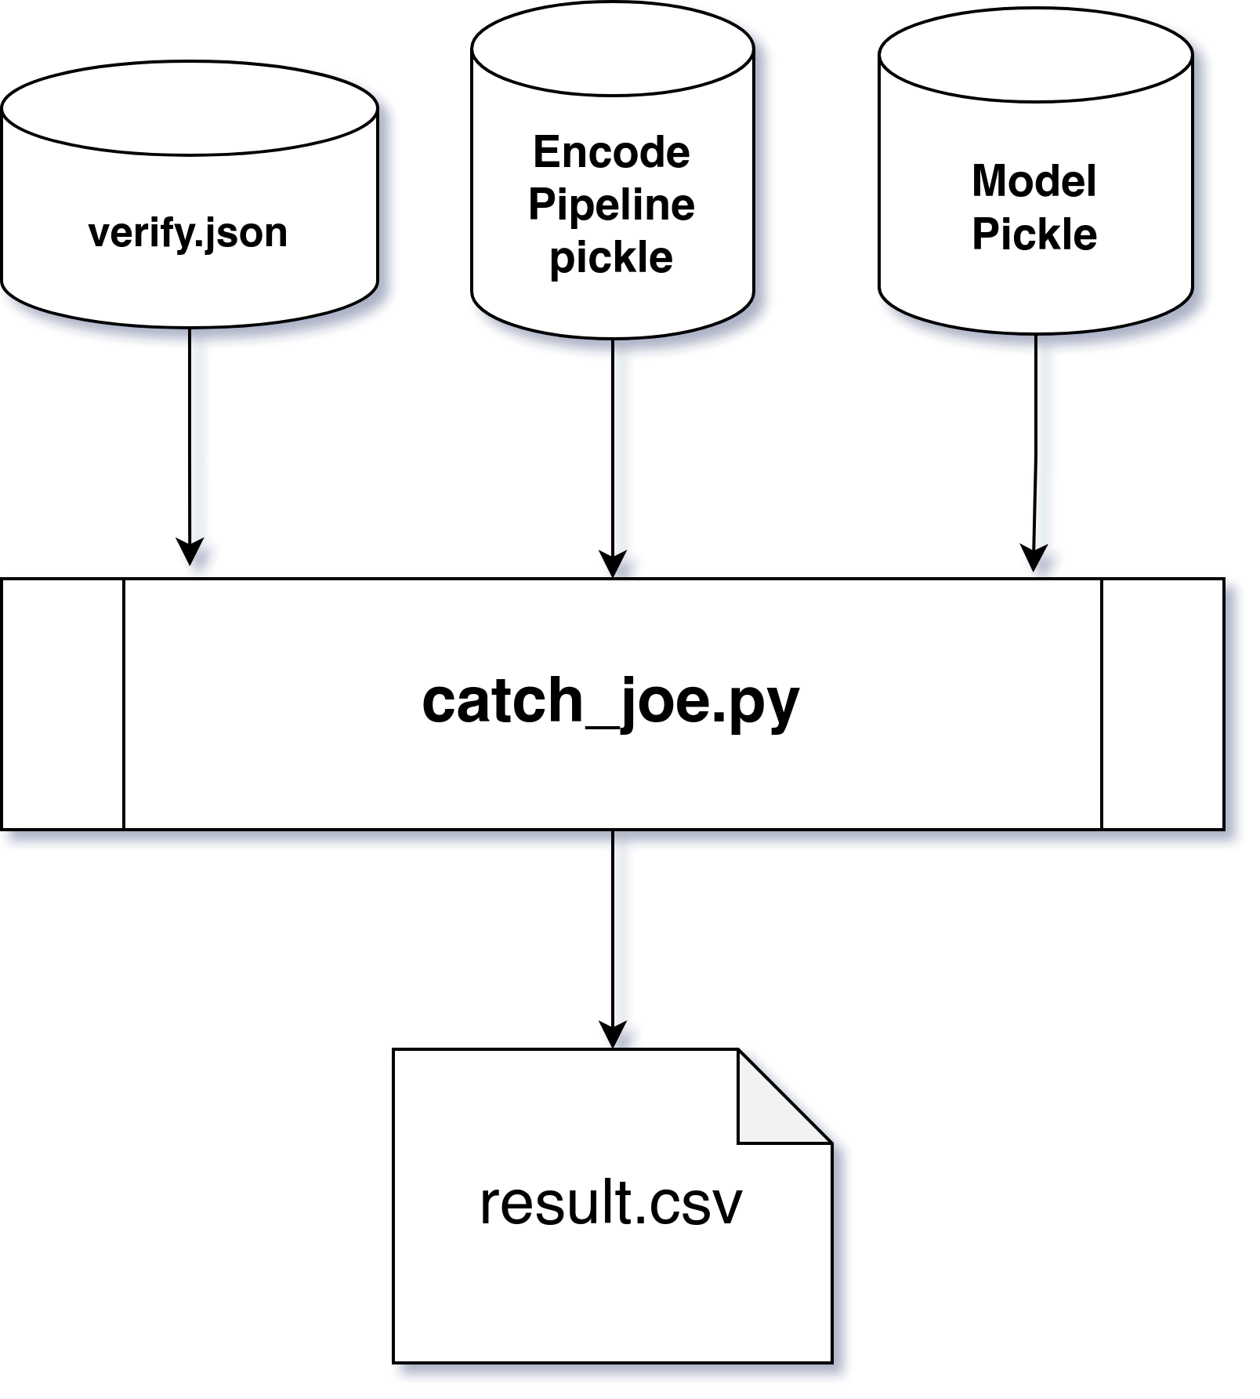
Data Pipeline
Test Data Pipeline
Train Data Pipeline

Slide 16
Modeling Experiments
Models \ Scores | Class+ (Joe) F1 Score Validation | Class+ (Joe) F1 Score Test | Class+ (Joe) Precision Test | Class+ (Joe) Recall Test | Macro ROC_AUC Score Test
Random Forest Baseline - Counts | 0.52 | 0.43 | 0.56 | 0.35 | 0.67
Random Forest Baseline - Length | 0.51 | 0.52 | 0.73 | 0.4 | 0.7
Random Forest - Length, Joes sites only. Overfit. | 0.68 | 0.27 | 0.64 | 0.17 | 0.59
Random Forest - Length, N-Gram = (2,3,4,5) | 0.84 | 0.89 | 0.97 | 0.82 | 0.91
Random Forest - Counts, N-Gram = (2,3,4,5) | 0.89 | 0.89 | 0.97 | 0.82 | 0.91
Random Forest - Counts, N-Gram = (3,4,5,6,7) | 0.89 | 0.89 | 0.97 | 0.82 | 0.91
Gradient Boosting - Counts, N-Gram=(3,4,5,6,7) | 0.89 | 0.89 | 0.90 | 0.88 | 0.94
XGBRFClassifier - Counts, N-Gram=(3,4,5,6,7) | 0.89 | 0.88 | 0.94 | 0.82 | 0.91
DNN - Counts, N-Gram=(3,4,5,6,7) | 0.98 (train) | 0.89 | 0.97 | 0.82 | 0.91

Slide 17
THANK YOU

