Slide 1
Battle Cats
Team #9:
Kyle Handy
Oliver Lynch
Eric DeMoney
Jacob Carlson
Ryota Haba
Tyler Lopez

Slide 2
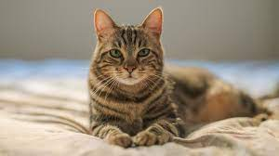
Presentation Outline
App overview
Requirements
Diagrams
Level 0 to level 2
Proof of Concept
Front end
Back end
Questions

Slide 3
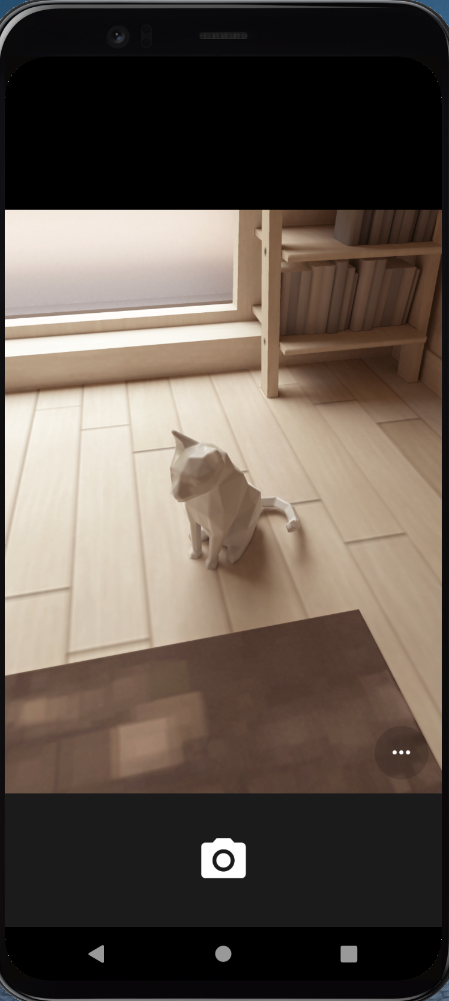
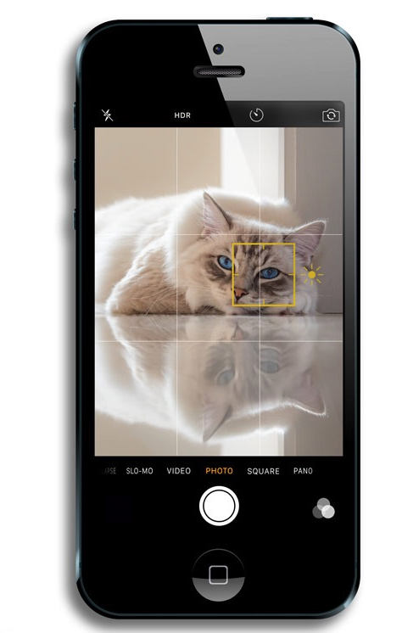
Overview of Battle Cat
For cats lovers
Collection of your favorite cats
Pokemon game feature
Battle with other cats
Mobile app developed with Flutter and Firebase

Slide 4
Requirements
Battle Cats must allow for users to take photos of their cats and stats must be randomly assigned.
Battle Cats must allow for users to battle other users' cats or randomly selected cats.
Battle Cats must allow for users to add friends and have real time battles with them.
Battle Cats must only allow for users to upload cats’ pictures
An admin shall upload cats’ pictures and manipulate the stats, which are used in battle with randomly selected cats.
Users must have accounts to play Battle Cats.
Battle Cats must use a real time database to allow for constant updates to the users view. (derived requirement)
User must have a smart phone with camera and stable internet connection. (system requirement)

Slide 5
Diagrams

Slide 6
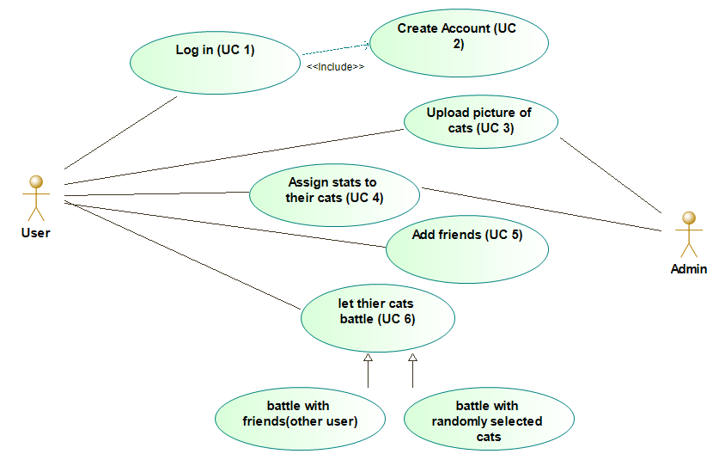
Use Case Diagram
Trace Analysis
 | Priority Weight | UC1 | UC2 | UC3 | UC4 | UC5 | UC6
R1 | 3 |  |  | X | X
R2 | 2 |  |  |  |  |  | X
R3 | 1 |  |  |  |  | X | X
R4 | 1 |  |  | X
R5 | 2 |  |  | X | X
R6 | 2 | X | X
Score |  | 2 | 2 | 6 | 5 | 1 | 3

Slide 7
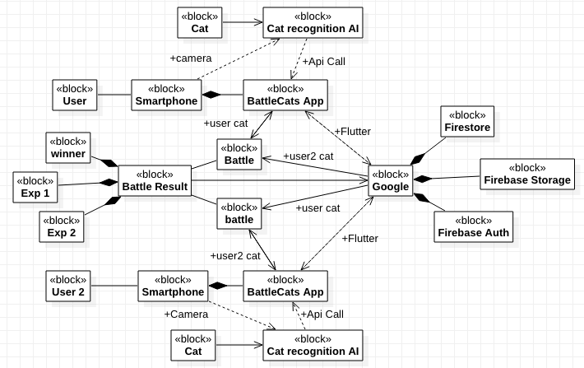
Block Diagram

Slide 8
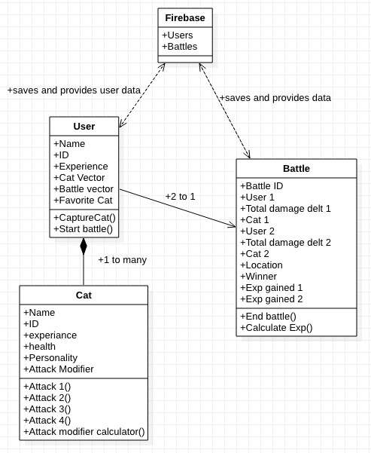
Class Diagrams

Slide 9
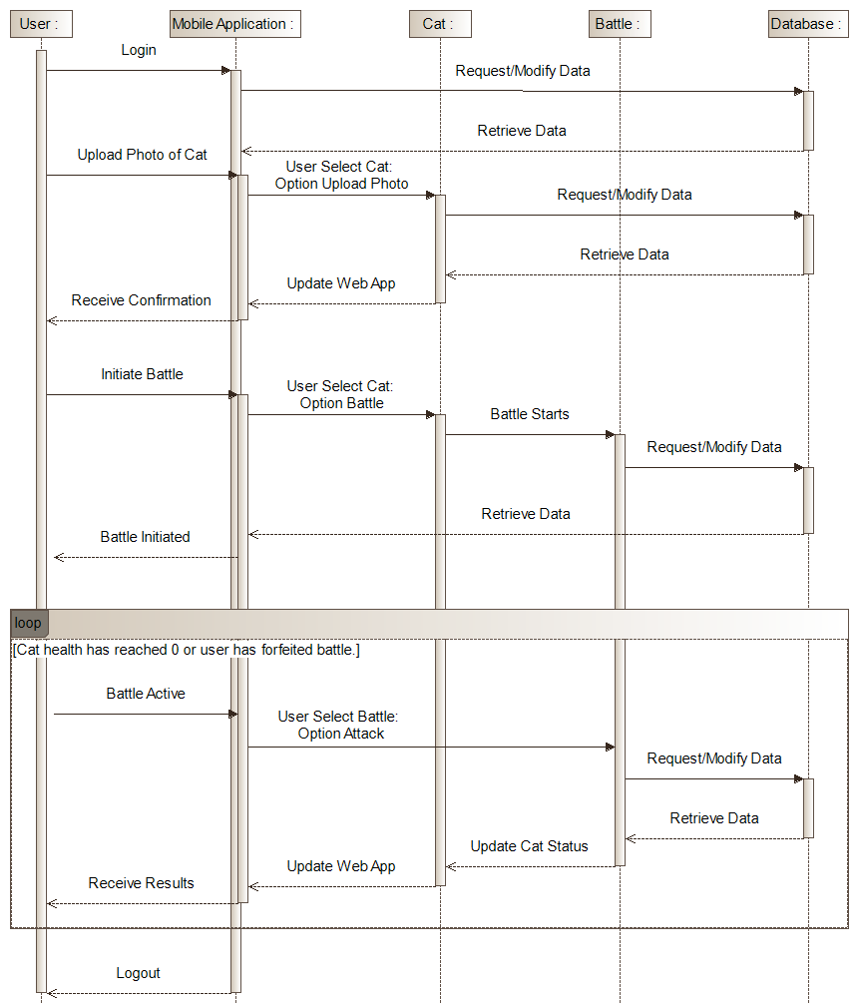
Interaction Sequence Diagram

Slide 10
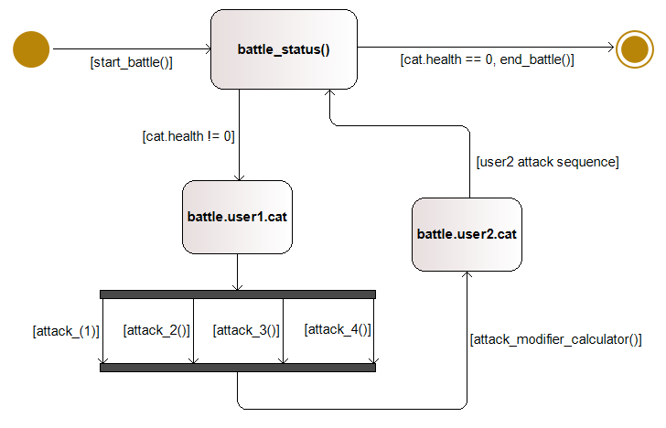
State Machine Diagram

Slide 11
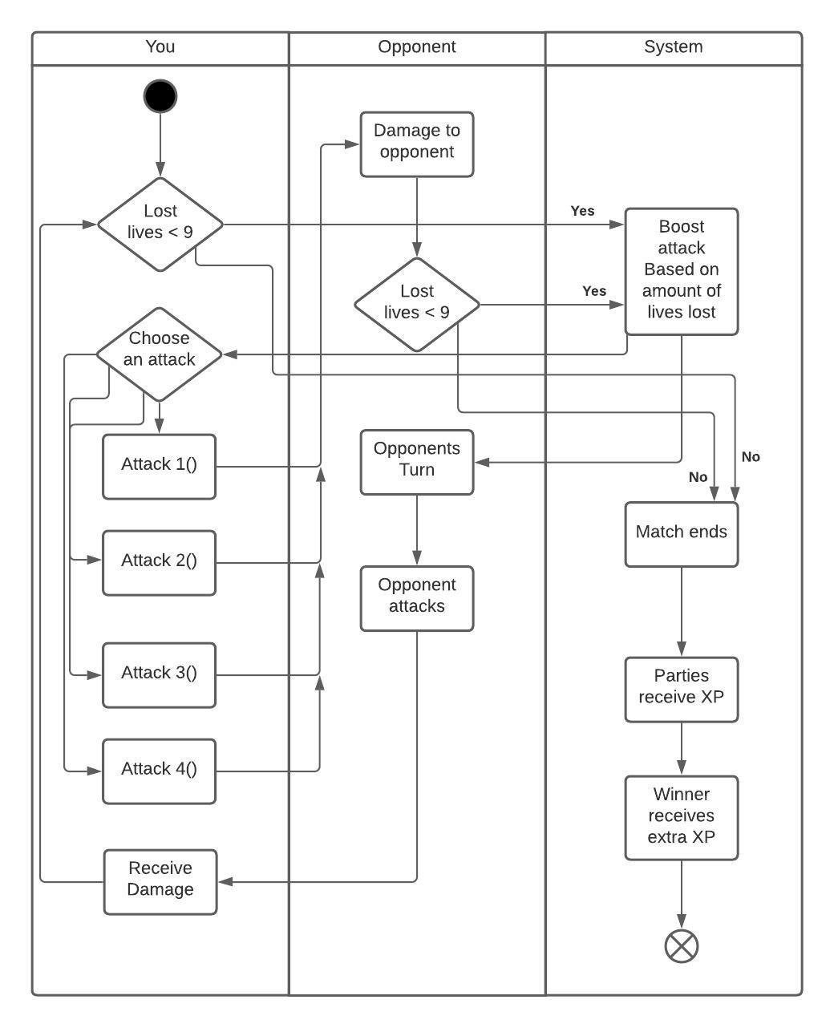
Activity Diagram (Battle Loop)

Slide 12
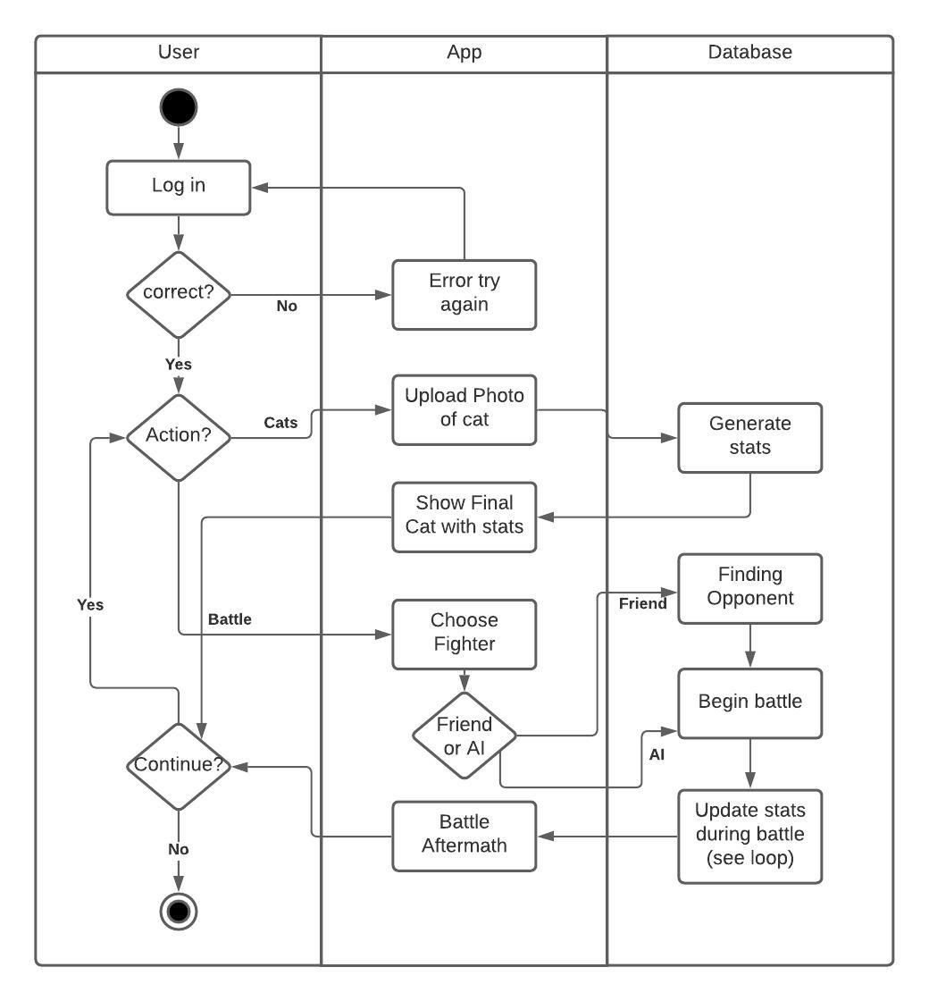
Activity Diagram

Slide 13
Front end demo

Slide 14
Back End

Slide 15
Architecture
MVVM using Stacked
State management using Provider package
Dependency Injection using GetIt package

Slide 16
Firebase
Firebase Storage for Large File Storage (images)
Authentication using FirebaseAuth
Cloud Firestore Database

Slide 17
Thanks for watching! Any Questions?
Kyle Handy - Front end programming using Flutter
Oliver Lynch - Front end programming / UML Diagram Engineer
Eric DeMoney - Back end programming mostly working with Firebase
Ryota Haba - UML Diagram engineer / back end programming
Jacob - UML Diagram engineer
Tyler - UML Diagram engineer

