Slide 1
Basic Electronics and Microcontrollers

Slide 2
Electronics

Slide 3
Electronic Components
- LED’s / Diodes
- Buttons / Switches
- Sensors
- Resistors
- Transistors
- Capacitors
- Motors
- Relay
- Displays
- Breadboards
- IC
- Battery
- Transformer
- Inductor
- Thermistor
- Light Dependent Resistor
- Potentiometer

Slide 4
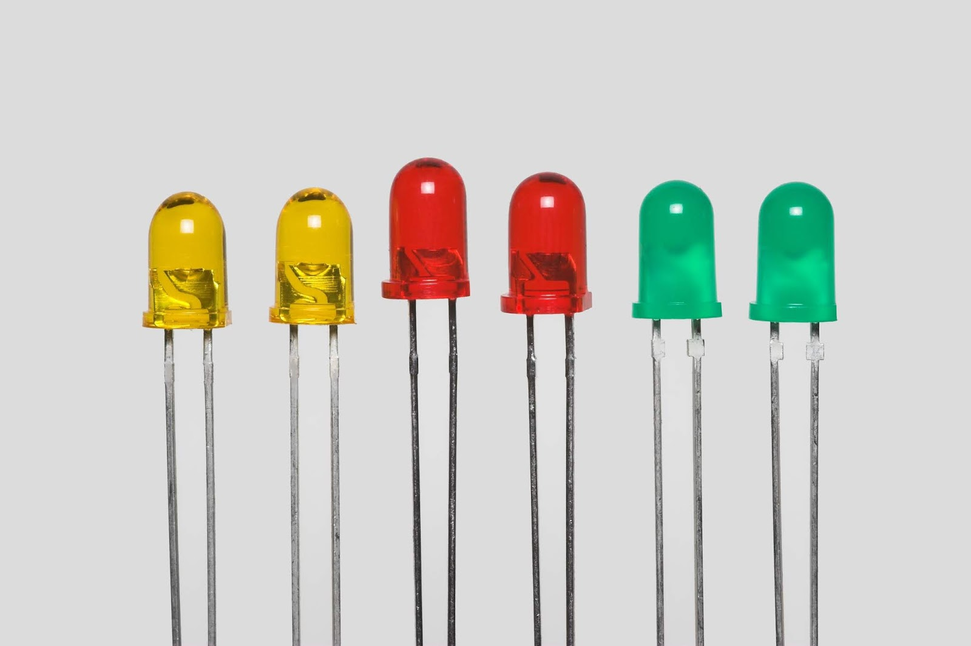

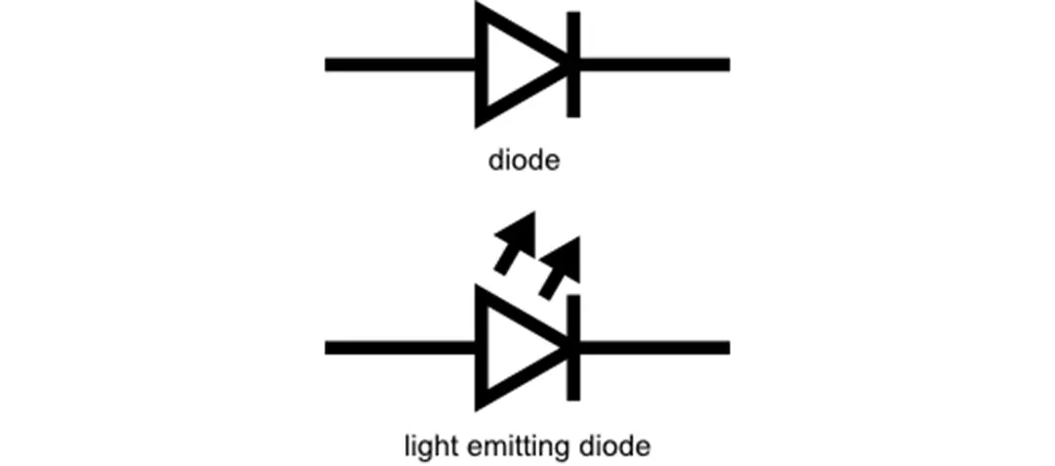
LEDs / Diodes
LEDs – Light Emitting Diode is a component that gives off light when electricity is passed through it.
Diode – The diode and including the LED only allows electricity to pass through in 1 direction
- +

Slide 5
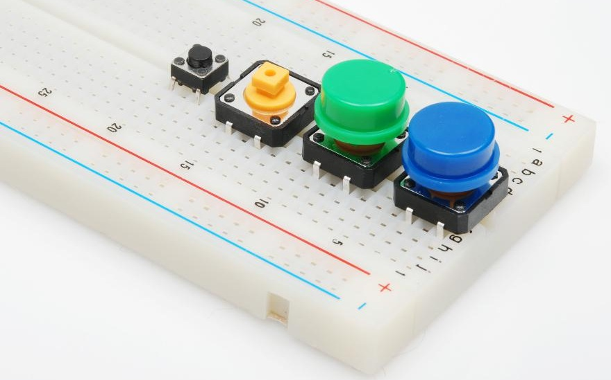
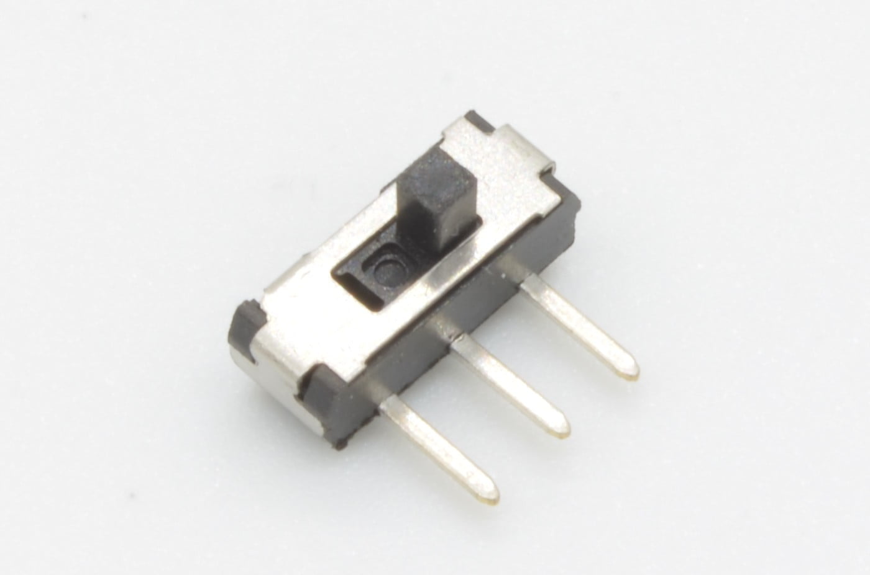
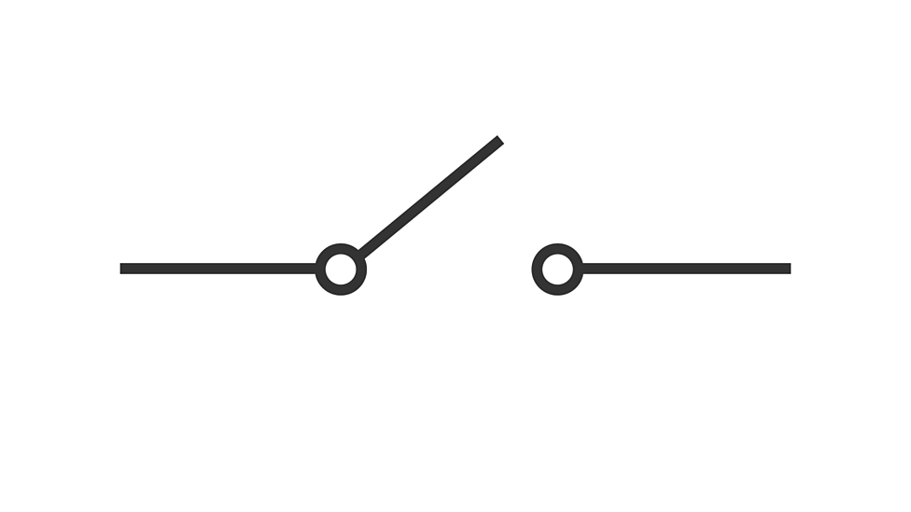
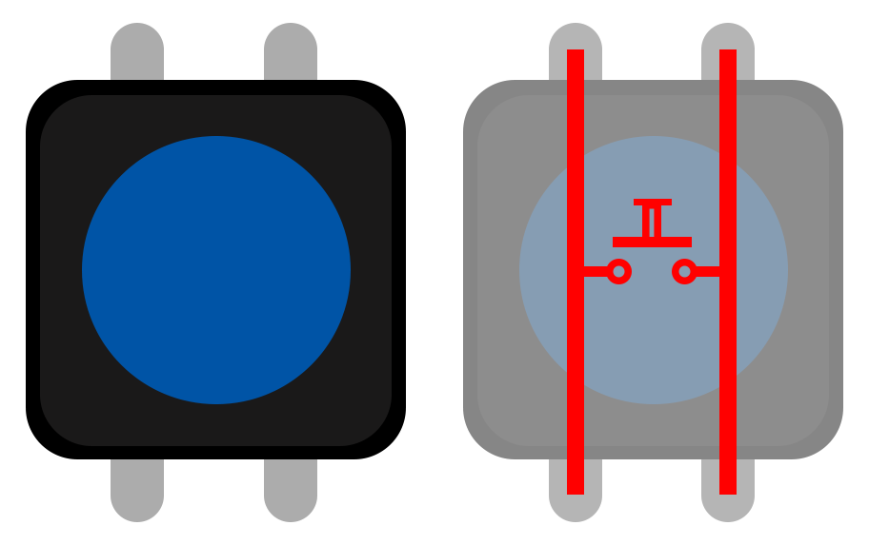
Buttons and Switches
Switch – A component that turns on/off the flow of electricity by opening and closing the circuit
Buttons – Act like a switch but normally have a spring inside to pop the circuit open after you have let go.

Slide 6
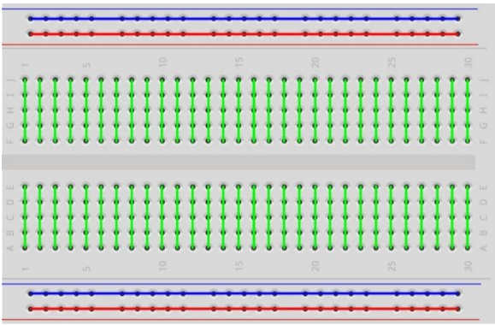
Breadboards
Breadboards are reusable platform to build electronic circuits on without soldering, these are great for prototyping projects.

Slide 7
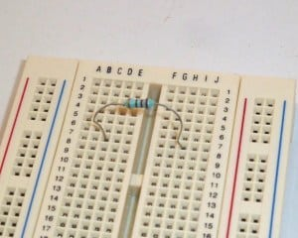
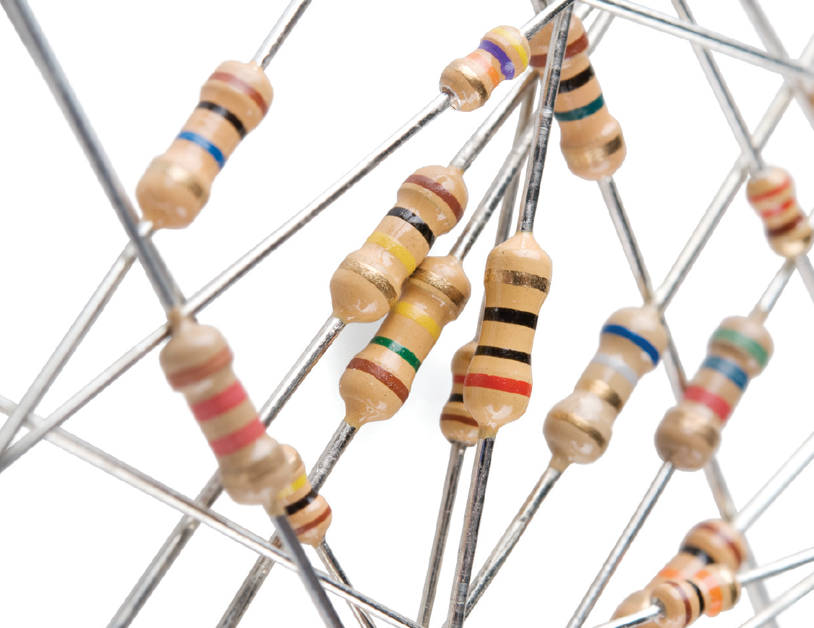
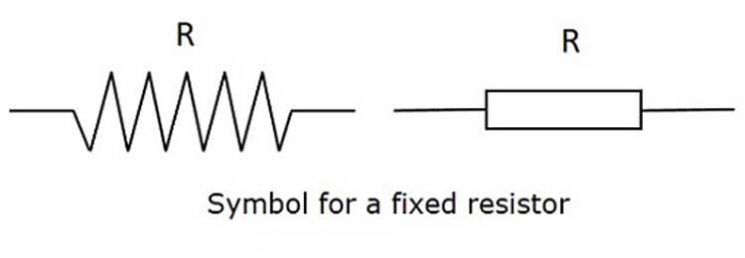
Resistors
Resistors – Restrict the current of electricity flow, these are commonly used with LEDs so they don’t burn out.
Think of this like a tap turning the flow of water down, more resistance less water.

Slide 8
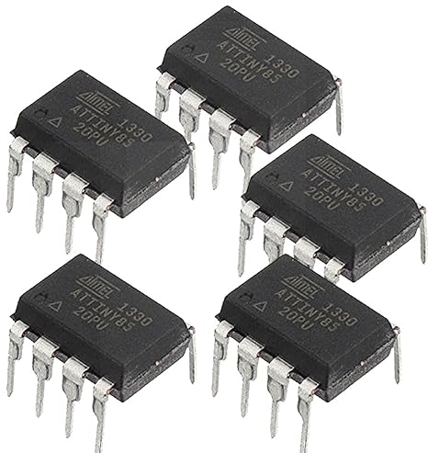
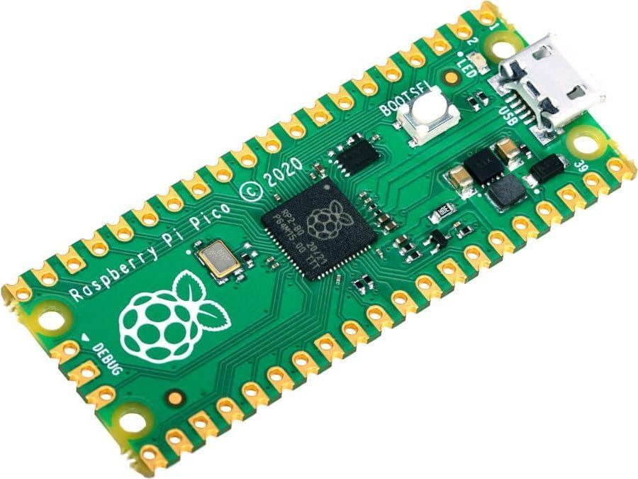
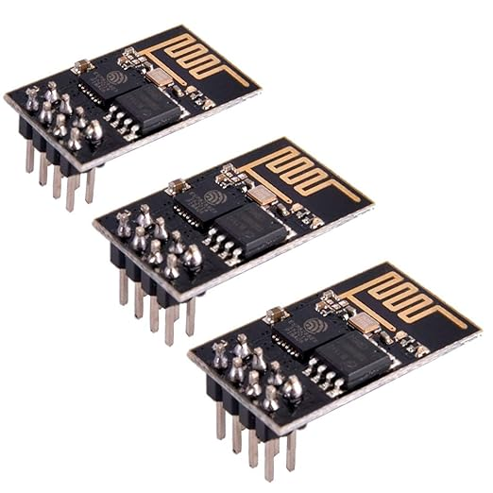
Microcontrollers
A Microcontroller is a small computer on a single integrated circuit, It contains a small processor and programmable inputs/outputs and a small flash memory to store programs that run when powered up.

Slide 9

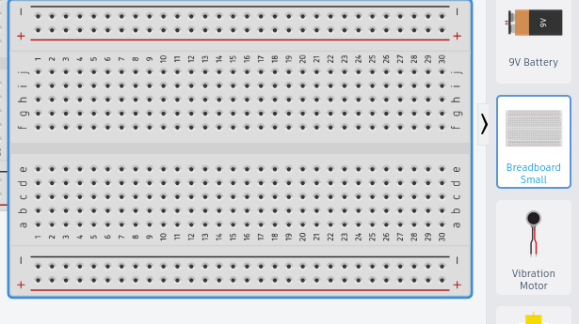

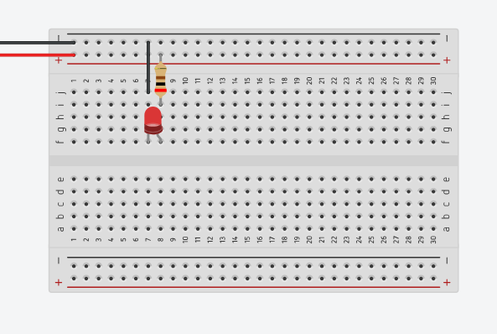
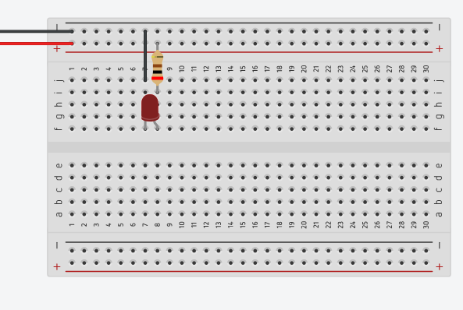
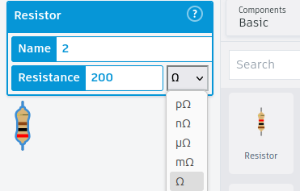
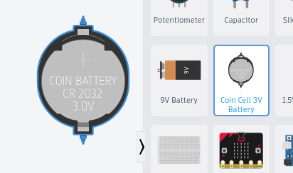
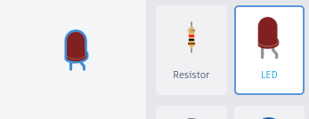
First Circuit
Item List:
- Breadboard
- LED
- 200 Ohm Ω resistor
- Coin Cell 3V Battery

Slide 10
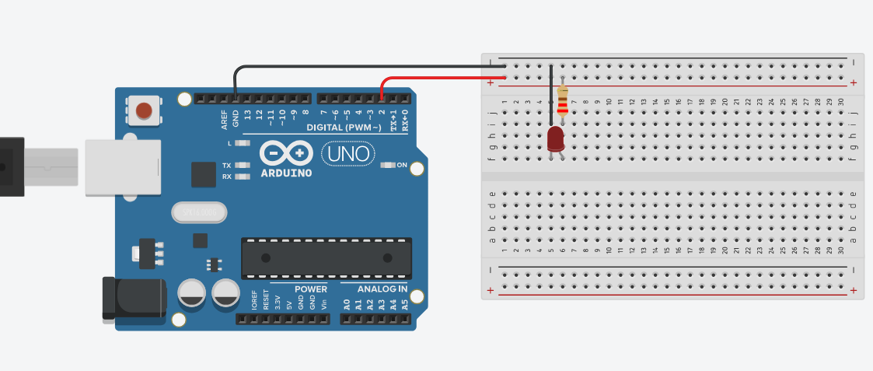
Blinking LED

Slide 11
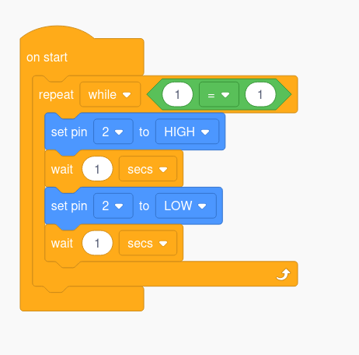
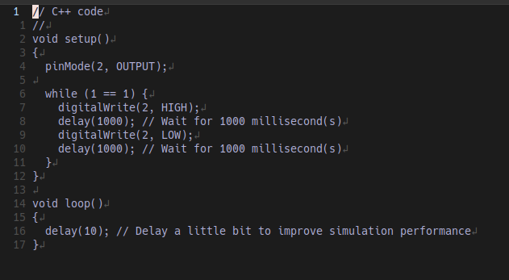
Code

Slide 12
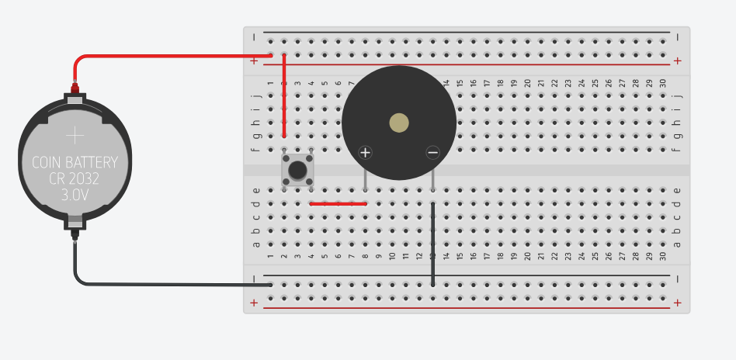
Button Buzzer

