Slide 1
Introduction to Python

Slide 2
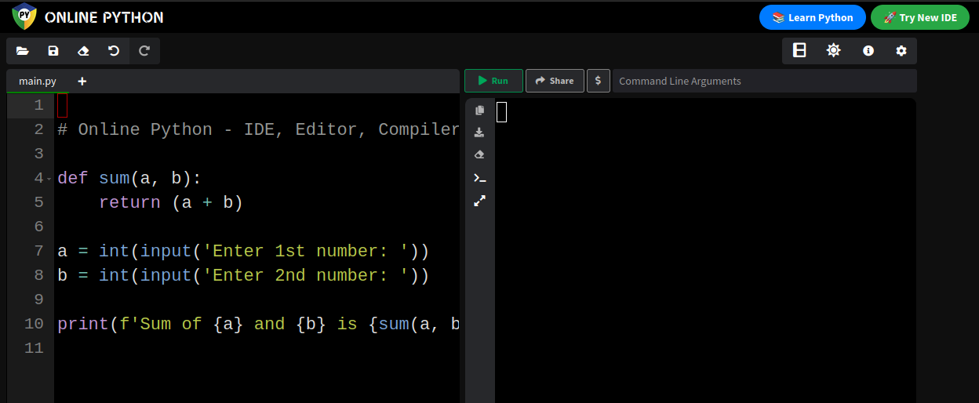
Get Coding
https://www.online-python.com/

Slide 3

Getting Started
Hello World:
The simplest program, this uses the `print` function to display `Hello, World
Code:
Output:

Slide 4
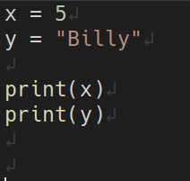

Variables
Variables are a place to store data values, variables are created by assigning a value to it.
example:
x = 5
y = “Billy”

Slide 5
Data types
In programming data types are important. Variables can store different data types and can do different things with different data types.
example(These are not all the data types):
Type | Name | Example
Text | str ( string ) | “Billy”
Number | int ( integer ), float, comples | int: 1 float: 3.14
Boolean | bool | 1/0 True/False

Slide 6
Numbers
Numbers can be whole or decimal or complex. We will focus on the first two.
example:
x = 1 ← this is an int or an integer
y = 3.1124125 ← This is a float or floating point number

Slide 7


Operators
Operations such as Addition(+), Subtraction(-), Multiplication(*),
Division(/) Are the basic Arithmetic Operators.
Code:
Output:

Slide 8
Logical Operators
There are other operators like comparison operators or logical operators. Logical operators are `and` , `or` and `not`.
Say, x = 5
Operator | Name | Example | Result
and | TRUE if both statements are TRUE | x < 6 and x < 10 | TRUE
or | TRUE if one Statement is true | x < 7 or x <4 | TRUE
not | FALSE if the result is TRUE | not(x < 5 and x < 10) | FALSE

Slide 9
Comparison Operators
Comparison operators: x = 5 , y = 5
Operator | Name | Example | Result
== | Equal | x == y | TRUE
!= | Not Equal | x !=y | FALSE
> | Greater than | x > y | FALSE
< | Less than | x < y | FALSE
>= | Greater than or Equal to | x >= y | TRUE
<= | Less than or Equal to | x <= y | TRUE

Slide 10
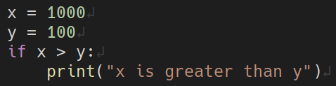

IF...
Using the Logical and Comparison Operators we can check `IF` statements are true or false.
Code:
Output:

Slide 11
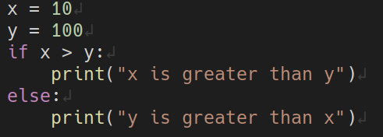

ELSE
Code:
Output:

Slide 12
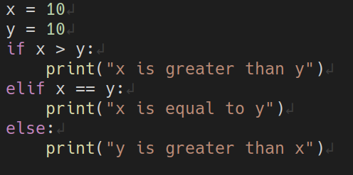

ELIF
elif is when the previous if statement returns false you can add another if statement to check multiple expressions for true.
Code:
Output:

Slide 13
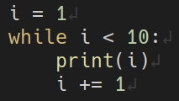
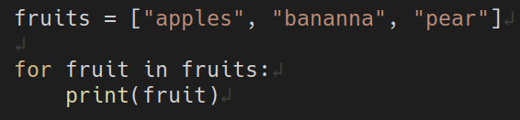
Loops
There are two main types of loops, `For loops` and `While loops`
While loop:
For loop:

