Slide 1
Computer Networks & The Internet

Slide 2
Hardware
Client ( Servers / Laptops / Mobiles / PCs )
Switches
Routers
WiFi Access Points ( WAP )
Cables ( Fibre Optics , Copper )
Satellites

Slide 3
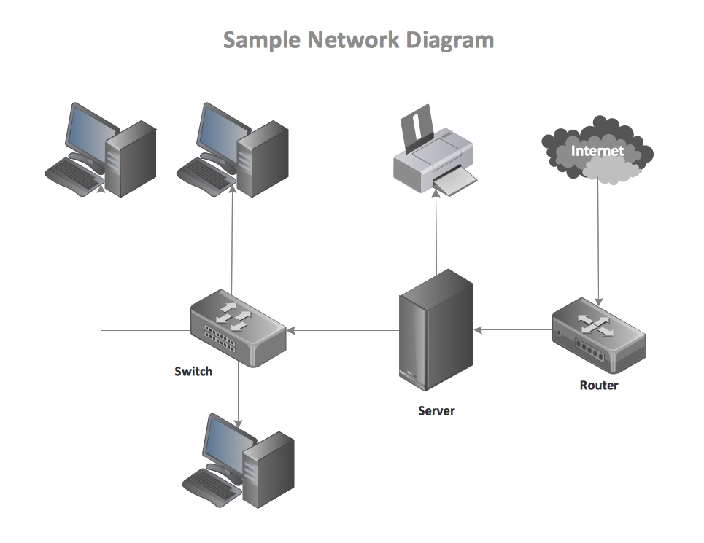
What is a Computer Network
More that one Client connected together to share/pass data

Slide 4
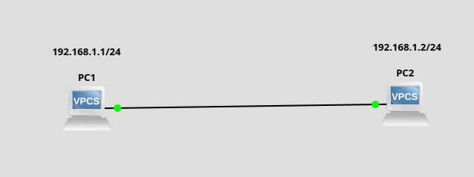
Point A to Point B

Slide 5
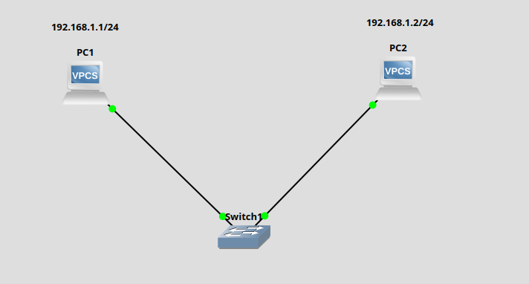
Switches

Slide 6
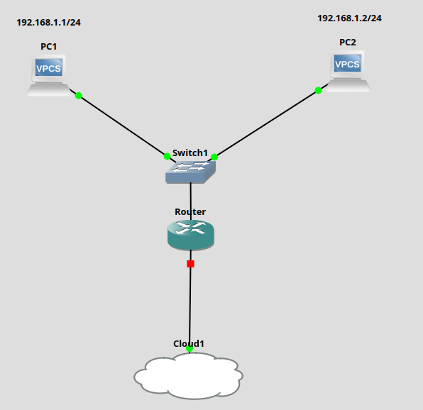
Routers
Typical Home network
but without WiFi

Slide 7
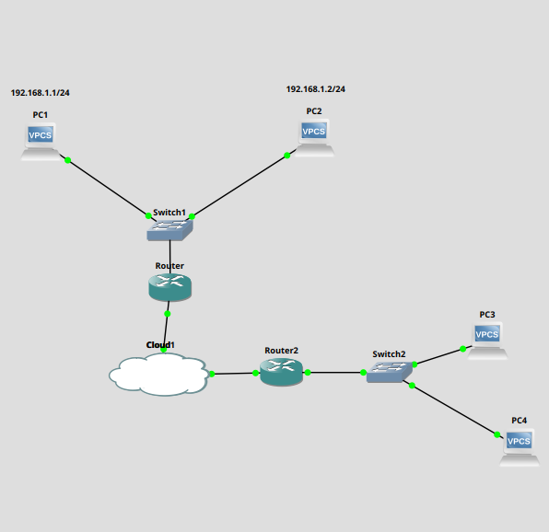
Networks of Networks

Slide 8
LAN / WAN
Local Area Network (LAN)
  Home
  School
  Offices
Wide Area Network ( WAN )
  Large network spanning large geographic area
  Internet is an extension of a WAN

Slide 9
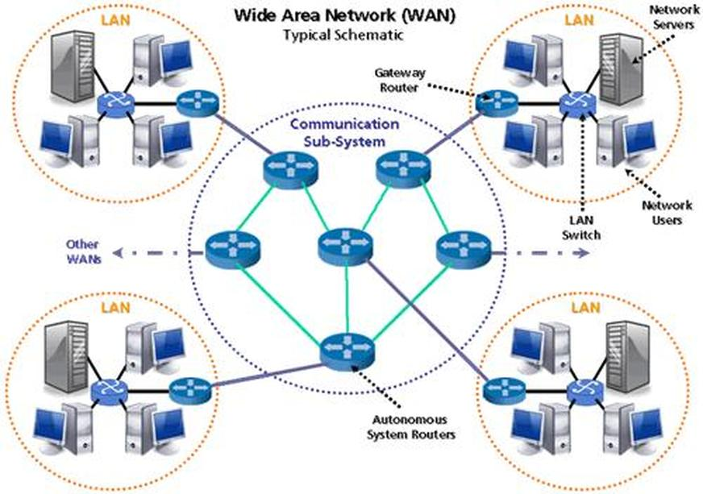
What is the Internet?
A Network of Computer Networks

Slide 10
How do computers communicate?
Computers have addresses like people do.
  MAC address ( Media Access Control address )
  IP address ( Internet Protocol Address )

Slide 11
MAC Address
MAC address is a unique identifier assigned to a Network Interface controller ( NIC )
Format of a MAC address is a 48bit hex string split into 6 octets
  eg aa:bb:cc:11:22:33
With this there is over 281 trillion possible combinations of MAC address

Slide 12
IP Address
An IP address is an numerical address assigned to a computer connected to a computer network.
IP addresses are 32 bit number split into 4 octets
  eg 192.186.1.1
There are about 4.2 Billion IPv4 addresses and these are used to communicate with computers over the internet
There are Public and Private IP network address spaces
There is also IPv6 which is not as commonly used but has 340,282,366,920,938,000,000,000,000,000,000,000,000* unique IP addresses
*340 undecillion

Slide 13
IP Addresses
Local/Private IP addresses – Not routable over the Internet
  192.168.1.1
  10.0.1.1
  172.16.1.1
WAN IP address – Example of some public IP addreses
  151.101.0.81
  1.1.1.1
  8.8.8.8

Slide 14
How Do I Reach Google.com
Computers can’t speak English only Binary so how can we get to google.com
google.com resolves to IP addresses
  142.251.29.100 > Binary 10001110.11111011.00011101.01100100
  142.251.29.101 > Binary 10001110.11111011.00011101.01100101
  142.251.29.102 > Binary 10001110.11111011.00011101.01100110
  142.251.29.113 > Binary 10001110.11111011.00011101.01110001
  142.251.29.138 > Binary 10001110.11111011.00011101.10001010
  142.251.29.139 > Binary 10001110.11111011.00011101.10001011

Slide 15
DNS ( Domain Name System )
This is like the Phone book of the internet and translates domains to IP addresses
  bbc.com – 151.101.0.81
  google.com – 142.251.29.100
DNS Servers – These are the DNS servers that give you the IP addresses. Here are some common ones.
  1.1.1.1 / 1.0.0.1 – cloudflare DNS
  8.8.8.8 / 8.8.4.4 – Google DNS
  9.9.9.9 - Quad9

Slide 16
Now we know where we are going
Next is what we are going to send.
Going to google.com in your browser `Chrome, Firefox, Edge`
This is a HTTP/S request and when requesting a website/page
  The first request is a GET#
We put this request inside of a packet that then gets sent down the wire ( or over the air for WiFi ) to your switch/router to then make its way to google.com IP address

Slide 17
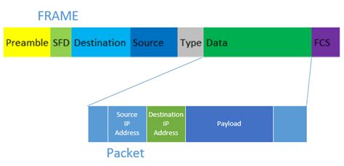
Packets & Frames
Data is sent over these Networks in Ethernet Frames, These contain packets.

Slide 18
IP Packet
The IP Packet is part of the TCP/IP Protocol which is the main protocol of the Internet.
Source IP : Where is this packet coming from
Destination IP: Where is this packet going
Payload: The data that is being sent

Slide 19
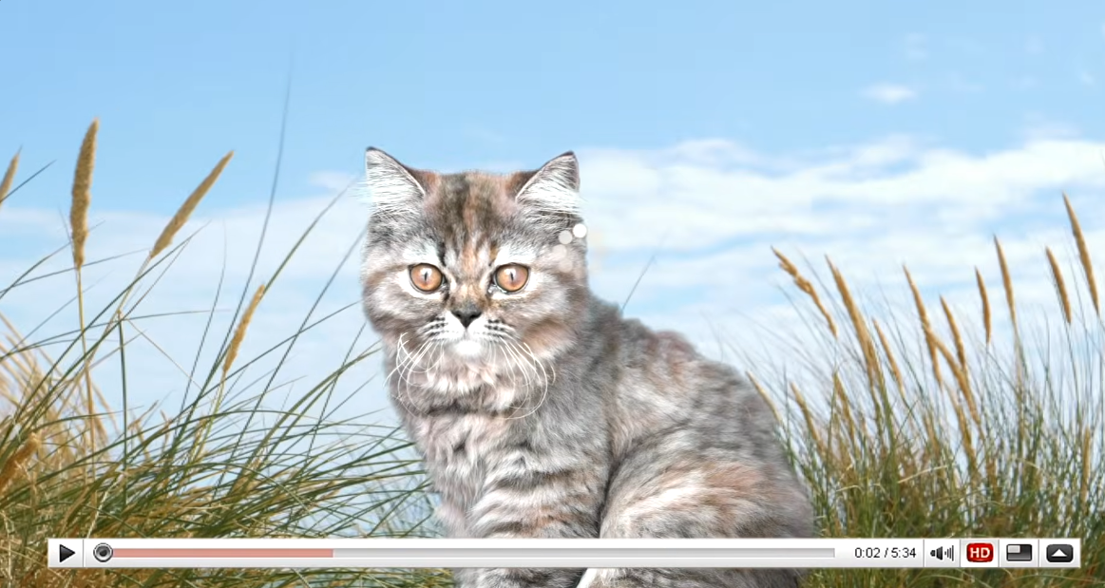
Cat Pic
How Does the Internet Work

Slide 20
Secure and Non Secure Networks
Networks like WiFi that use a password ( Pre Shared Key ), depending on the security type are pretty secure.
Public WiFi like at Coffee shops and Hotels that say `Free` WiFi, and you do not need a password are not secure.
On Ethernet/Cable, these are pretty secure but can be wire-tapped.
So how do we secure our Internet Traffic?

Slide 21

HTTPS
Using protocols Like HTTPS which connects to the server to establish a secure encrypted communication to the server
Plain HTTP shows all text being sent with no encryption.
This is what is used on most sites these days so make sure you look for the green lock(on most browsers)

Slide 22
VPNs
Virtual Private Networks
  Networks that connect two clients together with an encrypted tunnel
VPNs are used by businesses so workers can Connect to their office servers
VPNs are used to protect data on Public WiFi
VPNs are used for secure communications
VPNs can be used appear as if you are in a different part of the world.

Slide 23
VPNs
VPNs get given a bad reputation as they are also used by Bad actors/Hackers/Criminals
VPNs ‘Can’ be used to bypass country restricted content
  eg. Being able to watch US Netflix from UK via a VPN that appears that you are in the US.
VPNs are Essential for Privacy online.

Slide 24
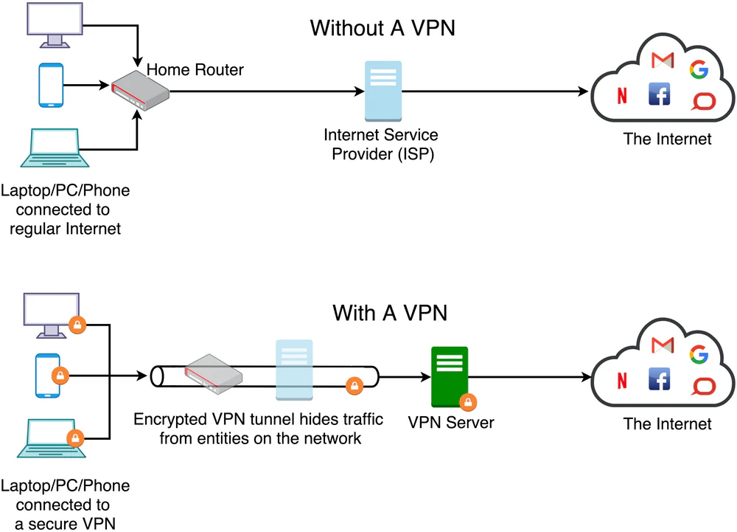
VPN Visual

Slide 25
Questions?

Slide 26
This work is licensed under a Creative Commons Attribution-ShareAlike 3.0 Unported License.
It makes use of the works of Mateus Machado Luna.

