Slide 1
Computers say what?

Slide 2




What language do computers speak?
Hej
Hello
こんにちは

Slide 3

01001000 01100101 01101100 01101100 01101111
Hello
Does anyone know the name for these types of numbers?

Slide 4
Binary
Binary is a number based system where the only digits: 1 and 0. This is called base2 . Computers use binary because electricity can only be ON(1) or OFF(0)
We are used to working in a base10 number system where we have digits from 0 – 9.

Slide 5
So how do computers talk binary?
Computers are made from millions if not billions of tiny switches, and like a light switch, you can turn it off (0) or on (1).
Computers use these switches in very complex chips to do maths such as addition, subtraction, multiplication.
These on/off (1/0) bits of data are sent via electrical signals like the light, it can be on or off . Each 1 or 0 is called a `bit`

Slide 6
Writing some Binary
Write your name in binary

Slide 7
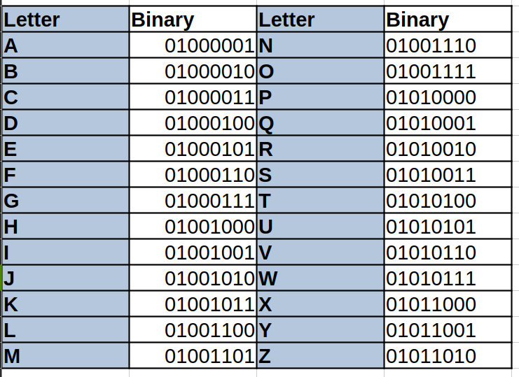

Slide 8
So how do we talk to computers?
We don’t speak fluent binary, so how do we talk to computers?
We humans created languages called computer programming languages to simplify talking to computers.
These come in two main types ( low level, high level ).
Low Level - Assembly and Machine Language that is closer to the computer
High Level - Pseudo English languages ( Java , C, C#, Python) , Block-based ( Scratch )

Slide 9
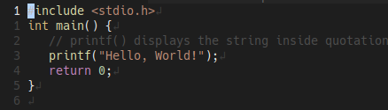
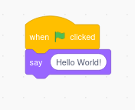
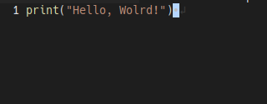
Hello, World!
The simplest program when learning any language is the `Hello World` program.
C: Scratch:
Python:

Slide 10
How do these programs work?
We do not speak binary, computers do not speak programming languages like C,Python,Scratch. So how do they communicate?

Slide 11
Translator
Computers need a translator (compiler or interpreter*), Just like if we wanted to understand another language we can use translators.
English - `Hello` > Spanish - `Hola`
Python - `print("Hello, Wolrd!")` > lots of 0101010101010101’s

Slide 12
Translation Ladder
Human Language
↓
Programming Language ( C, Python )
↓
Translator ( Interpreter / Compiler )
↓
Machine Code ( Binary 0/1 )
↓
Electricity ( On / Off

Slide 13
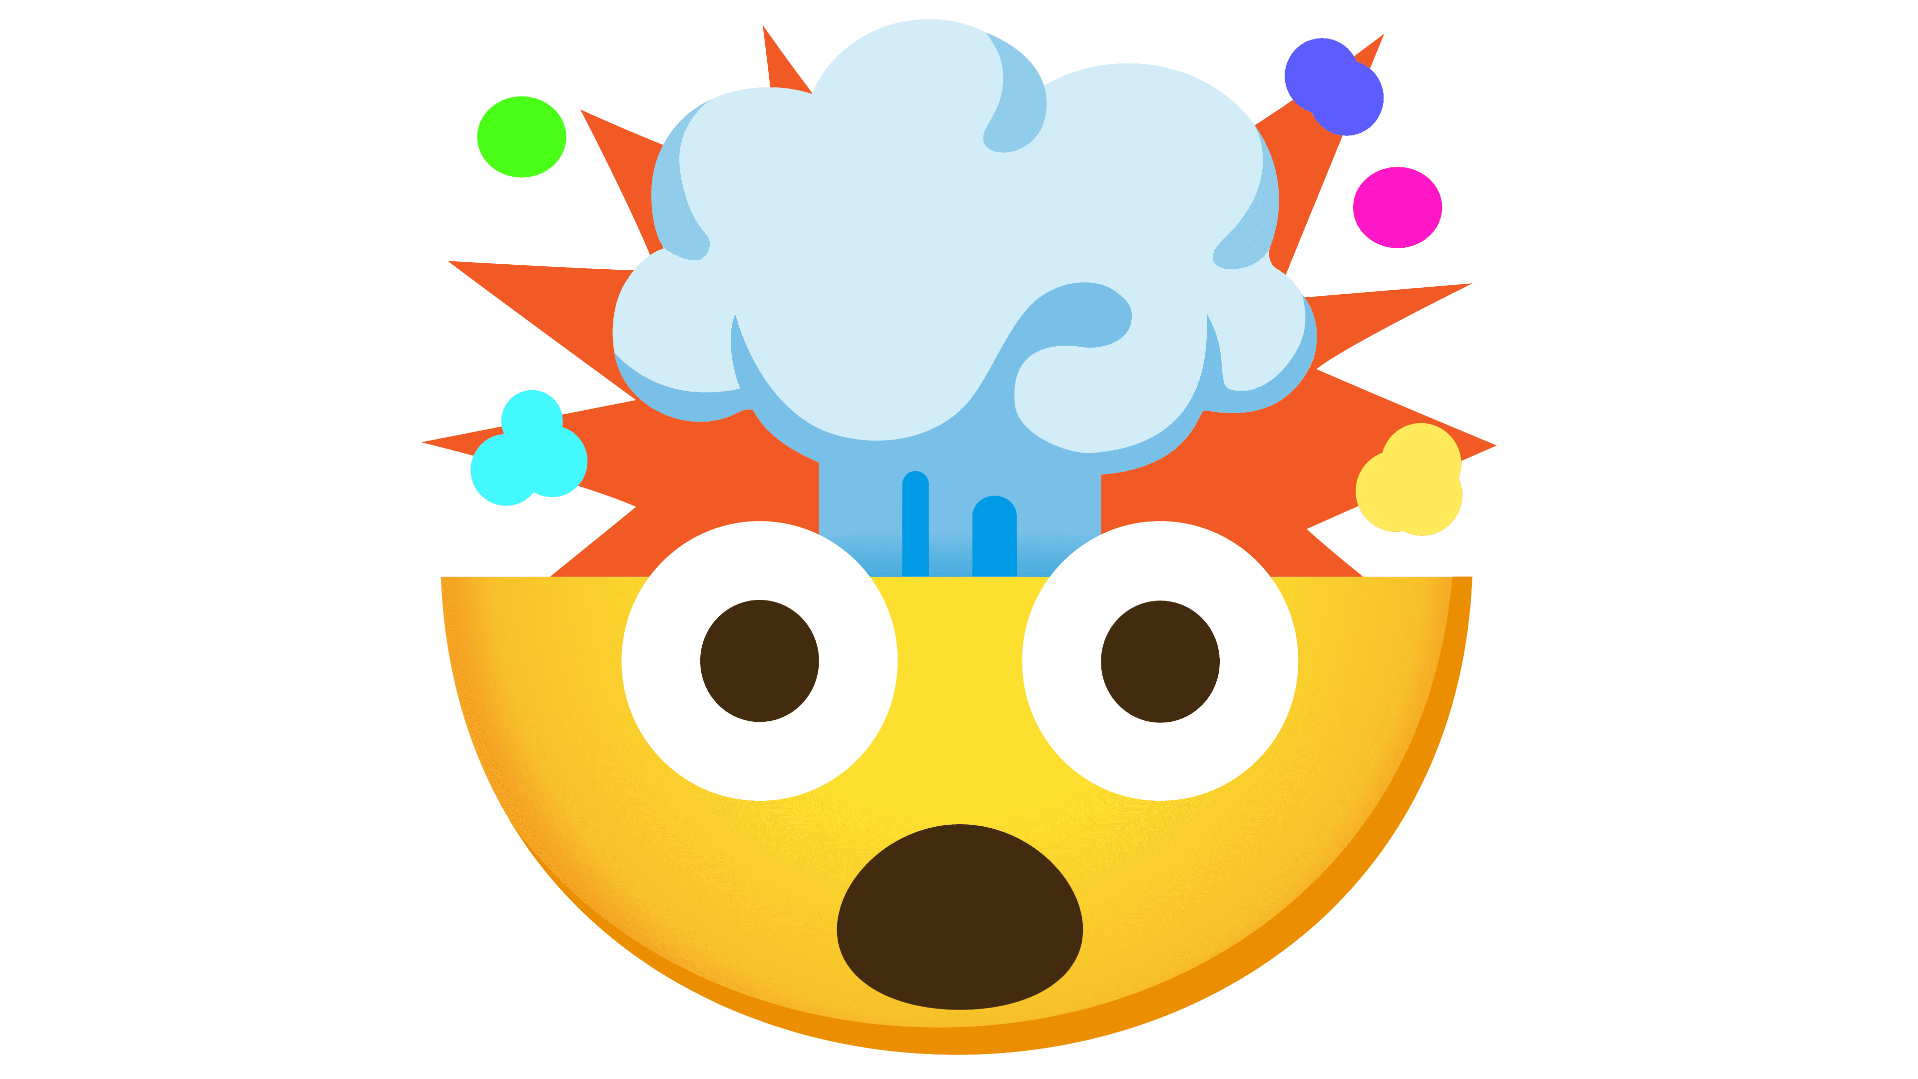
Everything you see on screen, Games, YouTube videos, Websites are all just 1s and 0s

Slide 14
This work is licensed under a Creative Commons Attribution-ShareAlike 3.0 Unported License. It makes use of the works of Mateus Machado Luna.

