Slide 1
OXMBIZDSYX KXN MSZROBC
ENCRYPTION AND CIPHERS

Slide 2
What is Encryption
Its the process of transforming information in a way that only authorised parties can read.
The original code/words/information known as `plaintext`
The encrypted version is known as `cyphertext`
To get `cyphertext` the `plaintext` is Encrypted through an encryption algorithm.

Slide 3
Encryption
There are many types of encryption algorithms, some stronger than others.
The encryption algorithm is usually based upon a `key` or a piece of information only known by the person/computer encrypting the data.
The key is usually `random` number/characters
The more `random` and longer they `key` the stronger the encryption.
The process is reversable

Slide 4
Decryption
The opposite to Encryption
Taking `cyphertext` and transforming it to `plaintext`
You need the `key` to decrypt the information

Slide 5
Why do we need Encryption?
Privacy ( Messaging Apps – WhatsApp, Signal )
Web browsing ( HTTPS )
Online Banking
Contactless Payments
Mobile Phones
Satellites
Laptops/Desktops/Servers
WiFi ( PSK – Pre-Shared Key, this is your WiFi Password )

Slide 6
Ciphers
Ciphers are the `Method` or `Algorithm` used to preform Encryption
Examples:
  AES ( Advanced Encryption Standard )
  DES ( Data Encryption Standard )
  RSA ( Rivest, Shamir, Adleman Algorithm )
  SHA ( Secure Hash Algorithm )

Slide 7
Early Ciphers
Ciphers have been around a very long time, even before computers
Ancient Greeks are known to have used it.
  Scytale which used Transposition*
Ancient Roman used it, Popularly by Julius Caesar
  Caesar Cipher – which was a Substitution cipher
Germany used it in World War II
  The Enigma machine

Slide 8
Transposition Cipher
Key | C | I | P | H | E | R
Sequence | 1 | 4 | 5 | 3 | 2 | 6
Plaintext | H | E | L | L | O | M
 | Y | N | A | M | E | I
 | S | O | L | I | * | *
Ciphertext by Column in Sequence: #1 HYS #2 OE #3 LMI #4 ENO #5 LAL #6 MI
Ciphertext : HYS OE LMI ENO LAL MI
Plaintext : HELLO MY NAME IS OLI

Slide 9
Decrypt
Can you work out the plaintext?
 | T | O | D | A | Y | W | E
 | L | E | A | R | N | C | I
 | P | H | E | R | S | * | *
Key | S | E | C | R | E | T | S
Sequence | 1 | 6 | 3 | 2 | 4 | 5 | 7
Plaintext
Ciphertext: TLP ARR DAE YNS WC OEH EI

Slide 10
Route Cipher
The plaintext is written in a grid of a certain size ( 3x5 ) and this would be part of the `key`
The Cipher text would then be read in a pattern ( row by row, spiral etc)
T | S | M | E | E
H | I | Y | C | T
I | S | S | R | !
Ciphertext: TSMEE HIYCT ISSR!
Plaintext: THIS IS MY SECRET!

Slide 11
Decrypt
Ciphertext: !!NU FSIG NITU PMOC
Key: 4x4 – right to left – bottom to top
! | ! | N | U
F | S | I | G
N | I | T | U
P | M | O | C
Plaintext: COMPUTING IS FUN !!

Slide 12
Caesar Cipher
A Caesar Cipher is a substitution Cipher and is one of the simplest.
It replaces characters by shifting the characters a fixed number, these are known as shifts, The below Cipher is shift right 11
Shift | 1 | 2 | 3 | 4 | 5 | 6 | 7 | 8 | 9 | 10 | 11 | 12 | 13 | 14 | 15 | 16 | 17 | 18 | 19 | 20 | 21 | 22 | 23 | 24 | 25 | 26
Plain | A | B | C | D | E | F | G | H | I | J | K | L | M | N | O | P | Q | R | S | T | U | V | W | X | Y | Z
Cipher | Q | R | S | T | U | V | W | X | Y | Z | A | B | C | D | E | F | G | H | I | J | K | L | M | N | O | P

Slide 13
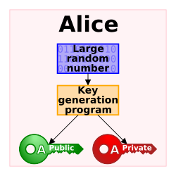
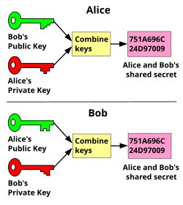
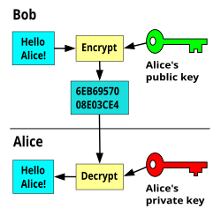
Public Key Cryptography
This type of encryption is what secures the internet today.
Relies on a large random number and a key generator algorithm to produce a `Public Key` and a `Private Key`

Slide 14
This work is licensed under a Creative Commons Attribution-ShareAlike 3.0 Unported License.
It makes use of the works of Mateus Machado Luna.

