Slide 1
Scratch game from Scratch

Slide 2
Recap
Variables
Data types
Operators
Logical
Arithmetic
Comparison
IF, ELSE, ELIF
Loops
For
While

Slide 3
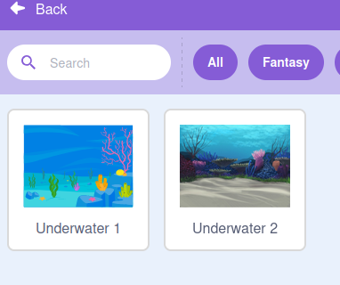
Scratch
Select your Stage/backdrop

Slide 4
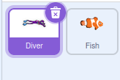
Sprites
Select two sprites:

Slide 5
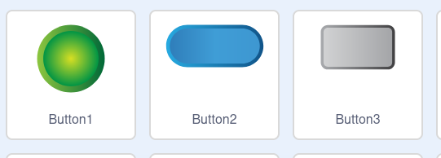
Button
Select a button sprite

Slide 6
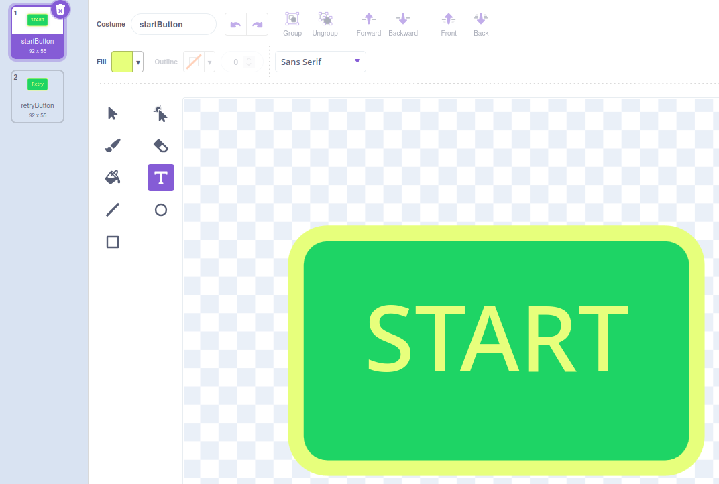
Edit button sprite
Edit button sprite to show costume1 – READY and costume2 – RETRY
Rename Costume:
startButton and retryButton

Slide 7
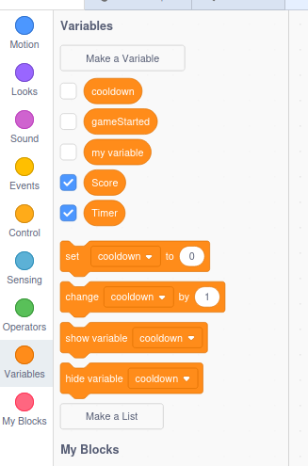
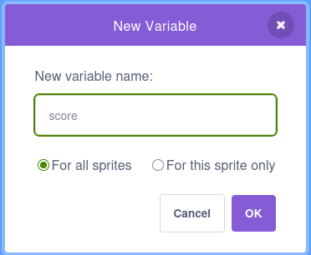
Variables
Set variables:
cooldown
gameStarted
score
timer
Make sure you set the variables `For all sprites`

Slide 8

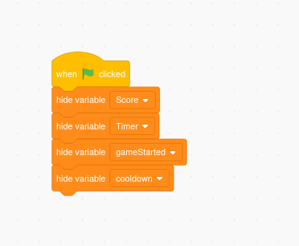
Backdrop
Start by hiding variables on in your backdrop

Slide 9
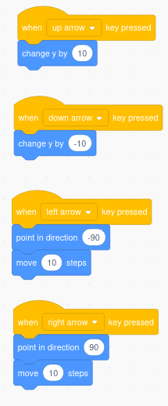
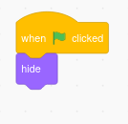
Your Character
Start by setting up your Character to hide when starting.
Set up character movements

Slide 10
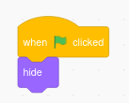
Set up NPC(Non Playable Character)
Start hidden

Slide 11
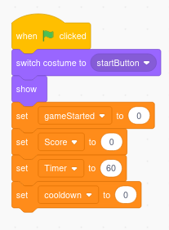
Button
The `Button` is the main function of the game that controls the everything, Start by setting the main event.

Slide 12
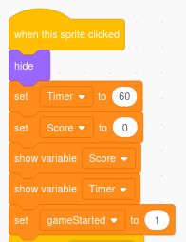
Click event
When we click the `Button` we want our game to start and `hide` the button and then set the variables we need for the game.

Slide 13
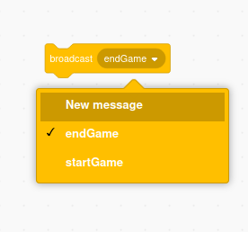
Broadcast
We need to let other items/sprites in the program aware the game has started so we do a `broadcast` . Create two `broadcast` messages endGame & startGame and add it to your last block.

Slide 14
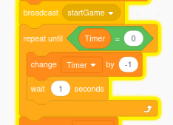


Game Loop
This is the main game loop that will run and start the timer. This is the same as the while loop.
This could be written like:
Or:

Slide 15
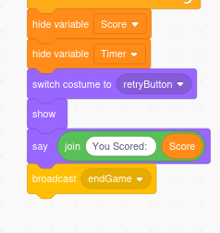
End of Game
At the end of the game loop we want to reset so we hide, score,timer and change the `button` costume to the `retryButton` , we then want to show the button and print the score and broadcast `endGame`.

Slide 16
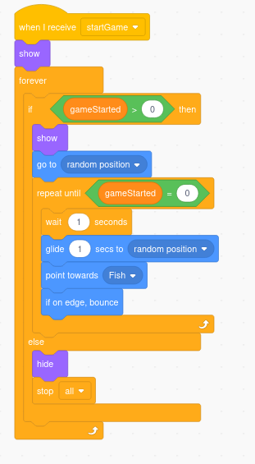
NPC Logic
Now we have the game loop we can now work on the NPC Logic. We have already set it hidden, but now we want it to be visible when the game hast started and to move around.
Receive startGame broadcast from button
Show
Forever loop
If gameStarted > 0
show
go to random possition
repeat until gameStarted
wait 1 second
glide 1 second to random position
point towards Character
Else
Hide
Stop

Slide 17
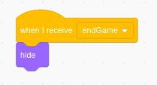
End NPC/Character
To finish of the NPC logic, we need to hide when game has ended. Do this for both NCP and Character

Slide 18
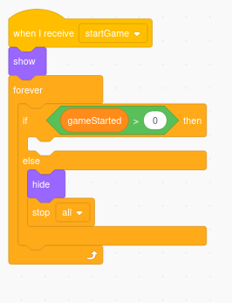
Character Logic
We need to follow similar logic to the NPC but the Character has a score and actions.
We will start with the game logic, When it receive the `startGame` show the sprite then run the loop to check if game has started, if not then hide.

Slide 19
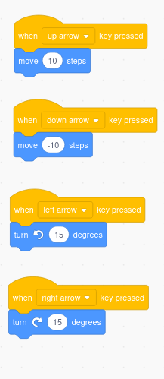
Character Actions
The character will have movement and an action for scoring.
Create events for Moving up/down and turning using the arrow,
keys.
We will come back to this and fix it up for better game play later.

Slide 20
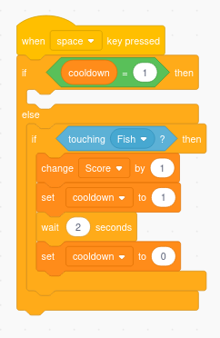
Scoring
For the Character to score we need to be touching the NPC and press an extra button, in my example I chose `space`. Just so we can’t spam space to score
when we are touching the NPC we add a cooldown.
First we check if we are in a `cooldown`.
Then we check if we are touching the NPC(fish), then we change
the score by 1 and set the `cooldown` to `1` and wait 2 seconds,
before setting `cooldown` back to 0

Slide 21
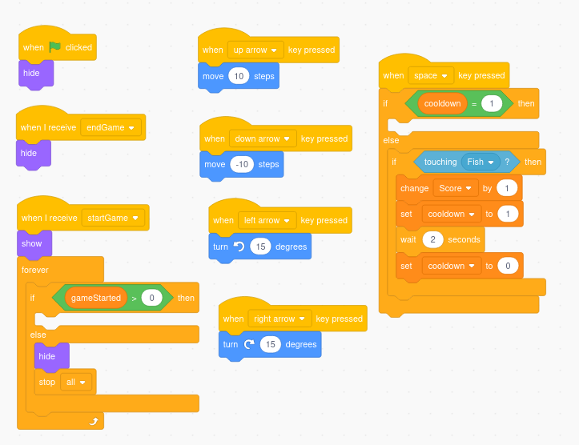
Recap - Character

Slide 22
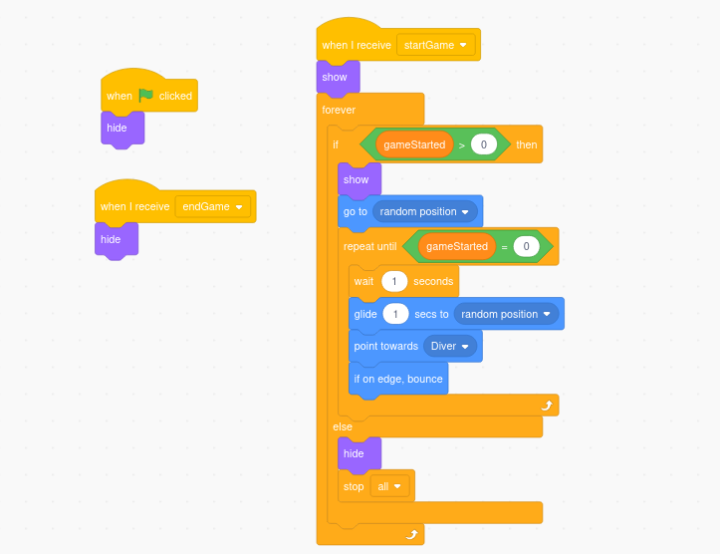
Recap - NPC

Slide 23
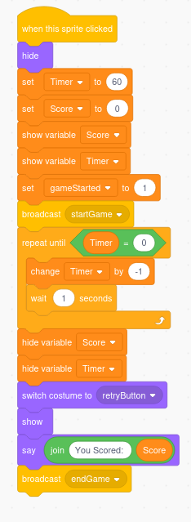
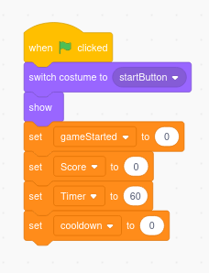
Recap Button

Slide 24
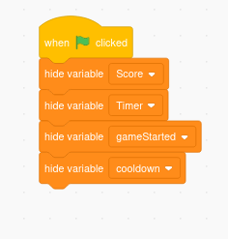
Recap - Backdrop

Slide 25
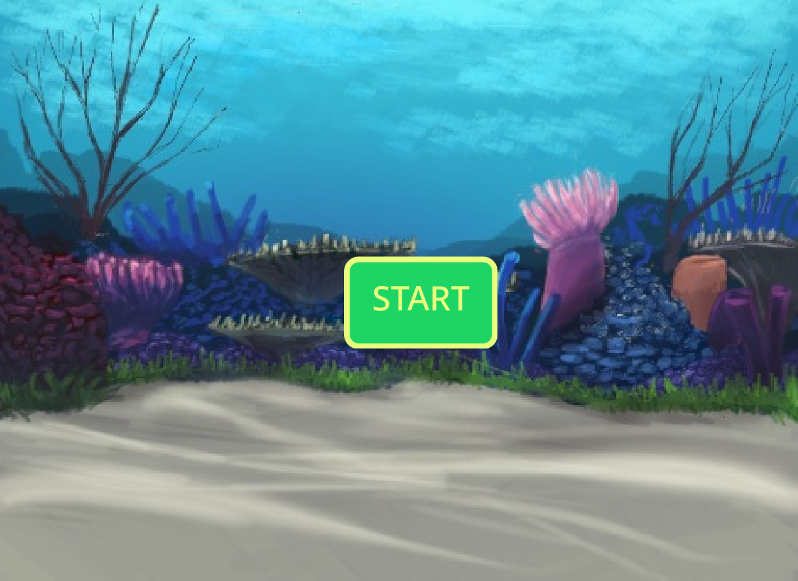
Play

Slide 26
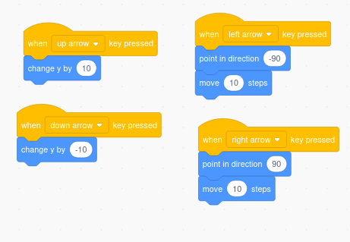
Improvements
Try changing your Character movements to something like below and play and see if it feels better.

Slide 27
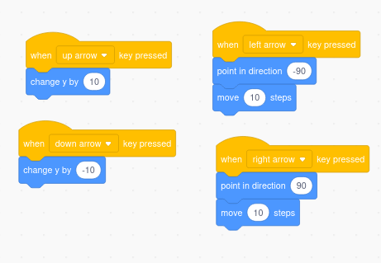
Movement Improvements
Try changing the left and right arrow press to change direction and move instead of rotate...

