Slide 1
Websites from Scratch

Slide 2
What is a Website
A website is a collection of pages(files) stored on a server on the internet.
A page can be made up of a couple of files and reference other files
Pages can contain Video,Images,Audio etc

Slide 3
How do websites work?
You use a browser like Chrome,Firefox,Safari
Navigate to a web address ( URL - uniform resource locator ), This is the address of the web servers FQDN
Your browser requests a page using a ‘GET’ request
The server then replies with the page you requested
Your browser then renders the page.

Slide 4
What does a webpage actually look like?
<!DOCTYPE html>
<html lang="en">
<head>
<meta charset="UTF-8">
<meta name="viewport" content="width=device-width, initial-scale=1.0">
<title>Document</title>
<link />
</head>
<body>
<p> HELLO WORLD </p>
</body>
</html>

Slide 5
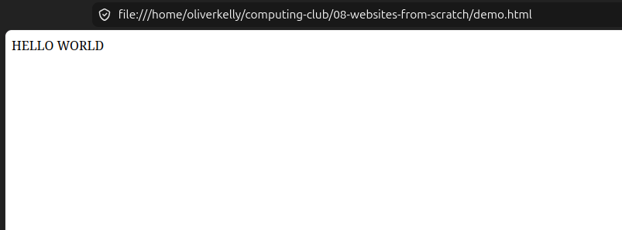

Slide 6
Early websites from the 90’s
https://info.cern.ch/hypertext/WWW/TheProject.html This was the first website from Aug 6th 1991
https://www.spacejam.com/1996/
https://web.archive.org/web/19990429045319/http://hampsterdance.com/

Slide 7
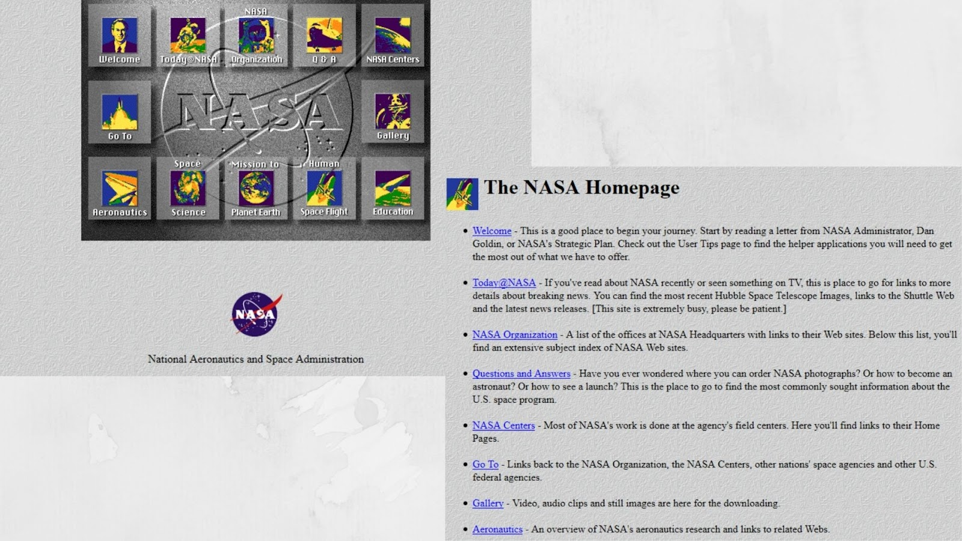
Original NASA website - 1997

Slide 8
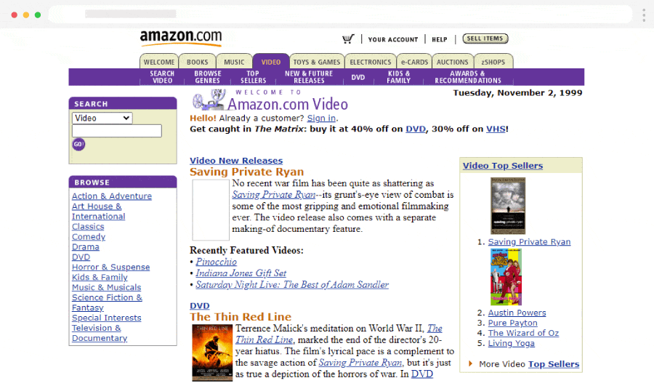
Amazon - 1999

Slide 9
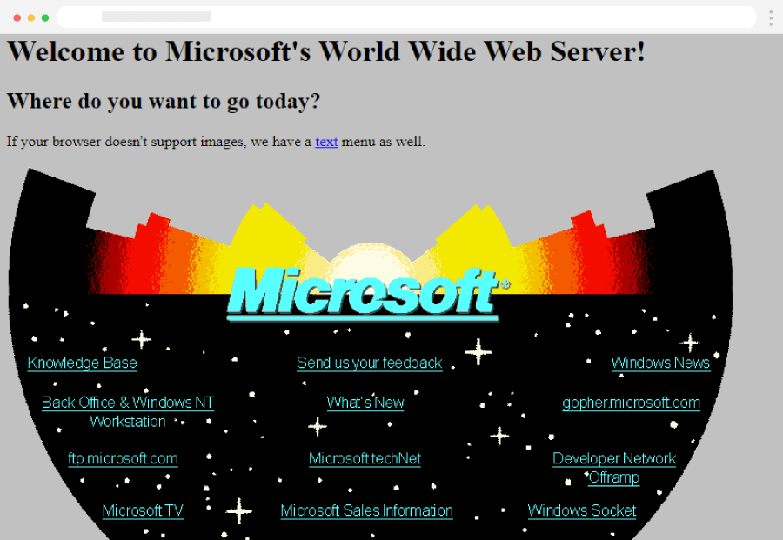
Microsoft - 1994

Slide 10
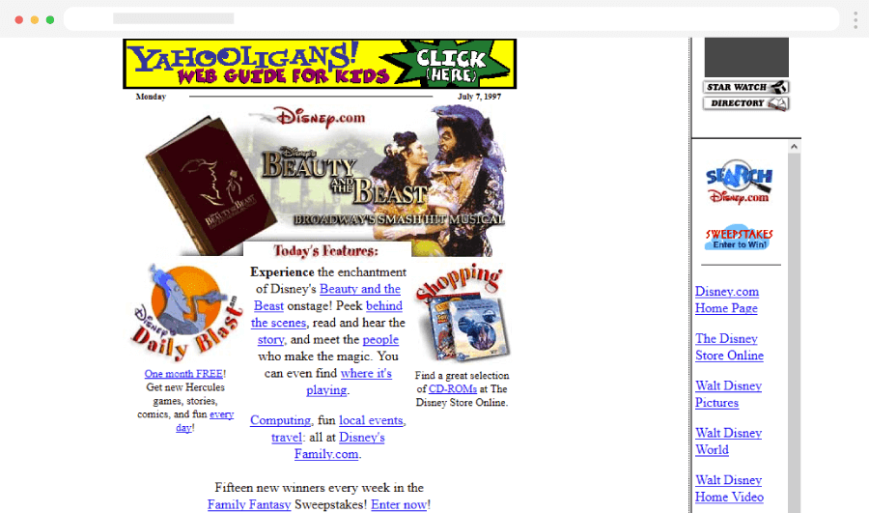
Disney - 1997

Slide 11
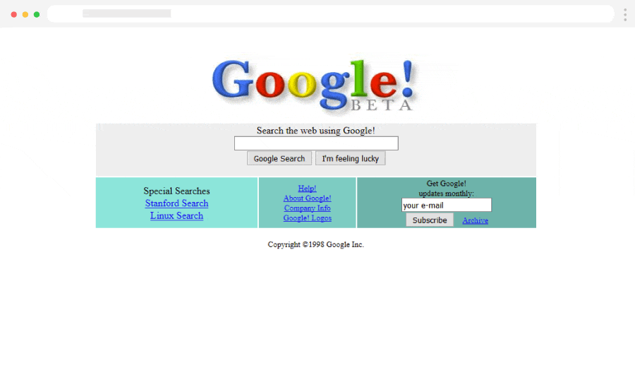
Google - 1998

Slide 12
HTML
HTML – HyperText Markup Language, This is the code/language to make websites
It tells Chrome,Firefox,Safari how to display the webpage

Slide 13
HTML
HTML Language use Tags or Elements to define the page, Most tags come in pairs and start with <TAG> something here </TAG> to end.
<h1> is a Heading tag used to create headings, there is also h2,h3 up to h6
<p> is paragraph text
<img> is an image tag, this is where you can reference an image
<a> this is a link tag, to link one page to another

Slide 14
HTML Attributes
HTML Attributes are extra information given to tags
These can be how big something should be, what colour it should be, where a link goes.
Some examples <a href=”https://google.com” >Visit Google</a> the `href=” ”` is the attribute <img src=”image_source.jpg” width=”500” height=”500”> here the img tag has `src`,`width` and `height` attributes

Slide 15
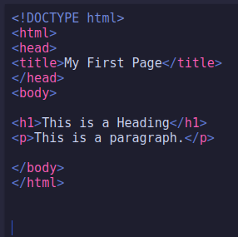
Creating your first webpage
Open text editor
Type the text opposite
Save as
Name `index.html`
Select file type as all or it may name it as index.html.txt or something.
double click on your file and it should open your browser and it should look like...

Slide 16
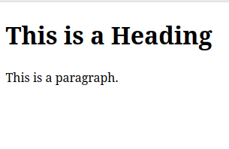

Slide 17
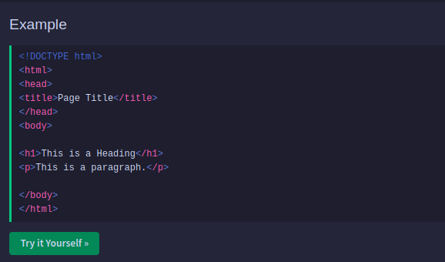
Creating your first webpage alternative
Open https://www.w3schools.com/html/ in Chrome
Scroll down and click ‘Try it Yourself’

Slide 18
Changing background Colour
Back in your index.html change <body> to <body style="background-color:blue;" >
Refresh your page to see the difference
There are 140 colour names that are supported out of the box by browsers https://www.w3schools.com/colors/colors_names.asp
You can also colour by using HEX value colours https://www.w3schools.com/colors/colors_picker.asp
You can also use RGBA ( Red Green Blue Alpha ) or HSL ( Hue Saturation Lightness )

Slide 19
Changing Text Colour
Within your index.html
Find the <p> element
Change it so it looks like <p style=”color:red;” … </p>
Refresh your page to check out the changes
Next try <p style=”color:rgba( 255,100,50,1);” … </p>

Slide 20
Inserting images
Download a picture from the internet and put it in the same location as your index.html
name it something easy
edit your index.html and add <img src=”image-name.jpg/png/webp” >
Save and then refresh the page in your browser, this will re-render the page.
The image can also be a web link to another image <img src=”https://fakewebsite.com/image.jpg” >

Slide 21
This work is licensed under a Creative Commons Attribution-ShareAlike 3.0 Unported License. It makes use of the works of Mateus Machado Luna.

