Slide 1

Data mining & text mining project 2019
GOAL: prediction of the speed average of vehicles in some roads during the occurrence of particular events
TEAM:
10644931 ANSALDI JACOPO
10680562 OMAR EMARA

Slide 2
Datasets manipulation
Inspect the datasets and deal with missing values
Merge speed, sensors, events and weather into a single dataset dealing with simultaneous events
Encode in a different way the events and the weather conditions (one-hot-encoding)
Remove reduntants features

Slide 3
Data preparation
One model for each sensor for the prediction
Normalization of the data
PCA
Conversion of the data into a supervised learning problem

Slide 4
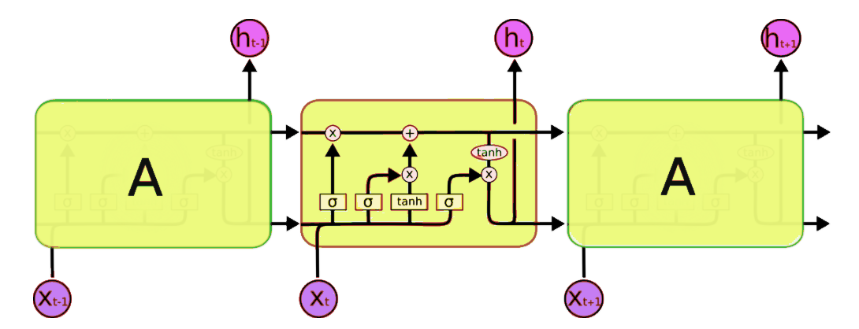
LONG SHORT-TERM MEMORY (LSTM)
Recurrent neural networks structure
Suitable for multivariate multi-steps time series prediction
Framework used: Keras

Slide 5
SUMMARY of the results

