Slide 1

Data mining & text mining project 2019
GOAL: prediction of the speed average of vehicles in some roads during the occurrence of particular events
TEAM:
10644931 ANSALDI JACOPO
10680562 OMAR EMARA

Slide 2
Datasets manipulation

Slide 3
Data preparation

Slide 4
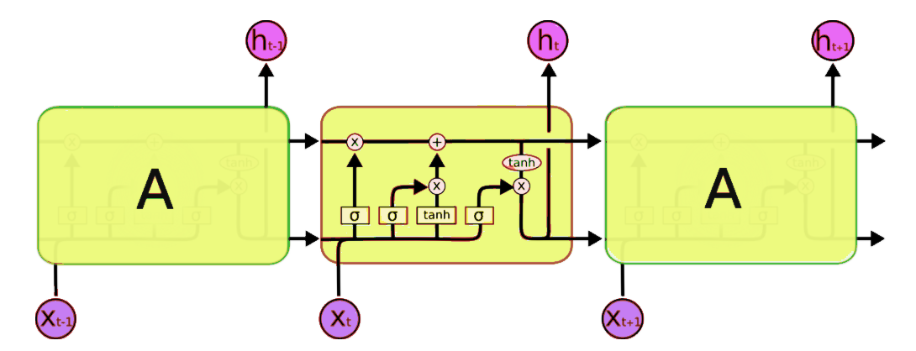
Lstm recurrent neural network

Slide 5
SUMMARY of the results

