Slide 1
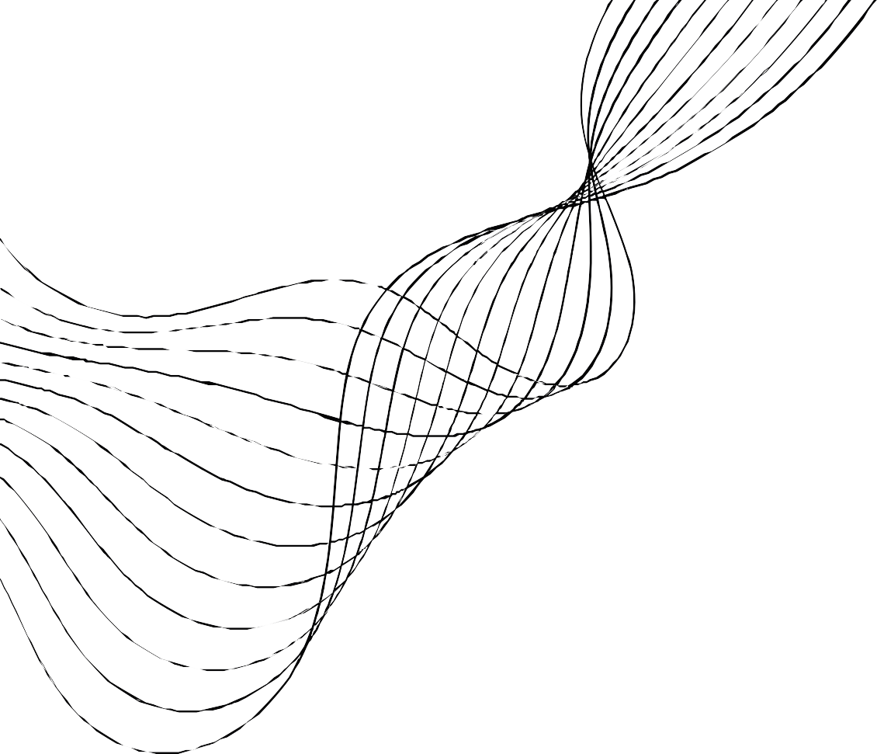
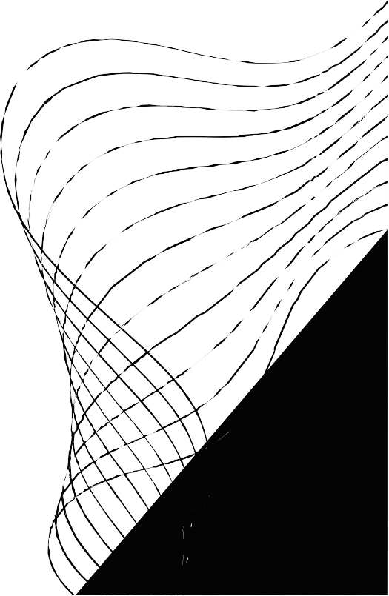
JOB FINDER
GL 2 - 1
Ahmed SILINI
Ghassen CHERIF Omar MEJDI
Mohamed Aziz BALTI

Slide 2




DESCRIPTION AND GOALS
Job Finder is a website that connects job seekers and employers.
Post job offers
As an Employer,
Hire the best talent with Job Finder.
Post your job today and connect with
qualified candidates
Look for jobs
As an Employee,
Discover your next career move with Job Finder - search thousands of job
opportunities from top employers

Slide 3

GITHUB LINK
https://github. com/Ghassen Cherif1 /Job Finder

Slide 4
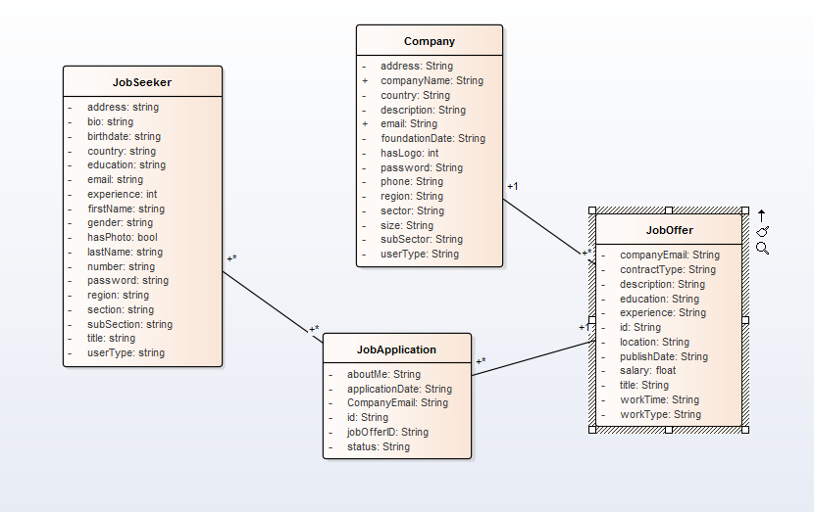

CLASS DIAGRAM

