Slide 1



EcoSort: Deep Learning-based Waste Classification for Sustainable Waste Management

Slide 2

Learning Objectives
To understand the role of Artificial Intelligence in sustainability:
Learn how AI, particularly deep learning, can contribute to solving environmental problems such as waste management.
To explore image classification techniques:
Gain a clear understanding of how convolutional neural networks (CNNs) and object detection models like YOLOv8 work in recognizing visual patterns.
To build a waste classification model:
Develop a model that can accurately classify waste images into multiple categories such as plastic, glass, paper, metal, and organic.
To apply real-world datasets:
Learn how to pre-process and use publicly available datasets (like Kaggle’s Garbage Classification v2) for model training and validation.
To improve model evaluation and optimization skills:
Understand how to measure model performance using accuracy, confusion matrix, and other evaluation metrics — and improve results through fine-tuning.
To develop a simple and practical AI application:
Implement a prototype that demonstrates how deep learning can make waste segregation smarter and more sustainable.
GOAL
Source :
www.freepik.com/

Slide 3
Tools and Technology used
Programming Language: Python
Deep Learning Frameworks: PyTorch / TensorFlow
Model Used: YOLOv8 (You Only Look Once version 8)
Libraries: OpenCV, NumPy, Pandas, Matplotlib, Scikit-learn
Dataset Source: Kaggle – Garbage Classification v2
Development Environment: Jupyter Notebook / Google Colab
Version Control: Git and GitHub
Optional Deployment Tools: Streamlit or Flask for web-based interface

Slide 4
Methodology
Data Collection & Exploration:
Downloaded the Garbage Classification v2 dataset from Kaggle and explored image categories and distribution.
Data Preprocessing:
Resized, normalized, and augmented the dataset to improve model generalization and balance between classes.
Model Selection & Training:
Implemented a YOLOv8 model trained on labeled images to detect and classify waste types.
Alternatively, CNN architectures like ResNet or MobileNet can be used for baseline comparisons.
Model Evaluation:
Evaluated model performance using accuracy, precision, recall, and F1-score metrics.
Deployment (Optional):
Built a simple user interface allowing users to upload an image and view the predicted waste category.
Analysis & Results:
Compared model performance, visualized confusion matrices, and identified areas for future improvement.

Slide 5
Problem Statement:
In urban environments, waste mismanagement is one of the biggest barriers to achieving sustainability. A large portion of recyclable or compostable materials end up in landfills due to improper segregation. Manual sorting is not only inefficient but also unhygienic and error-prone. This project aims to develop a deep learning model that can automatically classify waste images into distinct categories such as organic, recyclable, and hazardous, thereby promoting better waste segregation and supporting sustainable waste management practices.
The project “EcoSort: Deep Learning-based Waste Classification for Sustainable Waste Management” focuses on leveraging artificial intelligence to tackle one of the most persistent global environmental challenges — improper waste segregation. With the growing volume of waste generated every day, traditional manual sorting methods are no longer practical or sustainable. By using deep learning and computer vision, this project aims to create an automated system capable of classifying waste materials based on images. Such an approach not only supports efficient recycling and resource recovery but also minimizes human exposure to harmful waste, reduces landfill accumulation, and promotes cleaner, greener urban environments. Ultimately, the project aligns with the United Nations’ Sustainable Development Goals (SDGs), particularly those related to responsible consumption and environmental protection.

Slide 6
Solution:
To address the problem of inefficient waste segregation, this project proposes an AI-powered waste classification system that uses deep learning and image recognition to automatically identify different types of waste. The solution involves training a YOLOv8-based model on a labelled dataset containing images of materials such as plastic, paper, metal, glass, cardboard, and organic waste.
The trained model can then take an image of waste — captured from a camera or uploaded by a user — and instantly classify it into the correct category. This classification helps in proper disposal or recycling, reducing contamination between waste streams. A simple web-based interface or mobile prototype can also be developed to allow easy usage by the public, recycling centers, or smart waste bins.
By integrating artificial intelligence into waste management, the proposed solution promotes automation, accuracy, and sustainability, helping cities and communities manage their waste more effectively while supporting environmental conservation efforts.

Slide 7
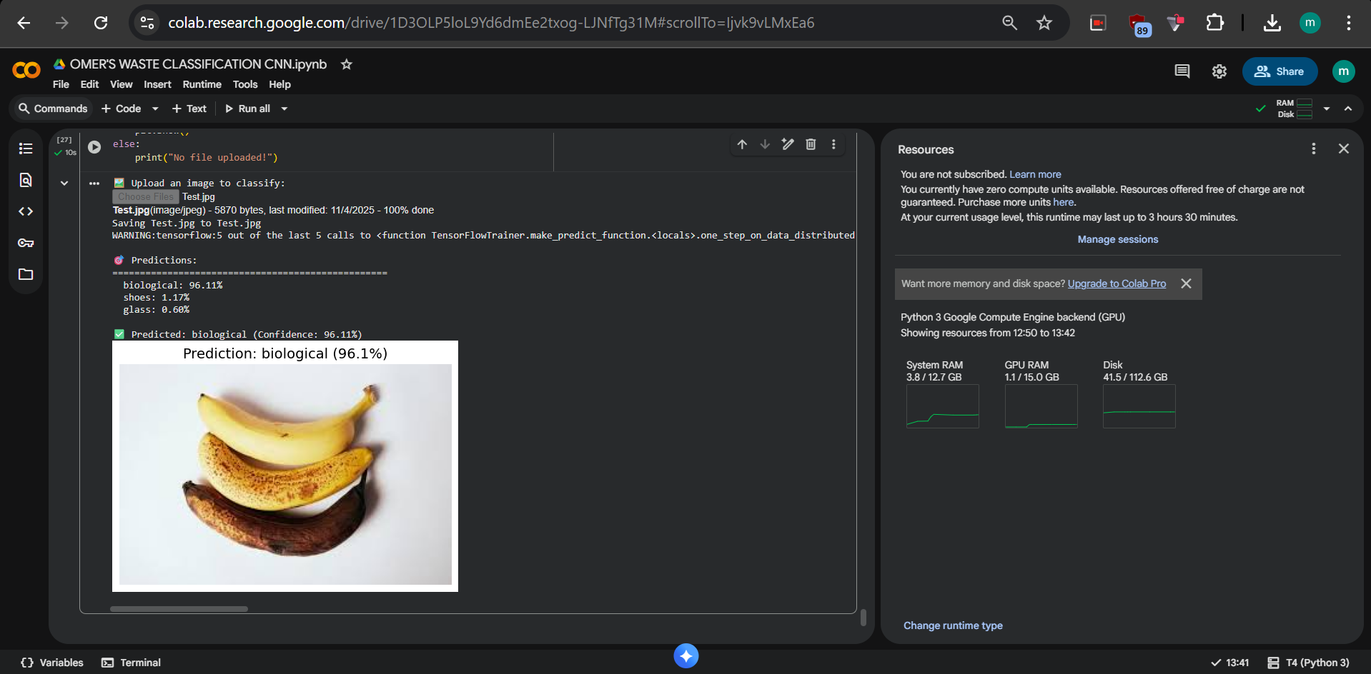
Screenshot of Output:

Slide 8
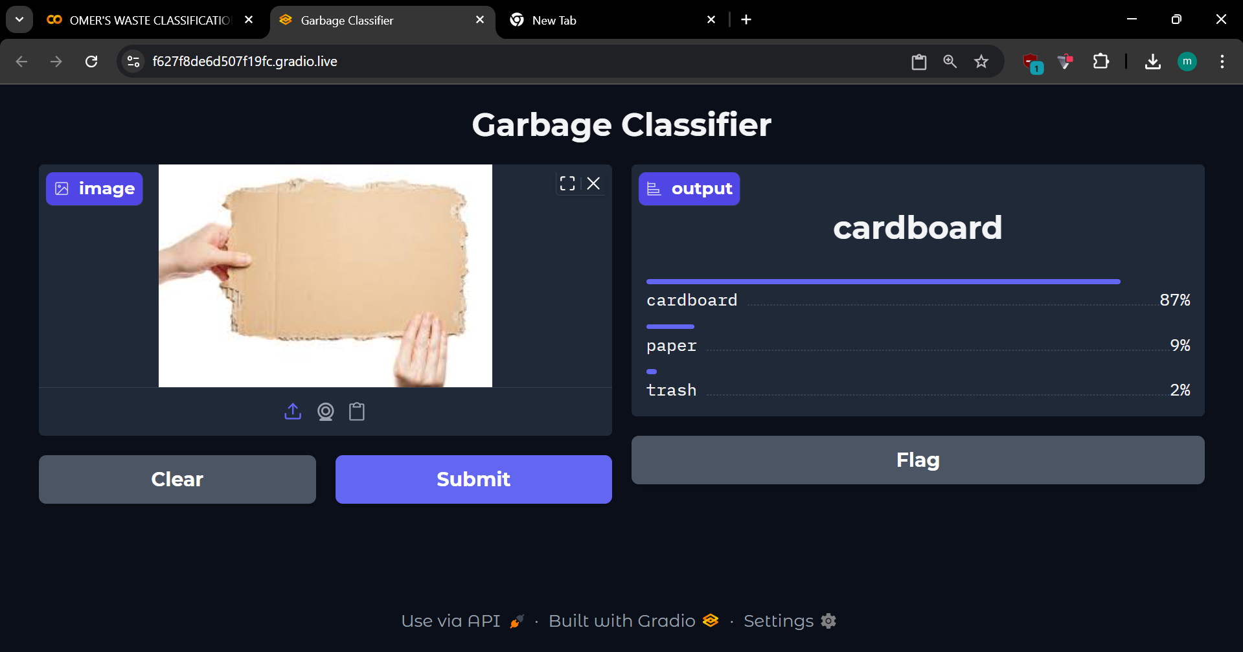
Screenshot of Output With UI:

Slide 9
Conclusion:
Successfully developed a CNN-based garbage classifier achieving 90.46% validation accuracy across 10 waste categories using 19,762 real-world images. The model leverages EfficientNetB0 transfer learning with only 16.85 MB size and minimal overfitting.
Key Achievements: • 90.46% accuracy on real-world dataset • Optimized 16.85 MB model with 365K trainable parameters • Deployed as interactive web application • Trained efficiently in single epoch
Impact & Applications: This system automates waste segregation for smart dustbins, recycling plants, and waste management facilities, reducing manual effort while promoting environmental sustainability through improved recycling accuracy.
Future Scope: • Fine-tune for 95%+ accuracy • Add specialized categories (e-waste, hazardous) • Deploy on mobile and edge devices • IoT integration for automated sorting
This project demonstrates how deep learning effectively solves real-world environmental challenges, creating a production-ready, scalable solution for smarter waste management systems globally.

