Slide 1

D Y Patil Technical Campus, Talsande,
Faculty of Engineering
& Faculty Of Management,
Talsande, Kolhapur
Mini Project Using C++

Slide 2
Project Title: Version Control System
Sr. No.
Name
Roll No.
PRN No.
1
Prajwal Shripati Jadhav
2016
2022078999
2
Omkar Bajrang Bhosale
2007
2022079012
3
Nikhil Gurudev Lonari
2017
2022078955

Slide 3
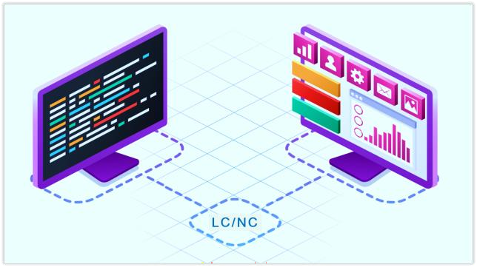

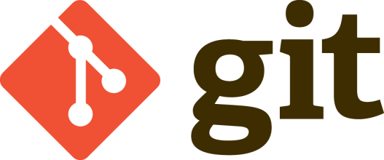
Version Control System

Slide 4
Contents
Introduction
Relevance
Objectives
Proposed Work:
Proposed Architecture
Scope
Methodology
Application
Requirements
Reference

Slide 5
Introduction
A version control system (VCS) is a software tool that helps in managing changes to source code or any other set of files, tracking modifications, and coordinating work among multiple developers.
Version control is crucial in software development to maintain a history of changes, collaborate effectively, and ensure the stability and reliability of software projects.
Types: There are two main types of version control systems: centralized (e.g.,
SVN) and distributed (e.g., Git).
Key Concepts: Branching, merging, commit, repository, clone, push, pull, etc.

Slide 6
Relevance
Collaborative Development: VCS enables multiple developers to work on the
same codebase simultaneously, facilitating collaboration and teamwork.
Change Tracking: It provides a detailed history of changes made to the code, including who made the changes, when they were made, and why they were made.
Risk Mitigation: Version control reduces the risk of code conflicts, accidental
deletions, and data loss by keeping a backup of previous versions.
Workflow Improvement: VCS streamlines the development workflow by
providing tools for code review, issue tracking, and continuous integration.

Slide 7
Objectives
Facilitate Collaboration: Enable multiple developers to work on a project concurrently without conflicts.
Track Changes: Maintain a comprehensive history of changes made to the
project.
Ensure Stability: Ensure that the software project remains stable and reliable
throughout its development lifecycle.
Enhance Productivity: Streamline the development process and improve
productivity by providing tools for code management and collaboration.

Slide 8
Proposed Work
Proposed Architecture
Create Repo
Commit Changes
Dist.
folder
no
Create Dist.
Directory
yes
For
Loop

Slide 9
Proposed Work
Scope
The scope includes implementing version control for the project to manage source code, documentation, and other project assets effectively.
It encompasses setting up the necessary infrastructure, defining workflows, and training team members on version control best practices.

Slide 10
Proposed Work
Methodology
The implementation follows an iterative and incremental approach, starting with basic version control functionalities and gradually expanding to more advanced features.
Regular reviews and feedback sessions are conducted to evaluate the effectiveness of the version control system and make necessary adjustments.

Slide 11
Applications
Software Development: Version control is extensively used in software development projects to manage source code, track changes, and collaborate among developers.
Document Management: It can also be used to manage documents, spreadsheets, presentations, and other non-code assets in a collaborative environment.
Content Publishing: Version control systems are used in content management systems and publishing platforms to manage website content, articles, and blog posts.

Slide 12
Requirements
Software Requirements:
C++17+ Version
G++ Compiler

Slide 13
Reference
Geeks for Geeks
3rd International Conference on Computer Science and
Computational Intelligence 2018 Research Paper

