Slide 1


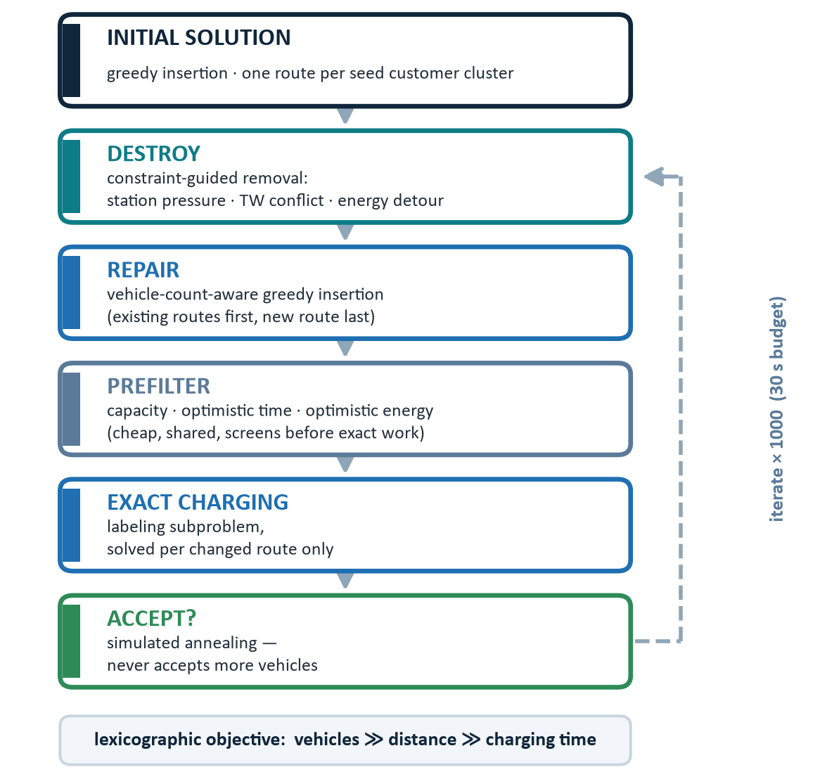


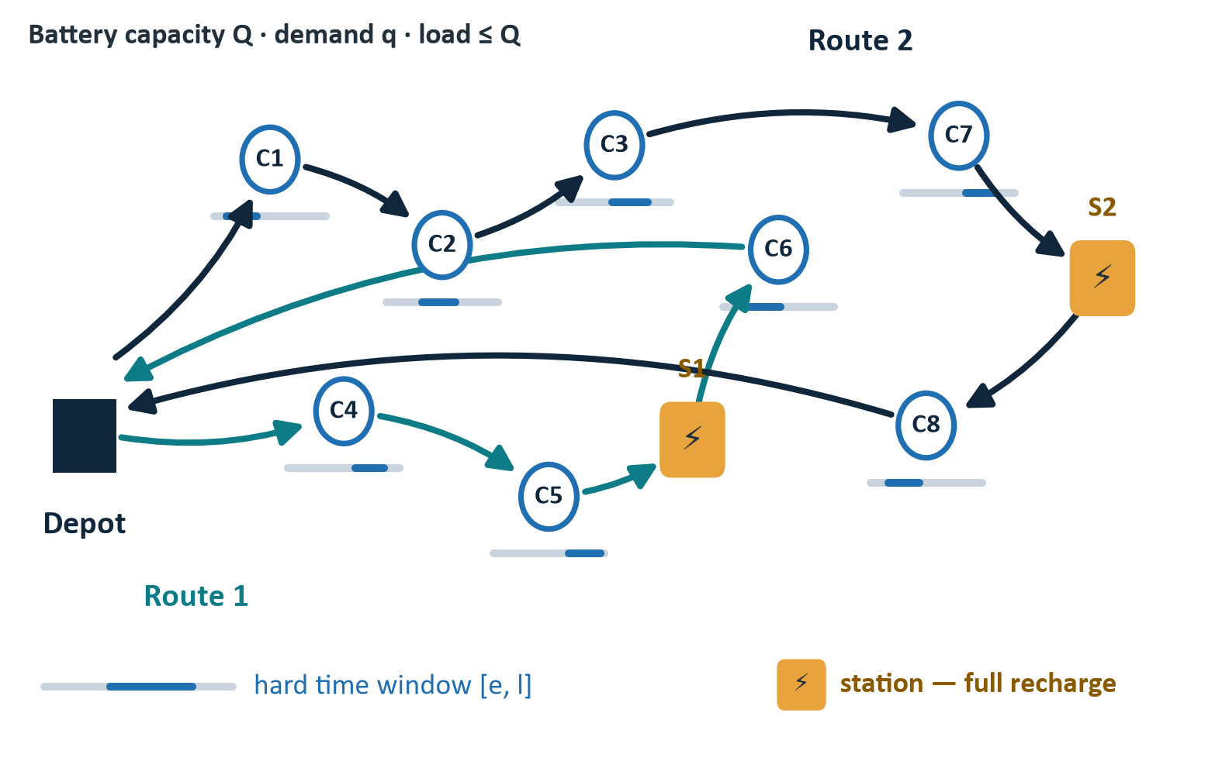
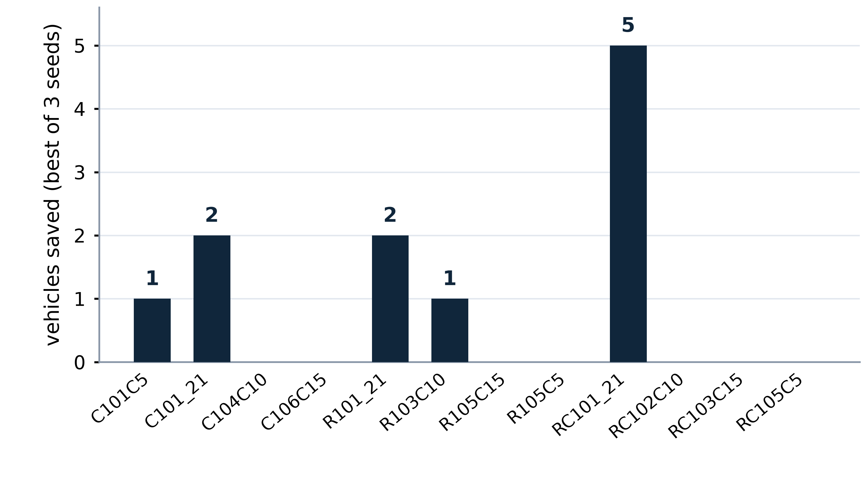
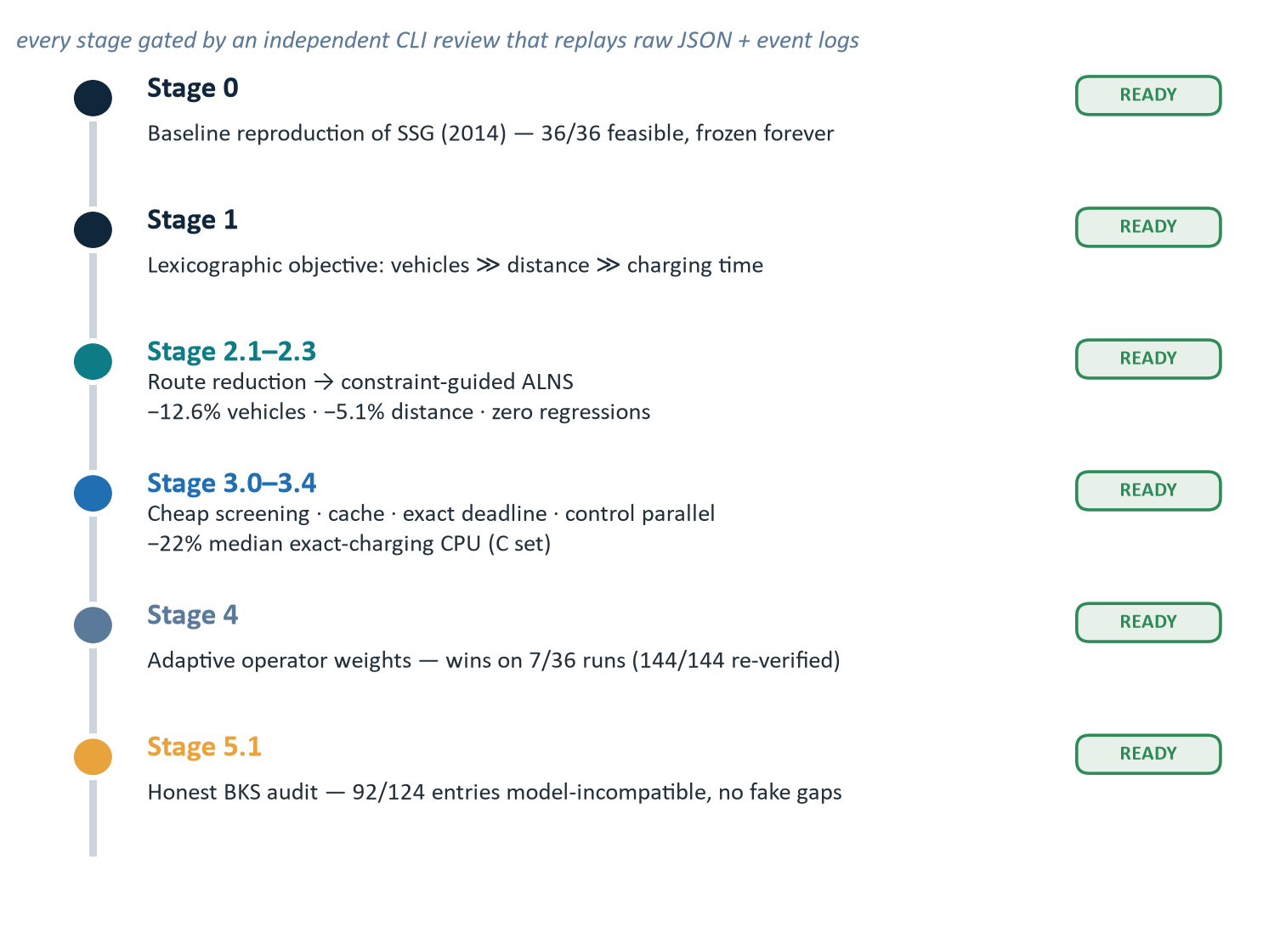
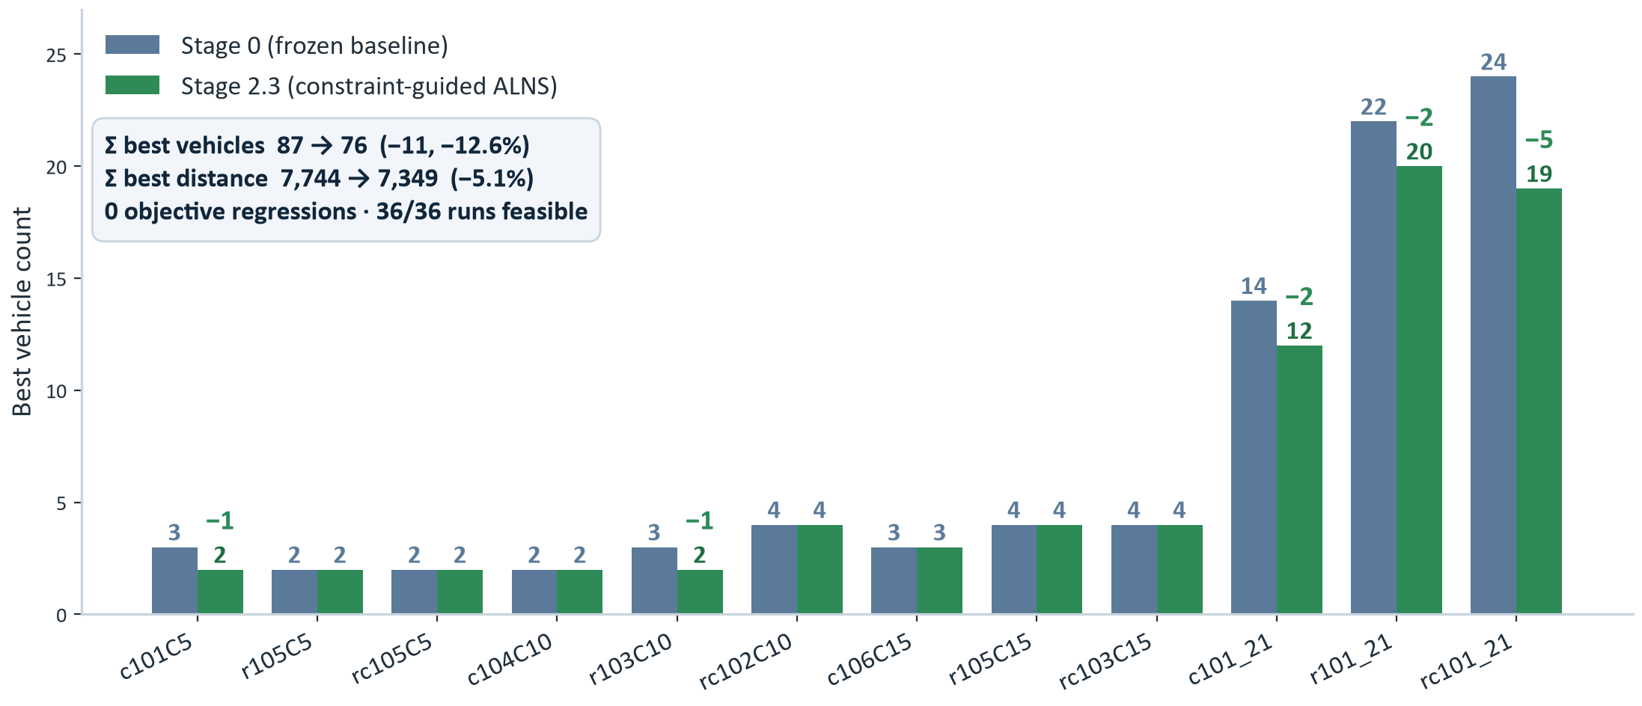
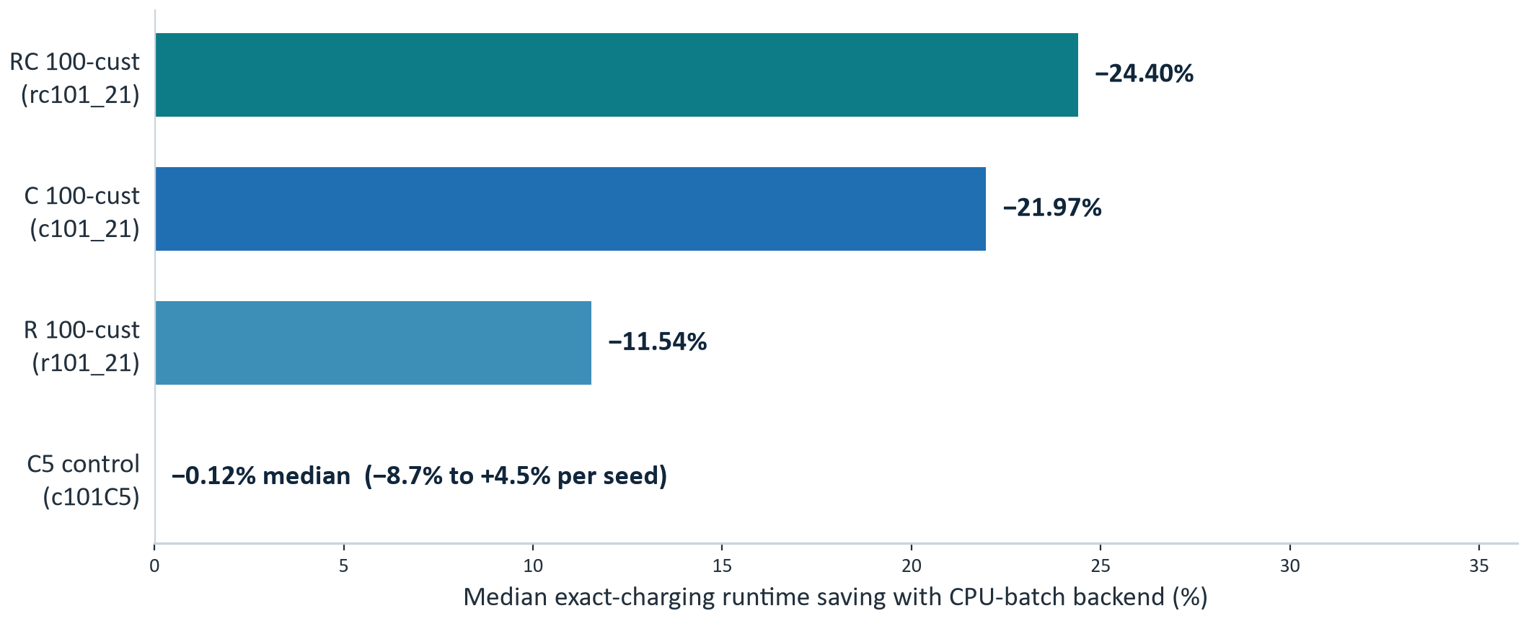



12.6% Fewer Vehicles, Zero Regressions:
An Audit-First ALNS for Electric-Vehicle Routing
Yiyang Guo | Department of Mathematical Sciences
Motivation
Method Overview
E-VRPTW: battery-limited EVs, hard time windows
KEY MECHANISMS
Fleet size first in the lexicographic objective
•Vehicle-count-aware repair: eliminate routes first; fleet can fall, never rise
•Optimistic prefilters (capacity · time · energy) screen before exact evaluation
•Constraint-guided destroy: station pressure, TW conflicts, energy detours
•Exact charging subproblems re-solve only the routes that changed
Feasibility hinges on exact charging decisions
AUDIT PROTOCOL
•Lexicographic objective — vehicles first; acceptance rejects any fleet-size increase
•Independent review CLI replays solutions, event logs & hashes before publication
VEHICLE SAVINGS
Objective — reproduce SSG (2014), then cut fleet size with zero regressions
Benchmark — SSG (2014) · 12 instances · 5–100 customers · C / R / RC
Model — battery-limited EVs · en-route charging · hard time windows
Constraint-guided ALNS engine — vehicle-first search with exact charging subproblems
Toolchain — Python · numba · CPLEX · Gurobi · HiGHS · OR-Tools (lockfile-pinned)
Exact charging dominates cost: 1,687–2,161 calls per 30 s run
Acceleration shipped: incremental cache · exact-deadline · parallel control
Best of 3 seeds per instance — total fleet 87 → 76 vehicles (−12.6%)
Experimental Settings
Key Results
Instances
12
Seeds
3
Time limit
30 s
Iterations
1,000
Thread
1
Stage 0 frozen & hash-verified — every number replays from raw evidence
Vehicle-first search cuts fleet on 5/12 instances — 87 → 76 vehicles, −5.1% distance, 36/36 feasible
Per-family best — C 22→19 · R 31→28 · RC 34→29 · mean fleet 90.7 → 77.0
Key Quantitative Highlights
Why It Works & Honest Audit
✓WHY IT WORKS
▲HONEST BOUNDARIES
✓Vehicle-count-aware repair — fleet can fall, never rise
✓Constraint-guided destroy targets station pressure · TW conflicts · energy detours
✓Dynamic removal size escalates on stagnation (17,892 logged)
✓Stage-gated: two independent complete reruns must agree
▲92/124 published BKS entries are model-incompatible — no gap claims against them
▲C5 control: −0.12% median (−8.7%…+4.5%) — speedup is structure-dependent, not universal
▲9/36 runs overran the 30 s budget by ≤ 0.02 s — all kept, with events
▲No unattested baselines — every number replays from raw solution JSON + event logs
EVIDENCE AT SCALE
12,121
200,731
20
0
−22.0% exact-charging CPU (median, C instances) — CPU-batch default after audit
evidence files on disk
operator event rows replayed
real failure cases kept
synthetic cases in audit
Batch pilot covers 4 instances (speedups 1.00–1.32×) — full-scope acceleration remains a Stage 3 target
[1] Schneider, Stenger & Goeke (2014) Transp. Sci. 48(4):500–520 [2] Pisinger & Ropke (2006) Transp. Res. B
[3] Keskin & Çatay (2016) Transp. Res. E [4] Hottung, Kwon & Tierney (2022) EJOR
Scan for code & evidence
−5.1% total distance
36/36 feasible formal runs
−22.0% exact-charging CPU
Department of Mathematical Sciences
Yiyang Guo (Student ID: 20719106)
Supervisor: Tianxing Cui

