Slide 1
CST 4215 PORTFOLIO
E-COMMERCE AMAZON DATASET
BY: M00778344
MARCELINO F MARIWA

Slide 2
Introduction to the Business Scenario
The site has excellent stats, but could always do better.
With more traffic , we could do better with the vendors sourcing better products,
Manufacturers kindersing towards what sells best, and more appealing towards the customers/consumers

Slide 3
Define the KPI, identify and investigate what the scenario is all about. One of the KPIs is defined
Using the provided dataset, products.csv we can find data on recent_purchases, price_value, rating_stars in which they could help predict
These points could help predict the frequency of new confirmed recent_purchases this will deal with confirmed purchase conversion index
Using availability, delivery_data, fastest_delivery_date, availability and price_value we could finally trap returning buyers
and know how much are they willing to pay more for the products since this focus will deal with the shipping velocity exclusive index

Slide 4
Form an Equation exdplaining the KPI
For the KPI of choice: index of cunsumer purchase, we require 3 variables all of which are weighted differently
recent_purchase: This is the variable that will determine if a consumer is a trend follower since this variable identifies the current trend
rating_stars: This is encoded towards the number of ratigs from 5 - 1 where by it will detemine if consumer is biased towards early adopters and money isn't a problem
price_value: This is encoded towards price tiers from expensive to cheapest, this will determine if the consumer cares about how much is spent
other variables to be considered is the time of receiving the package this could be very essential to returning clients
Since the trust is already established between vendor, platform and client. Fine tuning the service

Slide 5
Importance of the KPI
This KPI is sensitive towards the prediction / probability of new consumers that passby to browse, knowing exactly the key stats that will attract the consumer
Hence turning the consumer to a confired_purchase.
Since our whole scenario is targeted towards increase of confirmed purchase in order to fuel the R&D of the manufacturers, and get enough feedback to promote or demote vendors
All in the name of protecting the brand

Slide 6
DAta Profiling
With the provided dataset, in this case 2 are provided, one for products and the other for reviews.
Our main focus the (y) is in the reviews, since our trget is turning random scrapers to confirmed_buyers, the reviewers help in letting us know.
Since in the Products dataset we have a rough idea on how many products are sold with the min. count being 50

Slide 7
Methodology and Data preprocessing
This case has two datasets, products.csv and Reviews.csv
Both the data sets have primary_keys and foreign keys. With this it has been quite effective in joining them and makin sense of the data provided.
Both Datasets were merged to achieve the main dataset that we have used to perform our Machine Learning, testing and training
In the pre-processing new columns were created, img_cont, cont_rating, avg_rating, availability_grouped(encoded, availability column), number_of_clicks (processed breadcrumb column, this helped determine how precise a product was classified, CCV_score (logrithmic value).

Slide 8
Apply the Model selecting and
- 2-ML algos, to fit your features and how KPI is predicted with what is had
- Model Training and evaluation
- Accuracy or precission

Slide 9
CArefull: using correlation test, detect data leakeage

Slide 10
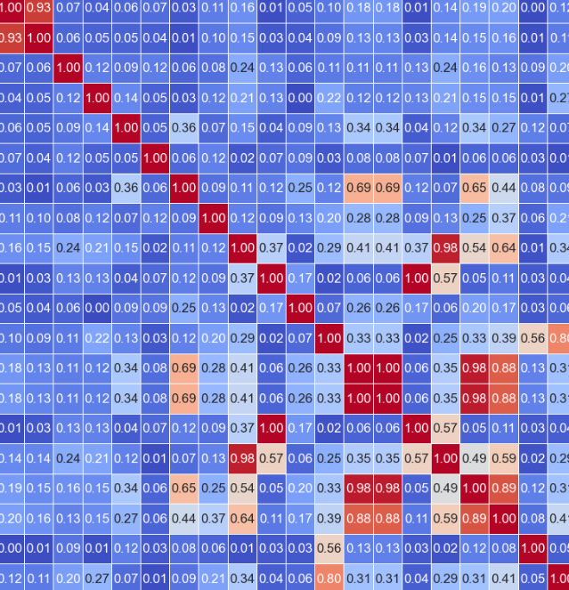
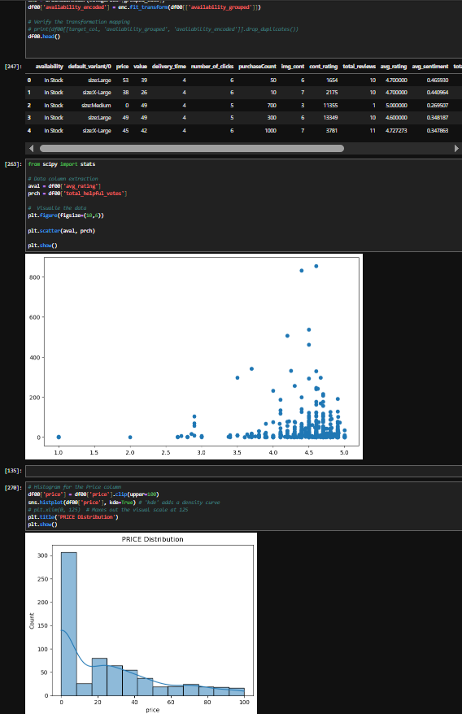
Utilize tables or chart

Slide 11
Compare the Evaluatrion metrics

Slide 12
Interpretation of various findings
- Key drivers of the business indicators (KPI)

Slide 13
Suggest next course of action
- Based on the Driver and Key results

