Slide 1
Unidata TDS Workshop TDS Overview – Part I
22-24 October 2012

Slide 2

Unidata – Who are we?
Funded primarily by the U.S. National Science Foundation
Mission:
To provide data, tools, and community leadership for improving Earth-system education and research
At the Unidata Program Center, we
Provide access to data (via push and pull systems)
Develop open source tools and infrastructure for data access, analysis, visualization, and data management
Advance metadata standards for the Earth system science community
Support users of our technologies: faculty, students, and researchers
Help to build, represent, and advocate on behalf of our community
Notes:
Although the main focus of our work is on providing real-time data, Unidata develops tools, middleware, and services that contribute to broader cyberinfrastructure needs of the community.

Slide 3
Access to Data: Push
IDD Real-time Data Flow
30 data feeds provide radar, satellite, text bulletins, lightning, model forecasts, surface and upper air observations, …
LDM routinely handles 10 GB/hour input, with as many as 280,000 products/hour
Worldwide collaboration of over 250 institutions running LDM software
Unidata’s LDM
Protocol and client/server software
Event-driven data distribution
Supports subscription to subsets of data feeds

Slide 4
Access to Data: Pull
IDD data from Unidata available via
Servers:
McIDAS ADDE
TDS
RAMADDA
Protocols:
http, FTP
ADDE, OPeNDAP
OGC WCS and WMS
The Unidata TDS server thredds.ucar.edu (formerly known as motherlode) “archives” latest month or so of IDD data

Slide 5
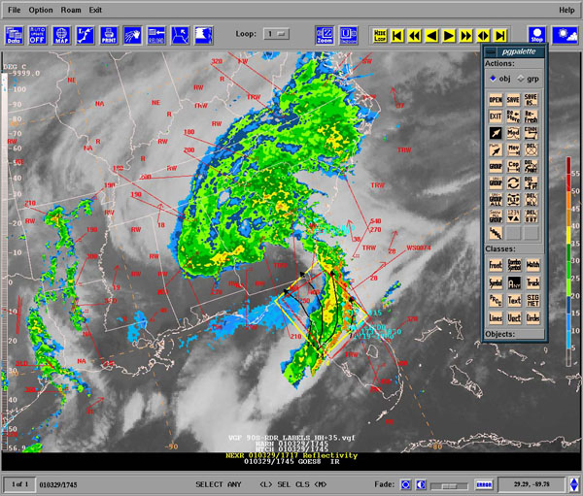
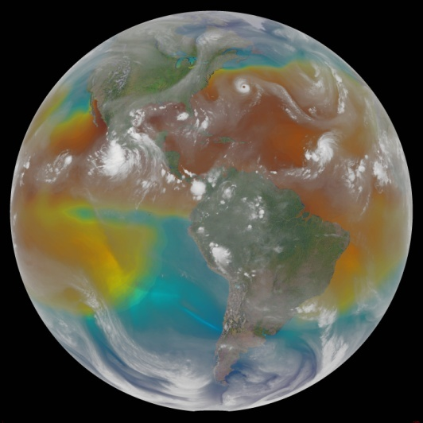
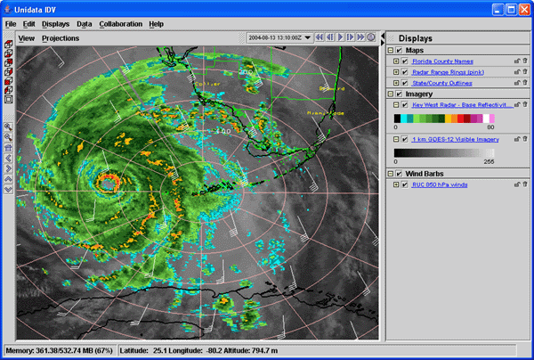
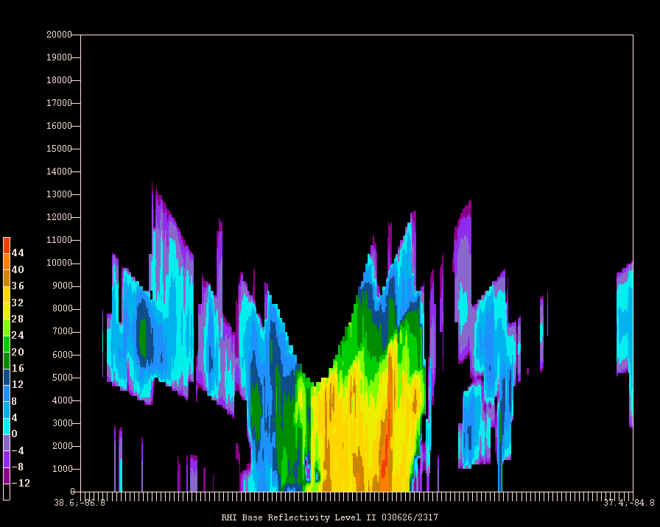
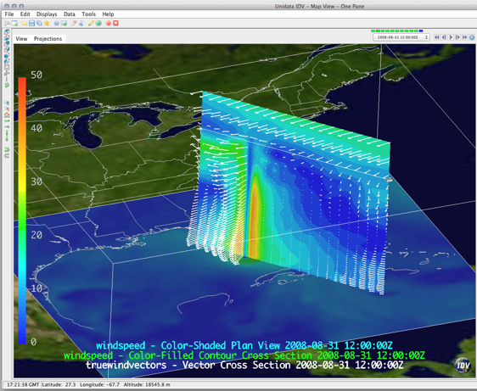
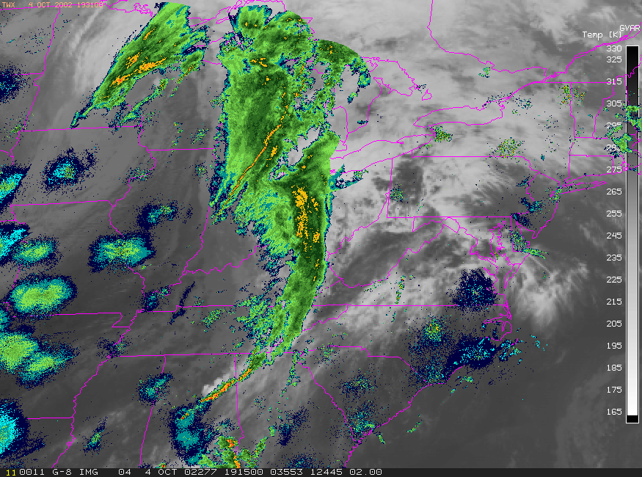
Visualizing and Analyzing Data
GEMPAK
McIDAS-X
IDV

Slide 6
Unidata User Community
Support the community
User Workshops
Training Workshops
Mailing lists
For specific software packages
“community” email list – for Unidata community announcements
Represent and advocate for the community
More: http://www.unidata.ucar.edu/

Slide 7
Why TDS – Users
As a user, some things I want to be able to do:
Easily ‘see’ information regarding the dataset, without the need to download any files
Temporal / spatial ranges, available variables, contact info, dataset details
Get only the data I need/want
Temporal, spatial, and variable subsetting
Get data remotely in a variety of ways
Download one file, even if data span multiple files

Slide 8
Why THREDDS Data Server (TDS) – Data Providers
As a data provider, I want to be able to:
Catalog my data holdings
Aggregate data files
Provide a ‘quick view’ of my data
Easily add information (metadata) to my datasets
Fix ‘incorrect’ datasets*
Allow flexibility in the way users access my data
Give users what they need to do science!

Slide 9
THREDDS Data Server (TDS)
Web server for scientific data (written in 100% Java)
Can serve any dataset the netCDF-Java library can read
E.g., netCDF-3, netCDF-4, HDF-4, HDF-5, HDF-EOS, GRIB-1, GRIB-2
Advertise available datasets and services via catalogs
Data access (subset) services:
OPeNDAP
OGC WMS and WCS
NCSS, cdmRemote
Data collection services
Aggregation
Point/station collection
Metadata services
THREDDS
ncISO: ISO, UDDC, NcML

Slide 10
THREDDS Data Server
Servlet Container
catalog.xml
Remote Access
Client
THREDDS Server
WCS
OPeNDAP
HTTPServer
WMS
NetCDF-Java
Library
configCatalog.xml
IDD Data
Datasets
thredds.ucar.edu

Slide 11
THREDDS Data Server
Servlet Container
catalog.xml
Remote Access
Client
THREDDS Server
WCS
OPeNDAP
HTTPServer
WMS
NetCDF-Java
Library
configCatalog.xml
IDD Data
Datasets
thredds.ucar.edu

Slide 12
Common Data Model (CDM)
Implemented in the netCDF-Java library (3 layers)
NetCDF Data Access:
Access to array-based scientific data (netCDF data model)
Read various file formats, map into data model (IOSP)
NetcdfDataset:
Geospatial coordinate systems (conventions)
NcML: Modify existing dataset
Aggregation of datasets
Scientific Feature Types, e.g.:
Gridded Data; Radial Data; Swath Data
Discrete Sampling Features:
Point Data; Station Data; Profile Data
Trajectory (e.g., aircraft track) Data

Slide 13
Application
Scientific Feature Types
Datatype Adapter
NetCDF-Java/
CDM architecture
NetcdfDataset
CoordSystem Builder
NetcdfFile
THREDDS
I/O service provider
Catalog.xml
OPeNDAP
NetCDF-3
NIDS
NetCDF-4
GRIB
NcML
HDF5
GINI
Nexrad
DMSP

Slide 14
THREDDS Data Server
Servlet Container
catalog.xml
Remote Access
Client
THREDDS Server
WCS
OPeNDAP
HTTPServer
WMS
NetCDF-Java
Library
configCatalog.xml
IDD Data
Datasets
thredds.ucar.edu

Slide 15
THREDDS Catalogs
Catalogs collect, organize, and describe datasets
Hierarchical collections of datasets (virtual directories)
Each dataset may have multiple access methods
Documentation (metadata) may be added
To collections of datasets
To individual datasets (inheritance optional)
Servers can use catalogs to advertise the datasets they serve

Slide 16
THREDDS Catalogs
<?xml version='1.0' encoding='UTF-8'?>
<catalog xmlns=“http://www.unidata.ucar.edu/namespaces/thredds/InvCatalog/v.0”
xmlns:xlink="http://www.w3.org/1999/xlink" version="1.0.2">
<service name="odap" serviceType="OPENDAP" base="/thredds/dodsC/" />
<dataset name="TDS Tutorial: example 2">
<metadata inherited="true">
<serviceName>odap</serviceName>
</metadata>
<dataset name="TDS Tutorial: example data 1" urlPath="test/example1.nc" />
<dataset name="TDS Tutorial: example data 2" urlPath="test/example2.nc" />
<dataset name="TDS Tutorial: example data 3" urlPath="test/example3.nc" />
<catalogRef xlink:title="My Other Catalog“
xlink:href="myOtherCatalog.xml" />
<catalogRef xlink:title="Far Away Univ catalog“
xlink:href="http://www.farAwayU.edu/thredds/catalog.xml" />
</dataset>
</catalog>

Slide 17
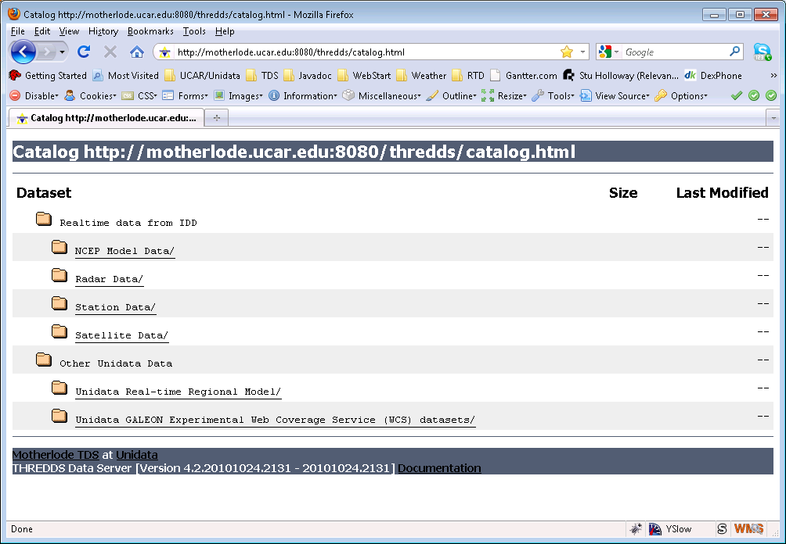
THREDDS Catalogs

Slide 18
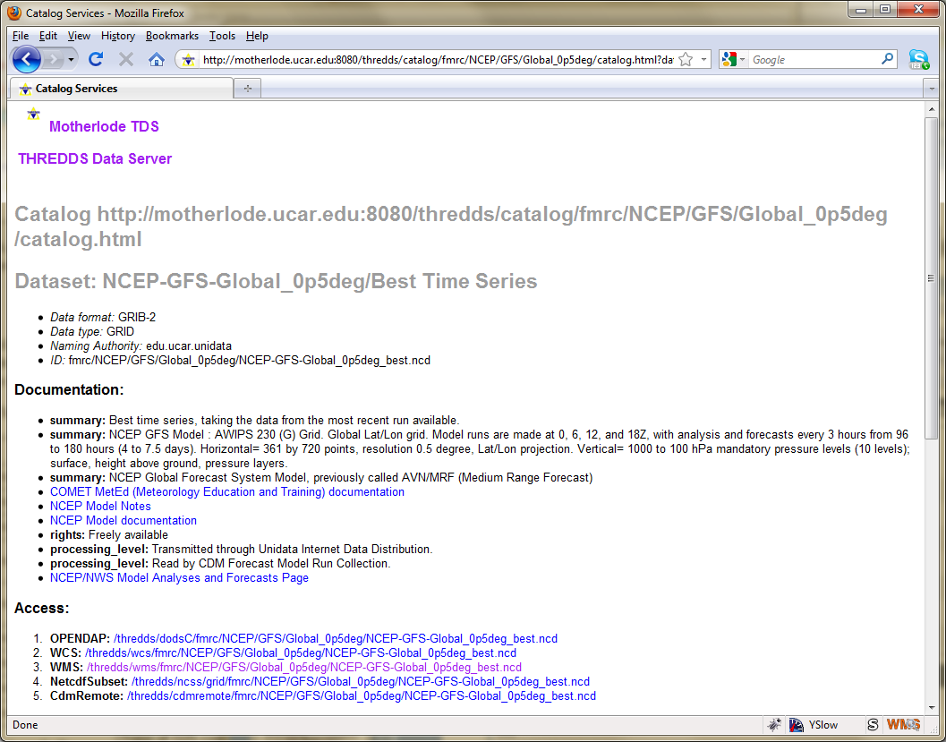
THREDDS Catalogs

Slide 19
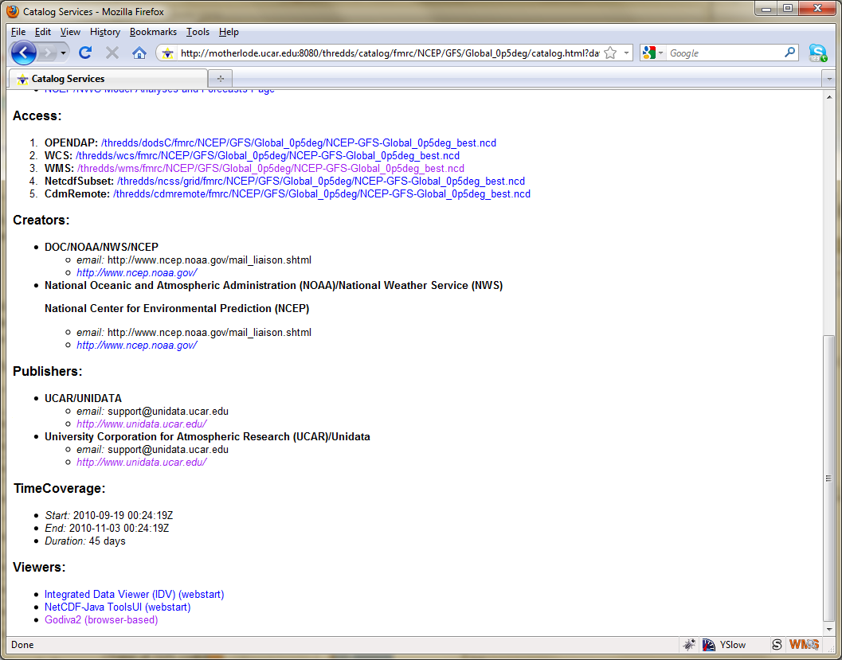
THREDDS Catalogs

Slide 20
THREDDS Data Server Getting Started
TDS is written in 100% Java
TDS uses the Java Servlet framework
Need to Install Tomcat or other servlet container
Tomcat used in many places (The Weather Channel, Netflix, LinkedIn, to name a few)
Note: many cloud services can use servlets (e.g. Google App Engine, Windows Azure Compute)
First up: Install and configure Tomcat

