Slide 1
GRIB in TDS 4.3

Slide 2
NetCDF 3D Data
dimensions:
lat = 360; lon = 720; time = 12;
variables:
float temp(time, alt, lat, lon);
temp:coordinates = “time lat lon”;
float lat(lat);
lat:units = “degrees_north”;
float lon(lon);
lon:units = “degrees_east”;
float time(time);
time:units = “months since 01-01-2012”;

Slide 3
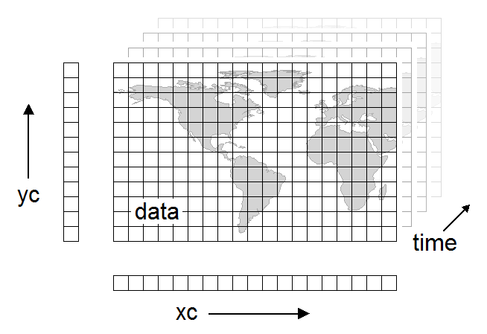
3D data

Slide 4
NetCDF 4D Multidimensional Data
dimensions:
lat = 360; lon = 720; time = 12; alt = 39;
variables:
float temp(time, alt, lat, lon);
temp:coordinates = “time alt lat lon”;
float lat(lat);
lat:units = “degrees_north”;
float lon(lon);
lon:units = “degrees_east”;
float alt(alt);
alt:units = “m”;
float time(time);
time:units = “months since 01-01-2012”;

Slide 5

netCDF storage

Slide 6

GRIB storage

Slide 7
GRIB Rectilyzer

Slide 8
GRIB collection indexing
GRIB file
1000x smaller
Index file
name.gbx9
TDS
Create
GRIB file
Collection Index
collectionName.ncx
Index file
name.gbx9
1000x smaller
CDM metadata
…
GRIB file
Index file
name.gbx9

Slide 9
GRIB time partitioning
GRIB file
gbx9
GRIB file
ncx
gbx9
TDS
…
GRIB file
gbx9
1983
GRIB file
Partition index
Collection.ncx
gbx9
GRIB file
ncx
gbx9
…
GRIB file
gbx9
1984
…
1985

Slide 10
NCEP GFS half degree
All data for one run in one file
3.65 Gbytes/run, 4 runs/day, 22 days
Total 321 Gbytes, 88 files
Partition by day (mostly for testing)
Index files
Gbx9: 2.67 Mbytes each
Ncx: 240 Kbytes each
Daily partition indexes : 260K each
Overall index is about 50K (CDM metadata)
Index overhead = grib file sizes / 1000

Slide 11
CFSR timeseries data at NCDC
Climate Forecast Series Reanalysis
1979 - 2009 (31 years, 372 months)
analyze one month (198909)
151 files, approx 15Gb. 15Mb gbx9 indexes.
101 variables, 721 - 840 time steps
records 144600 - duplicates 21493 (15%)
1.1M collection index, 60K needs to be read by TDS when opening.
Total 5.6 Tbytes, 56K files

Slide 12
Big Data
cfsr-hpr-ts9
9 month (275~ day run) 4x / day at every 5 day intervals.
run since 1982 to present!
~22 million files

Slide 13
What have we got ?
Fast indexing allows you to find the subsets that you want in under a second
Time partitioning should scale up as long as your data is time partitioned
No pixie dust: still have to read the data!
GRIB2 stores compressed horizontal slices
decompress entire slice to get one value
Experimenting with storing in netcdf-4
Chunk to get timeseries data at a single point

