Slide 1
Algorithm analysis
Learning objectives
• Understand searching algorithms
• Understand sorting algorithms
• Implement searching and sorting algorithms

Slide 2
Algorithm analysis
Algorithm analysis is a branch of computer science; it measures performance
and provides tools to analyse program efficiency. When we analyse an
algorithm, we check two aspects of performance, namely:
1. Time: how fast is the algorithm’s performance and how is this affected at
runtime?
2. Memory: the resources taken up, e.g. the amount of memory required to
execute the algorithm.

Slide 3
The main properties of Algorithms
In order for an algorithm to be useful, it must help us find a solution to a specific problem. For that to happen, an algorithm must satisfy five properties.
Input: The inputs used in an algorithm must come from a specified set of elements, where the amount and type of inputs are specified.
Output: The algorithm must specify the output and how it is related to the input.
Definiteness: The steps in the algorithm must be clearly defined and detailed.
Effectiveness: The steps in the algorithm must be doable and effective.
Finiteness: The algorithm must come to an end after a specific number of steps.
Correctness : Algorithm returns for any correct input a correct output in finite number of steps.
Generality : Algorithm solves all problems of a certain type.
When an algorithm satisfies these seven properties, it is a fail-proof way to solve the problem for which it was written.

Slide 4
Searching algorithms
We know that today’s computers store a lot of information. To retrieve this information proficiently we need very efficient searching algorithms.
Linear search
A linear search is the simplest search algorithm. It takes a data set and works
through such from start to end, looking for a value. If it finds such, it returns
the position. If it goes all the way to the end without finding such, it is not in
the data set. Linear searching is also called ‘brute force searching’.

Slide 5
Example
public int linearSearch(int[] dataset, int key)
{
//loop through values in dataset
for (int pos = 0; pos < dataset.length; pos++)
{
if (dataset[pos] == key)
{ //value is found
return pos;
}
}
return -1; //value not found, return -1 to indicate not in dataset
}

Slide 6
Binary search
A binary search is called ‘binary’ because of the way that data is split in two at
every comparison. It is very efficient because of the way it eliminates data that
is not relevant.
A binary search can be implemented via recursion or by just using iteration.
• Example:
Imagine that you are looking for a name in a telephone book. Because
the book is printed alphabetically, you can find the name very quickly;
you do not have to read the book from front to back to find the name.
You open the book somewhere in the middle, pick one name off a page
and compare such with the name that you are looking for. Since you
know your alphabet, you will know whether the name will be before or
after the one you are checking. You can, therefore, with a single check,
eliminate half the book. If you repeat this a few times you will be left
with very few names to search through in the end.

Slide 7
Sorting algorithms
• There are many different algorithms for sorting data.
• Some are very efficient, others are terribly inefficient depending on your data set or problem you’re trying to solve.
• Data sorting is essential to make finding data easier.
o Bubble sort
o Selection sort
o Insertion sort

Slide 8
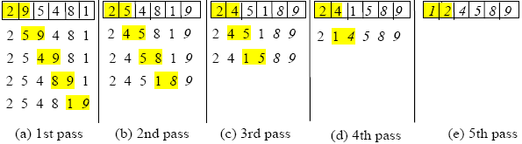
Bubble sort
Bubble sort is the easiest sorting algorithm to implement, however, it is also the most inefficient.
• Such works by repeatedly comparing two values in a
set and swopping them.
• It can work through a data set many times, making it
very slow.
• It has an average running time of O(n 2 ).
Bubble sort code example

Slide 9
Selection sort
• Selection sort also works by going through a list
repeatedly.
• It takes the first value, then goes through the list
looking for a value that is smaller.
• It then swops the two values.

Slide 10
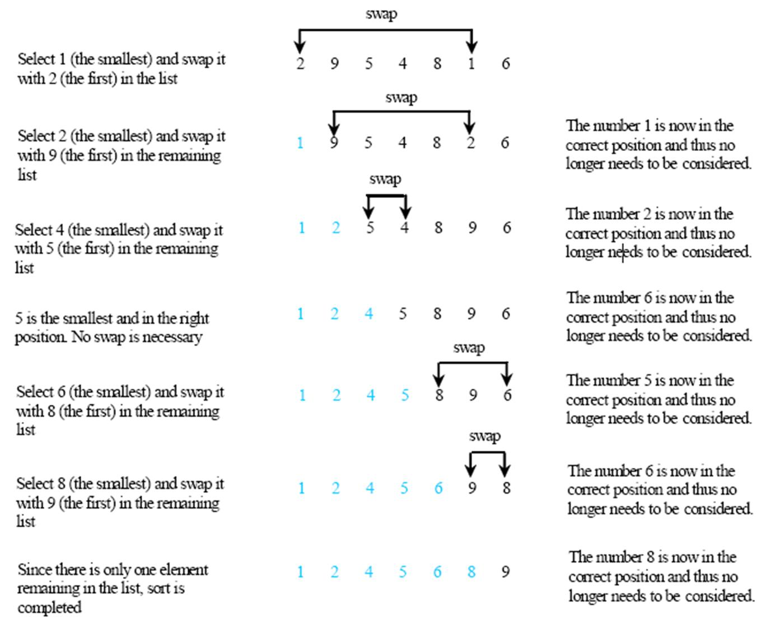

Slide 11
Insertion sort
• Insertion sort works by maintaining a list in two
sections: a ‘sorted’ section at the start and an
‘unsorted’ section at the end.
• It then works through the data and inserts each value
in its correct position in the sorted section.
• By the time it reaches the end of the list, all values are

Slide 12
