Slide 1
Sorting and Searching Cont.
  General discussion on sorting and searching
  Algorithm analysis(Time and Memory)
  Main properties of algorithms
  Sorting and Searchingvideos and demos

Slide 2
WHAT TO EXPECT TODAY
Linear Search/ Sequential Search
Binary Search(non-recursive)
Bubble Sort
Insertion Sort
Sets
Comparable
Q & A

Slide 3
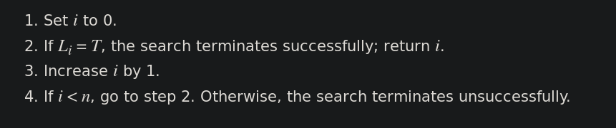
Linear Search
Data doesn’t have to be sorted
Worst case is O(n)

Slide 4
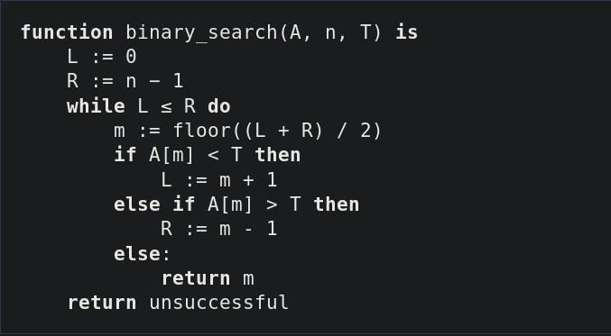
Binary Search
Also called Binary chop or half-interval search
Data MUST be sorted
Worst case is O(log n)

Slide 5
Bubble Sort
Also called Sinking Sort
Worst Case О(n x n)
Poor, mostly used for educational purpuses and there are othe better options like timesort and merge sort
It is better than “Monkey Sort”/ “Stupid Sort” etc

Slide 6
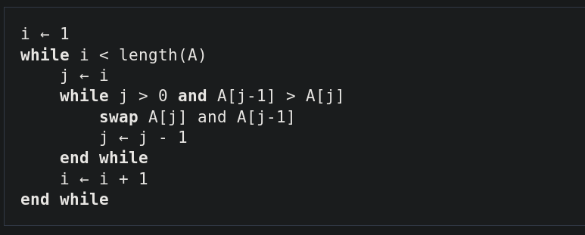
Insertion Sort
Not a bad sorting algorithm for small data sets and implemntation is relatively simple(In C/C++ = 3 lines)
Worst case is O(n x n)
Adaptive

Slide 7
Sets
Group of items/objects
It can also used to “sort ” data is some way
  Union (OR)
  Intersection (AND)
  Difference (NOT)

Slide 8
Comparable
Public interface found in Collections used for comparing objects
The class itself should implement java.lang.Comparable
It looks like public interface Comparable<T>
Integer.compare(x,y)

Slide 9
Q & A Session

