Slide 1
Lesson 6
Typescript and React

Slide 2
Topics
Recap typescript and object document model(DOM)
React and Single Page Application

Slide 3
Typescript
TypeScript is a typed superset of Javascript
TypeScript compiles into JavaScript
JavaScript is what you are actually going to execute (either in the browser or on the server)
There are two main goals of TypeScript:
• Provide an optional type system for JavaScript.
• Provide planned features from future JavaScript editions to current JavaScript engines

Slide 4
Types in Typescript
Union is a sort of sum, or set union:
A | B is a type that contains:
all the values of A,
and all the values of B, one next to each other;
type A = { x:"A1" | "A2" }
type B = { y:"B1" | "B2" | "B3" }
values of A | B are { x:"A1" }, { x:"A2" }, but also { y:"B1" }, etc. There are five of them;
Intersection is a sort of product, or cartesian product over sets:
A & B is a type that contains all the combinations of values of A and B at the same time:
type A = { x:"A1" | "A2" }
type B = { y:"B1" | "B2" | "B3" }
values of A & B are { x:"A1", y:"B1" }, { x:"A1", y:"B2" }, etc. There are six of them;

Slide 5
The View in MVC
Template engines render a template as a result
Template + data = HTML
The logic for the rendering is done on the server
We saw that it is possible to just return data in JSON format
Is there a way to process data for the V on the client?

Slide 6
React
React is a JavaScript library for building user interfaces. React is created for the V of MVC by reusable and interactive UI components.
Template engines render the whole DOM every a webpage is requested or when an event occurs
React general idea is just to render that part of the DOM that is relevant for the request or event

Slide 7
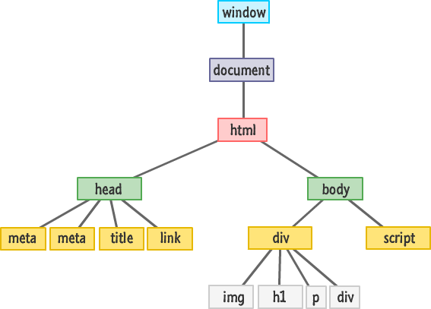
React and Document Object Model (DOM)
Dom connects web pages to scripts or programming languages. Usually that means JavaScript
The DOM model represents a document with a logical tree.
DOM methods allow programmatic access to the tree
Each branch of the tree ends in a node
This allows to change document's structure, style or content.
Nodes can have event handlers attached to them.

Slide 8
React…
Virtual DOM - Reactjs use the concept of virtual DOM
Unidirectional Data Flow - Compare to the 2 way data binding. which improve the over all performance and maintainability.
UI Components - Reusable and interactive components
Coding is simpler because of JSX

Slide 9
Core Concept of React…
Javascript and XML (JSX): javascript XML syntax transform. It helps in making our writing code easier and faster. JSX lets us write HTML with XML based object representation.
Example in VCode

Slide 10
…Core Concept of React
Virtual Dom: It selectively render the subtree of DOM elements into the rendering of the DOM on state change
Use different algorithm with the browser DOM tree to identify the changes
Instead of creating new object, Reactjs just identify what change is took place and once identify update that state.
This way it is creating a virtual DOM and improving the performance

Slide 11
…Core Concept of React
Components: the whole application is break into the components. Components are interactive and reusable. They have state and props
props: are like the HTML Properties. They are used to pass the data between the components or via the states. In React the props can be accessed by this.props.propsname
Props can be define by name=“value”. To access this we have to call this.props.name

Slide 12
…Core Concept of React
State: every component has a State object. It can be set by using the setState method or this.state = {}.
setState method triggers UI updates
to get the initial state before the setState() you can call : getInitialState.getDefaultProps

Slide 13
…Core Concept of React
Unidirectional Data-Flow:
Data flow is the flow of data from the parent to the children component by the state and the props.
Only one parent is responsible to update the states and passing the value to the children components via props.
setState is used to update/refresh the UI when the state change and the value can be pass to the children component by the this.props

Slide 14
…Core Concept of React
Component Lifecycle:
componentWillMount – Client and server side componenet Will Occur only once (before)
componentDidMount – Only once (after)
shouldComponentUpdate – Return value determines weather component should update
componentWillUnmount – Before unmounting component
Events: React has the concept of events that can be attached with the components similar to the props of the components
Events can trigger methods implemented inside a components

