Slide 1
PYTHON

Slide 2
What is Python?
Python is a high-level, general-purpose, and very popular programming language.
Python(Latest Python 3) is being used in web development, Machine learning applications.
Python is used by almost all tech-giant companies like-Google, Amazon, Facebook, Instagram……etc.
The Biggest Strength of python is huge collection of standard library which can be used for the following:
Machine Learning
GUI Applications (like Kivy, Tkinter, PyQt etc. )
Web frameworks like Django (used by YouTube, Instagram, Dropbox)
Image processing (like OpenCV, Pillow)
Web scraping (like Scrapy, BeautifulSoup, Selenium)
Test frameworks
Multimedia
Scientific computing
Text processing and many more..

Slide 3
Why learn Python?
Python is currently the most widely used multi-purpose, High-level programming language, which allow programing in object-oriented and procedural paradigms.
Python program are generally smaller than other programing language like java.
Programmers must type relatively less and the indentation requirement of the language, make them readable all the time.

Slide 4
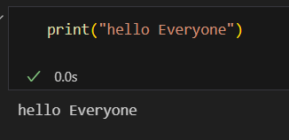
Python need Interpreter not compiler
In python ,the execution of code is line by line. Whenever the error will occur while execution at any line the code will generate error at that time it won’t execute code further.
First Code in Python:
print(“hello Everyone”)
To print something on the consol, print() function is used. This function also adds a new line after our message is printed(unlike in C).

