Slide 1
Priniciples of Reproducible Research
Patrick Mathias

Slide 2
What is reproducible research?
Reproducible research = any research result can be reproduced by anybody
Reproducibility can be achieved when the following criteria are met (Marecelino 2016):
All methods are fully reported
All data and files used for the analysis are available
The process of analyzing raw data is well reported and preserved

Slide 3
Why should I care about reproducibility?
Someone else may need to run your analysis
You will want to run the same exact analysis or a very similar analysis in the future
You may want to improve on that analysis
“Everything you do, you will probably have to do over again.” (Noble 2009)

Slide 4
Reproducbility practices discussed in this course
Develop a standardized but easy-to-use project structure
Adopt a style convention for coding
Enforce reproducibility when working with projects and packages
Use a version control system
Great resource: “Good enough practices in scientific computing” (Wilson 2017)

Slide 5
Develop a standard project structure
Put each project in its own directory, which is named after the project
Put text documents associated with the project in the doc directory
Put raw data and metadata in a data directory and files generated during cleanup and analysis in a results directory
Put project source code in the src directory
Put compiled programs in the bin directory
Name all files to reflect their content or function

Slide 6
Exercise 1
Navigate your directory structure

Slide 7
fs package: dir_ls to list files in a directory
library(fs) dir_ls("data")
## /Users/patrickmathias/src/MSACL-intermediate-R-course/data/2017-01-06_b.csv ## /Users/patrickmathias/src/MSACL-intermediate-R-course/data/2017-01-06_p.csv ## /Users/patrickmathias/src/MSACL-intermediate-R-course/data/2017-01-06_s.csv ## /Users/patrickmathias/src/MSACL-intermediate-R-course/data/2017-02-06_b.csv ## /Users/patrickmathias/src/MSACL-intermediate-R-course/data/2017-02-06_p.csv ## /Users/patrickmathias/src/MSACL-intermediate-R-course/data/2017-02-06_s.csv

Slide 8
Find files with a specific extension or pattern
dir_ls(path = "data", glob = "*_s.csv")
## /Users/patrickmathias/src/MSACL-intermediate-R-course/data/2017-01-06_s.csv ## /Users/patrickmathias/src/MSACL-intermediate-R-course/data/2017-02-06_s.csv ## /Users/patrickmathias/src/MSACL-intermediate-R-course/data/2017-03-09_s.csv ## /Users/patrickmathias/src/MSACL-intermediate-R-course/data/2017-04-08_s.csv ## /Users/patrickmathias/src/MSACL-intermediate-R-course/data/2017-05-09_s.csv ## /Users/patrickmathias/src/MSACL-intermediate-R-course/data/2017-06-08_s.csv

Slide 9
Create directory with dir_create
Optional exercise: create a projects directory
dir_create("Projects") setwd("/Projects")

Slide 10
Exercise 2
Create a new project using RStudio functionality

Slide 11
Exercise 2 Comments
RStudio projects can be easily closed and re-opened, preserving your work at a given time
RStudio projects can also help with directory organization
Working dir = project dir (unless otherwise explicitly specified)

Slide 12
Create a data directory and a results directory
Using programming languages (as opposed to Excel) can help separate analysis from data
Cannot trace what happened to data if overwritten during analysis
Raw data in data directory
Results from analysis in results or output directory
May want to separate out source code (src directory), figures, and documents (eg. manuscripts) as well

Slide 13
Exericse 3
Create a minimal project structure

Slide 14
Exercise 3 Comments
Can convert code into a function that will build project structure for you Refresher on writing functions
Alternately, use an existing package to create your project structure: eg. Project Template

Slide 15
Name all files (and variables) to reflect their content or function
Compare the following names:
results.csv
morphine_precision_results.csv
Avoid sequential numerical names: what happens to figure2.jpg and figure3.jpg if you need to insert a figure between them in the manuscript?
Pro tip: avoid white space and camel case (upper and lower case) in names
More efficient to type all lower case
Ambiguity about whether you used white space or not

Slide 16
Adopt a style convention for coding
Consistent style makes it easier for others (and yourself to read code)
Tidyverse style guide: http://style.tidyverse.org/
styler and lintr packages can style a code chunk or document for you

Slide 17
Adopt a style convention for coding
Highlights:
-Use underscores to separate words in a name (see above comments for file names)
Put a space before and after operators (such as ==, +, <-), but there are a few exceptions such as ^ or :
Use <- rather than = for assignment
Try to limit code to 80 characters per line
If a function call is too long, separate arguments to use one line each for function, arguements, and closing parenthesis

Slide 18
Style convention example
# Good do_something_very_complicated( something = "that", requires = many, arguments = "some of which may be long" ) # Bad do_something_very_complicated("that", requires, many, arguments, "some of which may be long" )

Slide 19
Representing sequential operations in R - pipes
# one way to represent a hop, scoop, and a bop, without pipes foo_foo <- hop(foo_foo, through = forest) foo_foo <- scoop(foo_foo, up = field_mice) foo_foo <- bop(foo_foo, on = head) # another way to represent the same sequence with less code but in a less readable way foo_foo <- bop(scoop(hop(foo_foo, through = forest), up = field_mice), on = head)

Slide 20
Same example using pipes
foo_foo %>% hop(through = forest) %>% scoop(up = field_mouse) %>% bop(on = head)

Slide 21
Reproducibility of directory structure
Scenario:
you have an analysis to share with a colleague
want to share entire project folder
directory calls specific files
you use setwd() to put yourself in the right place to call scripts
Problem:
Your working directory name is almost never the same as someone else’s!

Slide 22
The here package
Function in here package anchors you in one directory
Call library(here) in script
Follows algorithm to find the right place:
Looks for .Rproj and uses that directory as reference
Looks for empty “.here” file (can create this using set_here())
Looks for other relevant files such as “.git”

Slide 23
Reproducibility of packages
Scenario:
in September 2019 you want to run an analysis you wrote in September 2018
you are using cutting edge packages that may have changed in 1 year
some changes impact expected input and output data structure
Problem: Your script may fail to run or (much worse) your script runs but produces incorrect output!

Slide 24
Package management solutions
checkpoint package couples package install to a date
Based on Microsoft server that is taking daily snapshots of CRAN
Add library(checkpoint) and checkpoint("2018-09-09") to begining of script
packrat package allows explicit specification of package versions
More complex to manage but arguably the “ideal” way to manage packages
RStudio integration with Packages window

Slide 25
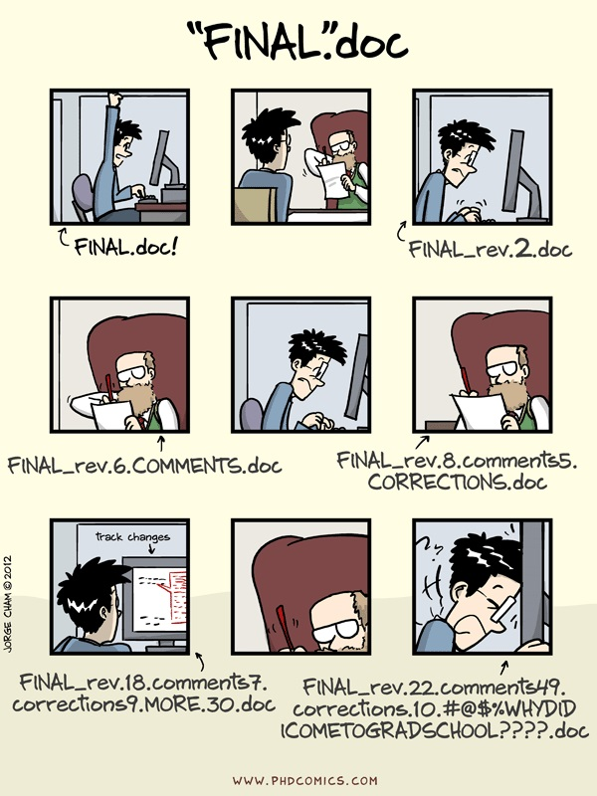
Why use version control?
One of many justifications for using version control. Source: phdcomics.com

Slide 26
Git principles
Git works by taking snapshots of a set of files over time
Most operations are performed on your local machine
Every change is captured
Git generally adds data and does not remove it (which means it is hard to lose data)

Slide 27
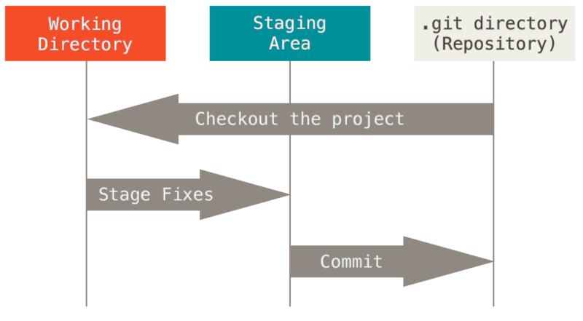
Git workflow
Git basic workflow. Source: https://git-scm.com/book/en/v2/Getting-Started-Git-Basics

Slide 28
Git setup
If you have not set up Git per the pre-course instructions (https://git-scm.com/book/en/v2/Getting-Started-Installing-Git) and signed up for an account on Github.com (https://github.com/join), you will need to do so before you can complete the next exercise.

Slide 29
Exercise 4
Walk through a local Git workflow to commit a file in your sample-project-structure

Slide 30
Exercise 4 Comments
Local Git workflow addresses versioning issues
You decide when to stage and commit a version
Commit messages can help trace your work
Provides ability to roll back to a previous version (not covered but quick access through History button)

Slide 31
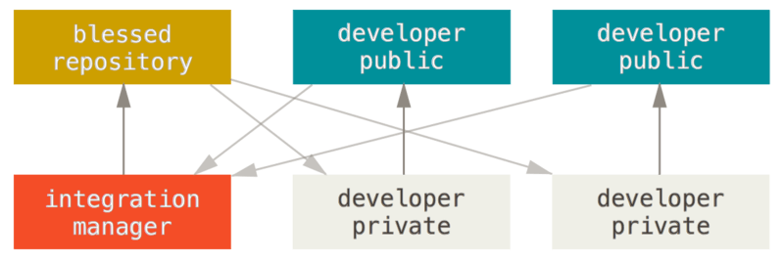
Distributed workflows: central management
Integration manager workflow with Git. Credit: https://git-scm.com/book/en/v2/Distributed-Git-Distributed-Workflows

Slide 32
Exercise 5
Fork course repository and open as new project in RStudio

Slide 33
Exercise 6
Push your changes to your remote repository

Slide 34
Exericise 5 & 6 comments
Github (or other hosted Git solution) allows a remote repository to be synced and worked on at multiple locations/computers
More importantly, a remote repository provides a mechanism for collaboration

Slide 35
Optional exercise
Open a pull request and have your edits come back into the base repository

Slide 36
Additional Git wisdom
Use branches and couple to features/issues
Set up ssh to transfer data
Consider what should and shouldn’t go into version control
Happy Git and GitHub for the useR online book - Git in RStudio
Pro Git - general Git info

Slide 37
Bringing it all together: an example of Git + Packrat
Bo Burla, Data Science 201 alumnus from MSACL EU 2018, created the following reproducible analysis: https://github.com/pcmathias/Manuscript_Sieber-Ruckstuhl_Burla_2019

Slide 38
Lesson 1 wrap-up
Reproducible research is the principle that any research result can be reproduced by anybody
Practices in reproducible research also offer benefits for to the code author in producing clearer, easier to understand code and being able to easily repeat past work

Slide 39
Lesson 1 wrap-up
Important practices in reproducible research include:
Developing a standardized but easy-to-use project structure
Adopting a style convention for coding
Enforcing reproducibility when working with projects and packages
Using a version control system to track work and collaborate with others

