Slide 1
Lesson 5: Blending data from multiple files and sources

Slide 2
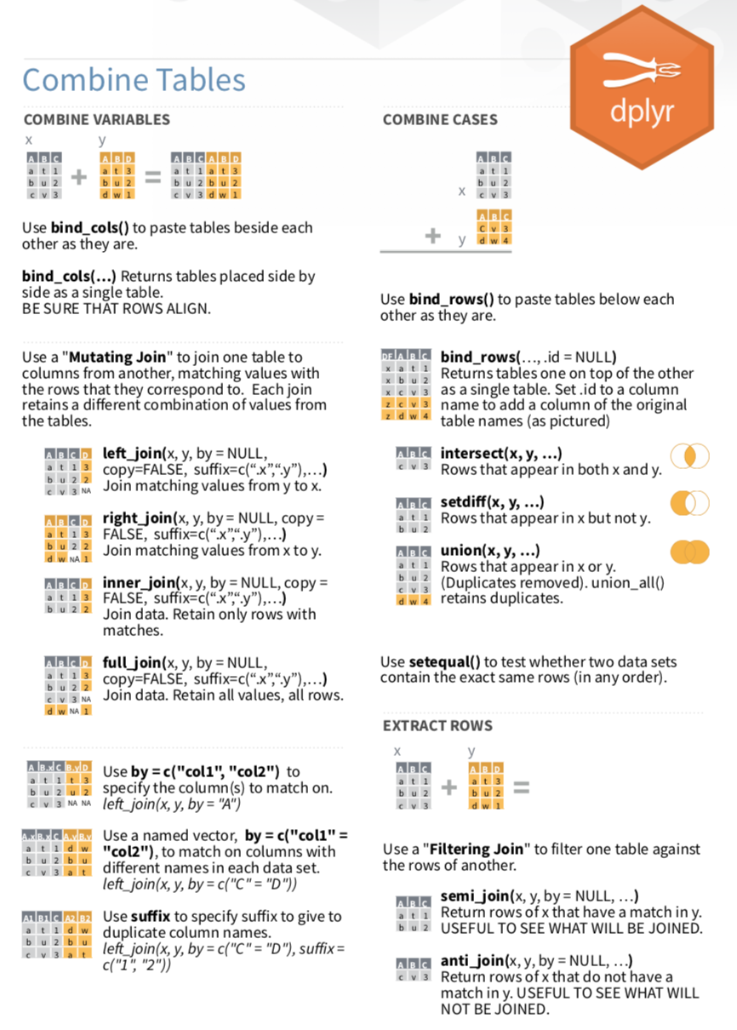
When would you need to blend data?
When you want to analyze:
Multiples of the same type of files from different dates, batches, assays, etc. (same cols, add rows)
Different data files that need to be combined – EHR extracts with lab data (same rows, add cols)
Files of different structure and dimension – lab data from different sources or tables (diff rows, diff cols)

Slide 3
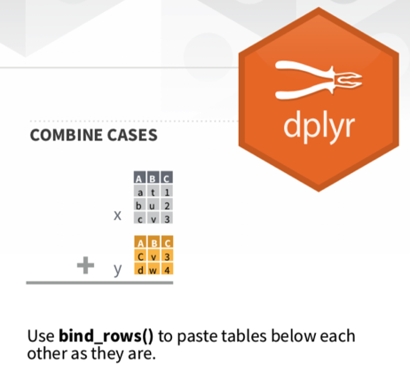
Exercise 1
bind_rows(january_peaks, february_samples)
bind_rows(january_batches, february_samples)
A | B | C | D | E | F | G
A | B | C | H | I | J | K | L | M | N
A | B | C | D | E | F | G
H | I | J | K | L | M | N
a | b | c | 1 | w | 3 | y | NA | NA | NA | NA | NA | NA | NA
a | b | c | 2 | x | 4 | z | NA | NA | NA | NA | NA | NA | NA
b | b | C | NA | NA | NA | NA | 3 | I | J | 1 | 3 | m | 0
b | b | C | NA | NA | NA | NA | 4 | i | j | 2 | 4 | m | 0
Binds the rows where columns line up
Where not, values = NA

Slide 4
Exercise 1
bind_rows(january_samples, february_samples)
A | B | C | D | E | F | G
A | B | C | D | E | F | G
A | B | C | D | E | F | G
a | b | c | 1 | w | 2 | z
a | b | c | 1 | w | 2 | z
b | b | C | 3 | X | 4 | A
b | b | C | 3 | X | 4 | A

Slide 5
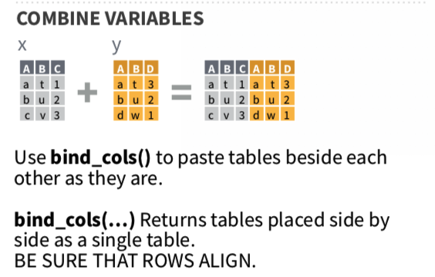
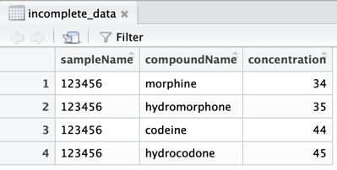
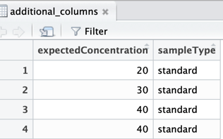
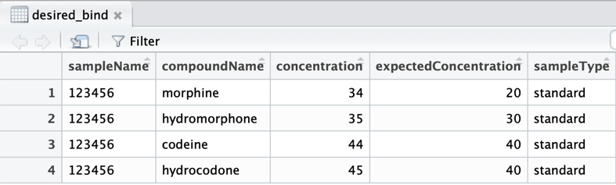
bind_cols(incomplete_data,additional_columns)
incomplete_data
additional_columns
+
incomplete_data
additional_columns

Slide 6
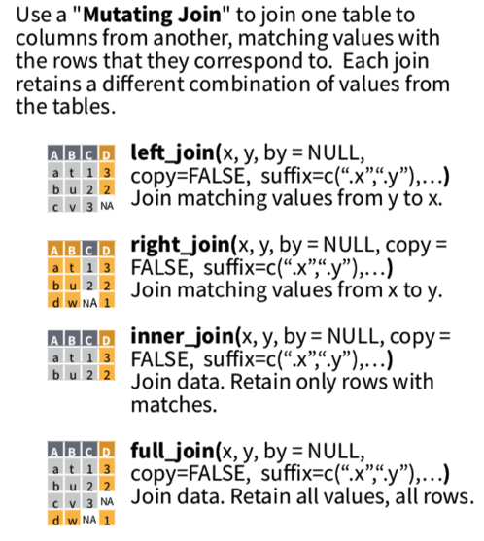
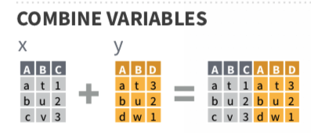

Slide 7
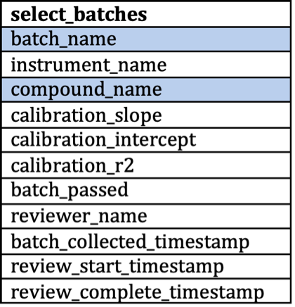
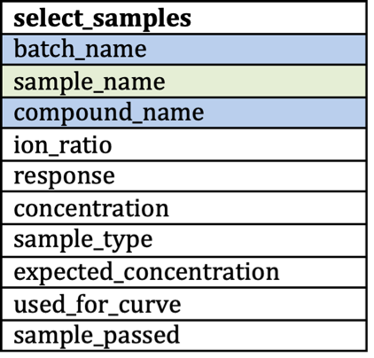
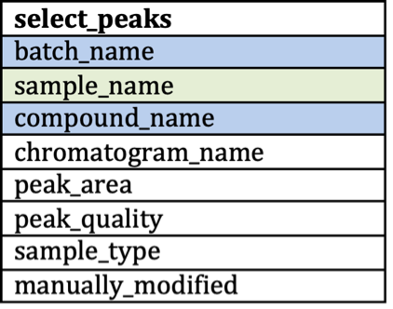
Visualizing relational data structure and keys

Slide 8
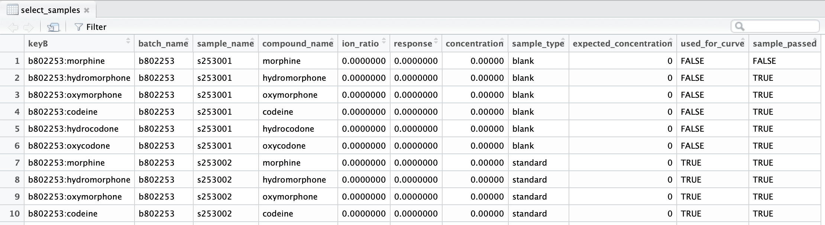
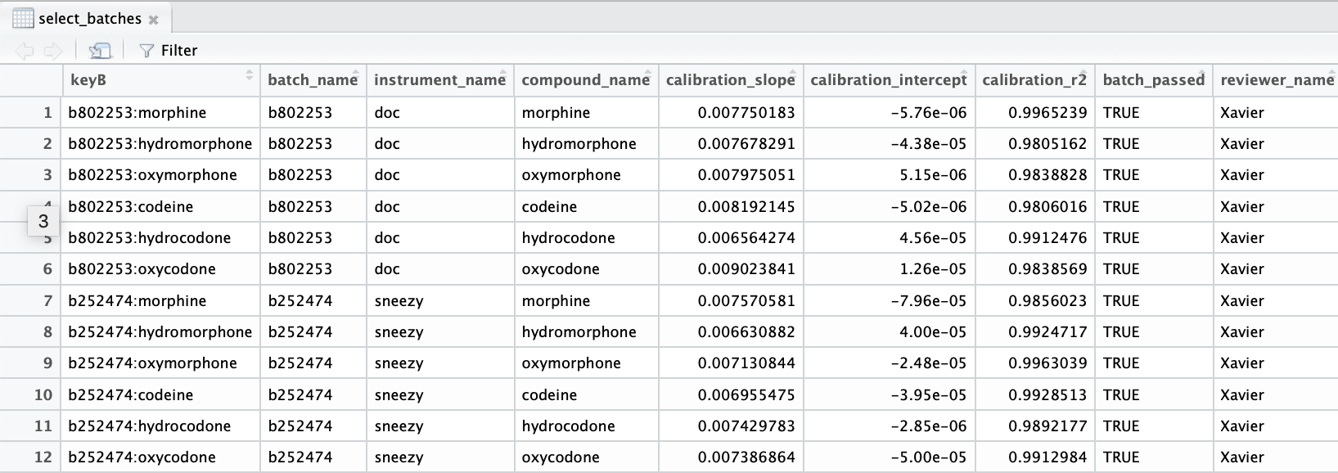
left_join(select_samples, select_batches, by= "keyB")

Slide 9
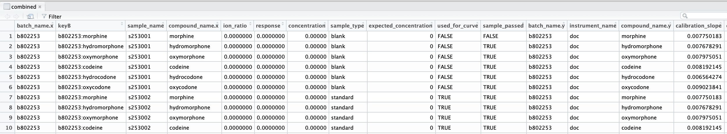
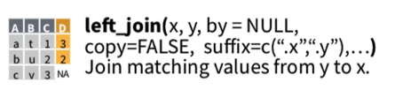
select_samples
select_batches
Get batch_name.x and batch_name.y (and compound_name.x and compound_name.y) because these are duplicate columns. (We did not remove these columns when creating primary key.)
If undesired, how to prevent this?
remove = TRUE (default) when creating primary key (but will lose these columns) OR
instead of creating primary key, specify which columns to join by in call (by = c(“batch_name”, “compound_name”) OR
create primary key and use remove = FALSE, but join by = c(“keyB”, “batch_name”, “compound_name”)
left_join(x,y, by = c(“A”, “B”))

Slide 10
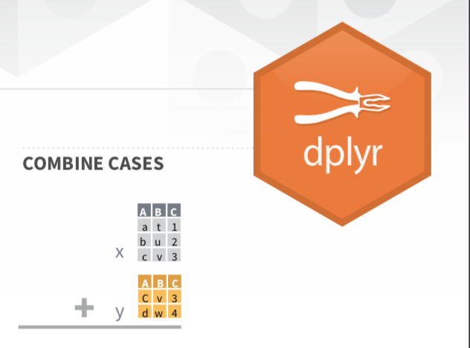
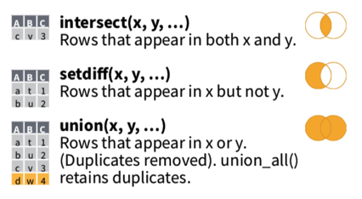
A
B
1
2
3
4
5
6
7
8
9
10
1
2
3
4
5
6
7
8
9
10
2
4
6
8
10
12
14
16
18
20
union(A,B)
intersect(A,B)
1
2
3
4
5
6
7
8
9
10
2
4
6
8
10
setdiff(A,B)
setdiff(B,A)
12
14
16
18
20
1
3
5
7
9
12
14
16
18
20

Slide 11
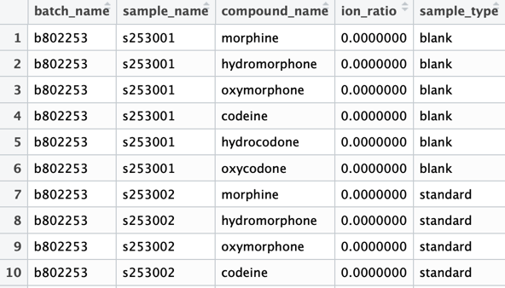
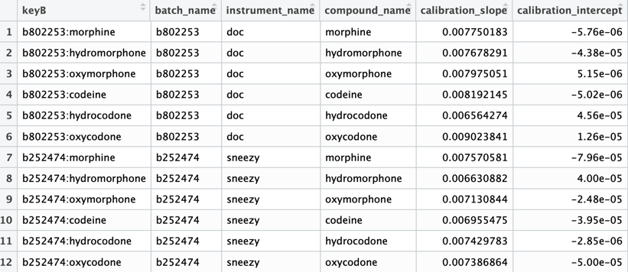
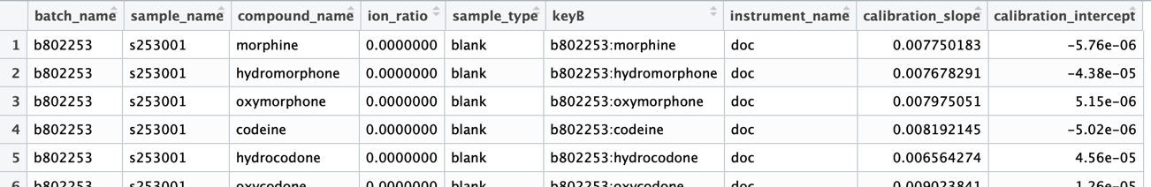
x
y
inner_join(x,y, by = c(“batch_name”, “compound_name”)
x
y

Slide 12
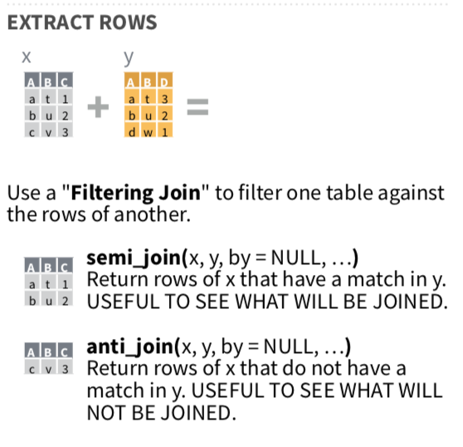

Slide 13
Some people, when confronted with a problem, think "I know, I'll use regular expressions." Now they have two problems.
-- Jamie Zawinski
replacement
mutate(analyte = sub("-.*$", "", analyte))
pattern
look where
-.*$ = from – to end of string, match on 0+ of any character
compound: morphine
internal standard: morphine-13C

Slide 14
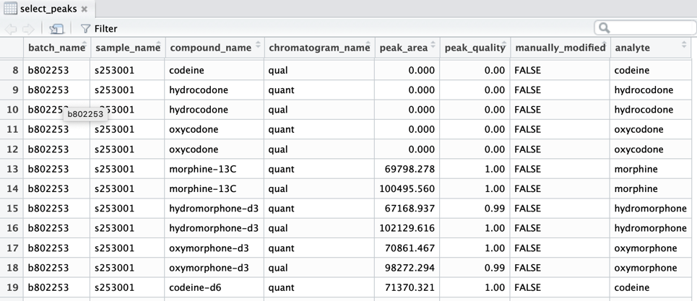

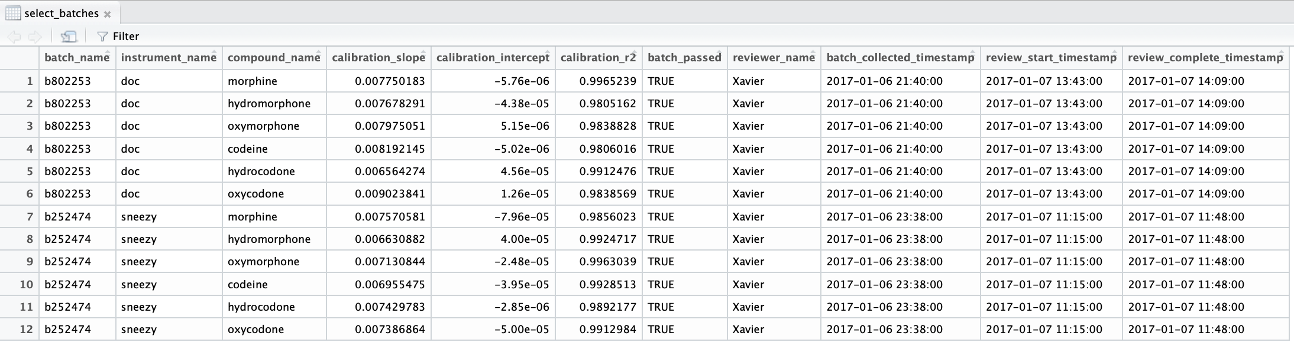
version1
version2
version 1: noMatch <- anti_join(select_peaks, select_batches)
version 2: noMatch <- anti_join(select_peaks, select_batches,
by=c("batch_name","analyte"="compound_name"))

Slide 15
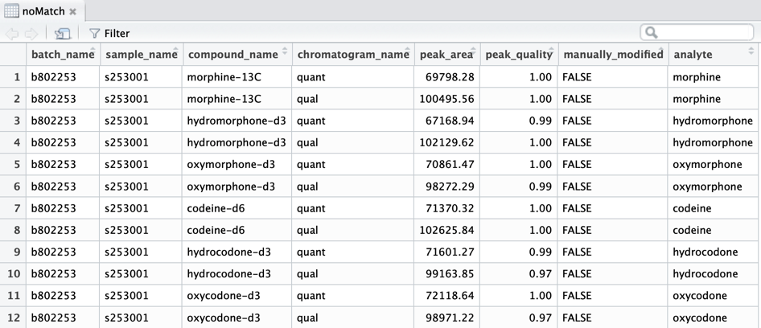
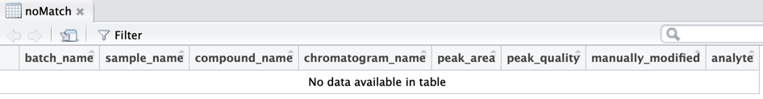
version 1: noMatch <- anti_join(select_peaks, select_batches)
version 2: noMatch <- anti_join(select_peaks, select_batches,
by=c("batch_name","analyte"="compound_name"))
version1
version2:

Slide 16
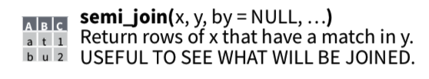
semi_join(select_peaks, select_batches, by=c("batch_name","analyte"="compound_name"))

Slide 17
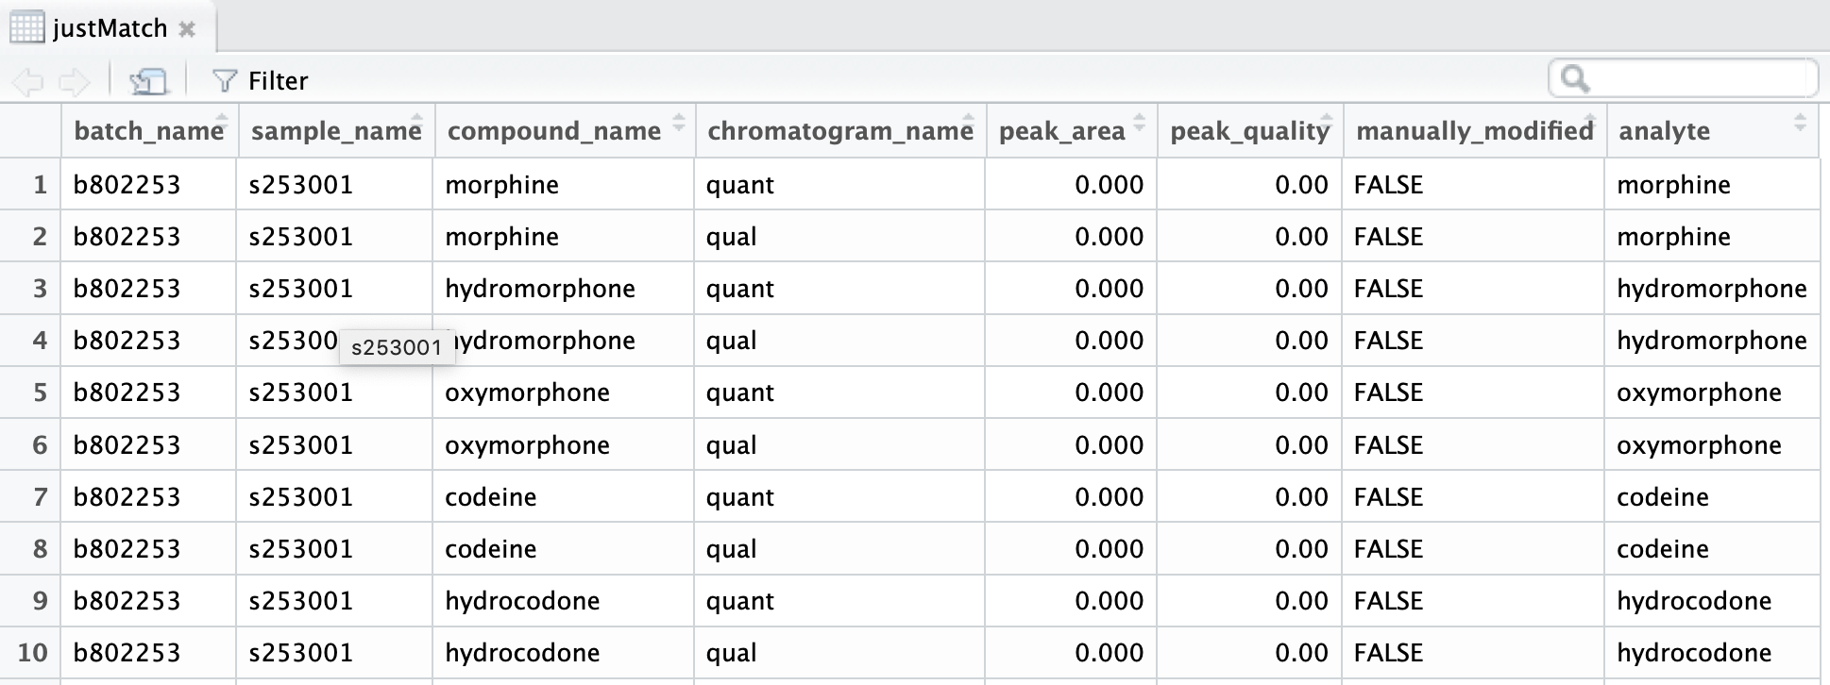
justMatch is same as select_peaks
semi_join(select_peaks, select_batches, by=c("batch_name","analyte"="compound_name"))

Slide 18
Exercise 2
Our noMatch experiment showed that we need the modified analyte column so we don’t omit the internal standard rows
Using our regex skills with sub, modify entries in analyte column of select_peaks to match available entries in select_batches:
select_peaks$analyte <- sub("-.*$", "", select_peaks$analyte)
OR
select_peaks <- select_peaks %>%
mutate(analyte = sub("-.*$", "", analyte))
Call the left join and specify to use the analyte column of select_peaks for comparison with compound_name of select_batches
left_join(select_batches, select_peaks,
by=c("batch_name","compound_name" = "analyte")

