Slide 1
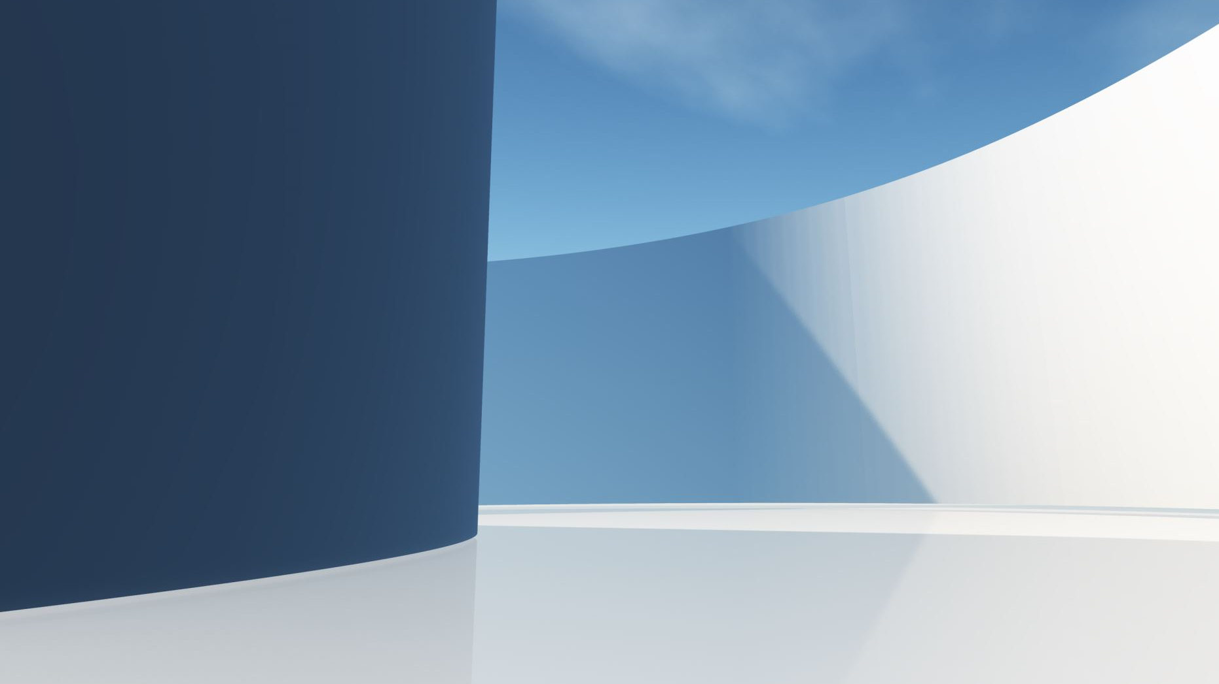
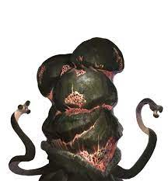
Project Discoverty (A.k.a tHE bLORG hUNT)
Membrii ECHPEI:
CHITIGA ALEXANDRU GABRIEL(DESIGN)
BENEA VASILE(MUZICA/PREZENTARE)
CHIRILA STEFAN(Main CODER/Level Logic)
THE BLORG

Slide 2
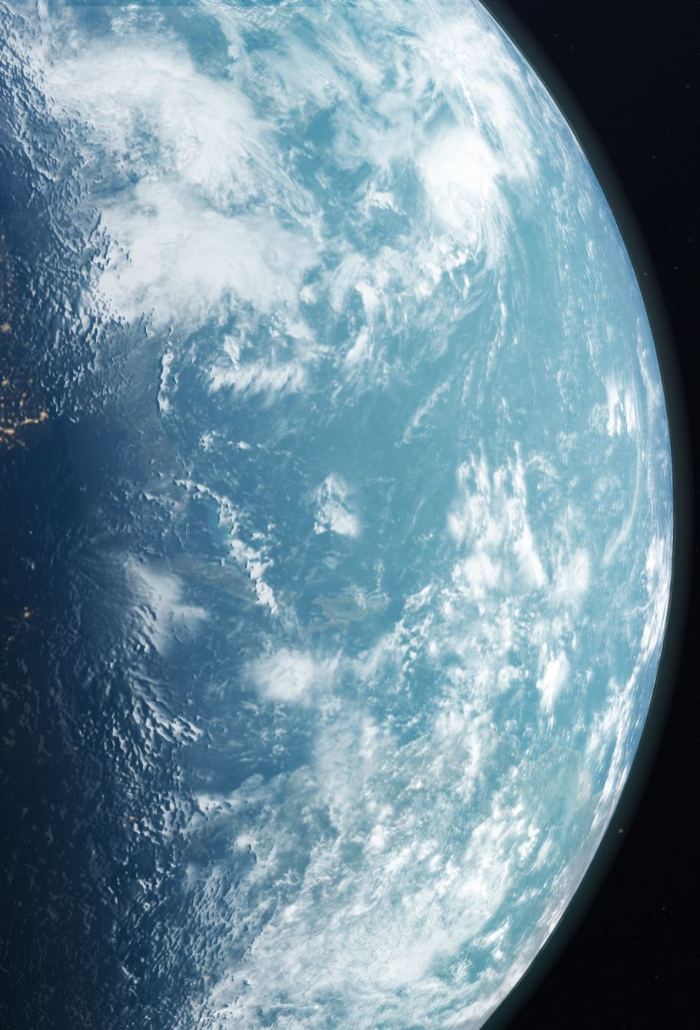
WHO ARE THE BLORG?
In the very distant past, the Blorg were living alone and unnamed in the vast jungles of Blorg prime. Eventually these nameless primitives gain sentience and built a rudimentary civilization. This civilization was hollow and without purpose as the blorg went about their days wandering aimlessly in search of a purpose. But on one fateful day they received strange radio transmissions from a distant star system. What their flagellum heard shook them to the core. The sounds of friends, movies, culture, and music - things the Blorg had dreamed of for eons. After finally understanding what their species had been missing all along, the Blorg took their names from these awe inspiring transmissions and went out into the stars in search of these so called "friends". The Blorg, using this discovery as a purpose of living, had set out to the stars hoping that one day they can source of these messages that brought purpose into their lives.This is where our robot Kyle comes in , he was sent on a mission by his creators the Blorg to find this "friends".

Slide 3



THE SCOPE OF THE GAME:
In acest joc gol-ul nostru ca si jucator este de-a il ghida pe Kayl in calatoria lui de a gasi prieteni pentru Blorgi
Kyle
Gol

Slide 4

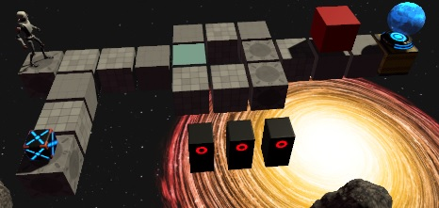


The selling pointS of the game:
Complexitatea nivelelor/designul acestora
Soundtrack-ul genial
Hand Crafted Art(majoritatea cazurilor)

Slide 5
IN CONCLUSION:
TRUST ME BRO!JUST BUY THE GAME!!!

