Slide 1
Unit 4 Sports and Sportsmanship

Slide 2
Learning Objectives
Moral
Achieve a thorough understanding of “sportsmanship”.
Appreciate the role of sports in the development of an individual and sportsmanship both on and off the field.
Skills
Learn to write a notice or poster
Develop critical thinking abilities
language
Grasp key language points and their usage in context

Slide 3
CONTENTS
Part 1
Before Reading
Part 2
In Reading
Part 3
After Reading
Part 4
Critical Thinking
Part 5
Culture Focus
Part 6
Home Reading

Slide 4

Before Reading
Watch the interview with Natalie Hawkins and list the benefits competitive sports can have on children. The blank filling exercise on page 111 can be of some help.

Slide 5
Before Reading
For your reference
P 111
1. Sports really helped Gabrielle become a more mature individual. Natalie Hawkins watched her and her other three children, all involved in sports, blossom before her eyes.
2. Sports taught Natalie’s children extreme self-discipline. It taught them how to work as a team to achieve a common goal.

Slide 6
Before Reading
For your reference
P 111
3. Natalie’s children also learned about time management through sports. They had to figure out how to focus on their schoolwork while taking up sports activities. And they even became their mom’s timekeepers, keeping her accountable for time.
4. Natalie thinks her children have learned some beautiful lessons and those lessons could have only been learned in sports/in the arena of sports. So, she truly believes that elite sports has many positive aspects to it.

Slide 7

Before Reading
Discuss in pairs.
1. What are some other benefits aside from those mentioned in the video that young children can derive from playing competitive sports?
2. What is your favorite sport? How has playing that sport benefited you physically, mentally and even emotionally?

Slide 8

In Reading
Global Reading
Detailed Reading

Slide 9
In Reading – Global Reading
Text Organization
Parts | Para(s). | Main Ideas
One | Paras. 1
Two | Paras. 2–8
Three | Paras. 9–10
It is soccer that captures my heart and soul.
How I have evolved from a couch potato into an esteemed member of a college soccer team.
Soccer has made a huge difference in my life and my love for it will never diminish.

Slide 10
In Reading – Global Reading
Questions about the Text
How did the author start playing soccer?
His parents signed him up for soccer because they didn’t want him to be a couch potato.
2. Did he enjoy playing soccer at first? Why or why not?
He didn’t enjoy it. For one thing, there were too many concepts that were unfamiliar to him. For another, he was frustrated because he was not as good as other children.

Slide 11
In Reading – Global Reading
Questions about the Text
3. Why did the author give up baseball in the end even though he was quite good at it?
He was irritated by the overall duration of each inning and the entire game. And speed, thrill, intensity and fun were missing.
4. Why does the author call himself a “late bloomer”?
He didn’t become good at soccer until he was much older and after having tried other sports.

Slide 12
In Reading – Global Reading
Questions about the Text
5 How has soccer shaped the author’s personality?
He has evolved from a shy and timid person into a strong player and a man.
6 What has the author gained from playing soccer?
He has gained from playing soccer honors, skills, experiences with different people and cultures, and a change in his personality for the better.

Slide 13
In Reading – Detailed Reading
Why Soccer Is More Than Just a Game
Love, passion and commitment have all defined my life playing soccer.
by Kaushik Dhanyamraju
1 Certain things have a way of capturing our hearts and souls. It could be music, painting or gaming. All of our troubles, even for a moment, seem to just disappear and we can enjoy ourselves to the fullest with that one thing. For me, that one thing is soccer.

Slide 14
In Reading – Detailed Reading
2 It all started when I was six years old. I was a happy-go-lucky child who was content with life as a couch potato. One day, my parents came back from work and said, “We signed you up for soccer. You can’t spend each and every day going to school and doing nothing.” I definitely have my parents to thank because that very decision they made 15 years ago would forever change my life. When I started playing, however, I had no idea what I was doing. Passing, dribbling, shooting, teamwork — they were all foreign concepts to me. Although it was normal for most six-year-old kids to feel the same way, that uncertainty led to apathy. I would have rather been playing “Super Mario Brothers” on my old Gameboy Advance, or watching the latest episodes of “Spongebob Squarepants ” on Nickelodeon .

Slide 15
In Reading – Detailed Reading
3 Eventually, my stubbornness began to give. As I began to play more often, there was just something mystifying, yet fun, about playing the beautiful game. Maybe it was being around other kids my age outside of school, or maybe it was feeling useful and appreciated while playing as a defender or goalie. I couldn’t place my finger on it, but soccer had my attention.

Slide 16
In Reading – Detailed Reading
4 As time went on, my father bought me the latest soccer video games for my computer and PlayStation . He even called Dish Network, our satellite cable provider, to unblock the soccer channels. Even though I wouldn’t start watching soccer on a daily basis until I was 13, the intentions my father had definitely spoke volumes. However, my frustration with not being as good as other kids my age began to wear me down. I ended up giving up the beautiful game for a year in order to play baseball.

Slide 17
In Reading – Detailed Reading
5 With baseball, I was actually pretty good. Throughout the North Brunswick little league, I developed quite the reputation for my batting prowess. My teammates and I really enjoyed each other’s company. However, the long periods I had to wait to bat and just the overall duration of each inning, let alone the entire game, really irritated me. Also, some aspects were missing — speed, thrill, intensity, excitement and most importantly, fun. It was at that moment I realized I wanted to return to soccer, and once again, my life would never be the same.

Slide 18
In Reading – Detailed Reading
6 I’m a late bloomer, and it was evident on numerous occasions as I erupted into a ferocious 9-year-old forward in recreational soccer, started playing travel/club soccer for North Brunswick when I was 11 and eventually becoming a tenacious forward and midfielder for my local Monroe travel team. By then, soccer had everything I’ve always wanted: the speed, the thrill, the intensity, the excitement and most importantly, the fun. However, the game still lacked a certain essence, but it’s clearer in hindsight than it was at the age of 13.

Slide 19
In Reading – Detailed Reading
7 That all changed when I tried out and made the Monroe Township Middle School Boys’ Soccer team during the fall of my eighth-grade year. Immediately, I was catapulted into a whole new world of soccer that exceeded the wildest of my imaginations. The culture was incredible, and I was surrounded by players who already played for state and regionally ranked clubs. The constant discussions about tactics took my young mind by storm. I wanted to reach and surpass the level of play my middle school teammates were at.

Slide 20
In Reading – Detailed Reading
7 After that fall 2008 season, I committed myself to improving as a player. I contacted multiple teams to try out for, practiced soccer in my house (much to the chagrin of my parents) and registered for a number of camps and clinics for my age and up. Throughout the beginning of this newfound experience in soccer, what I was searching for became apparent — love. The respect I had for the game turned into admiration, and that admiration, into love.

Slide 21
In Reading – Detailed Reading
8 Throughout this journey, I’ve traveled all over the country for the beautiful game. Whether it was league games, one-day tournaments, or college showcases, the weekends would always be my favorite time of the week. I loved soccer so much that I decided I would not let myself go to college without receiving a quality education and playing NCAA soccer, and that was a goal I had since I was 16. Soon after my last season of high school soccer, I subjected myself to productive, yet rigorous training that I still follow to this day.

Slide 22
In Reading – Detailed Reading
8 With this course of action, I’ve increased my size, strength and stamina in addition to my technical ability. Through the blood, sweat and tears, I’ve evolved into both a player and man my teammates, coaches, supporters and most importantly, myself, would be proud of. Being an esteemed member of both Men’s Soccer and the overall community at Rosemont College is proof of that evolution, and I could not be more fulfilled with a rewarding experience.

Slide 23
In Reading – Detailed Reading
9 By now, it’s pretty obvious that I have played a lot of soccer. Everyone else, especially in high school, would be out hanging out with friends, partying, so on and so forth. While they chose these routes, I chose to play soccer. It wasn’t because I thought I was better than everyone else. I simply played soccer because I loved it with a burning passion. It was my goal to train and go as far as I possibly could in my footballing career. I am always thinking about the next practice, game or chance to just go to the local fields and just shoot around.

Slide 24
In Reading – Detailed Reading
9 My social life thrived off of playing the beautiful game, as I have come across a multitude of skill levels, people, cultures and much more from this sport. My friends were my teammates, and my best life experiences came from playing soccer. My coaches were not only there for growth and development in soccer — they were my mentors outside the classroom. I’m no longer the shy and timid person I used to be thanks to the way the beautiful game shaped my personality.

Slide 25
In Reading – Detailed Reading
9 The love I have for this game cannot be measured. Throughout the course of my career, trophies were won, goals were scored, championships were lost, chances were squandered, tears were shed and bones were broken. Regardless of the good and the bad, the happiness, sadness, anger, frustration, determination, tenacity and fun that simply come with the game, I will always love the sport.

Slide 26
In Reading – Detailed Reading
10 Bill Shankly, one of Liverpool FC’s most iconic managers, once said, “Football is not a matter of life and death … it’s more important than that.” I hold this quote to be true — it’s who I am, it’s the embodiment of my soul and it’s in my blood. Through the good, bad and ugly, my fire for the game burns brightly all the same. I’m not a professional, All-American or up-and-coming prodigy. I’m simply a man who loves a sport. Regardless, one thing remains certain: soccer will always be more than just a game to me.

Slide 27


D R _ word _ fantasy1
In Reading - Language Focus
commitment: n. a willingness to give one’s time and energy to sth. that one believes in, or a promise or firm decision to do sth. 投入；承诺
A career as an actor requires one hundred percent commitment.
干演员这一行需要百分之百的投入。
这家公司保证供货质优价廉的承诺是它成功的关键。
The company’s commitment to providing quality products at a reasonable price has been vital to its success.

Slide 28
D R _ Sentence 1
In Reading - Language Focus
All of our troubles, even for a moment, seem to just
disappear and we can enjoy ourselves to the fullest
with that one thing.
Translate the sentence into Chinese.
只要有了它，哪怕只是片刻，我们所有的烦恼似乎立刻烟消云散，让我们能尽情享受。

Slide 29

In Reading - Language Focus
I was a happy-go-lucky child who was content with life as a couch potato.
How do you understand the term “a couch potato” ?
A couch potato is someone who spends a lot of time sitting and watching television.
Paraphrase the sentence.
I was a carefree child and I was content with my life with leisure time spent watching a lot of television.

Slide 30
In Reading - Language Focus
sign (sb.) up (for sth.): agree to (let sb.) become involved in an organized 报名（让某人）参加
她已经报名参加社区学院夜间课程的学习。
She’s signed up for evening classes at the community college.
我已报名为聚会做三明治。
I’ve signed up to make the sandwiches for the party.

Slide 31
In Reading - Language Focus
each and every:（用于强调）每一个
Each and every one of the flowers has its own color and smell.
每一种花的色彩和气味都各不相同。
公司将继续致力于从小型到大型机器的产品多样化，以满足每一位客户的需要。
The company will continue to provide a wide range of products from small to large machines in order to suit each and every customer need.

Slide 32
In Reading - Language Focus
episode: n. a part of a serialized work, such as a novel or television series（电视连续剧的）一集；（小说的）一个事件
One of the funniest episodes in the book occurs in Chapter 6.
书中最有趣的事件之一发生在第六章。
The first episode of the first season of a TV show is also known as the “pilot”.
电视剧的第一季第一集也被称为“试播集”。

Slide 33
D R _ Sentence 1
In Reading - Language Focus
Passing, dribbling, shooting, teamwork — they were all foreign concepts to me.
Paraphrase the sentence.
Passing, dribbling, shooting, teamwork — they were all beyond my comprehension.

Slide 34
D R _ Sentence 1
In Reading - Language Focus
Although it was normal for most six-year-old kids to feel the same way, that uncertainty led to apathy.
What does “uncertainty” refer to?
The author couldn’t fully understand and appreciate soccer.
Translate the sentence into Chinese.
尽管对于大多数六岁孩童来说，这种感觉实属正常，可是这种捉摸不定使我对足球产生不了兴趣。

Slide 35
In Reading - Language Focus
appreciate: vt. recognize the good qualities of sb./sth.; be grateful for sth. that sb.has done 欣赏；感激
She feels that he does not appreciate her.
她觉得他并不赏识她。
看翻译作品不能真正欣赏外国文学原著的美妙之处。
You can’t really appreciate foreign literature in translation.
I would appreciate it if you could let me know in advance.
如能提前告知我，我将不胜感激。

Slide 36
D R _ Sentence 1
In Reading - Language Focus
Eventually, my stubbornness began to give.
Paraphrase the sentence.
Eventually, my stubbornness started to fade away.

Slide 37
D R _ Sentence 1
In Reading - Language Focus
I couldn’t place my finger on it, but soccer had my attention.
Translate the sentence.
我说不清楚，但足球吸引了我的注意力。
place/put one’s finger on
discover the exact reason why a situation is the way it is
准确地找出原因

Slide 38
In Reading - Language Focus
on a daily basis: 每一天
How much desktop software do you generally use on a daily basis?
你平日里常用的桌面软件有多少？
安全设备每天都进行检查。
Safety equipment was checked on a daily basis.

Slide 39
In Reading - Language Focus
intention: n. what one intends or plans to do 打算；计划；意图
I have no intention of going to his wedding.
我无意去参加他的婚礼。
他说他为自己弹吉他的风格感到自豪，并一心想露一手。
He’s proud of his guitar style, he says, and he has every intention of showing it off.

Slide 40
In Reading - Language Focus
speak volumes: give a lot of information without the use of words 不言自明
The crowd gathered at the entrance to the stadium spoke volumes of the soccer team’s popularity.
看体育馆进口处聚集的人群，就知道这支足球队有多受欢迎。
有时什么都不用说，仅仅一个眼神交汇就够了。
Sometimes nothing needs to be said. A mere glance at each other can speak volumes.

Slide 41
In Reading - Language Focus
wear sb./sth. down: make sb./sth. weaker and less able to deal successfully with a situation 使精疲力竭；磨垮
They hoped the waiting and the uncertainty would wear down my resistance.
他们希望这种等待和不确定性将拖垮我的抵抗。
Both sides are trying to wear the other down by being obstinate in the negotiations.
双方在谈判中都不肯让步，试图耗尽对方的耐性。

Slide 42
D R _ Sentence 1
In Reading - Language Focus
However, my frustration with not being as good as other kids my age began to wear me down.
Paraphrase the sentence.
However, compared with kids my age I was not much of a soccer player, and the resulting sense of frustration began to make me lose interest in the game.

Slide 43
In Reading - Language Focus
let alone: to say nothing of; not to mention 更不用说
Many thousands of children had never even seen, let alone owned a pair of shoes.
There isn’t room for all of us, let alone your cats.
病人很虚弱，他不能坐起来更别说走路了。
The patient was so weak that he could not sit up, let alone walk.
他连带领保龄球队的本事都没有，更别提领导国家了。
He was incapable of leading a bowling team, let alone a country.

Slide 44
In Reading - Language Focus
evident: a. clear; easily seen 清楚的；显而易见的
Her love for him was evident in all that she did.
她所做的一切都清楚地表明她爱他。
散发出的气味表明下水道显然已经被堵好几天了。
From the smell it was evident that the drains had been blocked for several days.

Slide 45
In Reading - Language Focus
essence: n. the most important quality or feature of sth. that makes it what it is 本质；精髓
Yet change is the very essence of life.
然而变迁恰恰是人生的本质。
他观点的要旨是教育应该持续终生。
The essence of his argument was that education should continue throughout life.

Slide 46
D R _ Sentence 1
In Reading - Language Focus
I’m a late bloomer, and it was evident on numerous occasions …
Paraphrase the sentence.
I’m a person who achieves success later than my peers, and this was evidenced/proved many times…
Translate the sentence into Chinese.
我成才较晚，这一点无数次得到了印证：九岁一跃成为休闲足球凶猛的前锋，十一岁进入北布伦斯威克少年/俱乐部足球队，最终成为我们当地门罗少年足球队顽强的前锋和中场。

Slide 47
D R _ Sentence 1
In Reading - Language Focus
However, the game still lacked a certain essence, but it’s clearer in hindsight than it was at the age of 13.
Paraphrase the sentence.
However, the game still lacked a certain spirit, and that spirit is clearer when I look back on it now than it was when I was 13.
Translate the sentence into Chinese.
然而，这项运动还是缺了一点精髓，不过这一点是我后来回想时才明白过来的，其时十三岁的我还懵懵懂懂。

Slide 48
In Reading - Language Focus
exceed: vt. be greater than a number or amount, or go past an allowed limit 超过；超越
The final cost should not exceed $5,000.
最终的花费不应超出5,000美元。
你超速行驶，罚款200元。
You’re fined 200 yuan for exceeding the speed limit.

Slide 49
In Reading - Language Focus
take…by storm: captivate, overwhelm 征服
Her performance has taken the critics by storm.
她的表演完全征服了评论界。
这部新剧在伦敦大获成功。
The new show took London by storm.

Slide 50
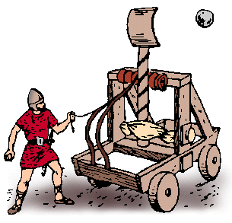
D R _ Sentence 1
In Reading - Language Focus
Immediately, I was catapulted into a whole new world of soccer that exceeded the wildest of my imaginations.
Translate the sentence into Chinese.
我一下子被送进了一个崭新的足球世界，这个世界超乎我最狂野的想象。
catapult: n.弹弓，石弩，弹射器
vt.vi. 弹射；(使)突然处于
catapult… into: if something catapults you into a particular state or situation, you are suddenly and unexpectedly caused to be in that state or situation.

Slide 51
In Reading - Language Focus
multiple: a. many in number; involving many different people or things 多个的；多种,多样的
We’ve made multiple copies of the report.
我们把报告复印了多份。
我们现在习惯于从不同渠道获取信息。
We’re now used to accessing information through multiple channels.

Slide 52
D R _ Sentence 1
In Reading - Language Focus
Whether it was league games, one-day tournaments, or college showcases, the weekends would always be my favorite time of the week.
“Whether…or” can be used in an adverbial clause of concession to indicate that something is true in any of the circumstances you mention.
“whether... or...”可以引导包含选择范围的让步状语从句，意为“不管……”。

Slide 53
D R _ Sentence 1
In Reading - Language Focus
Whether it was league games, one-day tournaments, or college showcases, the weekends would always be my favorite time of the week.
I shall go, whether you come with me or stay at home.
不论你来还是留在家中，我都要去。
Whether she wins or loses, this is her last chance.
不管是赢是输，这都是她的最后一次机会。
Whether we like a particular piece of news or not, all we have to do is to sit in front of the TV and let it happen.
不管我们喜欢不喜欢某条新闻，我们所能做的只是坐在电视机前任其播放。
This happens whether the children are in two-parent or one-parent families.
不管孩子是生活在双亲还是单亲家庭，这种情况都会发生。

Slide 54
In Reading - Language Focus
subject sb./sth. to sth.: make sb./sth. experience, suffer or be affected by sth., usually sth. unpleasant 使经受；使遭受
The police subjected him to hours of questioning.
警察对他进行了长时间的盘问。
那座城市遭受了猛烈轰炸。
The city was subjected to heavy bombing.

Slide 55
In Reading - Language Focus
productive: a. having positive results; resulting in or providing a large amount or supply of something 富有成效的；多产的
He had an amazingly productive five years in which he managed to write four novels.
五年内他写了四部小说，如此多产真让人难以置信。
我们大多数人早上效率较高。
Most of us are more productive in the morning.

Slide 56
In Reading - Language Focus
evolve: v. (cause to) develop gradually（使）逐步发展；（使）逐步演变；进化
Did humans evolve from apes?
人类是由猿进化而来的吗？
这家公司已逐步发展成一个大型的化工厂。
The company has evolved into a major chemical manufacturer.
evolution: n. the gradual development of sth.

Slide 57
D R _ Sentence 1
In Reading - Language Focus
Being an esteemed member of both Men’s Soccer and the overall community at Rosemont College is proof of that evolution, and I could not be more fulfilled with a rewarding experience.
Paraphrase the sentence.
Being a respected member of both Men’s Soccer and the whole community at Rosemont College is evidence of that self-development, and I was extremely satisfied with this worthwhile experience.

Slide 58
In Reading - Language Focus
thrive: vi. grow, develop, or be successful 茁壮成长；兴旺，繁荣
Revolutions in technology bring benefits to millions, but the companies that make them happen do not always thrive.
技术上的革新总是给数百万人带来好处，但是那些实现技术革新的公司却不一定能因此而兴旺发达。
新商家在这一地区蓬勃兴起。
New businesses thrive in this area.

Slide 59
In Reading - Language Focus
squander: v. to spend or use (money, time, etc.) extravagantly or wastefully 浪费，挥霍（金钱、时间等）
He squandered all his money on gambling.
他把自己所有的钱都糟蹋在赌博上了。
他发誓不会浪费这次机会。
He vowed not to squander this opportunity.

Slide 60
D R _ Sentence 1
In Reading - Language Focus
Throughout the course of my career, trophies were won, goals were scored, championships were lost, chances were squandered, tears were shed and bones were broken. Regardless of the good and the bad, the happiness, sadness, anger, frustration, determination, tenacity and fun that simply come with the game, I will always love the sport.
Translate the sentence into Chinese.
我的整个足球生涯有过赢得奖杯、射门得分，有过痛失冠军、错失良机，还有过流泪哭泣、骨头断裂。不管它带来的是好是坏、是喜是悲，还是愤怒、沮丧、果断、坚韧、乐趣，我将永远热爱这项运动。

Slide 61
D R _ Sentence 1
In Reading - Language Focus
I hold this quote to be true — it’s who I am, it’s the embodiment of my soul and it’s in my blood.
Translate the sentence into Chinese.
我认为其所言极是——足球就是我，是我精神的体现，是融入我血液的东西。

Slide 62
In Reading - Language Focus
embody: v. to represent sth.in a clear and obvious way; to be a symbol or example of sth. 具体表现，体现，代表（思想或品质）；to include (something) as a part or feature 包括；包含；收录
The poet embodied her ideas in words.
这位诗人用文字表现了她的思想。
The proposal has been embodied in a draft resolution.
这项提议已经被包含在一分决议草案中。

Slide 63
In Reading - Language Focus
embodiment: n. one that embodies something; the act of embodying; the state of being embodied 化身；体现；具体化
Mother Theresa was often regarded as the embodiment of selfless devotion to others.
特蕾莎修女经常被视为对他人的无私奉献的化身。
Rogge also said the sight of Georgian and Russian athletes embracing was an embodiment of the Olympic spirit.
罗格还表示，格鲁吉亚和俄罗斯选手互相拥抱，是奥运精神的体现。

Slide 64
After Reading
Useful Expressions
Sentence Translation
Writing Task
Speaking Task

Slide 65
After Reading
Useful Expressions
常有某种特征或常做某事
抓住心，勾住魂
尽情享受
报名参加
生疏的概念
和我同龄的孩子
感到有用和被人赏识
准确地找出…原因
每天
不言自明
have a way of
capture hearts and souls
enjoy oneself to the fullest
sign (sb.) up (for sth.)
foreign concepts
kids my age
feel useful and appreciated
place/put one’s finger on
on a daily basis
speak volumes

Slide 66
After Reading
Useful Expressions
使精疲力竭 ；磨垮
在…方面攒集了相当的名气
相处愉快
更不用说
回想时才明白
成才较晚
无数次
一跃成为
顽强的前锋和中场
缺了一点精髓
wear sb./sth. down
develop the/quite a reputation for…
enjoy each other’s company
let alone
be clear in hindsight
be a late bloomer
on numerous occasions
erupt into sb./sth.
tenacious forward and midfielder
lack a certain essence

Slide 67
After Reading
Useful Expressions
选拔
加入足球队
突然进入(某种状态或局面)
超乎最狂野的想象
征服
致力于
多支球队
报名参加
优质教育
try out (for)
make the soccer team
be catapulted into
exceed the wildest of one’s imagination
take…by storm
commit oneself to…
multiple teams
register for
quality education

Slide 68
After Reading
Useful Expressions
使经受；使遭受
做法，行动步骤
体型变魁梧了，体力和耐力增加了
球技
逐步发展为，逐渐成为
受人尊重的一员
对一段颇有收获的经历感到非常满足
等等
subject sb./sth. to sth.
a course of action
increase one’s size, strength and stamina
technical ability
evolve into
an esteemed member
be fulfilled with a rewarding experience
so on and so forth

Slide 69
After Reading
Useful Expressions
似火的激情
社交生活
变得兴旺，丰富，繁荣
许多不同水平的球技
塑造某人的个性
进球，射门得分
错失良机
流泪哭泣
生死攸关的事
精神的体现
融入血液
明日之星
a burning passion
social life
thrive off
a multitude of skill levels
shape one’s personality
score a goal
squander a chance
shed tears
a matter of life and death
embodiment of one’s soul
be in the blood
an up-and-coming prodigy

Slide 70
After Reading
Sentence Translation
Translate the following sentences into English.
随着踢球日渐频繁，从事这项美丽的运动变得既神秘又好玩。(Para. 3)
As I began to play more often, there was just something mystifying, yet fun, about playing the beautiful game.

Slide 71
After Reading
2)我说不清楚，但足球吸引了我的注意力。(Para. 3)
I couldn’t place my finger on it, but soccer had my attention.
3)我一下子被送进了一个崭新的足球世界，这个世界超乎我最狂野的想象。(Para. 7)
Immediately, I was catapulted into a whole new world of soccer that exceeded the wildest of my imaginations.

Slide 72
After Reading
4)高中最后一个足球赛季之后不久，我迫使自己接受富有成效却又十分严格的训练，至今不断。(Para. 8)
Soon after my last season of high school soccer, I subjected myself to productive, yet rigorous training that I still follow to this day.
5) 凭藉血水、汗水和泪水，我逐渐成为一名足球运动员和一条汉子，让队友、教练、球迷，还有最重要的，我自己，引以为豪。(Para. 8)
Through the blood, sweat and tears, I’ve evolved into both a player and man my teammates, coaches, supporters and most importantly, myself, would be proud of.

Slide 73
After Reading
Writing Task
Suppose your school is planning a summer sports day on campus. The activities include a basketball match, track and field events, and a tug of war. Design a poster for it.
Before putting pen to paper, read the advice given in Writing Strategy: Notices and Posters ( Student’s Book p.144 ) and study the samples.

Slide 74
After Reading
Speaking Task
Group Discussion:
Discuss the following in small groups.
1) Why is soccer more than just a game for Kaushik Dhanyamraju?
2) Good sportsmanship is sometimes defined as the “golden rule” of sports — in other words, treating the people you play with and against as you’d like to be treated yourself. Can you think of one or two examples of great sportsmanship demonstrated either on or off the field, for instance, in sports, in business dealings, in research projects, etc.?

Slide 75
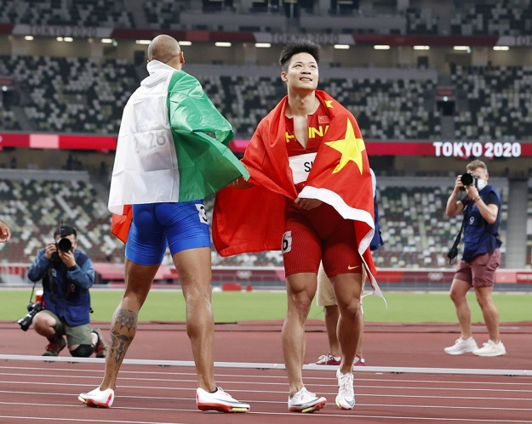
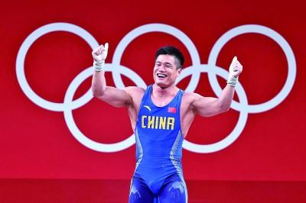
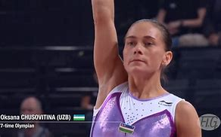
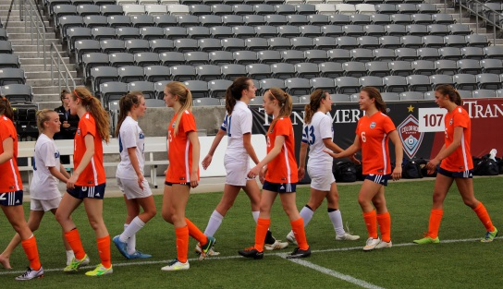
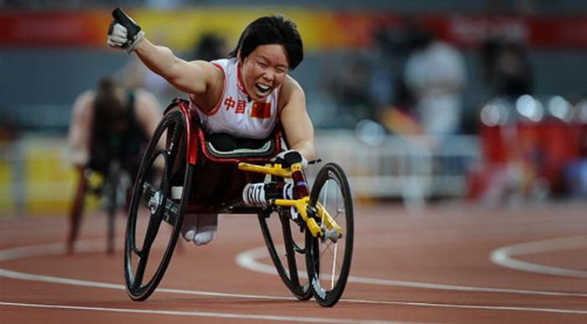
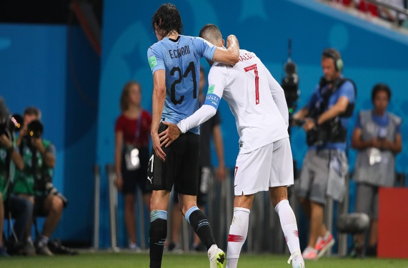
After Reading
Speaking Task
Work in pairs and talk about sportsmanship.
1.What is the essence of sportsmanship?
2.Why is it important?

Slide 76
After Reading
For your reference
Generally speaking, sportsmanship represents fairness, respect for one's opponent, and graciousness in winning or losing.
The benefits of good sportsmanship are many. Good sportsmanship builds teamwork, character, and teaches respect, honor, discipline, kindness, inclusion, resilience, perseverance, and more.

Slide 77
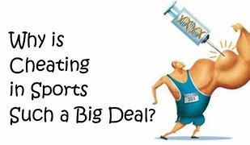
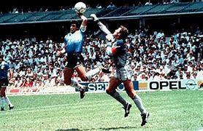
Critical Thinking
As long as athletic competition exists, so will the concept of using underhanded methods to gain an advantage. Cheating in sports is as old as sports itself. Work in groups and discuss:
1.reasons why some athletes engage in cheating.
2.whether these behaviors jeopardize sportsmanship and why.

Slide 78
Critical Thinking
For your reference
Athletes often make every effort to win in competition. They may use performance-enhancing drugs such as steroids, purposely play poorly or lose a game, play dirty, and jeopardize the fairness of a sport by gambling and bribes. Athletes may cheat include a faulty value system, peer pressure, ego, one’s past experience, and greed for money.

Slide 79
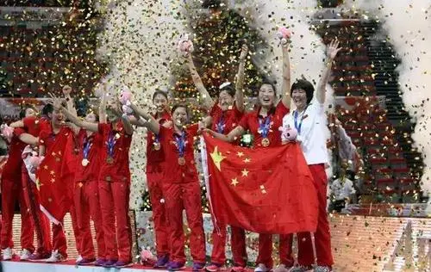
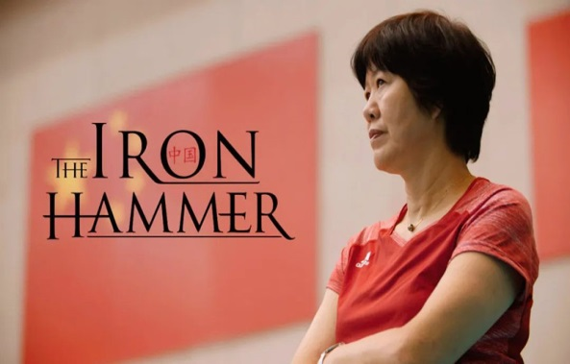
Culture Focus
·唐风》
The Cricket
Songs collected in Tang
The Book of Poetry
From 1981 to 1986, the Chinese women's volleyball team won five consecutive world championships, earning glory for the nation and creating a collective memory for Chinese people old and young. Their spirit has inspired numerous people and remains a symbol of sporting excellence. Of course, no team can be always victorious in the sporting arena. They have on occasion lost matches and experienced failures. However, the players have never lost faith, but girded their loins and prepared for the next challenge.

Slide 80
Culture Focus
·唐风》
The Cricket
Songs collected in Tang
The Book of Poetry
In September 2019, the team successfully defended their status as World Cup champions. This was their 10th successful world championship. In his congratulatory telegram, President Xi Jinping praised the team for displaying once again their traditional teamwork and indomitable spirit in competing with every strong rival.
The team's influence on the Chinese nation has transcended the volleyball court, and their spirit has inspired people from every sector of society to continue their endeavors in their fields.

Slide 81
Culture Focus
Further thoughts:
What is the essence of the so-called “Chinese women’s volleyball team spirit” ?
tenacity, teamwork, pursuit of excellence and unyielding spirit
顽强奋斗、团结协作、勇攀高峰、永不言败

Slide 82
Home Reading
Paragraph Identification
Sentence Translation

Slide 83
Home Reading
1. The following statements contain information from Text B, where each paragraph is numbered. Identify the paragraph from which the information is derived.
1) Sportsmen would hug or shake hands with their opponents after a hardfought match.
2) You display good sportsmanship when you treat others as you’d like to be treated yourself.
(Para. 1)
(Para. 5)

Slide 84
Home Reading
3) Poor sportsmanship, foul play and lack of grace have become very common in sports in recent years.
4) When you lose, you should congratulate the winners promptly and willingly.
5) When you win, be gracious and generous and let victories speak for themselves.
(Para. 7)
(Para. 12)
(Para. 13)

Slide 85
Home Reading
6) There are ways to practice good sportsmanship in real-life situations.
7) It is not part of good sportsmanship to win at any cost.
8) Good sportsmanship can be carried over into other areas of life.
(Para. 14)
(Para. 15)
(Para. 18)

Slide 86
Home Reading
2. Translate the following sentences from Text B into Chinese.
1) It’s all part of sportsmanship, a great tradition in sports and competition that means playing clean and handling both victory and defeat with grace, style, and dignity.(Para. 3)
这是体育精神的一部分，是体育运动和体育比赛的一个伟大传统，它意味着公平竞技，不管胜败，都不失优雅、风度和尊严。
2) You’ve probably seen athletes who take their own successes too seriously, too. They celebrate a goal with a prolonged victory dance or constantly brag about their abilities. (Para. 7)
你或许也见到过运动员把自己的成功太当回事儿。为了一个进球，他们长时间地手舞足蹈或不断夸耀他们的能耐。

Slide 87
Home Reading
3) When you do lose — and it will happen — don’t take it out on your opponent, blame the officials, or blame your team. Take it in your stride. When you lose, lose with class. (Para. 11)
当你真的输了——你总有输的时候——不要拿对手出气，不要责怪主持比赛的官员或你的队友。要泰然自若，输也要输得有风度。

Slide 88
Home Reading
4) Good sportsmanship means acknowledging victories without humiliating opponents, being quietly proud of success, and letting victories speak for themselves. (Para. 13)
良好的体育精神意味着承纳胜利而不羞辱对手，为获胜感到骄傲但不事张扬，让胜利自己说话。

