Slide 1
Unit 6 Learning about English

Slide 2
Learning Objectives
Moral
Understand the changing nature of English and acquire a tolerance for such changes
Skills
Learn to built up an active vocabulary around the history of English
Develop critical thinking abilities
language
Grasp key language points and their usage in context

Slide 3
CONTENTS
Part 1
Before Reading
Part 2
In Reading
Part 3
After Reading
Part 4
Critical Thinking
Part 5
Culture Focus
Part 6
Home Reading

Slide 4

Before Reading
Learning about English

Slide 5
Before Reading
The history of English
The following is the family tree of the Indo-European Languages. Talk about the history of the English language by drawing on the information you get from this tree diagram.

Slide 6
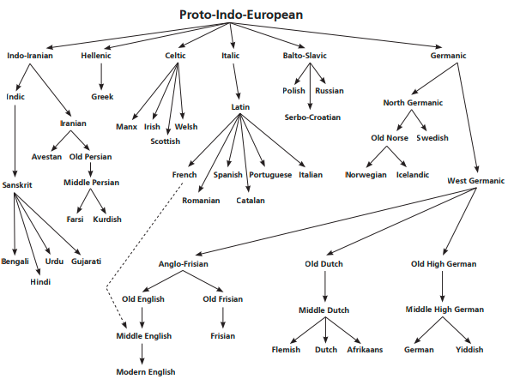

Slide 7
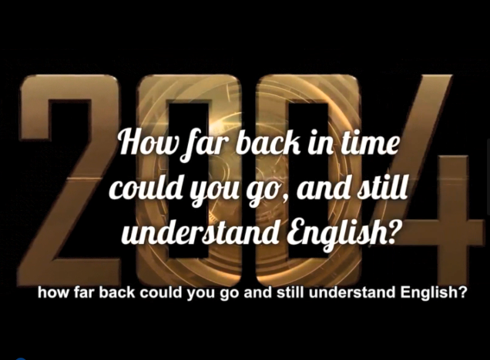
Before Reading
Watch the video How far back in time could you go and still understand English and complete the missing information in the following statements.

Slide 8
Before Reading
Discuss in pairs: If you go back in time …
1. to the 19th and 18th centuries, you probably will with both written and spoken English.
2. to the time of Shakespeare, you would find English hard to follow. You would hear . But the bigger problem lies in .
3. to the time of Middle English, you could written or spoken.
still be OK
plenty of words you didn’t understand
the pronunciation
hardly understand anything
Back

Slide 9

In Reading
Global Reading
Detailed Reading
Back

Slide 10
In Reading – Global Reading
Text Organization
Parts | Paragraphs | Main Ideas
Part One | Paras. 1–3
Part Two | Paras. 4–16
Part Three | Paras. 17–19
The messiness of the English language resulting from its massive borrowing from other languages.
The history of the English language from Old English to Modern English, with its roots in the Indo-European parent language.
Tolerance, love of freedom, and respect for the rights of others — the qualities of the English speaking people that explain the richness of their language.

Slide 11
In Reading – Detailed Reading
The Glorious Messiness of English
by Robert MacNeil
1 The story of our English language is typically one of massive stealing from other languages. That is why English today has an estimated vocabulary of over one million words, while other major languages have far fewer.

Slide 12
In Reading – Detailed Reading
2 French, for example, has only about 75,000 words, and that includes English expressions like snack bar and hit parade. The French, however, do not like borrowing foreign words because they think it corrupts their language. The government tries to ban words from English and declares that Walkman is not desirable; so they invent a word, balladeur, which French kids are supposed to say instead — but they don’t.

Slide 13
In Reading – Detailed Reading
3 Walkman is fascinating because it isn’t even English. Strictly speaking, it was invented by the Japanese manufacturers who put two simple English words together to name their product. That doesn’t bother us, but it does bother the French. Such is the glorious messiness of English. That happy tolerance, that willingness to accept words from anywhere, explains the richness of English and why it has become, to a very real extent, the first truly global language.

Slide 14
In Reading – Detailed Reading
4 How did the language of a small island off the coast of Europe become the language of the planet — more widely spoken and written than any other has ever been? The history of English is present in the first words a child learns about identity (I, me, you); possession (mine, yours); the body (eye, nose, mouth); size (tall, short); and necessities (food, water). These words all come from Old English or Anglo-Saxon English, the core of our language. Usually short and direct, these are words we still use today for the things that really matter to us.

Slide 15
In Reading – Detailed Reading
5 Great speakers often use Old English to arouse our emotions. For example, during World War II, Winston Churchill made this speech, stirring the courage of his people against Hitler’s armies positioned to cross the English Channel: “We shall fight on the beaches, we shall fight on the landing grounds, we shall fight in the fields and in the streets, we shall fight in the hills. We shall never surrender.”

Slide 16
In Reading – Detailed Reading
6 Virtually every one of those words came from Old English, except the last — surrender, which came from Norman French. Churchill could have said, “We shall never give in,” but it is one of the lovely — and powerful — opportunities of English that a writer can mix, for effect, different words from different backgrounds. Yet there is something direct to the heart that speaks to us from the earliest words in our language.

Slide 17
In Reading – Detailed Reading
7 When Julius Caesar invaded Britain in 55 B.C., English did not exist. The Celts, who inhabited the land, spoke languages that survive today mainly as Welsh. Where those languages came from is still a mystery, but there is a theory.
8 Two centuries ago an English judge in India noticed that several words in Sanskrit closely resembled some words in Greek and Latin. A systematic study revealed that many modern languages descended from a common parent language, lost to us because nothing was written down.

Slide 18
In Reading – Detailed Reading
9 Identifying similar words, linguists have come up with what they call an Indo-European parent language, spoken until 3500 to 2000 B.C. These people had common words for snow, bee and wolf but no word for sea. So some scholars assume they lived somewhere in north-central Europe, where it was cold. Traveling east, some established the languages of India and Pakistan, and others drifted west toward the gentler climates of Europe. Some who made the earliest move westward became known as the Celts, whom Caesar’s armies found in Britain.

Slide 19
In Reading – Detailed Reading
10 New words came with the Germanic tribes — the Angles, the Saxons, etc. — that slipped across the North Sea to settle in Britain in the 5th century. Together they formed what we call Anglo-Saxon society.
11 The Anglo-Saxons passed on to us their farming vocabulary, including sheep, ox, earth, wood, field and work. They must have also enjoyed themselves because they gave us the word laughter.

Slide 20
In Reading – Detailed Reading
12 The next big influence on English was Christianity. It enriched the Anglo-Saxon vocabulary with some 400 to 500 words from Greek and Latin, including angel, disciple and martyr.
13 Then into this relatively peaceful land came the Vikings from Scandinavia. They also brought to English many words that begin with sk, like sky and skirt. But Old Norse and English both survived, and so you can rear a child (English) or raise a child (Norse). Other such pairs survive: wish and want, craft and skill, hide and skin. Each such addition gave English more richness, more variety.

Slide 21
In Reading – Detailed Reading
14 Another flood of new vocabulary occurred in 1066, when the Normans conquered England. The country now had three languages: French for the nobles, Latin for the churches and English for the common people. With three languages competing, there were sometimes different terms for the same thing. For example, Anglo-Saxons had the word kingly, but after the Normans, royal and sovereign entered the language as alternatives. The extraordinary thing was that French did not replace English. Over three centuries English gradually swallowed French, and by the end of the 15th century what had developed was a modified, greatly enriched language — Middle English — with about 10,000 “borrowed” French words.

Slide 22
In Reading – Detailed Reading
15 Around 1476 William Caxton set up a printing press in England and started a communications revolution. Printing brought into English the wealth of new thinking that sprang from the European Renaissance. Translations of Greek and Roman classics were poured onto the printed page, and with them thousands of Latin words like capsule and habitual, and Greek words like catastrophe and thermometer. Today we still borrow from Latin and Greek to name new inventions, like video, television and cyberspace.

Slide 23
In Reading – Detailed Reading
16 A s settler s landed in North America and established the United States, English found itself with two sources — American and British. Scholars in Britain worried that the language was out of control, and some wanted to set up an academy to decide which words were proper and which were not. Fortunately their idea has never been put into practice.

Slide 24
In Reading – Detailed Reading
17 That tolerance for change also represents deeply rooted ideas of freedom. Danish scholar Otto Jespersen wrote in 1905, “The English language would not have been what it is if the English had not been for centuries great respecters of the liberties of each individual and if everybody had not been free to strike out new paths for himself.”

Slide 25
In Reading – Detailed Reading
18 I like that idea. Consider that the same cultural soil producing the English language also nourished the great principles of respect for the rights of others and tolerance of their way of using language. The first shoots sprang up in England, and they grew stronger in America. The English-speaking peoples have defeated all efforts to build fences around their language.
19 Indeed, the English language is not the special preserve of grammarians, language police, teachers, writers or the intellectual elite. English is, and always has been, the tongue of the common man.

Slide 26
In Reading – Detailed Reading
Paraphrasing Sentences
1. The story of our English language is typically one of massive stealing from other
languages. (Para. 1)
The history of English is a typical one of massive borrowing from other languages.
2. They invent a word, balladeur, which French kids are supposed to say instead — but they don’t. (Para. 2)
They make up a word, balladeur, and tell the French kids to use it instead of Walkman, but the kids just go on using Walkman.
3. That doesn’t bother us, but it does bother the French. (Para. 3)
We are quite happy with that. But the French are not.

Slide 27
In Reading – Detailed Reading
Paraphrasing Sentences
4. Yet there is something direct to the heart that speaks to us from the earliest words in our language. (Para. 6)
The Old English words have something that appeals directly to our heart.
5. Identifying similar words, linguists have come up with what they call an Indo-European parent language, spoken until 3500 to 2000 B.C. (Para. 9)
After linguists found more similar words in Greek, Latin and Sanskrit, they proposed that there was a parent language, which was spoken until 3500 to 2000 B.C. They called the parent language the Indo-European language.
Back

Slide 28


In Reading - Language Focus
corrupt: vt.
cause errors to appear in; cause to act dishonestly in
return for personal gains 使（语言）变得不标准；贿赂
What corrupts people more: money, material items or power?
什么更使人堕落：金钱，物质还是权力？
Back

Slide 29
In Reading - Language Focus
ban: vt.
forbid (sth.) officially 禁止，取缔
The new law bans drivers from using hand-held phones while driving.
这一新出台的法律禁止驾车者开车时使用手机。
Back

Slide 30
In Reading - Language Focus
desirable: a.
worth having or doing 值得有的，值得做的
Of course, a diplomatic solution is always more desirable than war.
当然，通过外交谈判解决总比战争更好。
Back

Slide 31
In Reading - Language Focus
invent: vt.
create (sth. that never existed before) 发明
She invented an explanation for being late this morning.
她为上午迟到编造了一个理由。
Back

Slide 32
In Reading - Language Focus
be supposed to do:
be required to do 应该做
The contract is supposed to be made without fear or pressure.
这合同应该是在没有恐惧没有压力的情况下签订的。
Back

Slide 33
In Reading - Language Focus
fascinating: a.
of great interest or attraction 迷人的，有极大吸引力的
fascinate: v.（使）着迷
The book offers a fascinating glimpse of the lives of the rich and famous.
这本书让人一瞥名人阔佬们令人陶醉的生活。
Back

Slide 34
In Reading - Language Focus
strictly speaking:
being completely accurate, in actual fact 严格地讲
Strictly speaking, a tomato is a fruit, not a vegetable.
严格地讲，西红柿是水果而不是蔬菜。
Back

Slide 35
In Reading - Language Focus
tolerance: n.
willingness to accept or allow behavior, beliefs, etc. which one does not like or agree with 容忍，宽容；忍耐
The large number of immigrants who flood this border region is testing its tradition of tolerance.
涌入这个边境地区的大量移民正在考验着这地区包容的传统。
Back

Slide 36
In Reading - Language Focus
extent: n.
the range over which a thing extends; the degree to which a thing extends 范围；程度
The drug reduces pain to a real extent, particularly in the short term.
这种药能极大地缓解疼痛，特别是短期止痛。
Back

Slide 37
In Reading - Language Focus
core: n.
the most important part of anything; the hard central part of certain fruits 核心；果核
The company’s core mission, claimed its CEO, is to help patients with memory loss.
公司总裁说，公司的核心使命是帮助丧失记忆的病人。
Back

Slide 38
In Reading - Language Focus
arouse: vt.
provoke (a particular feeling or attitude) 唤起，激起
Football arouses a good deal of passion among its fans.
足球往往使球迷们冲动。
Back

Slide 39
In Reading - Language Focus
opportunity: n.
a chance to do sth. 机会
The exhibition offers visitors a great opportunity to see some of the masterpieces of the Renaissance.
展览给参观者提供了一次观看文艺复兴时代巨作的好机会。
Back

Slide 40
In Reading - Language Focus
for effect:
in order to impress people or make people notice 为了增强效果，为了引起 注意
The author used some slang words just for effect.
作者使用了一些俚语，为的是增强效果。
Back

Slide 41
In Reading - Language Focus
invade: vt.
enter with armed forces 侵入，侵略
She felt that the guard had invaded her privacy when he searched her bag.
她觉得警卫搜查她的包是侵犯了她的隐私。
Back

Slide 42
In Reading - Language Focus
mystery: n.
that which cannot be explained 神秘的事
How the massive stones were brought here from hundreds of miles away remains a mystery.
这些巨石是怎么从数百英里以外搬过来的，至今还是个谜。
Back

Slide 43
In Reading - Language Focus
resemble: vt. be like or similar to 与…相似
resemblance: n. 相似（之处）
She found Jack’s room to resemble more a study than a youth’s bedroom.
她觉得杰克的房间更像一个书房而不像一个年轻人的寝室。
He doesn’t look exactly like his father, but there is some resemblance.
他不完全像他爸，但他们俩长相有相似之处。
Back

Slide 44
In Reading - Language Focus
descend: vi.
come down (from a source); go down 起源于；下降，下来
Humans are thought to have descended from ape-like creatures.
人类被认为是起源于类猩猩动物。
Back

Slide 45
In Reading - Language Focus
come up with:
think of (a plan, reply, etc.); produce 想出（计划、回答等）；提出
They came up with a plan to increase productivity.
他们提出了一个提高生产力的计划。
Back

Slide 46
In Reading - Language Focus
establish: vt.
cause to be set up 建立，确立
Being a career diplomat, he spent a good part of his life trying to establish friendly relations between China and other countries.
作为一名职业外交家，他把一生的许多时间都用于努力建立中国和其他国家间的友好关系。
Back

Slide 47
In Reading - Language Focus
slip: v.
go somewhere, esp. quickly and quietly without people noticing you 悄悄地走
Time slipped by.
时间悄悄地流逝了。
Back

Slide 48
In Reading - Language Focus
pass (sth.) on to (sb.):
hand or give (sth.) to (sb.) 将…传给…
If a company spends a lot on advertising, it will pass the higher cost on to its customers.
一个公司在广告上花许多钱，必然会把高成本转嫁给客户。
Back

Slide 49
In Reading - Language Focus
replace: vt.
take or fill the place of 取代
Tourism has replaced agriculture as the nation’s main industry.
旅游业取代了农业，成了这个国家的主要产业。
Back

Slide 50
In Reading - Language Focus
modify: vt.
change slightly 修改，更改
The original plan was too ambitious and costly. The modified one looks more reasonable.
原计划太激进也太花钱，经修订后的计划更趋合理。
Back

Slide 51
In Reading - Language Focus
spring from:
be caused by, come from 源于
His desire for money springs from a sense of financial insecurity.
他对钱的欲望源于经济上的不安全感。
Back

Slide 52
In Reading - Language Focus
source: n. 源头，来源
Fruit is a good source of Vitamin C.
The journalist refused to reveal his sources of information.
1) 水果是维生素C的很好的来源。
2) 记者拒绝透露他的消息来源。
Back

Slide 53
In Reading - Language Focus
out of control: 失去控制，不受约束
To prevent costs from getting out of control is the top priority of the company right now.
公司目前的头等大事就是防止成本失控。
Back

Slide 54
In Reading - Language Focus
put … into practice: 将…付诸实施
I will try to put the new technique you showed me into practice.
我将把你展示给我的新技术用于实践。
Back

Slide 55
In Reading - Language Focus
represent: vt.
stand for; symbolize 代表；象征
The new car model is more environment-friendly and represents a step in the right direction on the part of its manufacturer.
这新款汽车更环保，代表了制造商走出的正确的一步。
Back

Slide 56
In Reading - Language Focus
individual:
1) n. a person considered separately from their society or community 个人，个体
How could a single individual have achieved all this?
1) 单独一个人怎么会取得这么大的成就呢？
Back

Slide 57
In Reading - Language Focus
individual:
2) a. 个人的，个体的
2）We try to meet the individual needs of students.
2) 我们试图满足学生的个人需求。
Back

Slide 58
In Reading - Language Focus
strike out:
originate, devise; set out 创造，设计；启程
After hatching, the baby turtles struck out toward the ocean.
小海龟孵出来后，就各自爬向大海了。
Back

Slide 59
In Reading - Language Focus
nourish: vt.
give (sb. or a living thing) what is needed so that they can grow and stay healthy 滋养，培育
He has long nourished an ambition to bring the show to Broadway.
他早就怀抱雄心壮志，要把这场演出推向百老汇。
Back

Slide 60
In Reading - Language Focus
principle: n.
a basic belief, theory, or rule 原则；主义
The organization works on the principle that all members have the same rights.
这组织的运作原则是所有成员同权。
Back

Slide 61
In Reading - Language Focus
spring up:
appear or be produced suddenly and quickly 涌现
Thousands of new businesses have sprung up in this town over the past 20 years.
过去二十年中这个城市里有成千上万的新商户开张。
Back

Slide 62
In Reading - Language Focus
preserve:
1) n. 独占的地区或范围；禁猎地
The civil service seems to have become the preserve of the educated middle.
1) 公务员这个行业似乎已成为受过教育的中产阶级的专属领地。
Back

Slide 63
In Reading - Language Focus
preserve:
2) vt. keep from harm, damage, etc., protect; save 保护，保存
2）The city is spending lots of money on preserving these ancient buildings.
2) 这座城市正在花大钱保护古建筑。
Back

Slide 64
In Reading - Language Focus
intellectual: a.
relating to the ability to think in an intelligent way 智力的
He concentrates too much on his books and neglects the social and intellectual life on campus.
他太专注于书本，忽略了校园里的社会和思想活动。
Back

Slide 65
After Reading
Useful Expressions
Sentence Translation
Writing Task
Speaking Task

Slide 66
After Reading
Useful Expressions
在很大程度上
起源于
越过
丰富多元
大量涌入
信息传播技术的革命
(to a very real extent)
(descend from)
(slip across)
(richness and variety)
(the flood of …)
(a communications revolution)

Slide 67
After Reading
Useful Expressions
(come up with)
想出
保持语言的纯粹
传承
横行霸道
对变化的包容大度
独辟蹊径
(preserve the purity of the language)
(pass on to)
(throw one’s weight around)
(the tolerance for change)
(strike out new paths)
Back

Slide 68
After Reading
Sentence Translation
Translate the following sentences into English.
这种乐意包容的精神，这种不管源自何方都来者不拒的精神，恰好解释了英语为什么会这么丰富，解释了 英语缘何确确实实地成了第一种真正的国际语言。(Para. 3)
That happy tolerance, that willingness to accept words from anywhere, explains the richness of English and why it has become, to a very real extent, the first truly global
language.

Slide 69
After Reading
2) 当时不列颠的居民凯尔特人使用的诸种语言流传至今，主要演变成威尔士语。(Para. 7)
The Celts, who inhabited the land, spoke languages that survive today mainly as Welsh.
3) 系统的研究显示，许多现代语言起源于一个共同的母语，但由于没有文字记载，该母语已经失传。 (Para. 8)
A systematic study revealed that many modern languages descended from a common parent language, lost to us because nothing was written down.

Slide 70
After Reading
4) 另一次新词的大量涌入发生在1066年诺曼人征服英国的时候。(Para. 14)
Another flood of new vocabulary occurred in 1066, when the Normans conquered England.
5)历经三个世纪，英语逐渐吞并了法语，到15世纪末，发展成为一种经过改进的大大丰富了的中古英语，它 拥有一万多个“借来”的法语词汇。(Para. 14)
Over three centuries English gradually swallowed French, and by the end of the 15th century what had developed was a modified, greatly enriched language — Middle English — with about 10,000 “borrowed” French words.
Back

Slide 71
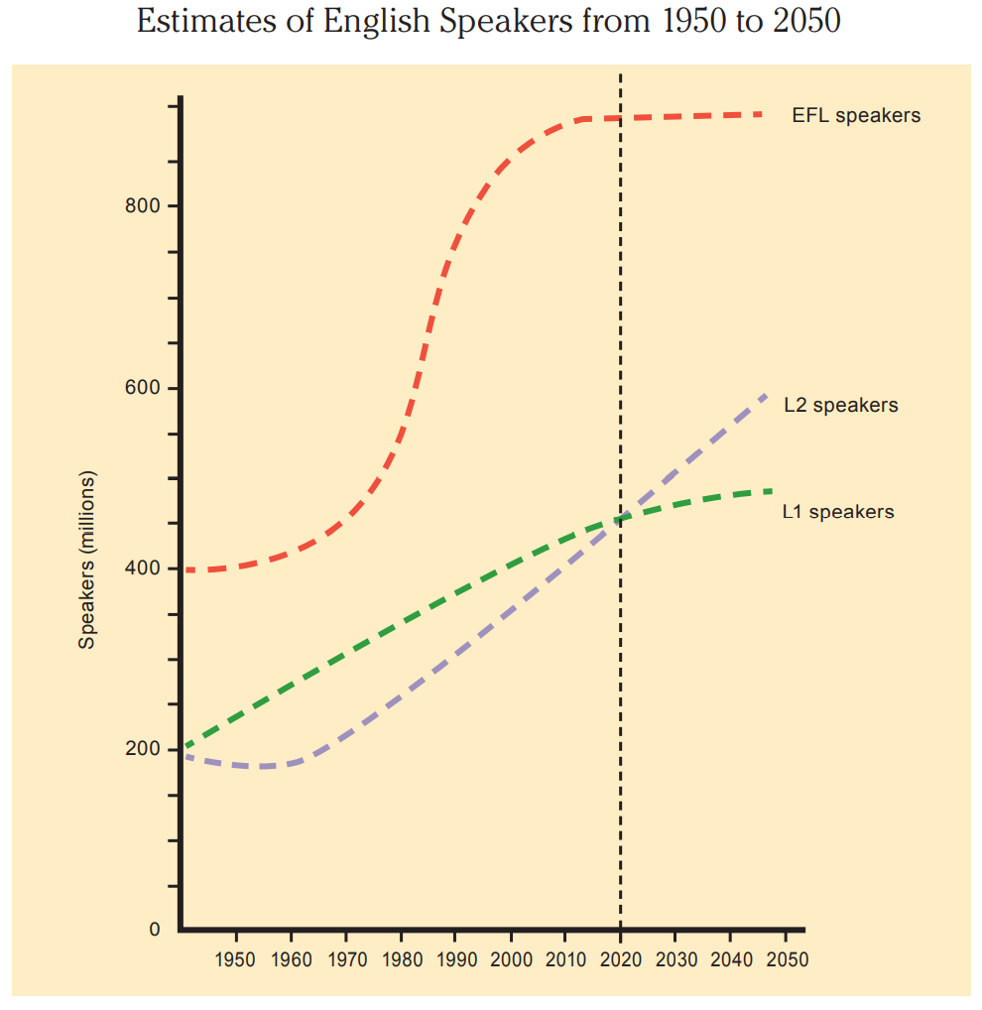
After Reading
Writing Task
Write a short essay entitled “Estimates of English speakers from 1950 to 2050” by drawing on the information you get from the graph.

Slide 72
After Reading
Writing Task
Writing Strategy
Steps of information transfer from graphs:
1. Look at the title of the graph to get to know what it is about.
2. Examine each line/curve and figure out what it represents.
3. Sum up or generalize the overall picture or trend.
4. Take note of the specific details that stand out.
5. Comment on or analyze the general trend and/or some notable specific details.

Slide 73
After Reading
Writing Task Model
This graph shows the estimated numbers of English speakers from 1950 to 2050. English speakers are divided into three groups, L1 speakers (native speakers of English), L2 speakers (those who speak English as a second language), and EFL speakers (those who speak English as a foreign language).
The three lines tell us that L1, L2 and EFL speakers were over 200 million, close to 200 million and 400 million respectively in 1950 and will reach 400 million, 400 million and almost 1 billion in 2020. After 2020, the numbers of L1 and EFL speakers will level off, but that of L2 speakers will continue to rise.

Slide 74
After Reading
Writing Task Model
Although all three groups grow in number, they differ in the pattern of growth. The number of L1 speakers tends to rise steadily over the entire period, but not as fast as that of L2 speakers. As a result, L2 speakers are expected to outnumber L1 speakers after 2020. One thing particularly worth noting is the dramatic growth of EFL speakers in the 30 years between 1980–2010. This sharp rise, it seems evident to me, is, to a great extent, a result of China’s opening-up, which stimulated millions to learn English.
If the estimates are correct, it seems safe to say that English is well on its way to becoming a leading global language of the 21st century.
Back

Slide 75
After Reading
Speaking Task -- Debate
English or Chinese, which language do you think will most likely become the most global language in the future? Give reasons for your choice.
Group Work:
➢ Work in groups of four or five either for English or for Chinese.
➢ Groups brainstorm possible arguments.
➢ Split the class into two groups, one for English and the other for Chinese, and hold a debate on this topic.
Back

Slide 76
After Reading
Hints
肢体语言 body language
非语言语言 nonverbal language
言贵简洁。 Brevity is the soul of wit.
没有语言便无法接近。 No language, no access.
事实胜于雄辩。 Actions speak louder than words.

Slide 77
After Reading
畏问之人耻于学。 He who is ashamed of asking is ashamed of learning.
读书让人充实，交谈使人明智。 By reading we enrich the mind; by conversation we polish it.
深奥的思想是用凝练的语言来表达的的。 Deep thoughts are expressed in condensed language.
语言是科学的唯一工具，词汇只是思想的符号。Language is the only tool of science, vocabulary is only the symbol of thought.
Back

Slide 78
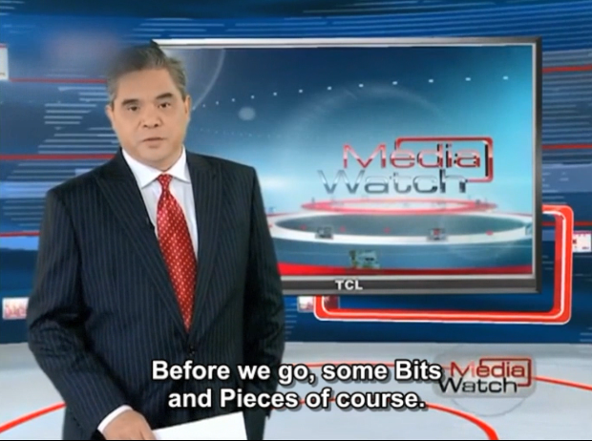
Critical Thinking
Watch a 2013 TV report to learn which new words of Chinese origin might be included in The Oxford English Dictionary the following year.

Slide 79
Critical Thinking
Complete the following sentences after watching the video.
1. China’s new buzzword tuhao may appear in next year’s .
2. Tuhao traditionally has referred to rich people who
in China’s rural areas.
3. The word Tuhao is now often used by the online community to refer to people who have the cash but to go with it.
4. Two other Chinese words, dama and hukou, may also ___________
the dictionary.
Oxford English Dictionary
throw their weight around
lack the class
make it into

Slide 80

Critical Thinking
Discuss in pairs.
List out several English words borrowed from Chinese and talk about the cultural and historic significance underneath them.
Tao yin and yang
Kungfu Tai chi
Confucianism
Add oil!
Back

Slide 81
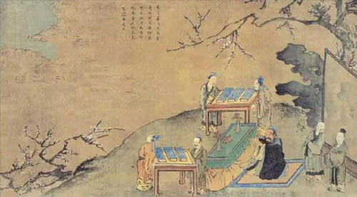
Culture Focus
《论语》
The Analects of Confucius
The Master said, “Why not study the Book of Poetry, my boys? The poems help to stimulate your passions, to look wide, to associate more and to complain rightly.

Slide 82
Culture Focus
《论语》
The Analects of Confucius
From them you learn to attend upon your parents at home and serve your prince at court. From them you become largely acquainted with the names of birds, beasts, and plants.”

Slide 83
Culture Focus
《论语》
The Analects of Confucius
子曰：“小子何莫学夫《诗》？诗，可以兴，可以观，可以群，可以怨。迩之事父，远之事君；多识于鸟兽草木之名。

Slide 84
Culture Focus
Further thoughts
Talk about your favorite poems and the wisdom inspired by the global languages at ancient and modern times.
Back

Slide 85
Home Reading
Paragraph Identification
Sentence Translation

Slide 86
Home Reading
1. The following statements contain information from Text B, where each paragraph is numbered. Identify the paragraph from which the information is derived.
1) People differ in their language experiences.
2) Young people tend to introduce more changes in language than other age groups.
(Para. 3)
(Para. 4)

Slide 87
Home Reading
3) New words are created in various ways.
4) Standard English is not necessarily better than other forms of English.
5) Split infinitives should not be considered ungrammatical.
(Para. 5)
(Para. 11)
(Para. 16)
Back

Slide 88
Home Reading
2. Translate the following sentences from Text B into Chinese.
1) We pick up new words and phrases from all the different people we talk with, and these combine to make something new and unlike any other person’s particular way of speaking. (Para. 3)
我们从与我们交谈的所有不同的人那里学到新的词汇和短语，这些词汇和短语汇集成不同于任何其他人说话方式的新的语言。
2) The fact that language is always changing doesn’t mean it’s getting worse; it’s just becoming different. (Para. 8)
语言总是在变化，这并不意味着它在变糟；它只是变得不同而已。

Slide 89
Home Reading
3) By “correct English”, people usually mean Standard English. (Para. 11)
“正确的英语”通常是指标准英语。
4) Language will never stop changing; it will continue to respond to the needs of the people who use it. (Para. 17)
语言永远不会停止变化；它将继续响应使用者的需求。
Back

