Slide 1
Unit 2 Overcoming Obstacles

Slide 2
Learning Objectives
Moral
Achieve a thorough understanding of “obstacles”
Build confidence to overcome obstacles
Skills
Apply writing a narrative
Develop critical thinking abilities
language
Grasp key language points and their usage in context

Slide 3
CONTENTS
Part 1
Before Reading
Part 2
In Reading
Part 3
After Reading
Part 4
Critical Thinking
Part 5
Culture Focus
Part 6
Home Reading

Slide 4
Before Reading
Brainstorming
What could be obstacles in people’s life ?

Slide 5
Reference answers
Types of obstacles | Content
Personal Obstacles | physical/mental limitations, financial condition, bad habits, fears, emotional dysfunction, limited beliefs, disorganization, procrastination, bad attitude
Social Obstacles | people who are uncooperative, lack of support, toxic relationships, tradition, social norms, conformity
Environmental Obstacles | time, place, space, noise, climate

Slide 6
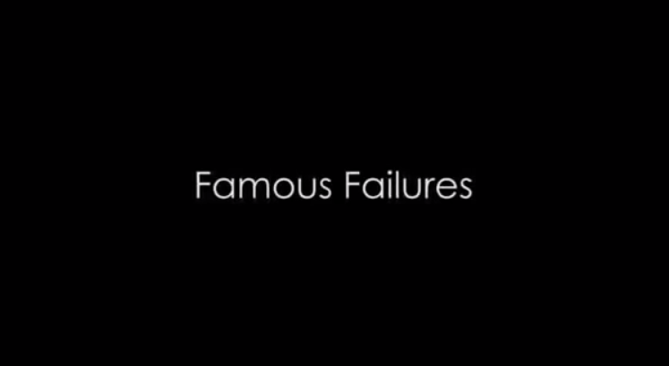
Before Reading
Watch this video about the failures of eleven famous people, learn what obstacle(s) they each had to overcome, and summarize what they have in common.

Slide 7
Before Reading
Name | Profession | Obstacle(s)
Michael Jordan
Albert Einstein
Oprah Winfrey
Walt Disney
Lionel Messi
Steve Jobs

Slide 8
Before Reading
Name | Profession | Obstacle(s)
Thomas Edison
The Beatles
Eminem
Dr. Seuss
Abraham Lincoln

Slide 9
Before Reading
Name | Profession | Obstacle(s)
Michael Jordan | basketballer | dismissed from his high school basketball team
Albert Einstein | scientist | late in speech development
Oprah Winfrey | talk show host | demoted from her job as a news anchor
Walt Disney | film and TV producer | dismissed from a newspaper job
Lionel Messi | footballer | dismissed from his football team for his small stature
Steve Jobs | businessman | removed from the company he started

Slide 10
Before Reading
Name | Profession | Obstacle(s)
Thomas Edison | inventor | deemed too stupid by his teacher
the Beatles | musician | rejected by a recording studio
Eminem | musician | struggles with drugs and poverty leading to a suicide attempt
Dr. Seuss | writer | rejected by 27 publishers
Abraham Lincoln | statesman | family misfortune, business failure and repeated setbacks in politics

Slide 11
Before Reading
Some Suggestions to Overcome Obstacles
If there hadn’t been any obstacles in the past, you would have scored outstanding successes in your studies or career. It’s the obstacles you have faced all your life that have kept you from enjoying a perfect life. Overcoming obstacles is thus a necessity of success. Here are some suggestions .

Slide 12
Before Reading
Get started.
Often, once you begin, you’ll find the task is easier than you expect.
2. Break your task into smaller tasks.
Take one big task and break it into smaller tasks. For instance, do part of your assignment each time rather than the entire one.
3. Work with the time you have.
Don’t wait until you have time to do the entire thing. Instead, even if you only have five minutes, get started.

Slide 13
Before Reading
4. Set small deadlines.
After meeting each deadline, give yourself a reward. For example, play video games when you finish an hour of studying.
5. Eliminate distractions.
Turn off the TV. Put away your smartphone.
6. Ask for help.
Sometimes, the reason you don’t start is because you don’t know what to do. If that’s the case, ask for help.
7. Begin now.
What one thing can you do right now that will move you closer to your goal?
Back

Slide 14

In Reading
Global Reading
Detailed Reading

Slide 15
In Reading – Global Reading
Text Organization
Parts | Para(s). | Main Ideas
One | Paras. 1–2
Two | Paras. 3–5
Three | Paras. 6–12
Four | Paras. 13
Michael faced the most challenging competition in his pole-vaulting career.
Michael’s childhood was marked with dreams and tough training.
Michael topped his personal best, won the championship and set a new world record.
What was most unusual about Michael’s victory was that he was blind.

Slide 16
In Reading – Global Reading
Questions about the Text
What does the text title “True Height” mean?
It has more than one meaning. It may refer to:
1) the new bar heights that Michael cleared one after another;
2) the tremendous obstacles Michael had overcome in attaining his goal.
2. As the text consists of the main story and a flashback, can you figure out the flashback?
The flashback is from paragraph 3 to paragraph 5.

Slide 17
In Reading – Global Reading
3. From the description of Michael’s parents, what can you learn about his parents?
4. What individual characteristics should Michael’s
success be attributed to?
Michael’s mother is romantic and passionate, while his father is a hard-core realist.
He is diligent, perseverant, optimistic, ambitious, etc.

Slide 18
In Reading – Global Reading
Questions about the Text
5. Who would you admire better, a Michael Stone with a sound body or a blind Michael Stone?

Slide 19
In Reading – Detailed Reading
Pair work
Work in pairs and find out those details about Michael Stone that show him to be his mother’s boy or his father’s son.

Slide 20
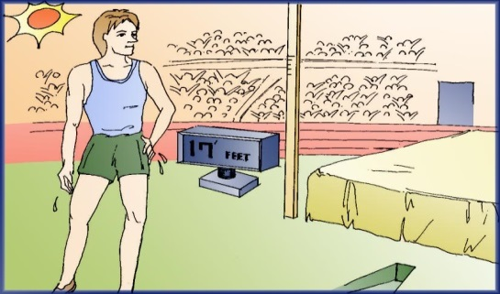
In Reading – Detailed Reading
True Height
David Naster
1 His palms were sweating. He needed a towel to dry his grip. The sun was as hot as the competition he faced today at the National Junior Olympics. The pole was set at 17 feet. That was three inches higher than his personal best. Michael Stone confronted the most challenging day of his pole-vaulting career.

Slide 21
In Reading – Detailed Reading
2 The stands were still filled with about 20,000 people, even though the final race had ended an hour earlier. The pole vault is truly the highlight of any track and field competition. It combines the grace of a gymnast with the strength of a body builder. It also has the element of flying, and the thought of flying as high as a two-story building is a mere fantasy to anyone watching such an event.

Slide 22
In Reading – Detailed Reading
3 As long as Michael could remember he had always dreamed of flying. Michael’s mother read him numerous stories about flying when he was growing up. Her stories were always ones that described the land from a bird’s-eye view. Her excitement and passion for details made Michael’s dreams full of color and beauty. Michael had this one recurring dream. He would be running down a country road. As he raced between golden wheat fields, he would always outrun the locomotives passing by. It was at the exact moment he took a deep breath that he began to lift off the ground. He would begin soaring like an eagle.

Slide 23
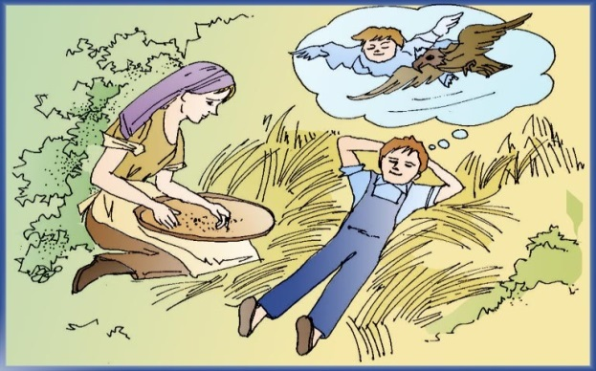
In Reading – Detailed Reading
4 Where he flew would always coincide with his mother’s stories. Wherever he flew was with a keen eye for detail and the free spirit of his mother’s love. His dad, on the other hand, was not a dreamer.Bert Stone was a hard-core realist. He believed in hard work and sweat. His motto: If you want something, work for it!

Slide 24
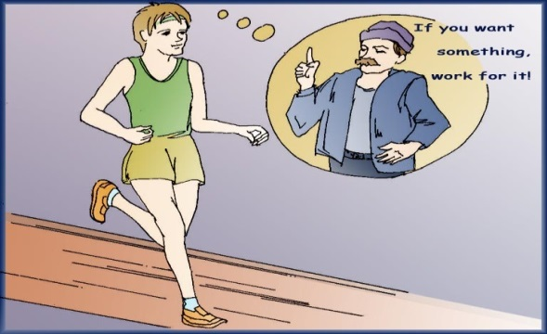
In Reading – Detailed Reading
5 From the age of 14, Michael did just that. He began a very careful training program. He worked out every other day with weightlifting, with some kind of running work on alternate days. The program was carefully monitored by Michael’s coach, trainer and father. Michael’s dedication, determination and discipline was a coach’s dream.

Slide 25
In Reading – Detailed Reading
Besides being an honor student and only child, Michael Stone continued to help his parents with their farm chores. Mildred Stone, Michael’s mother, wished he could relax a bit more and be that “free dreaming” little boy. On one occasion she attempted to talk to him and his father about this, but his dad quickly interrupted, smiled and said, “You want something, work for it!”

Slide 26
In Reading – Detailed Reading
6 All of Michael’s vaults today seemed to be the reward for his hard work. If Michael Stone was surprised, excited or vain about clearing the bar at 17 feet, you couldn’t tell. As soon as he landed on the inflated landing mat, and with the crowd on its feet, Michael immediately began preparing for his next attempt at flight. He seemed unaware of the fact that he had just beaten his personal best by three inches and that he was one of the final two competitors in the pole-vaulting event at the National Junior Olympics.

Slide 27
In Reading – Detailed Reading
7 When Michael cleared the bar at 17 feet 2 inches and 17 feet 4 inches, again he showed no emotion. As he lay on his back and heard the crowd groan, he knew the other vaulter had missed his final jump. He knew it was time for his final jump. Since the other vaulter had fewer misses, Michael needed to clear this vault to win. A miss would get him second place. Nothing to be ashamed of, but Michael would not allow himself the thought of not winning first place.
8 He rolled over and did his routine of three finger-tipped push-ups. He found his pole, stood and stepped on the runway that led to the most challenging event of his 17-year-old life.

Slide 28
In Reading – Detailed Reading
9 The runway felt different this time. It startled him for a brief moment. Then it all hit him like a wet bale of hay. The bar was set at nine inches higher than his personal best. That’s only one inch off the National record, he thought. The intensity of the moment filled his mind with anxiety. He began shaking the tension. It wasn’t working. He became more tense.

Slide 29
In Reading – Detailed Reading
Why was this happening to him now, he thought. He began to get nervous. Afraid would be a more accurate description. What was he going to do? He had never experienced these feelings. Then out of nowhere, and from the deepest depths of his soul, he pictured his mother. Why now? What was his mother doing in his thoughts at a time like this? It was simple. His mother always used to tell him when you felt tense, anxious or even scared, take deep breaths.

Slide 30
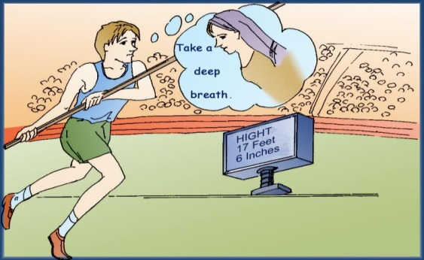
In Reading – Detailed Reading
10 So he did. Along with shaking the tension from his legs, he gently laid his pole at his feet. He began to stretch out his arms and upper body. The light breeze that was once there was now gone. He carefully picked up his pole. He felt his heart pounding. He was sure the crowd did, too. The silence was deafening. When he heard the singing of some distant birds in flight, he knew it was his time to fly.

Slide 31
In Reading – Detailed Reading
11 As he began sprinting down the runway, something felt wonderfully different, yet familiar. The surface below him felt like the country road he used to dream about. Visions of the golden wheat fields seemed to fill his thoughts. When he took a deep breath, it happened. He began to fly. His take-off was effortless. Michael Stone was now flying, just like in his childhood dreams. Only this time he knew he wasn’t dreaming. This was real. Everything seemed to be moving in slow motion. The air around him was the purest and freshest he had ever sensed. Michael was soaring like an eagle.

Slide 32
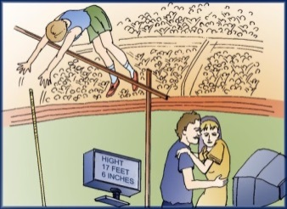
In Reading – Detailed Reading
12 It was either the eruption of the people in the stands or the thump of his landing that brought Michael back to earth. On his back with that wonderful hot sun on his face, he knew he could only see in his mind’s eye the smile on his mother’s face. He knew his dad was probably smiling too, even laughing. What he didn’t know was that his dad was hugging his wife and crying. That’s right: Bert “If You want It, Work For It” Stone was crying like a baby in his wife’s arms.

Slide 33
In Reading – Detailed Reading
He was crying harder than Mildred had ever seen before. She also knew he was crying the greatest tears of all: tears of pride. Michael was immediately surrounded by people hugging and congratulating him on the greatest accomplishment of his life. He later went on that day to clear 17 feet 6½ inches: a National and International Junior Olympics record.

Slide 34
In Reading – Detailed Reading
13 With all the media attention and sponsorship possibilities, Michael’s life would never be the same again. It wasn’t just because he won the National Junior Olympics and set a new world record. And it wasn’t because he had just increased his personal best by 9½ inches. It was simply because Michael Stone is blind.
Back

Slide 35


In Reading - Language Focus
D R _ word _ sweat
sweat
1. v. produce sweat
The white shirts were sweated through.
He was sweating after working so hard.
2. n. liquid which comes out from the body through the
skin to cool it
I was covered in sweat after running to catch the bus.
Back

Slide 36

In Reading - Language Focus
D R _ word _ sweat
confront vt.
come face to face with, esp. in competition or hostility; deal with 面对（尤指比赛或敌对行动）；应对，处理
I got very nervous when I was confronted with the TV camera.
面对电视镜头，我变得紧张万分。
不管它有多讨厌，我们终究要面对这个问题。.
It’s an issue we’ll have to confront at some point, no matter how unpleasant it is.
Back

Slide 37
In Reading - Language Focus
highlight n.
the best or most exciting, or interesting part of sth.
最精彩的部分
Highlights of the match will be shown after the news.
比赛的精彩片断将在新闻之后播出。
担任中国驻英国大使是他职业生涯的高光时刻。
A highlight of his career was serving as China’s ambassador to the UK.

Slide 38
In Reading - Language Focus
D R _ word _ sweat
highlight v.
1) to emphasize sth. so that people give it more attention 突出；强调
The report highlights the major problems facing society today.
报告特别强调了当今社会所面临的主要问题。
2) to mark part of a text in a different color, either with a special type of pen or on a computer （用不同颜色）标出；突出显示；使醒目
I’ve highlighted the important passages in yellow.
我用黄笔标出了重要段落。
Back

Slide 39
In Reading - Language Focus
It combines the grace of a gymnast with the strength of a body builder.
Translate the sentence into Chinese.
它融合了体操运动员的优雅与健美运动员的力量。
Back

Slide 40
In Reading - Language Focus
fantasy n. fancy, esp. the free play of imagination 幻想
She dreamed of going into a fantasy world, where she could be anything she wanted.
她梦想进入梦幻世界，在那里她想要成为什么都可以。
他一直幻想住在城堡里。
He’s always had fantasies about living in a castle.
Back

Slide 41
In Reading - Language Focus
Her stories were always ones that described the land from a bird’s-eye view.
Paraphrase the sentence.
Her stories always described the land as if viewed from a high position.
Back

Slide 42


In Reading - Language Focus
recur vi.
1) come or happen again再来；再发生
If the pain recurs, take this medicine.
2) (of ideas, events etc.)come back 重现
My first meeting with her often recurs to my memory.
Thoughts of home and family recurred to the lonely traveler.
他许多书里都有爱情主题。
The theme of love recurred in many of his books.
Back

Slide 43
D R _ Sentence 2
In Reading - Language Focus
He would be running sown a country road. As he raced between golden wheat fields, he would…
Why is Michael’s dream of flying described in details?
Because Michael has a very deep impression about the dream. There are two evidence for that: 1) His mother read him numerous stories about flying when he was growing up. 2) He always dreamed of flying.
Back

Slide 44
In Reading - Language Focus
Where he flew would always coincide with his mother’s stories.
Paraphrase the sentence.
In his dreams, he would always fly over those places described in his mother’s stories.
Back

Slide 45
In Reading - Language Focus
coincide vi.
1) (of ideas, opinions, etc.) to be in agreement
Her views coincide with his on most subjects.
The judges did not coincide in opinion.
2) happen at the same time of during the same period
of time
We timed our trip to coincide with my cousin’s wedding.
艺术展览的时间恰逢他逝世50周年。
The art exhibition coincides with the 50th anniversary of his death.
Back

Slide 46
In Reading - Language Focus
His dad, on the other hand, was not a dreamer.
What can you infer from the sentence?
Michael’ s parents are totally different types of people and they play the different roles in Michael’s success.
Back

Slide 47
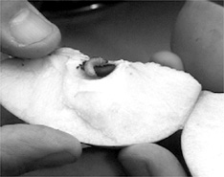
In Reading - Language Focus
core n.
1) most important or central part of anything
The core of the problem is the lack of fund.
让我们直击此事的本质。
Let’s get to the core of the matter.
2) hard central part containing the seeds of certain fruits,
such as the apple
an apple core
Collocation：
to the core
彻底地; 完全地
She is French to the core.
她是个地道的法国人。
Back

Slide 48
In Reading - Language Focus
alternate adj.
1) every other or second
He works on alternate days.
The show was sponsored by different clients on alternate weeks.
2) (or two things) happening by turns
This is a week of alternate rain and sunshine.
这是晴雨交替的一周。
She wears a shirt with alternate stripes of blue and white.

Slide 49
In Reading - Language Focus
alternate vt.vi (cause to ) follow by turns
We alternated periods of work and rest.
汤姆时而发怒，时而害怕。
Tom alternated between anger and fright.
Collocation：
alternate between
时而…时而…
They alternate between supporting us and opposing us.
alternate in
轮流
We alternate in doing the household chores.
alternate with
（使）与…交替
Sunny weather alternates with rain.
Back

Slide 50
In Reading - Language Focus
vain adj.
1) too pleased with one’s own abilities or looks
She’s vain of her beauty.
他极其自负。
He’s as vain as a peacock.
2) without result; useless
After a number of vain attempts to climb the mountain, we were forced to return to camp.
It is vain to resist.
Collocation：
vain的常用词组是in vain，意为“徒劳地，白白地”
Back

Slide 51
In Reading - Language Focus
Then it all hit him like a wet bale of hay.
Paraphrase the sentence.
If something strikes you like a wet bale of hay, it comes as a sudden, forceful and unpleasant surprise.
Use some adjectives to describe how Michael felt at that time.
He felt anxious, tense, nervous, etc.
Back

Slide 52
In Reading - Language Focus
startle vt. give a sudden shock or surprise to
You startled me! I didn’t hear you come in.
She was startled to see him looking so ill.
Back

Slide 53
In Reading - Language Focus
intensity n. state of being intense强烈；紧张；剧烈
intensity of light/sound/color 光/声音/色彩的强度
intensity of feeling/concentration/relief 感情的强烈；高度精神集中；大为宽慰
The poem shows great intensity of feeling.
In order to finish the job in time, we have to work with greater intensity.
为了及时完成工作，我们必须更加紧张地工作。
市长没有意识到在住房问题上民情有多强烈。
The mayor didn’t realize the intensity of people’s feelings on the housing issue.
Back

Slide 54
In Reading - Language Focus
anxiety n.
1) feeling of worry of fear
They felt strong anxiety for her safety.
After hearing their advice he had no more anxieties.
2) strong wish to do something; eagerness
The teacher praised him for his anxiety for knowledge.
He always shows his anxiety to please his employers.
Collocation：
anxiety about/over sth.
对…的焦虑
anxiety to do/ for
对…的渴望
Back

Slide 55
In Reading - Language Focus
tension n.
1) worry or nervousness
Smiling has been shown to relieve tension and stress.
一天紧张的脑力劳动之后，锻炼是缓解压力最理想的办法。
Exercise is the ideal way to relieve tension after a hard day of mental work.
2) degree of tightness of a wire, rope, etc.
If you increase the tension of that violin string, it will break.
Back

Slide 56
In Reading - Language Focus
tense adj.
1) feeling worried or nervous; making people worried or
nervous
The two countries began to discuss their tense relations.
There is a tense moment before we heard the news.
2) stretched tight; stiff
With his body so tense, it seemed as though he were listening for something.
Is the rope tense?
Back

Slide 57
In Reading - Language Focus
along with: together with
He went on the journey along with his two friends.
她把钞票连同找回的零钱和发票一起重又放进抽屉。
She placed the bank notes, along with the change and receipts, back in the drawer.
Collocation：
all along
始终, 一直
come along
进展；跟着来
get along
进展； 与…和睦相处
go along
进展；前进； 同行
Back

Slide 58
In Reading - Language Focus
The silence was deafening.
Is this sentence contradictory with “silence” and “deafening”?
No. “Deafening” is often used to modify the noise. Here it is used to modify “the silence”. It is not an ordinary silence, but a deafening one. It shows that it was extremely quiet as both Michael and the crowd were very tense at that moment.
Back

Slide 59
In Reading - Language Focus
bring (sb.) back to earth: cause (sb.) to stop daydreaming; cause (sb.) to return to reality
Emily’s voice brought him back to earth.
You had better bring yourself back to earth for an hour and cook us some dinner.
Back

Slide 60
In Reading - Language Focus
in one’s mind’s eye: in one’s imagination
In my mind’s eye I saw the cliffs rising sheer.
她在想象中酝酿自己的下一步作品。
She was writing her next piece in her mind’s eye.
Back

Slide 61
After Reading
Useful Expressions
Sentence Translation
Writing Task
Speaking Task

Slide 62
After Reading
Useful Expressions
田径比赛
俯瞰
深呼吸
像雄鹰一样飞翔
每个教练所梦寐以求的
如出一辙; 不谋而合
每隔一天
农场杂活
有一次
站着
没有意识到
track and field competition
a bird’s eye view
take a deep breath
soar like an eagle
a coach’s dream
coincide with
every other day/on alternate days
farm chores
on one occasion
on one’s feet
unaware of

Slide 63
After Reading
Useful Expressions
对…惭愧
感到…
摆脱紧张情绪
在内心的最深处
在这种时候
舒展；伸展
缓缓移动
使…回到现实中
想象
体操运动员的优雅
健美运动员的力量
be ashamed of
fill one’s mind with…
shake the tension
from the deepest depths of one’s soul
at a time like this
stretch out
in slow motion
bring sb. back to earth
see in one’s mind’s eye
the grace of a gymnast
the strength of a body-builder

Slide 64
After Reading
Useful Expressions
仰面躺着
重复做的一个梦
从地面一跃而起
彻头彻尾的现实主义者
简直是一件不可思议的事
没能越过横杆
第二名
翻身
与全国纪录差一英寸
一份非常周密的训练计划
从内心深处
lie on one’s back
recurring dream
lift off the ground
a hard-core realist
a mere fantasy
miss a jump
the second place
roll over
be one inch off the national record
a very careful training program
from the depths of one’s soul/heart

Slide 65
After Reading
Sentence Translation
Translate the following sentences into English.
太阳火辣辣的，而他今天在全国青少年奥林匹克运动会上所面临的竞争的火热程度一点也不逊色于烈日。(Para. 1)
The sun was as hot as the competition he faced today at the National Junior Olympics.
2) 它还具有飞翔的特征，对观看该项目比赛的观众来说，飞跃两层楼的高度简直是一件不可思议的事情。(Para. 2)
It also has the element of flying, and the thought of flying as high as a two-storybuilding is a mere fantasy to anyone watching such an event.

Slide 66
After Reading
3) 她对细节的激情和酷爱使得迈克尔的梦境色彩缤纷、绚丽无比。(Para. 3)
Her excitement and passion for details made Michael’s dreams full of color and beauty.
4) 或许是看台上人们爆发出的欢呼声，或许是他着地时嘭的一声响使迈克尔回到现实之中。(Para. 12)
It was either the eruption of the people in the stands or the thump of his landing that brought Michael back to earth.

Slide 67
After Reading
5) 随着媒体的关注以及可能随之而来的各种赞助，迈克尔的生活肯定会不同以往。(Para. 13)
With all the media attention and sponsorship possibilities, Michael’s life would never be the same again.

Slide 68
After Reading
Writing Task
Write a story about a person you have heard of or read about who has overcome various difficulties to realize his/her dream.
Before putting pen to paper, read the following advice on the writing skills.

Slide 69
After Reading
Writing Skills
Narration 3 (Organizing Details in Narration)
Narration is story-telling. People tell stories to make a point. Therefore details in the story should be carefully selected to explain and support the point. In Text A of this unit, the author gives a detailed account of a day in Michael’s life, a day when he made his crowning (顶点的) achievement. In the course of the narrative, the author repeatedly goes back in time to give us the story of Michael’s early life. Go over the text again to see how the details are chosen and arranged, and how the arrangement helps bring out the point the author wants to make.

Slide 70

After Reading
Tips for writing an interesting story:
In telling a story, first ask yourself if you have a point to make and what it is if you have.
Select details to explain and support your point.
Organize the details appropriately so that they will be effective in bringing out your point.
For more detailed instructions concerning narrative writing, you can study the attached mini-lecture.

Slide 71
After Reading
Speaking Task
Work in groups and tell your group members:
A. one or two obstacles that you have been faced with in your life.
B. the ways in which you overcame these difficulties.
C. what you have learned from these experiences.
Back

Slide 72
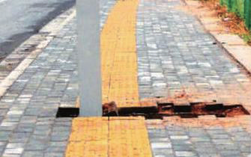
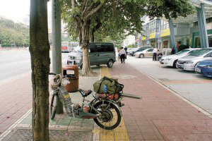
Critical Thinking
What are the problems as shown in these pictures and what would you suggest we do to help the handicapped?

Slide 73
Critical Thinking
The following questions may serve as prompts:
1) What’s wrong with the tactile paving（盲道） in the pictures?
2) What measures can be taken to make sidewalks friendlier to blind people? Who should take the responsibility and who should be involved?
3) What other problems have you found with accessibility（无障碍环境） in your neighborhood or on campus?
Back

Slide 74
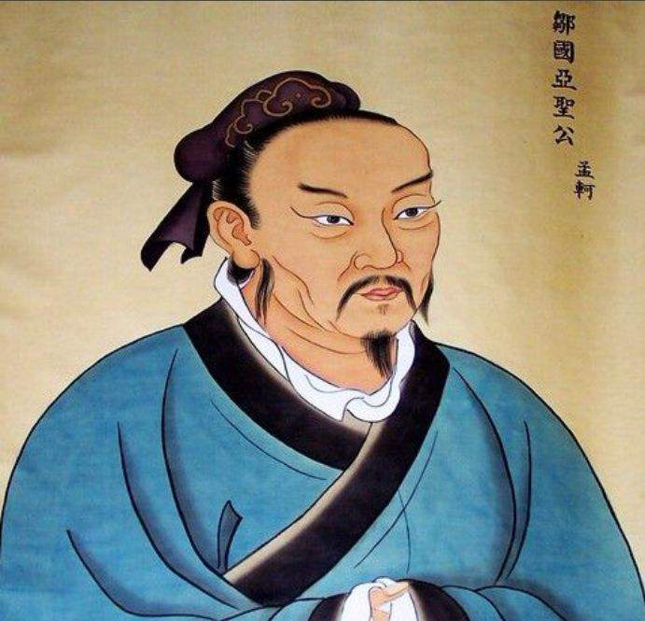
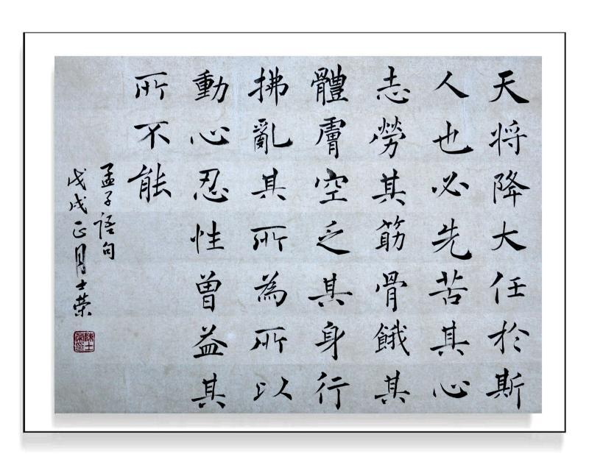
Culture Focus
故天将降大任于斯人也，必先苦其心志，劳其筋骨、饿其体肤，空乏其身，行拂乱其所为，所以动心忍性，曾益其所不能。—— 孟子
Thus, when Heaven is about to confer a great office on any man, it first exercises his mind with suffering, and his sinews and bones with toil. It exposes his body to hunger, and subjects him to extreme poverty. It confounds his undertakings. By all these methods it stimulates his minds, hardens his nature, and supplies his incompetencies.
— Mencius

Slide 75

Culture Focus
Further thoughts
Can you give some examples of people in Chinese history who have overcome obstacles to achieve excellence?
Back

Slide 76
Home Reading
Paragraph Identification
Sentence Translation

Slide 77
Home Reading
1. The following statements contain information from Text B, of which each paragraph is numbered. Identify the paragraph from which the information is derived.
1) I was very happy during the early years of my marriage.
2) I tried my best to keep healthy and optimistic in spite of my disease.
3) One of the tires went flat and it was impossible for me to change it.
(Para. 2)
(Para. 6)
(Para. 12)

Slide 78
Home Reading
4) The man and the little girl worked very hard to fix the car in the storm.
5) Inspired by the old man, I am trying to help others in my small way.
(Para. 16)
(Para. 29)

Slide 79
Home Reading
2. Translate the following sentences from Text B into Chinese.
1) They say a cat has nine lives and I am inclined to think that possible since I am now living my third life and I’m not even a cat. (Para. 1)
人们都说猫有九条命，我觉得这是可能的，因为我现在经历的是自己的第三次人生，而我还不是猫呢。
2) I felt that if the day arrived when I was unable to lift one foot up one step and then drag the other painfully after it — repeating the process 14 times until, utterly spent, I would be through — I could then admit defeat and lie down and die. (Para. 8)
我觉得如果有一天我无法再抬起一只脚迈上一个台阶，再痛苦地拖起另一只脚——将这个过程重复14遍，直到精疲力竭爬上去——到那时我就会服输并躺下死去。

Slide 80
Home Reading
3) Here hobbled a bitterly disillusioned cripple, a man who held on to his sanity and his wife and his home and his job because of 14 miserable steps leading up to the back door from his garage. (Para. 10)
这里一瘸一拐走着的是一个幻想破灭、内心痛苦的跛子，一个靠着从车库通往后门的那14级令人苦不堪言的台阶才没有失去理智、没有丢下妻子和家庭并坚持工作的男人。
4) She went into the house and a moment later came out bundled in raincoat and hat, followed by a man who called a cheerful greeting. (Para. 15)
她回到屋内，稍后裹着雨衣、戴着帽子又出来了，身后跟着个男的，愉快地跟我打招呼。

Slide 81
Home Reading
5) I don’t remember how long I sat there after they said good night and left me, but it was long enough for me to search deep within myself and find some disturbing traits.(Para. 25)
我不记得他俩道别走后我在那儿坐了多久，但时间之长，足以让我内心深刻反省，发现令自己深感不安的品行。
Back

