Slide 1
Flows Task Force
Part of the W3C Web Payments Working Group
February 2016 Face to Face – Status Update
Matt Saxon, Worldpay

Slide 2
Contents
What is the Flows Task Force
Objectives
Progress to Date
Example Exploration
Questions for the WG

Slide 3
What is it?
The Web Payment Working Group formed at the 2016 W3C TPAC Event in November 2015.
At that stage there were two API specification proposals, however there was no specific approach to specifying requirements. (Whilst there are the Interest Group Use Cases - https://www.w3.org/TR/web-payments-use-cases , these are functionally focused, not interaction based)
Following a session exploring some current payment flows, it was decided that a Task Force would be created to further explore ‘in-the-wild’ payment flows such that these could be used to help guide the specifications to be able to meet real world problems.
The Task Force has been run as an loose team of WG members interested in supporting this effort.
The output (and working area) for the TF is held within the W3C WebPayment repository;
https://github.com/w3c/webpayments/wiki/Flows
https://github.com/w3c/webpayments/tree/gh-pages/PaymentFlows

Slide 4
Objectives
Document existing payment flows as proxy for requirements for the API
Document current production flows, not hypothetical future states
Flows are real-world manifestation of actual requirements and so are a measure of success of the applicability of the API to the current ecosystem
Constraints
Expedience & Resourcing has dictated that full coverage cannot be achieved
flow that explore diverse interaction methods have been favoured

Slide 5
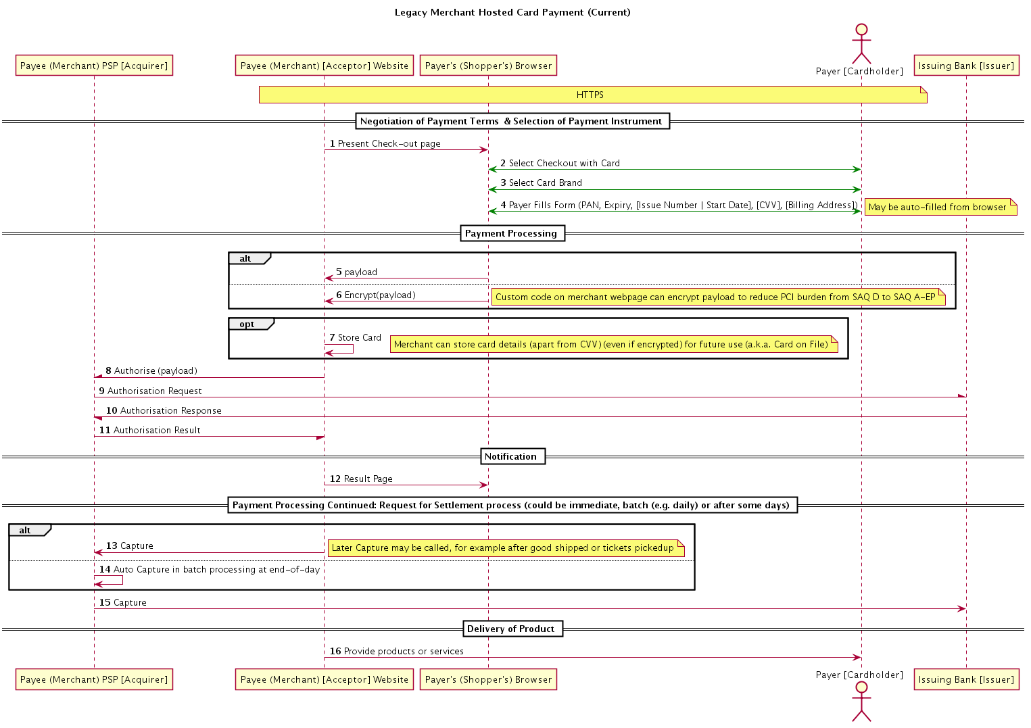
An example flow

Slide 6
Progress
Flow Type | Flows Documented
Cards | 3 (Legacy, 3DS, Token)
Credit Transfer | 5 (SEPA, PISP x2)
Direct Debit | 1
Wallets | 5 (PayPal x 2, AliPay, ApplePay, SamsungPay
Crypto | 2 (Bitcoin x 2)
Intermediated | 3 (Payment Pages, Redirect, PayPal
Native | 2 (ApplePay, SamsungPay)
Compound | 2 (ILP, Escrow)
Registration | 1 (SamsungPay)
Flows list base-lined at 7th January 2016
23 Flows documented (multiple flows for some types)
ISO 20022 alignment begun
Standardisation of flows begun
The flows and API proposals have now evolved to the point where review of the alignment can being to be evaluated.
Thanks are due to the team of Frédéric Meignien, Cyril Vignet, Vincent Kuntz, Kris Ketels, Laurent Castillo, Manu Sporny, Adrian Hope-Bailie, Ian Jacobs, Mountie Lee, Dave Longley & Zephyr Tuan

Slide 7
Examples Flows and what they highlight
Flow | Highlights
Legacy Card | Storage of card details at merchant for later reuse (Recurring Payments)
3D Secure | Dynamic behaviour upon merchant risk appetite (Risk Processing)
PSP Tokenised Card | Back-channel between browser code and Merchants PSP to protect the merchant from PCI burden (Privacy)
PSP Intermediated Payments | Delegation to Merchant PSP of complexities of handling multiple payment instrument types (Delegation)
PayPal | Two Phase Payments split between authorisation and execution allows for merchant to make risk assessment after payer has authenticated themselves as part of authorisation (Risk)
Credit Transfer | Out of Band Payment Mechanisms (Offline)
3DS 2.0 and ApplePay | The emergence of non-browser payment flows (Native)
It needs to be investigated if the highlighted requirements identified by the Flows are met by the emerging API specification proposals
To do this we need to map the flows onto the target architecture. What parts of the flows are services by the Browser, Payment Application, Merchant WebPage and Webserver

Slide 8
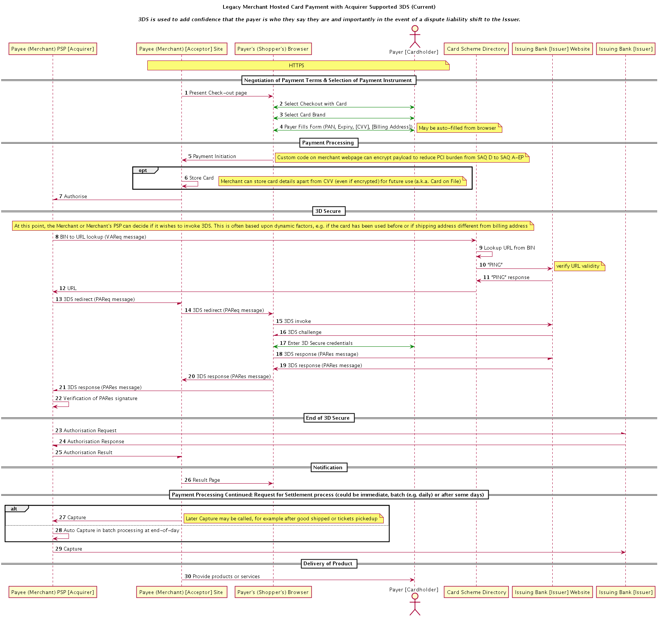
3D Secure – An Issue for the Architecture?
Under WebPayments, the ability for the merchant to optimise the purchase process based upon the risk level may be compromised

Slide 9
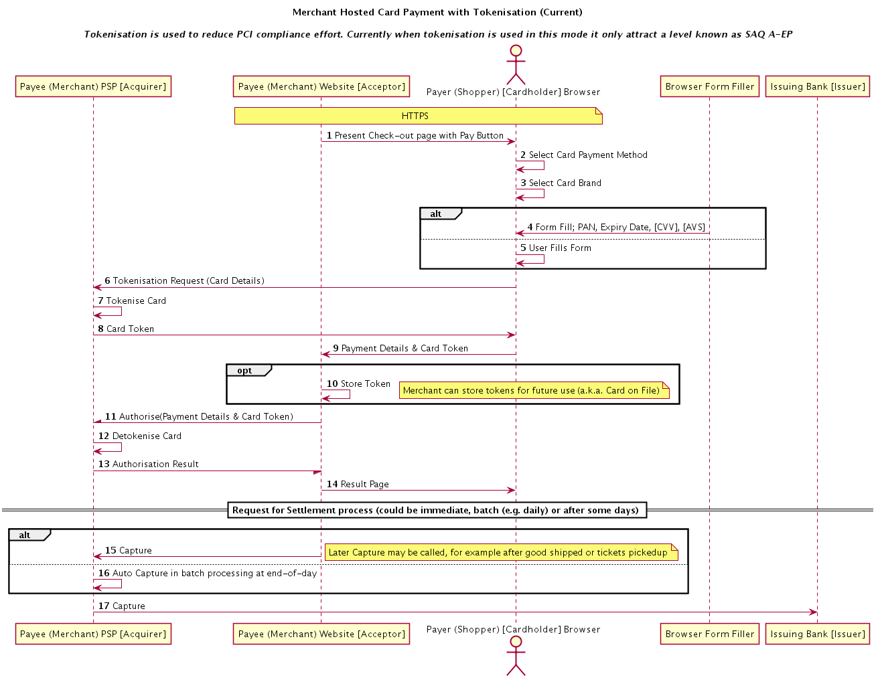
PSP Tokenisation – An Issue for the Architecture?
Today
PSP Tokenisation is implemented by many Merchant PSPs
It is an innovation driven by the certification requirements of PCI
It protects both Shopper and Merchants
It needs coupling between the Merchants PSP and code executing at the client
The Shopper is not aware this is occurring – they don’t need to know.
WebPayments
Client side processing is controlled by browser and Payment Applications
Payment Applications are registered by Shoppers
Registration expected to be driven by Shopper Brand Awareness
It is anticipated that Payment Applications will be tightly coupled to the Payment Instrument Issuers
Under WebPayments, there is little opportunity for merchants to influence the payment flow
There is a risk that the architecture stifles opportunity for innovation by merchant side providers

Slide 10
Questions for the Working Group
Answers on IRC (#wpwg) please………
Time is Limited………..
Where are the Task Force’s Efforts Best Directed over the coming months?
New+, e.g. OpenBanking API, 3DS 2.0, Native Flows?
Refine+ and Standardisation of the current flows? ISO20022+?
Review of the Specifications+ against the Flows?
Formalisation of Requirements (e.g. Technical Use Cases+, Refinement of IG Use Cases – e.g. Phase Categorisation)?
Stop+, we have other things to worry about
max 1 vote per person
Should the Flows discussion be brought into the mail mailing list/issues list? Do people have bandwidth/time to review in that forum? (Bring It In +1 -1))
Who else wants to get directly involved? (Flows+ nickname)

Slide 11
Appendices

Slide 12
Adoption & Transition Observations
Registration
In order to meet the objective of fewer shopping cart abandonments, there is going to need to be significant work in the area of Payment Application registration. Otherwise Shoppers will favour the methods they use today.
The WG discussions have focused around User Choice, however Merchants are the other party in the transaction and they may have preferred payment applications or wish to use a bespoke one for the payment that is coupled to their systems.
Rollout Speed
The multitude of payment methods in use today dictates that adoption will be slow. We need to work on approaches that acknowledge this, perhaps the creation of ‘Shim’ payment applications that wrap existing payment flows is something that should be investigated?
Coexistence
The likely slow adoption will mean that merchant will be faced with the situation where they wish to accept some payment methods that are API compliant and other that are not, how can the group look to address this without significantly impacting usability in transition?
Merchant Wallets
Merchants that have existing stored card details with agreements in place with customers to use them. Also storage of shipping addresses and other checkout related information. How can this data be used/migrated to the target architecture? Do merchants want this?
Ubiquitous Schemes
The CG proposal doesn’t appear to have direct support for existing card schemes without payment applications registration, this is contrary to Section 6.2.1 of the IG Use Cases

Slide 13
Emerging Observations – API Capabilities / Use Cases
Payment Status
Much discussion in the WG appears to assume that payments are a binary activity, succeeding or failing, however there are a number of transition states that need to be considered
Push/Pull
Most payments today are pull payments, whereas much discussion at the WG is around push payments. These terms are often not binary. It is often considered that PayPal transactions are ‘Push’ since the user goes to the PayPal website. However this is just an authorisation and the transaction is actually executed by an interaction from the merchants website to PayPal.
Risk/Liability
Focus in WG has been on providing user anonymity, however this needs to be balanced with risk appetite of the merchant. The API needs to be able to take this into account, surfacing user credentials to the merchant as well as the payment application in certain situations where the merchant may be faced with a fraud.
Native Applications / IoT payments
3DS 2.0 is an enhancement to 3DS (currently 1.0.2) which focuses specifically on optimising acceptance for mobile devices. The absence of considerations for native applications to date for the WG might risk the API seeming ignorant of the changes in the industry.
Additionally the emergence of IoT as another important type of user-agent seems worth of consideration.

Slide 14
Emerging Observations – IG Uses Cases Extensions
Roadmaps Phases
Many important use-cases have an uncategorised roadmap phase.
Missing Use Cases
Agreement on terms is missing;
Ad-hoc Recurring Payments (a.k.a. Card on File)
Unspecified amount, e.g. maximums
Coexistence Use Cases missing entirely
Multi-currency

