Slide 1
RNA-seq workflow
Simplifying differential gene expression data generation using Snakemake and KNIME
Tilman Mehl, Andrea Dell’ Orco

Slide 2
Project goal
Model and implement a workflow in Snakemake and KNIME that uses
RNA sequencing data of two different samples to generate an overview of their
differentially expressed genes (DEG).

Slide 3
Why DEG?
...the study of differential gene expres-
sion enables the comparison of gene expression
profiles from different tissues and conditions to iden-
tify genes that play a major role in the determination
of the phenotype. For instance, the comparison of
healthy versus diseased tissues can provide new
insights over the genetic variables involved in
pathology
F. Finotello, B. Di Camillo - Measuring differential gene expression with RNA-seq: challenges and strategies for data analysis - BRIEFINGS IN FUNCTIONAL GENOMICS. VOL 14. NO 2. 130 ^142
Notes:
+ 1 min

Slide 4
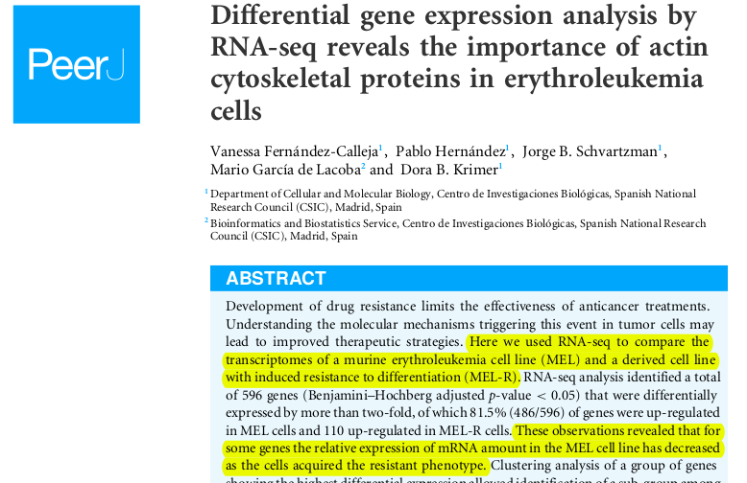
Why DEG?

Slide 5
What is RNA-seq
RNA sample is converted to cDNA
cDNA sequences are read using established DNA-sequencing technology (e.g. Illumina sequencing machines)
Output: file in fastq/fasta format that contains the reads

Slide 6
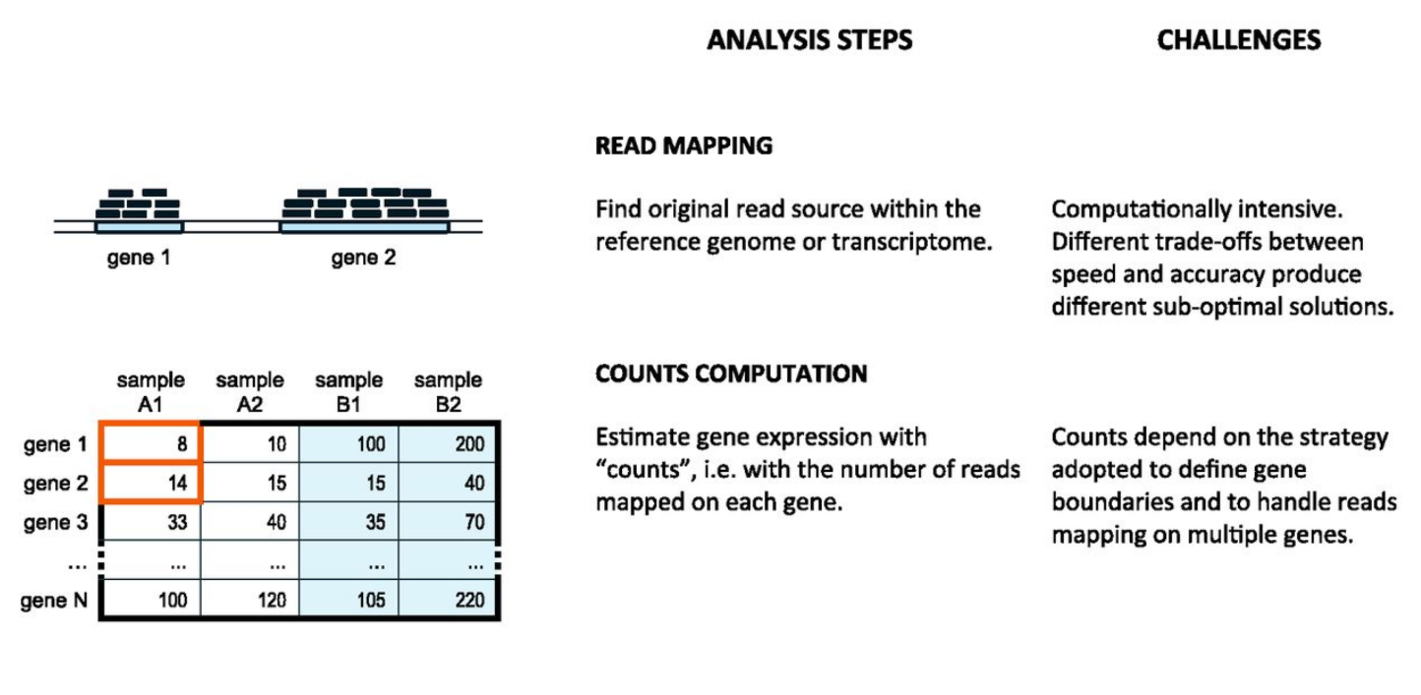
DEG - Steps
F. Finotello, B. Di Camillo - Measuring differential gene expression with RNA-seq: challenges and strategies for data analysis - BRIEFINGS IN FUNCTIONAL GENOMICS. VOL 14. NO 2. 130 ^142
Notes:
+2 min

Slide 7
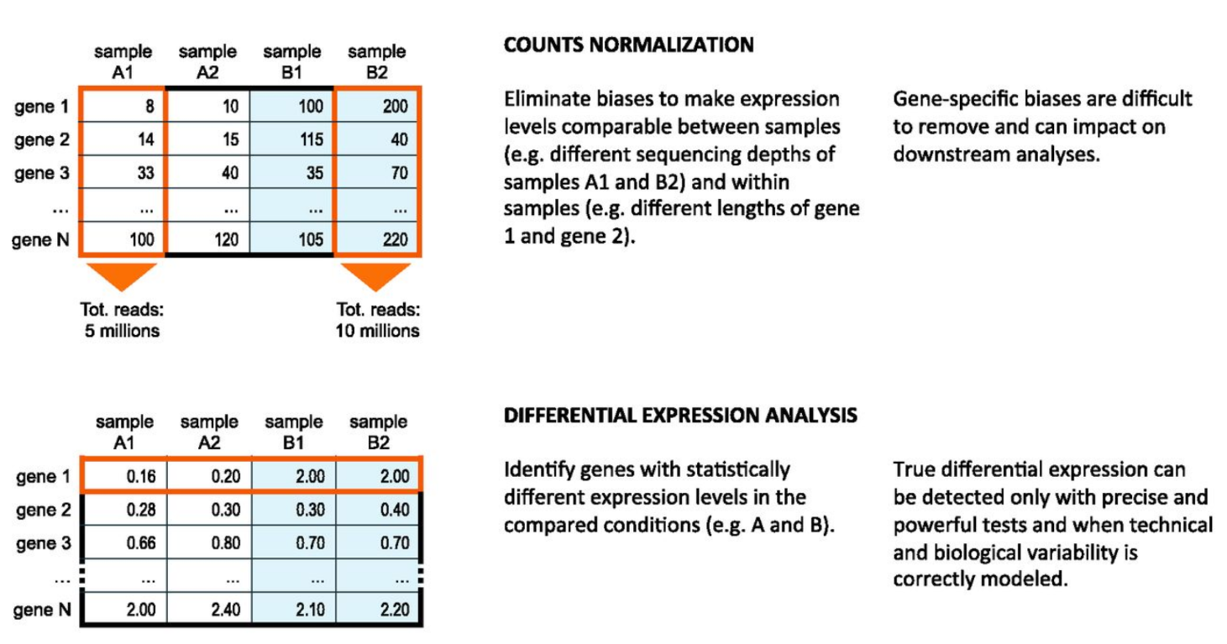
DEG - Steps
F. Finotello, B. Di Camillo - Measuring differential gene expression with RNA-seq: challenges and strategies for data analysis - BRIEFINGS IN FUNCTIONAL GENOMICS. VOL 14. NO 2. 130 ^142
Notes:
2 min = 6-7min

Slide 8
A closer look at the steps
Sequencing RNA (not in scope of workflow)
Aligning reads to genes
Counting reads per gene
Determining differentially expressed genes
Quality Control

Slide 9
A closer look at the steps
Sequencing RNA (not in scope of workflow)
Aligning reads to genes
Counting reads per gene
Determining differentially expressed genes
Quality Control

Slide 10
A closer look at the steps
Sequencing RNA (not in scope of workflow)
Aligning reads to genes
Counting reads per gene
Determining differentially expressed genes
Quality Control

Slide 11
Aligning reads to genes
A number of tools exists
HISAT2 (formerly Tophat)
STAR
kallisto
Salmon
Bowtie2
…
Output SAM/BAM files
Notes:
Zu den read alignment tools können wir noch nicht viel sagen, ausser dass sie existieren und unterschiedliche alignment algorithmen verwenden.
kallisto benutzt z.B. gar kein klassisches alignment, sondern nur ein sog. pseudo-alignment

Slide 12
A closer look at the steps
Sequencing RNA (not in scope of workflow)
Aligning reads to genes
Counting reads per gene
Determining differentially expressed genes
Quality Control

Slide 13
Counting reads per gene
Possible Tools
HTSeq-count
featureCounts
...
List of features (GFF/GTF)
Alignment file (SAM/BAM)
count
Table of counts per feature
Notes:
Anhand der alignment Datei und einer Liste an annotierten Genen wird berechnet wie viele der reads einem einzelnen gen zugeordnet werden können
Für viele Genome findet man GFF/GTF Dateien auf ensembl (https://www.ensembl.org/index.html)

Slide 14
A closer look at the steps
Sequencing RNA (not in scope of workflow)
Aligning reads to genes
Counting reads per gene
Determining differentially expressed genes
Quality Control

Slide 15


Determining differentially expressed genes
Several tools available
DESeq2
sleuth
SAMSeq
edgeR
baySeq
NOIseq
Limma
Characteristic Direction
...
All use R in some capacity
Notes:
Diese tools verwenden statistische methoden um differentiell exprimierte gene zwischen den zwei proben zu finden

Slide 16
A closer look at the steps
Sequencing RNA (not in scope of workflow)
Aligning reads to genes
Counting genes
Determining differentially expressed genes
Quality Control

Slide 17
Quality Control
At various points in the workflow, quality control should be performed
Several QC tools exist
Quality of raw reads: FastQC, HTSeq-qa
Quality of mapped reads: Qualimap2, HTSeq-qa
Compiled quality report: MultiQC

Slide 18
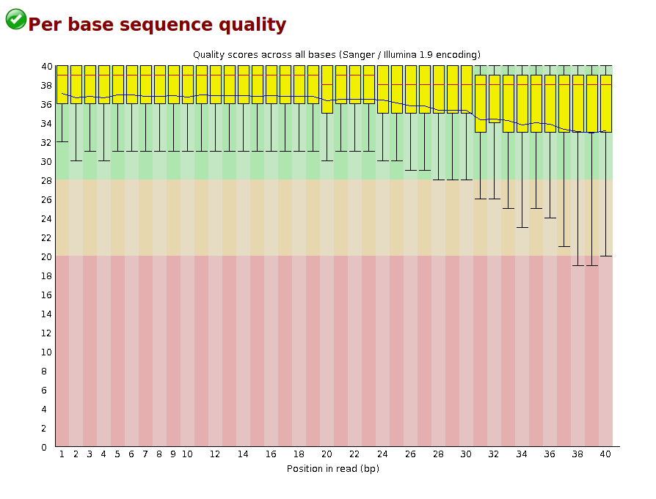

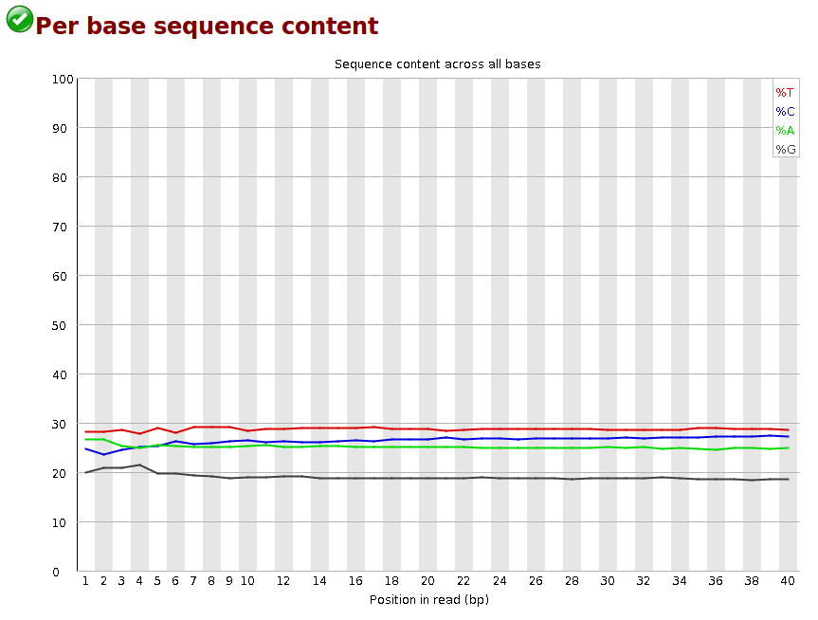
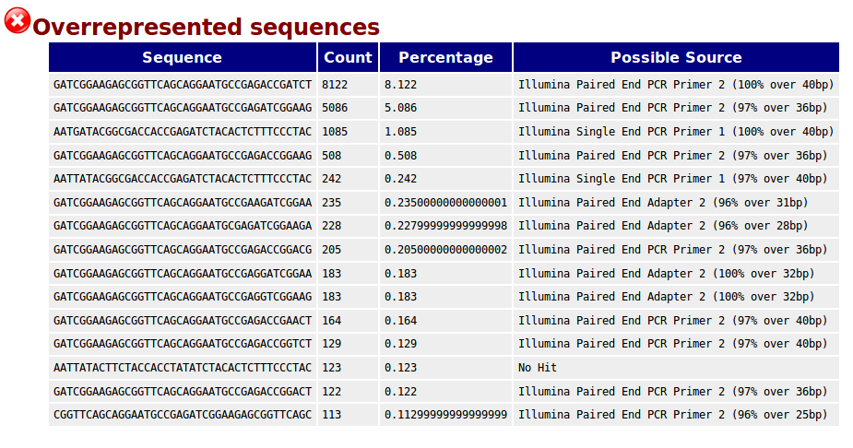

Slide 19
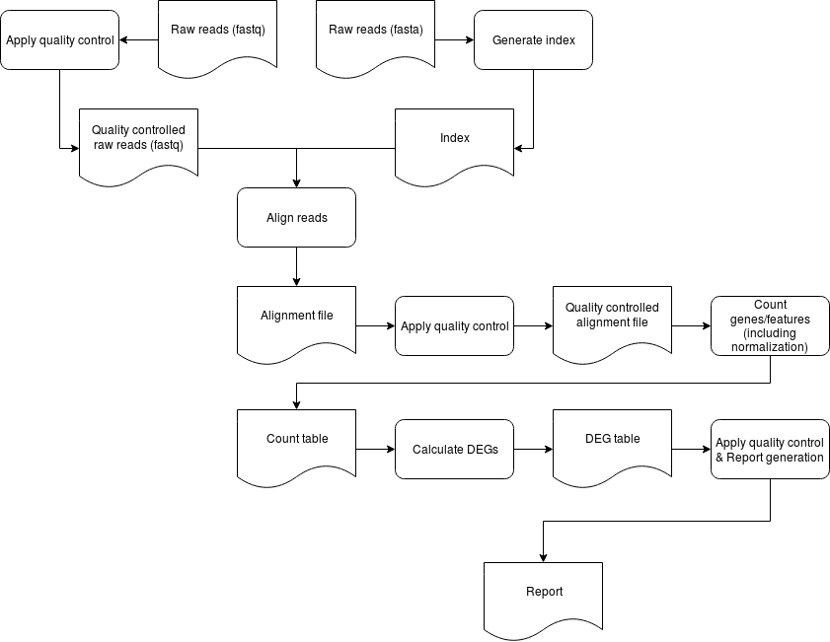
Generic DEG workflow
Notes:
Der obige workflow sieht für kallisto - sleuth anders aus

Slide 20
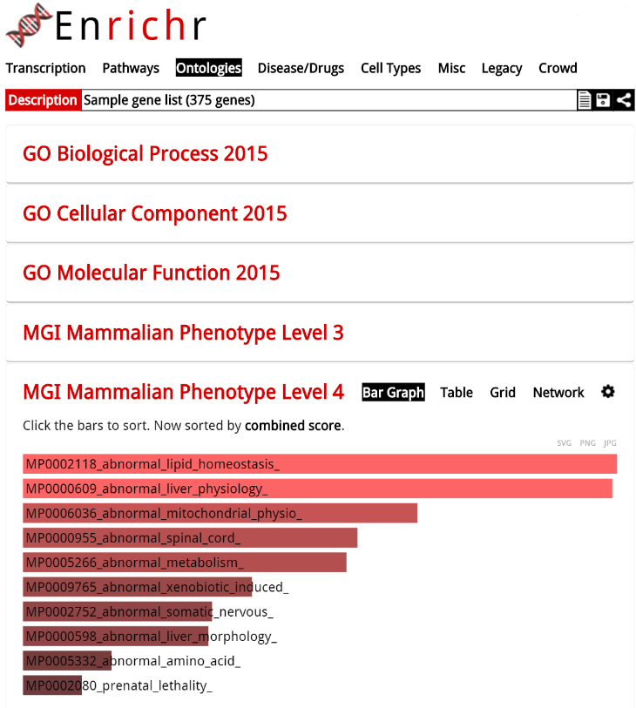

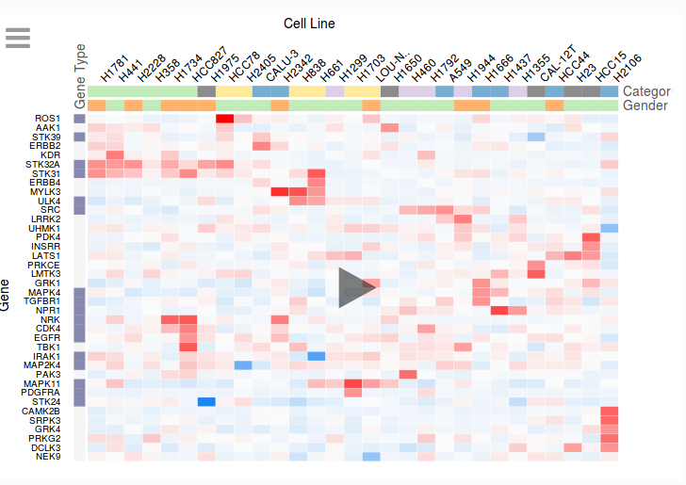
Visualization
clustergrammer

Slide 21


Our Project
Phase 1 - Snakemake:
Testing different tools and comparing results
Phase 2 - KNIME:
Implementing the chosen workflow in KNIME

Slide 22
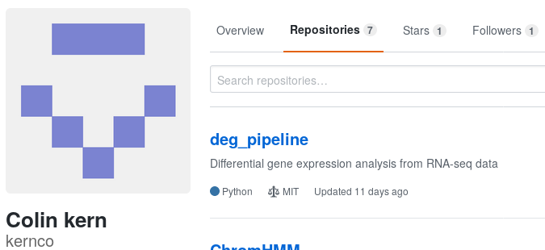


No need to reinvent the wheel

Slide 23
Start Point
Trim Galore - quality control, wrapper FastQC
Samtools
STAR - alignment
HTSeq - count
DESeq2 - analysis

Slide 24
Phase 1 - Snakemake
HISAT
HISAT (hierarchical indexing for spliced alignment of transcripts) is a highly efficient system for aligning reads from RNA sequencing experiments. HISAT uses an indexing scheme based on the Burrows-Wheeler transform and the Ferragina-Manzini (FM) index, employing two types of indexes for alignment: a whole-genome FM index to anchor each alignment and numerous local FM indexes for very rapid extensions of these alignments.
https://github.com/infphilo/hisat

Slide 25
Phase 1 - Snakemake
Kallisto and Sleuth
Kallisto is an “alignment free” RNA-seq quantification method that runs very fast with a small memory footprint, so that it can be run on most laptops
Sleuth is a companion package for Kallisto which is used for differential expression analysis of transcript quantifications from Kallisto. While you could use other differential expression packages such as limma or DESeq2 to analyze your Kallisto output, Sleuth also takes into consideration the inherent variability in transcript quantification as explained above. Sleuth also allows the modeling of covariates such as batch, individual, tissue type etc. in the same way as DESeq2/edgeR/limma, which is useful for experimental designs with multiple varying factors
https://scilifelab.github.io/courses/rnaseq/labs/kallisto

Slide 26
Phase 2 - KNIME
KNIME has extensions for Bioinformatics and NGS (https://www.knime.com/community/next-generationsequencing)
Most of the cited tools have no node available in KNIME
Something on Github?
Nodes have to be implemented in KNIME

Slide 27


Any Question?
Andrea Dell’Orco https://github.com/0rC0
Tilman Mehl https://github.com/TilMeh

